Slide 1
Evaluation for improvement: ‘tools of the trade’ Liz cook Roddy Henry

Slide 2
KPIs
Staff
Surveys
Students
Ideas
Employers
Test of Change
Partners

Slide 3
Course Committee Meetings: The Model
Dialogical approach based on robust evidence bank
Representatives from across the system
Range of ‘tools’ at teams disposal
Regular check in points to monitor progress

Slide 5
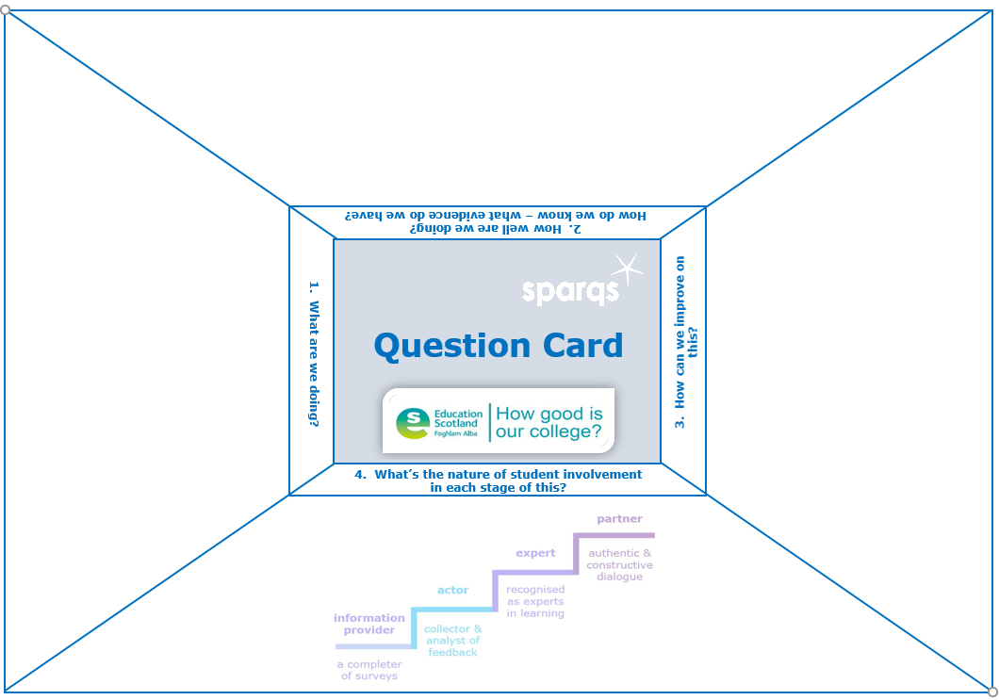
Dialogue Box

Slide 6
Quality Improvement Methods
Driver Diagrams https://www.youtube.com/watch?v=yfcE_Q-IRFg
Tests of Change https://www.youtube.com/watch?v=1hCWdJ_W9Ws
Process Mapping https://www.youtube.com/watch?v=A2LFJF1SUBg
Force Field Analysis https://www.youtube.com/watch?v=HCe2H3AsHio
Fishbone Diagrams https://www.youtube.com/watch?v=387chd8p54c

Slide 7
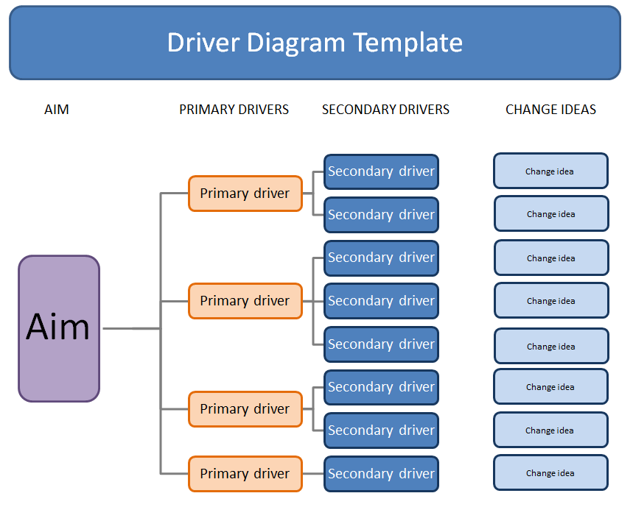
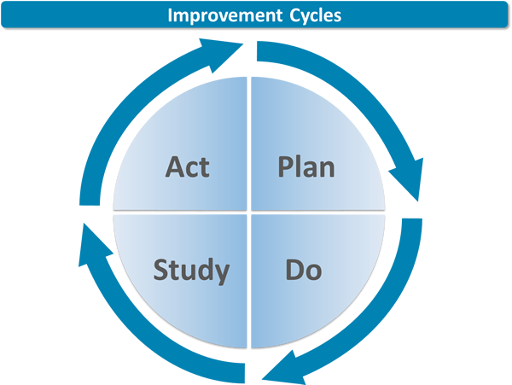

Slide 8
In order to achieve this aim.. |  | We need to ensure... |  | Which requires... |  | Ideas to ensure this happens
Inclusive, consistent interviews
Longer induction proces - tied into 'new PAT' role
Effective systems
Early identification of support needs
System training: Insight, mental health, roles of all
'Marketing' info to reflect and articulate the support available and the college envronment
Smooth application process and funding
Effective progress, management and planning (e.g. timetabling, units, etc)
VLE engagement tools
People: high calibre, engaged, aware
Recruitment, staff - effective
Presence at national job fair
Reduce EW by 5% by 1/11/19
Timely, clear, induction (staff)
Longitudinal Induction for staff
Pre-enrolment / interview assignments
Training - bespoke to role
Clear communication of college offer and culture
Students updating website with course information
Guidance and course choice

Slide 10
What students said……
“it was constructive [the feedback] and yeah they listened to it”
“I was able to speak and be honest”
“It was actually quite interesting”
“I’ll go again”
“And not only for our class, but all the other classes as well…just like how they were getting on…”
“I actually feel like you’re getting listened to…instead of you say it to somebody and then you never hear about it again. Not that that happens often, but it can happen”
“yeah I mean its helpful. But I think its something that you kind of knew anyway but it was nice to kind of be able to have that… chat I think” (on why something might not be possible)

Slide 11
What staff said……
“It was quite enjoyable cuz it was done in groups of people together, and particularly the opportunity always to have some interaction with support staff”
“It did surprise me a little bit – just about how there was so much to say”
“I did wonder how comfortable [one student group] might be speaking up in that kind of set up…but everyone just got on with it fine...and at the end of the day, you could barely stop them or hold them back – so they were very vocal”
“It’s more meaningful as well – not only for students but for staff as well – to see that there is actually some outcome to attending these course committee meetings, and it’s not just another ticky box exercise”
“I think it’s actually given us more scope to say no, we really need to listen to the student”

Slide 12
What’s next?
Embedding across teaching and support teams
Close monitoring of tests of change – collaborative approach
Sharing practice
Student training on use of data and other evidence sources
Peer and external review
Learner Rep and Engagement Award

Slide 13
Any questions?

