Slide 1
Social Media & Employability It’s not all Meme, Meme, Meme!

Slide 2
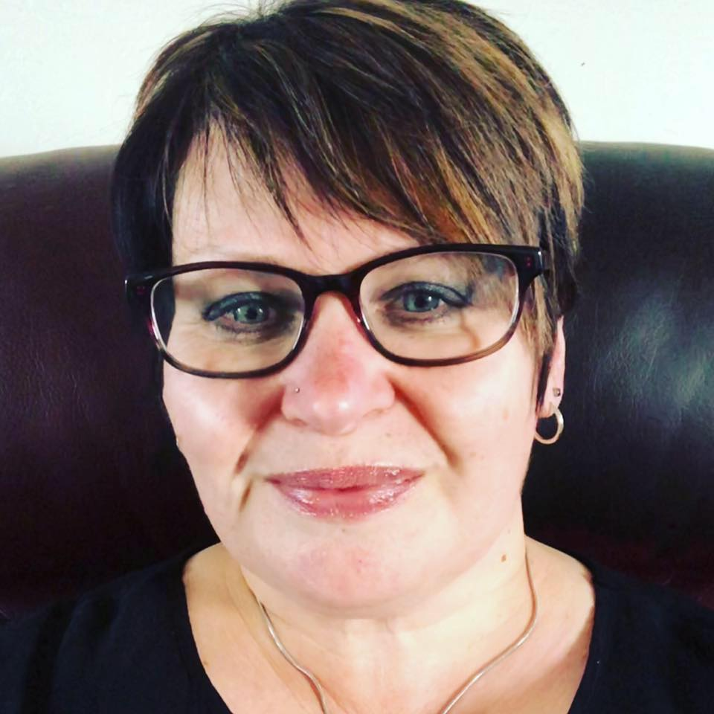
HELLO!
I am Fiona Morrison
Student Adviser
Engagement & Employability, Fife College.
Connect with me:
@fionalmorrison
@fionaleemorrison
@ fionaleemorrison
@fionaleemorrison

Slide 3
Let’s Get Social
THE FACTS

Slide 4
“ We’re living at a time when attention is the new currency. Those who insert themselves into as many channels as possible look set to capture the most value. ”
Pete Cashmore, Founder of mashable.com

Slide 5
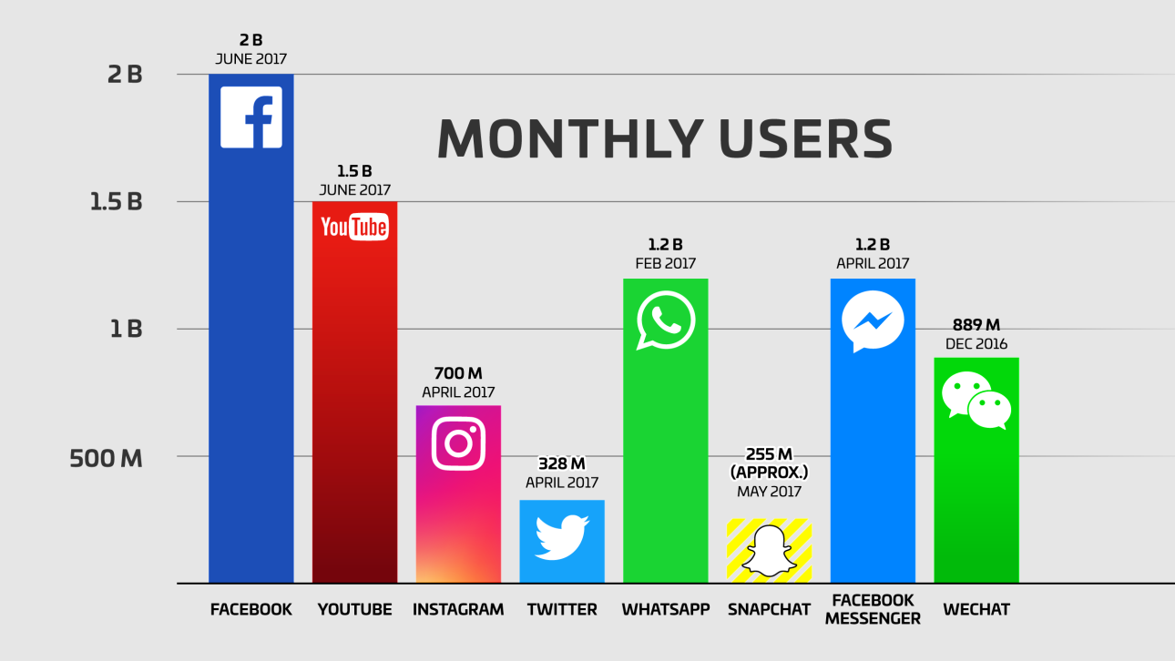

Slide 6
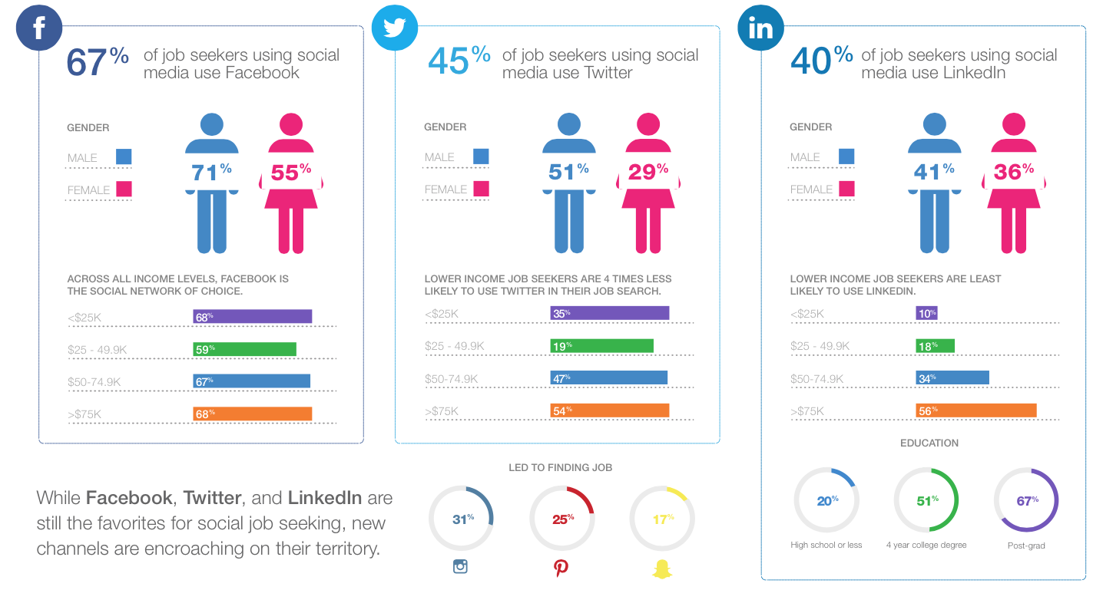

Slide 7
“Everything you post on Social Media impacts on your personal brand. How do you want to be known?”
Lisa Horn, aka The Publicity Gal

Slide 8
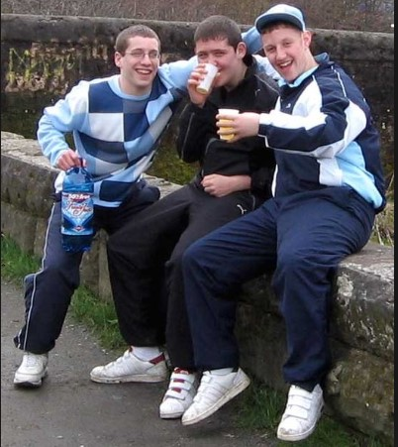
FIRST IMPRESSIONS
Place your screenshot here

Slide 9
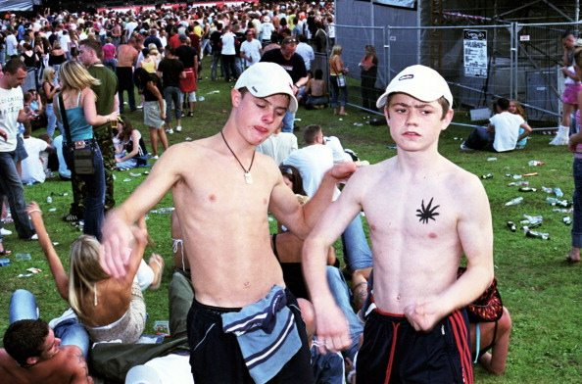
CHECK YOUR NETWORK
Can your friends tag you in appropriate photos?
Place your screenshot here

Slide 10
48%
70%
43%
Candidates who believe their social media presence is important to employers.
Employers use social media to screen candidates during the hiring process.
Employers using social media to check on current employees
Source: 2018 CareerBuilder survey

Slide 11
CONTENT
NEGATIVITY
CONFIDENTIALITY
Inappropriate photos and content
Unprofessional conduct and commentary regarding previous employers, colleagues and peers.
Posting confidential information about work practices, colleagues, customers and previous employers.

Slide 12
EMBELLISHMENT
OVER SHARING
COMMUNICATION
Lying about qualifications or experience
Inappropriate discussions
Poor grammar, text speak

Slide 13
VALUES
CONTROVERSY
AFFILIATION
Lack of alignment with company values.
Posting controversial topics, images, memes.
Controversial original author of posts, fake news.

Slide 14
Professional emails please!
eccybeats99@....
420forever@....
smokeweed420@
eccieseccieseccies@...
stonedandbaked@...
Celtictiladie@...

Slide 15
BRANDOLOGY
What’s your brand?

Slide 16
Three words…
Organised
Creative
Reliable

Slide 17
WHEN IT ALL GOES WRONG…

Slide 18
In 2015, according to Rolling Stone Magazine , six bankers from Birmingham decided to re-enact, record, and post on Instagram a mock ISIS beheading. They went all out with costumes and method acting — and they were fired as soon as the clip circulated online.

Slide 19
This is almost unbelievable…. a New York high school teacher posted pictures of several female students on Facebook with captions like, “this is sexy.” In addition, his FB tagline said, “I’m not a gynaecologist, but I’ll take a look inside.

Slide 20
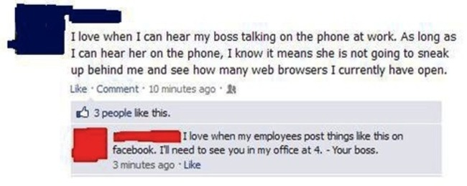

Slide 21
THE FUTURE

Slide 22
SOCIAL MEDIA FOR JOB SEEKERS
FACEBOOK
Great for localised job searching and for following industry influencers. Popular with recruiters and careers guidance. Useful for seasonal job opportunities.
TWITTER
Great for localised job searching as well as for connecting with industry influencers. A great tool to find remote working opportunities and to engage with companies directly.
LINKEDIN
A fantastic tool for developing your professional network as well as connecting with industry influencers and companies that are relevant to your career.

Slide 23
REMOTE WORKING
DIGITAL PORTFOLIOS
NETWORK WORTH
Increased opportunities. Entrepreneurial ventures.
Recruitment driven by digital presence.
Revenue through influence.

Slide 24
CONNECT
Most big companies have a career specific Twitter account or Facebook page - these will help you make the right connections with companies. Twitter is an excellent place to ask questions and connect with companies and their employees as well as industry influencers.

Slide 25
SHOW OFF!
Employers will always look for vital skills and traits when screening a candidate but they also want someone who is personable and enhances company culture.
On social media you can show this off before you’ve even met your new employer!

Slide 26
BE YOURSELF
White
Is the color of milk and fresh snow, the color produced by the combination of all the colors of the visible spectrum.
Managing your presence online is an important part of expanding your employability appeal.
Be yourself, everyone else is already taken!

Slide 27
THANKS!

Slide 28
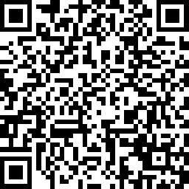
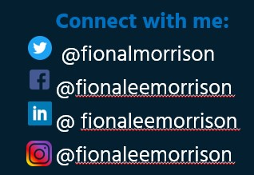
BEFORE YOU GO
Any questions?
You can find me at:
fionamorrison@fife.ac.uk

