Slide 1
Developing Creativity Through
Enterprising Learning
Jacquie Clark: Lecturer / Learning & Teaching Leader
Sam Eccles: Lecturer/Enterprise &Entrepreneurship Facilitator ​

Slide 2
What are we talking about?
Creativity? “often obvious in young children, but it may be harder to find in older children and adults because their creative potential has been suppressed by a society that encourages intellectual conformity” Sternberg (2006: 93)
Research? “a detailed study of a subject, especially in order to discover (new) information or reach a (new) understanding” (Cambridge Dictionary).
Innovation? “The action of innovating; the introduction of novelties; the alteration of what is established by the introduction of new elements or forms” (Oxford English Dictionary).
Entrepreneurship? “applies to both individuals and groups (teams or organisations), and it refers to value creation in the private, public and third sectors, and in any hybrid combination of the three” (QAA 2018: 7).

Slide 3
Activity
Turn the circles into as many everyday or recognisable objects as you can
You have 3 minutes
Go!
3 minutes

Slide 4
Activity reflection
What happened?

Slide 5
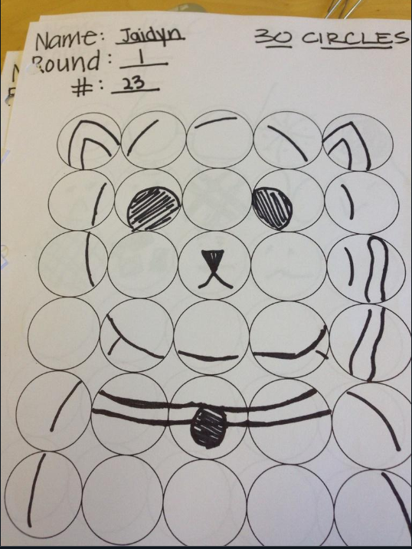

Slide 6
Creativity: Thinking styles…
Divergent thinking
Convergent thinking

Slide 7
From Creativity to Innovation
Who Invented the lightbulb ?

Slide 8
Remember!
Divergent Guidelines ​ | Convergent Guidelines ​
Suspend judgement​ | Cluster similar ideas​
No editing​ | Be decisive​
Allow repetition​ | Check your objective​
Include the obvious​ | Improve your ideas​
Allow humour​ | Seek novelty​
Go for quantity​ | ​

Slide 9
Activity - leaky cups
10 minutes

Slide 10
NAF ideas
NAF
ovel
ttractive
easbile

Slide 11
Sticky-Dot voting
2
3

Slide 12
Why entrepreneurship?
What changes are ahead for your students
How can we prepare them?
How can we ensure they can adapt?

Slide 13
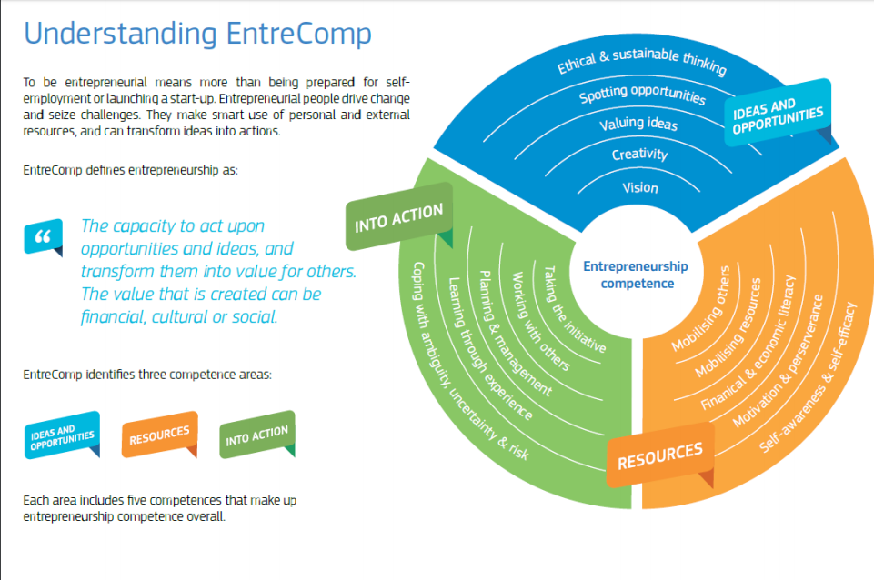
Entrepreneurial skills in the classroom
https://ec.europa.eu/jrc/en/publication/eur-scientific-and-technical-research-reports/entrecomp-action-get-inspired-make-it-happen-user-guide-european-entrepreneurship-competence

Slide 14
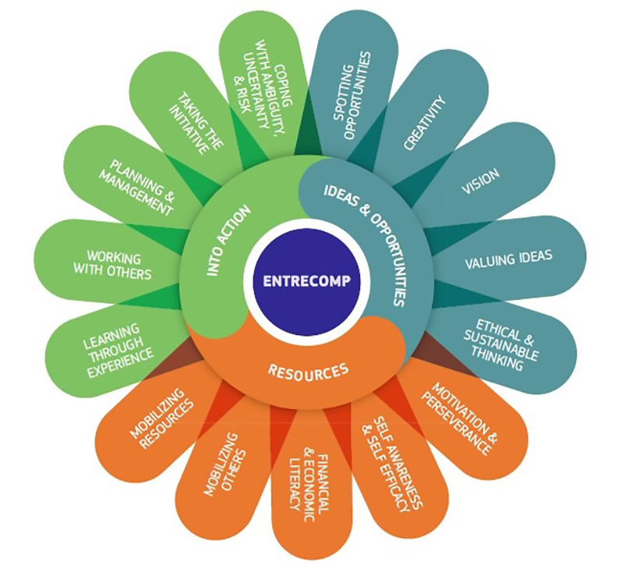
Entrepreneurial skills
in the classroom
https://ec.europa.eu/jrc/en/publication/eur-scientific-and-technical-research-reports/entrecomp-action-get-inspired-make-it-happen-user-guide-european-entrepreneurship-competence

