Slide 1
John Gallacher , Regional manager
BA, MSc , ACIS

Slide 2
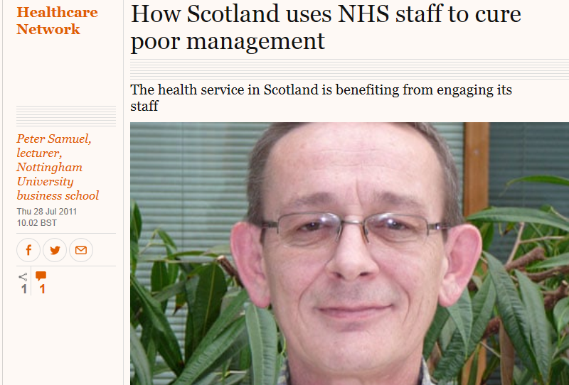
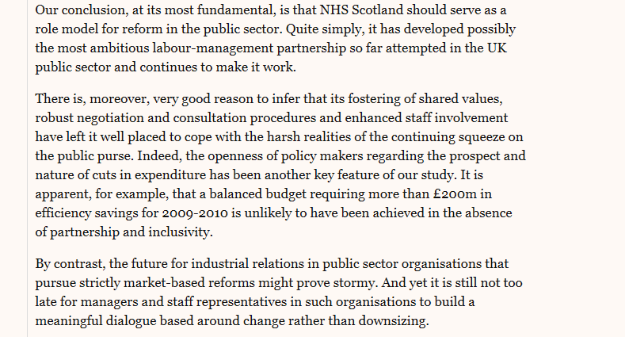
https://www.staffgovernance.scot.nhs.uk
THE GUARDIAN
26 July 2011

Slide 3
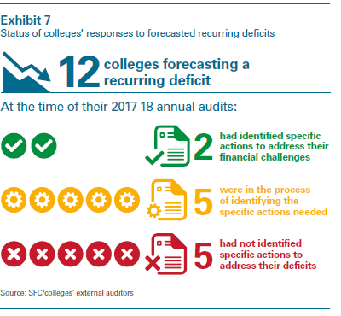

Slide 4
3. involved in decisions which affect them through:
• working in partnership to enable the involvement of all staff, through recognised trades
unions.
• working together by developing an appropriate framework within colleges with recognised
Trade Unions to enable effective involvement in strategic college issues. This framework will
also provide for the opportunity to review and evaluate Staff Governance on an on-going
basis.
In addition to this, the Standard, in accordance with the Information and Consultation Regulations
(ICE), entitles all staff to be:
1. well informed
2. appropriately trained
3. involved in decisions which affect them
4. treated fairly and consistently
5. provided with a safe working environment.

Slide 5
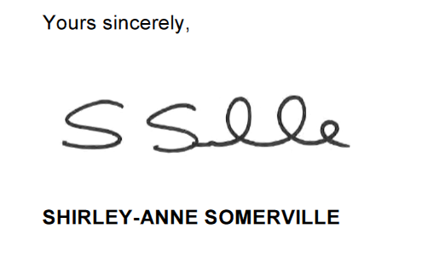

Slide 7
The Fair Work Framework
Our vision is that,
by 2025, people in Scotland will have a world-leading working life where fair work drives success, wellbeing and prosperity for individuals, businesses, organisations and society.
The Fair Work Convention (FWC) introduced the Fair Work Framework in March 2016

Slide 8
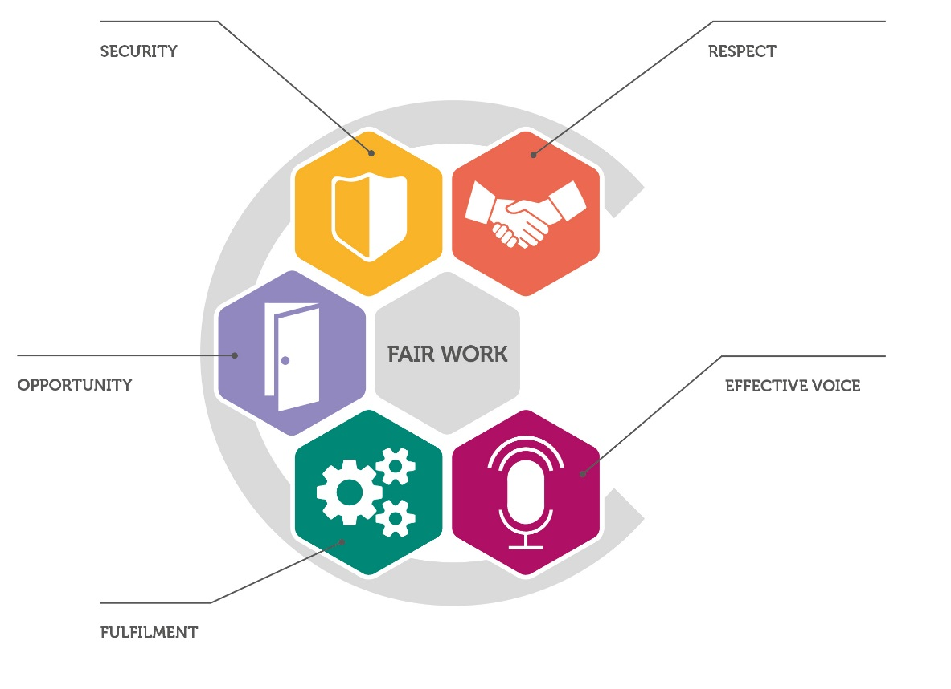
5 dimensions of fair work
Effective voice
Opportunity
Security
Fulfilment
Respect

Slide 9
One recommendation:
That organisations deliver fair work that provides effective voice, opportunity, security, fulfilment and respect

Slide 10
“I would consider cutting facility time a false economy.”

Slide 11
As the longest established and most extensive set of partnership arrangements in the British public sector, NHS Scotland provides a leading-edge example of the extent to which innovative industrial relations arrangements may contribute towards improving public service delivery. In our view, partnership in NHS Scotland has matured into probably the most ambitious and important contemporary innovation in British public sector industrial relations. These arrangements have evolved since 1999 to ensure partnership adapts to the needs of the service. The research outlined in this report informed NHS Scotland’s latest review of partnership arrangements.

Slide 12
In developing and sustaining partnership in NHS Scotland, all sides have worked hard to meet six key partnership challenges. First, partnership requires a shared aim and a post-devolution consensus developed in NHS Scotland around how to organise health( education) services. This consensus has endured for more than a decade, and partnership is legally-mandated and an integral part of the service. Sustained commitment from all those involved has produced genuine national-level partnership working between government, employers and staff representatives that helps the Scottish Government to develop and deliver key health ( education) policies and initiatives to improve patient ( student) services, drive organisational change, and develop and implement appropriate workforce policies.
Second, appropriate partnership structures have developed with three distinct but inter­related fora. The Scottish Partnership Forum (SPF) discusses overarching strategic issues affecting the service and facilitates joint problem-solving at an early stage of policy-development. Appropriate workforce policies are then developed in the Scottish Workforce and Staff Governance Committee (SWAG) to help deliver improved health ( education) services. Outstanding issues are negotiated in the Scottish Terms and Conditions Commitee (STAC). This structure fosters cooperative behaviours.

Slide 13
Third, frequent partnership meetings provide appropriate opportunities for staff-side involvement in key decisions and, fourth, the broad scope of issues discussed extends staff-representatives’ involvement in a wide range of issues beyond those covered by traditional collective bargaining arrangements.
Fifth, enhanced voice in partnership meetings brings together diverse views to develop, refine and help implement a range of health( education) and workforce policies. This allows mutual interests to develop around a shared agenda and a joint commitment to implementing the preferred solution.

