Slide 1
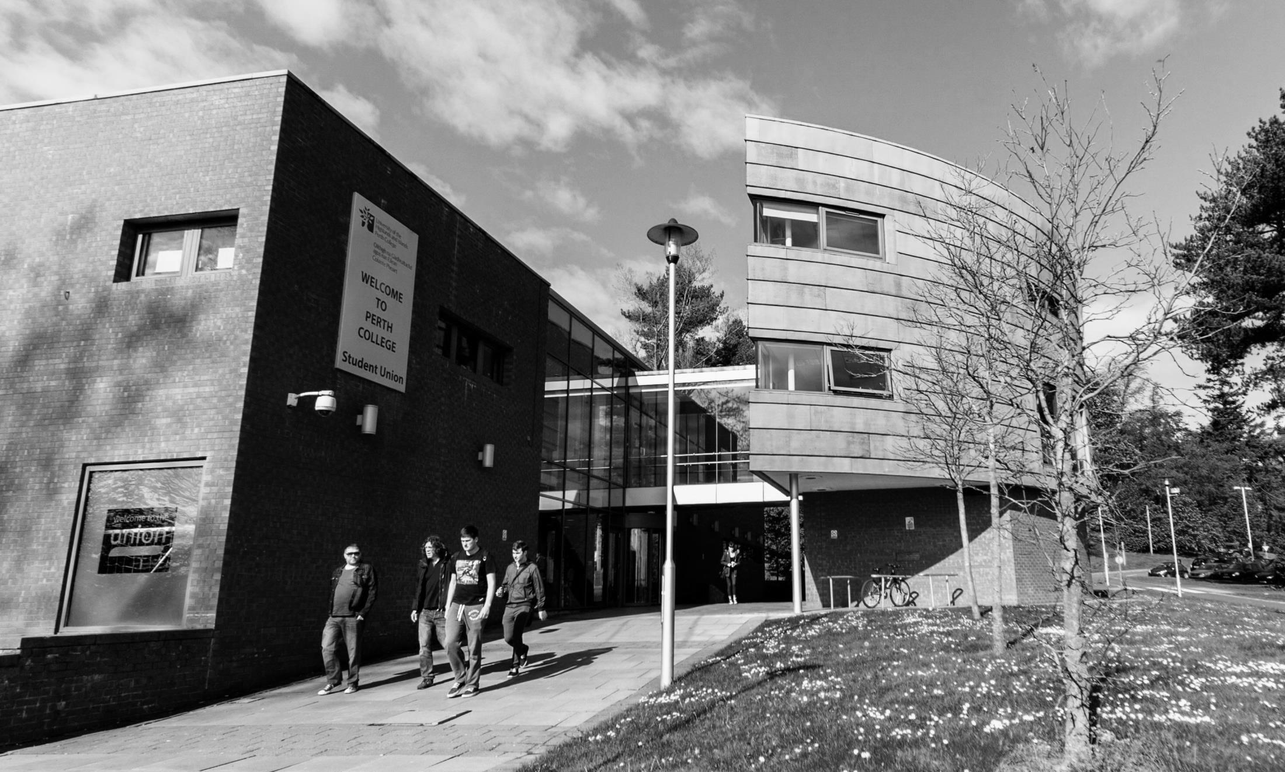
Connecting Businesses to Academics 12 June 2019
Andrew Youngson
Senior Policy Officer
Scottish Funding Council

Slide 2
Connecting businesses to
academics
Dr Siobhán Jordan
Director, Interface
siobhan@interface-online.org.uk

Slide 3
Driving Knowledge Exchange in Scotland
Interface’s free and impartial service connects businesses to the right academic expertise for increased R&D activity leading to the creation and development of new products, services and processes.
Notes:
“Businesses and organisations need a knowledge exchange system that is easy to navigate and provides them with the expert knowledge and research they need……and has the potential to stimulate even greater knowledge exchange”. That’s where Interface comes in, as we match the right business to the right academic expertise.
Scotland has 26 colleges, 19 universities and 4 research institutes, with over 1,200 specialist facilities for commercial use. There are over 2,000 academic departments and more than 27,000 academic staff between them (22,400 university / 5,343 college).
4 of our universities are in the world’s top 200 and we have above the UK average proportion of world-leading research in disciplines such as chemistry, biological sciences, physics, history, art and design, agriculture, veterinary, food science, music, drama, dance and the performing arts.
Scotland has research teams from all disciplines (science, medicine, arts and social sciences) to support businesses in product, process, workforce and service innovation.
BUILDING A SMARTER FUTURE TOWARDS A SUSTAINABLE SCOTTISH SOLUTION FOR THE FUTURE OF HIGHER EDUCATION-Scottish Government 2011

Slide 4
Interface
Impartial central point of access connecting businesses and organisations from all regions and sectors to Scotland's Universities, Research Institutes and Colleges.
Business Engagement
Demand Stimulation
Sector Engagement
Funding
Policy Influencing & Development
Promote benefits and impacts of business and academic collaborations to stimulate and identify increased industry demand.
Supporting groups of businesses in key industry sectors by creating links with academia to encourage growth within the sector.
Stakeholder engagement including:
Scottish Funding Council (SFC)
Scottish & UK Governments
Enterprise agencies
Scotland Can Do
Universities Scotland
Colleges Innovation Working Group
Administration of funding awards to help businesses offset the costs of academic collaborations.
Notes:
Four interlinked priorities outline the Interface ambition:-
PRIORITY ONE - Inspire more businesses to partner with Scotland’s Universities - We will stimulate business demand for collaboration with Universities by significantly growing the number of business supported. We will further enhance our partnership approaches with the wider innovation ecosystem and are committed to adopting simplified and streamlined business user journeys with our partner Universities to deliver efficient working practices.
PRIORITY TWO - Escalate and deepen company partnerships with Scotland’s Universities to accelerate the scale up of businesses through innovation - We will provide greater support to businesses and Universities to escalate initial small scale “transactional” relationship to deep, long-term, synergistic partnerships leading to an enhanced business confidence to innovate with academic partners.
PRIORITY THREE - Enable economic and societal impact to transform lives locally and globally - We are committed to maximising the benefits from collaborative partnerships for businesses, Universities and Colleges to enable the greatest possible impacts. Our support will deliver enhanced skills and exploitation of new / improved products, processes and services.
PRIORITY FOUR - Inform policy and practice in an ever-changing landscape - Through our overarching national role we will continue to support the development and implementation of policy and practice through informed evidence including contributing to the seamless and simplified innovation ecosystem for businesses to maximise opportunities for Universities’ and Colleges’ support for skills and R&D development.

Slide 5
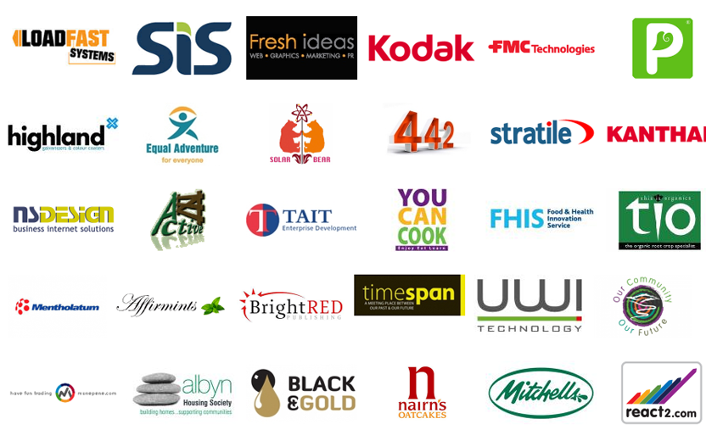
Interface – Some of our clients
Notes:
We work with organisations of all sizes and from all sectors and although 87% of enquiries are from Scottish SMEs, 13% are from the rest of the UK & International organisations (figures from January 2015)

Slide 6
Impartial Brokerage
Define
Problem to be Solved
Find
Right Capability
Scope
Project
Determine Right Incentive / Mechanism
Assist with
Contract Agreement
Academic s Identified
Brokering &
Facilitation
Execution
100
85
47
Expertise Searches
Discussions
Collaborative Projects
Notes:
Even when there is willingness by both parties to collaborate there are many other reasons or issues which ‘get in the way’ of a contracted project. The Research Connections facilitator assists with some of the administrative burden and helps sets the expectations for the project outcomes.

Slide 7
Collaborative Funding Opportunities
- Student projects
- Access facilities
- R&D grants
- Innovation vouchers
- H2020 SME Engagement Vouchers
- SMART
- UKRI/ Innovate UK collaborative grants
- Consultancy
- Horizon 2020
- Knowledge Transfer Partnerships

Slide 8
Funding through Innovation Voucher Programme
Standard Innovation Vouchers
Up to £5,000 of funding aimed at encouraging new business and academic partnerships. Support development of business led product, process, service or workforce.
Businesses can also apply together to pool their vouchers to solve a common issue.
Student Placement Innovation Voucher
Up to £5,000 to fund a PhD or Masters student who will work within your organisation on a clearly defined project.
Advanced Innovation Voucher
Up to £20,000 of match funding to encourage sustained relationships with academia or for those companies who are beginning their collaborative journey.
Horizon 2020 SME Engagement Scheme
Up to £5,000 of funding to help businesses, and academics, prepare applications for the €70 billion Horizon 2020 European Funding programme.

Slide 9
Innovation Voucher Funding Criteria
Projects must be innovative (a novel/pioneering idea) and lead to new products, services or processes or workforce development that will benefit the company, the institution and the Scottish economy. Only projects which cannot be delivered commercially and require the technical expertise of an academic partner are eligible.
Projects will not be funded if they are related to:
Consultancy e.g. to evaluate current products, systems and practices
Company and strategy planning
Data gathering and literature reviews
Marketing activities
Skills development, CPD and training courses
Activities that would promote/subsidise the cost of exports
Software purchases
Internships for students – separate funding is available for this

Slide 10
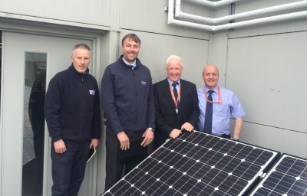
Technology & Engineering
Building services company providing integrated building services, including plumbing, heating, mechanical services and gas maintenance.
Committed to the training, health and safety of its employees, James Frew developed a new training planning process which monitors certification renewals, develops individual training plans and measures the impact of training.
Funded through an Innovation Voucher, new improved processes were created - leading to more structured approach to developing people through training, improving motivation of staff and employee satisfaction.
IMPACTS:
Increase in overall productivity, products and turnover for the business
Improvements in gas engineering service delivery for West College Scotland, including greater understanding of training needs analysis for building services sector
“We are delighted to work with West College Scotland on the Scottish Funding Council Innovation Voucher and it has helped us align training plans and enhance our service offer.”
Roddy Frew, James Frew
Notes:
Background
James Frew Ltd is one of the largest privately owned building services companies in Scotland providing integrated building services, including plumbing, heating, mechanical services, micro renewables, gas maintenance, and property upgrades for the public and private sectors, including design installation and maintenance.
The company operates from their headquarters in Stevenson, Ayrshire, covering all areas of Scotland.
Challenge
James Frew believes the strength of the company is in its people and is committed to the training, health and safety of its employees.
Over half of the total workforce consists of fully qualified gas engineers who are each required to be certified; often multiple certifications per employee are required to practice. The certification process requires each gas operative to undergo training and assessment of a core gas safety qualification in addition to various specialism qualifications relating to the nature of the work being undertaken. These qualifications must be refreshed every five years and, in almost all cases, are not synchronised which leads to difficulties in the training scheduling, increased training costs, and workforce planning issues through lost time and lack of continuity.
For a business such as James Frew Ltd and its employees, compliance in this field is paramount and non-compliance threatens jobs and the security of the business.
Solution
Academic input was required as the project involved a strong focus on developing pedagogy for identifying training needs and linking these requirements to business process improvement; in particular, in bringing into the industry context tools that have been developed and are widely used in education but can be further developed to meet the needs of business.
The company was awarded a Scottish Funding Council (SFC) Innovation Voucher, administered by Interface, which gave it the opportunity to collaborate with West College Scotland to develop a new innovative training planning process, including the monitoring of certification renewals, development of individual training plans and the measurement of the impact of training through AMI (Achievement Measurement Indexing).
"We are delighted to work with West College Scotland on the Scottish Funding Council Innovation Voucher and it has helped us align training plans and enhance our service offer". Roddy Frew, Managing Director.
"The SFC Innovation Voucher has allowed James Frew and WCS to positively collaborate to implement business improvements and develop more meaningful relationships that are mutually beneficial. In doing so, our staff at the college have been able to use this knowledge to work with other organisations to help them improve and enhance the products and services that they offer". Andrew Fogarty, Head of Energy and Engineering, West College Scotland
Dr Stuart Fancey, director of research and innovation at the Scottish Funding Council, said:
“The Innovation Voucher Scheme has been a huge success, linking hundreds of Scottish small businesses with universities’ expertise. Entrepreneurs growing their businesses have been able to develop their products in ways they would have struggled to do by themselves and I’m excited that this expertise now includes Scotland’s colleges as well as universities.”
Benefits
Company – Through reduced costs and improved quality of training, this new process will provide business efficiency savings ensuring that James Frew Ltd continues to maintain a sustainable competitive advantage in a fast moving commercial market. By enabling a more structured approach to developing people through training, the project will also impact on the motivation of staff and employee satisfaction.
College – West College Scotland will improve their service delivery in gas engineering and develop a greater understanding of training needs analysis for the building services sector as a result of the collaboration. The project will also enhance understanding of industry within the College and support the development of processes that will make the College more responsive to business needs.
Impacts
The project developed a process that identifies the need for early training interventions, determine more specifically exact training requirements and demonstrate measureable achievement in knowledge transfer.
The impact of the project will lead to improved training interventions that are linked to individual training plans and business process improvements. In terms of outcomes and impact it is envisaged that whilst improving the relevance of training interventions, significant cost savings and improved efficiency will be realised through a more planned and systematic approach to training.
By developing a more structured approach to developing people through training, the project will impact on the motivation of key staff and will increase employee satisfaction.

Slide 11
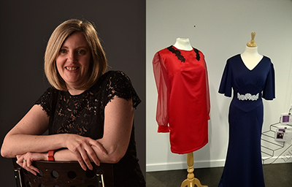
Creative Industries
Karen Hamilton is a designer and bespoke dress-maker creating tailored bridal and evening wear.
SFC Innovation Voucher awarded to develop pioneering 3D lace printing project, working with Dundee and Angus College.
Keen to access the College's specialist facilities, the designer worked with D&A to produce a prototype using different printing filaments which would allow her to print unique lace designs.
IMPACTS - the project could potentially change the way in which textiles can be manufactured in Scotland/UK. Karen going from strength to strength with additional support received through Zero Waste Scotland.
“This collaboration allowed me to develop a unique and innovative prototype, which can show alternative uses for 3D printing. My business has a unique selling point and offers a service that no other dressmaker or designer is currently offering in Scotland.”
Karen Hamilton, Designer and Dressmaker
Notes:
Background
Dundee entrepreneur, Karen Hamilton is a designer and a bespoke dress-maker creating tailored bridal and evening wear. As an independent fashion designer, Karen offers a unique service that means her outfits are made to fit the customer rather than a generic size that does not exist.
Challenge
Taught by her grandmother how to sew since the age of five, and with over 30 years’ experience of dressmaking and garment construction, Karen was keen to further develop her recently launched fashion business.
While studying for her Higher National Diploma (HND) in Textiles, Karen began to experiment with 3D printing and was keen to explore new ways of how it could be used within the creative industries sector. The entrepreneur began developing lace designs for printing and managed to print 3D lace samples and collar pieces which could be added to garments.
Previously, designers have developed component pieces that can be joined together to create clothing or component parts. However, Karen wanted to develop this further and produce a prototype using different printing filaments which would allow her to print unique lace designs that can be used as a textile.
Karen’s pioneering idea was that the lace fabric would be printed in a single piece and not printed in component parts that are then joined together. By using all recycled materials to produce the prototypes and because the design will be printed to the shape, there would be no material waste.
This is a new innovative use of an established printing technique as no other company or designer is using the technology to produce textiles with the potential to transform the industry. Therefore, academic support was required to access the specialist equipment and resources to develop a lace textile that is flexible, could be easily adapted and printed quickly by using 3D printing.
Solution
Karen’s project was successfully awarded a £5000 Scottish Funding Council (SFC) Innovation Voucher, administered by Interface, which enabled her to collaborate with Dundee and Angus College to access their specialist facilities. The Learning Lab at Dundee and Angus College, which is a space promoting the use of innovative technology through hands-on learning, with the support of learning technologies staff, provided Karen with guidance, expert knowledge and practical supervision of the use of equipment.
Dundee has always been a hub for design and innovation and in December 2014 it became the UK’s only UNESCO City of Design. The city has a long-established connection with the textiles industry, dating back more than a century.
Business benefits
This collaboration allowed me to develop a unique and innovative prototype, which can show alternative uses for 3D printing.
My business has a unique selling point and offers a service that no other dressmaker or designer is currently offering in Scotland.
Karen Hamilton, Designer and Dressmaker
Academic benefits
From the perspective of the College, this is an example of cutting-edge research and development activity within the digital field in respect of commercial fabric design and construction and depending on outcomes, could inform future curriculum content and afford student project opportunities.
The project has provided an excellent opportunity to engage in applied research- something not normally associated with the college sector - using internal resources and academic staff with expertise in digital and related areas of work activity. It represents a fine example of commercial and academic partnership and will serve as a good model for future collaborations.
Brian Riley, Business Advisor, Dundee and Angus College
Additional impacts
Earlier this year, Karen joined some of the best and brightest talents in the city and presented her first ever collection on the catwalk at Dundee Fashion Week.
The impact of the project has a potential to change the way how textiles can be manufactured in Scotland/UK.
There is also a societal impact to create a new form of textiles industry within Dundee and being able to develop a saleable product that can be produced directly by Karen’s business, to create jobs within the city for digital production as well as manufacturing 3D printed textiles.
The novelty and success of the project (in terms of producing a physical artefact) has also generated interest and welcomed publicity for the Dundee and Angus College as a participant in the Scottish Funding Innovation Voucher scheme.

Slide 12
Case Study – Live Demo
Electrical Engineering Graduate and part of the City of Glasgow’s Entrepreneurship Academy, Dale Colley, developed a prototype ‘Aquabot’ with mentoring support from the college, to monitor water quality in canals.
Demonstration by:
Dale Colley, Inventor, Altitude Thinking
Douglas Morrison, Associate Director of Innovation and STEM, City of Glasgow College & Director at Scottish Institute of Innovation and Knowledge Exchange

Slide 13
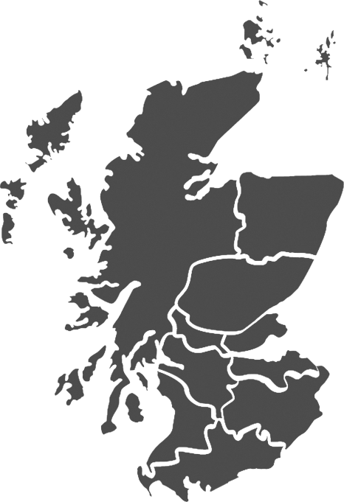
Contact Us
Tel: 0845 013 0536
Email: info@interface-online.org.uk
Web: interface-online.org.uk
@InterfaceOnline
InterfaceOnlineUK
Interface-the knowledge connection for business
facebook.com/InterfaceKE/

Slide 14
Connecting Businesses to Academics 12 June 2019
Discussion

