Slide 1
Kenny Anderson - SWAP Director Alan Roseweir - Associate Director Engineering Academy

Slide 2
‘Widening Access a Partnership Solution ’

Slide 3
Vision
In the context of Strathclyde being a socially progressive University with core values of being bold, ambitious and a place of useful learning the university embarked on the creation of the Engineering Academy. The Engineering Academy model would allow us the opportunity to widen access to additional students wishing to undertake a degree in engineering at Strathclyde.
Aims
To develop and implement the Engineering Academy model
To secure and provide sustainable funding to deliver our vision
To build a strong sustainable partnership model

Slide 4
Engineering Disciplines Seven university departments in Engineering
Biomedical Engineering
Chemical & Process Engineering
Civil & Environmental Engineering
Design, Manufacture & Engineering Management
Electronic & Electrical Engineering
Mechanical & Aerospace Engineering
Naval Architecture, Ocean & Marine Engineering

Slide 5
The Partnership

Slide 6
Engineering Academy (EA) - College Partner Funding Model
First 4 years (4 intakes) – 80 places initially which increased to 100
Funding components
Scottish Funding Council (SFC) funding element.
Students Awards Agency Scotland (SAAS) funding element.
Figures used for illustrative purposes only
SFC funding Group price (2/3) £9000 circa. per student.
SAAS funding £1285 circa. per student.
College Partners receive 75% of the fee. £6750, ( Minus the SAAS element) £5465 per capita payment.
College partner registers each student for SAAS element £1285.
Total income received by the partner college ( £5465 +£1285) = £6750.
University retains (Administration) 25% of SFC funding £2250
Additional SFC ended in 2016. EA funding for 2017 onwards is funded from the university using the same model.

Slide 7
Curriculum Model

Slide 8
Entry Requirements
Application process is through UCAS: Code OBRT
Note candidates from Low Progression Schools and SIMD 20/40 be give priority
https://www.strath.ac.uk/studywithus/wideningaccess/ for further information
Subjects | Grade | Receiving department
Higher Mathematics Higher Physics Any two other Highers The new Foundation Apprenticeship can be used. | B B *B *Note 1 of the higher grade can be at C if the student is from SIMD 20/40 | Civil & Environmental Engineering Design, Manufacture & Engineering Management Electronic & Electrical Engineering Mechanical & Aerospace Engineering Naval Architecture, Ocean & Marine Engineering
As above plus Higher Chemistry | As above | Chemical & Process Engineering
Higher Biology/Human Biology |  | Biomedical Engineering
Access to Engineering (full time programme delivered at a partner college). Including RPL | Complete programme successfully | Access to all departments
Equivalent to above (other countries) |  | Access to all departments

Slide 9
Delivery Model
NB Engineering Academy students are University of Strathclyde students from day 1 guaranteed direct entry to Year 2 upon meeting requirements
Traditional Route
4/5 As
Higher
Year 1
BEng (Hons)
Engineering Academy
4 Bs*
Year 2
Year 3
Year 4
MEng
Partner College
10-12 weeks work placement with option to sponsor
10-12 weeks work placement with option to sponsor
Academic project with option to sponsor
Access to Engineering (SWAP)
Enhanced HNC + practical
skills units
* Students from SIMD 20/40 can access with BBBC (Maths/Physics must be at B and Chemistry at B for Chemical Engineering or Biology/Human Biology at B for Biomedical Engineering). Engineering Foundation Apprenticeship can count as one of other Highers.

Slide 10
Added value
The Engineering Academy programme provides the following advantages:
National qualification in year 1 (HNC)
Paid work placement
Scholarships/sponsorships
Workshop skills development
Transitional support from receiving department
As students of the university they have access to all facilities as follows:

Slide 11
Engineering Academy students (year1)
Access to the following:
Academic counsellor at Strathclyde
University services
Electronic access to University VLE
Strathclyde email address and login
Member of Sports Centre
Access to University Library
Membership of the University of Strathclyde Students' Association
Eligible to apply for accommodation on University campus
Transition programme on campus

Slide 12
Progression Requirements
Progression to second year* guaranteed subject to satisfactory completion of programme
Pass all units within enhanced HNC curriculum
A in graded unit, (70% or above).
Completion of skills development training (Delivered at the university)
Second year students provided with additional support and induction
Third year onwards is identical to regular curriculum
* First year for Biomedical Engineering

Slide 13
Partnership Operation
Partnership Management Meetings - 2 per year, Status report presented a December meeting.
Partnership agreement in place.
Data sharing agreement in place.
College visits – 2 per semester
Attendance reporting – Monthly for partner colleges
Progress reporting – 2 per semester from partner colleges
Final reporting - Progression Board (June).

Slide 14
Partnership Operation Continued.
Established Working Groups as follows:
Working Groups | Membership (Chaired By Associate Director EA) | Activity
General Engineering Mechanical & Aerospace Design Engineering Manufacture Civil and Environmental Engineering Biomedical Engineering | Lecturing staff in the discipline areas from the university and the college partners | Identify curriculum ‘Hot Spots’, curriculum review(year1), share materials via university VLE and identify joint staff development opportunities.
Electrical & Electronic Engineering | As Above | As above
Chemical Process Engineering | As above | As above
Mathematics | As above | As above
Communication | Departmental Representatives and college communications lecturers | Integration of university transition student project reports for formal SQA assessment purposes.
Schools Liaison | College partners Schools liaison staff | Operational partnership working to engage with schools, especially low progression schools.

Slide 15
Relationship with Industry
.
Core to the success of the Engineering Academy is the industry engagement
Around 100 companies – large, medium and small -
Examples
Hosted employer events - company business presentation paid internships
Externally funded sponsorships
CV workshops - university careers service
Babcock Marine, Spirit Aerospace, Castle Precision Engineering, Aggreko, Cummins Diesel Recon, Star Refrigeration, NHS, Transport Scotland, SPT, (Glasgow Underground), Geoseas (Belgium)

Slide 16
Successes
Recognition
Scottish Funding Council –
“ The Engineering Academy has exceeded all expectations” CEO SFC 2017
Scottish Qualification Authority (SQA) Star Award-
Partnership of the year and Highly commended for Widening Access.
Successes
EA Student won the Telegraph STEM UK Award, cheque for £25k (2017)
30% of the Engineering Academy graduated MEng in 2017
Two Engineering students currently undertaking a PhD

Slide 17
Student View
“The Engineering Academy at Strathclyde provided me with opportunities through study and work placements that I would not have had otherwise. It gave me the confidence to apply for a graduate role at Cummins and I believe my industry experience was a deciding factor in my acceptance onto the graduate scheme.”
Elizabeth Collins

Slide 18
Student View
“Studying with the Engineering Academy has provided me with so many benefits. I have been given exclusive recruitment opportunities and really helpful CV workshops. I now have an amazing placement in Belgium with a great company, an experience I wouldn’t have had without joining this programme.”

Slide 19
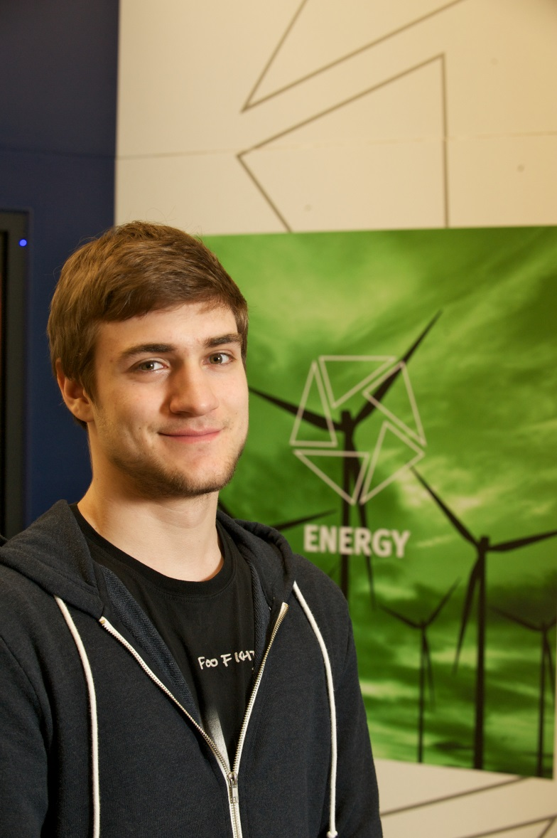
Student View
“I was looking for options to leave school at the end of my fifth year and progress to university. I came across the Engineering Academy which allowed me to attend college instead of taking a sixth year at school and then to progress straight into the second year of an Electronic & Electrical Engineering degree.”
Andrew MacLellan

Slide 20
SWAP our partnership working
Sustains the core work of SWAPWest since 1993
Looking at key challenges around step up – increasing enrolments and whole systems approach
strengthening our curriculum
meeting the needs of our College and University partners

Slide 21
SWAP a successful, tried and tested model

Slide 22
classic swap model
1. Academic: no qualifications – no problem.
SCQF level 6, SQA units, broad programmes with multiple progressions / specialist programmes.
Growth of science programmes – strategically important area.
2013 : 139 / 2018: 274.
New programmes across all regions. At least one science programme and preferably combination of life science and STEM
2. Guidance: preparation for higher education / study skills / transition
3. Progression: relationship with admissions / college profiling / transition
4. Cost effective: small team – big partnership

Slide 23
Working with eng academy a partnership solution
Long standing work with engineering – challenging area
Growth of science provision
Opportunities for our own students
Awareness of issues faced by our students in transition
“Getting in and moving on”
Grow your own – customised view of the programme. Glasgow Kelvin and City of Glasgow.
Good student successes …

Slide 24
But are you up to the challenge of where a partnership may take you …

Slide 25
Widening access partnership solution
Challenges of Commission on Widening Access – step up
Whole Systems approach to widening access – what will that mean to the normal focus of your work?
How can existing partnerships meet the challenge?
Can we as a partnership work with a local authority to develop a school college partnership to meet the challenges of the “getting in phase”.
Working with communities and families to meet our objectives.

Slide 26
Delivery Model
NB Engineering Academy students are University of Strathclyde students from day 1 guaranteed direct entry to Year 2 upon meeting requirements
Traditional Route
4/5 As
Higher
Year 1
BEng (Hons)
Engineering Academy
4 Bs*
Year 2
Year 3
Year 4
MEng
Partner College
10-12 weeks work placement with option to sponsor
10-12 weeks work placement with option to sponsor
Academic project with option to sponsor
Access to Engineering (SWAP)
Enhanced HNC + practical
skills units
* Students from SIMD 20/40 can access with BBBC (Maths/Physics must be at B and Chemistry at B for Chemical Engineering or Biology/Human Biology at B for Biomedical Engineering). Engineering Foundation Apprenticeship can count as one of other Highers.

Slide 27
Access to Engineering Programme
Engineering Academy Year 1
University of Strathclyde
S4
Pupil/parent awareness
Pupil selection
S5
S6
Safety Net Options
Full time access (1year) Also gives route to EA
Others
Alternatives
College
MA
Job
University
Other
Enhanced HNC + practical
skills units

Slide 28
Questions?

