Slide 1

Making Stratospheric
Change Strategically Circular

Slide 2
Entrepreneurial Mindset & Tools to Create Value
EiR- Session 1
South Lanarkshire/ Ayrshire and Dumfries & Galloway colleges

Slide 3


Wendy White Finnigan CEng FICE
managing people and the built environment, around wastewater and circular economy
The Carbon Shift is our accredited training to supercharge your team sustainability efforts.
The Way Forward 2045 Ltd –Founder gamification approach to sustainability
SDG 6 Ltd- Managing Director Portfolio offering: Circular Economy/ Regenerative agriculture/Business support-strategic direction /Developing strong values led teams
HCEIS and SEED- Enterprise Fellow- facilitating and teaching entrepreneurship alongside sustainability, behavior change and leadership as topics.

Slide 4
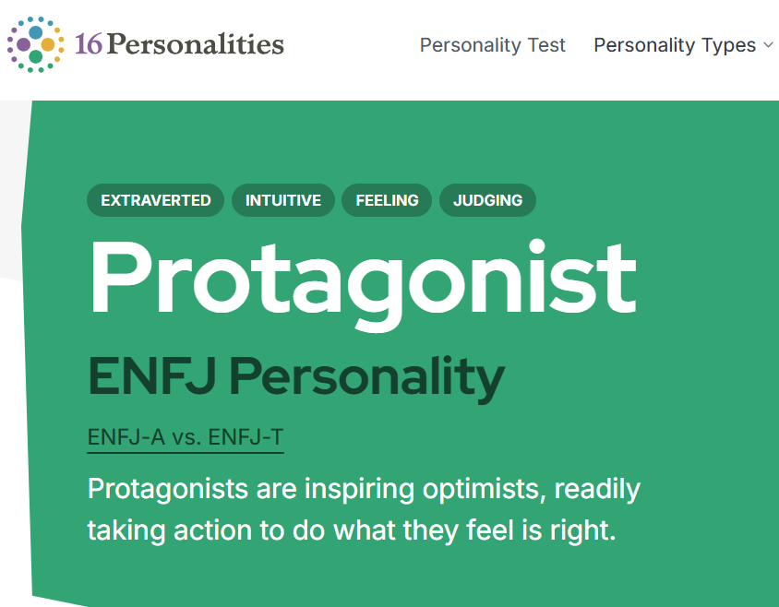
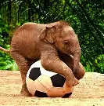
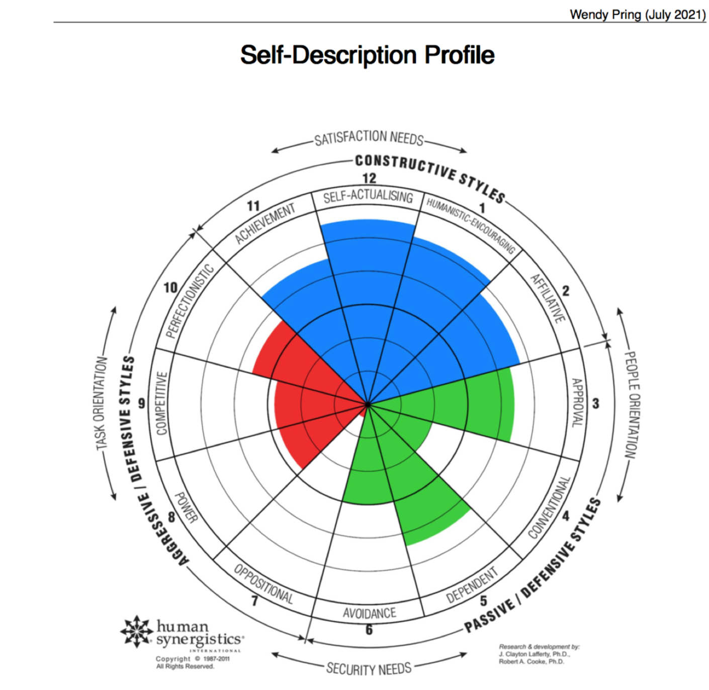
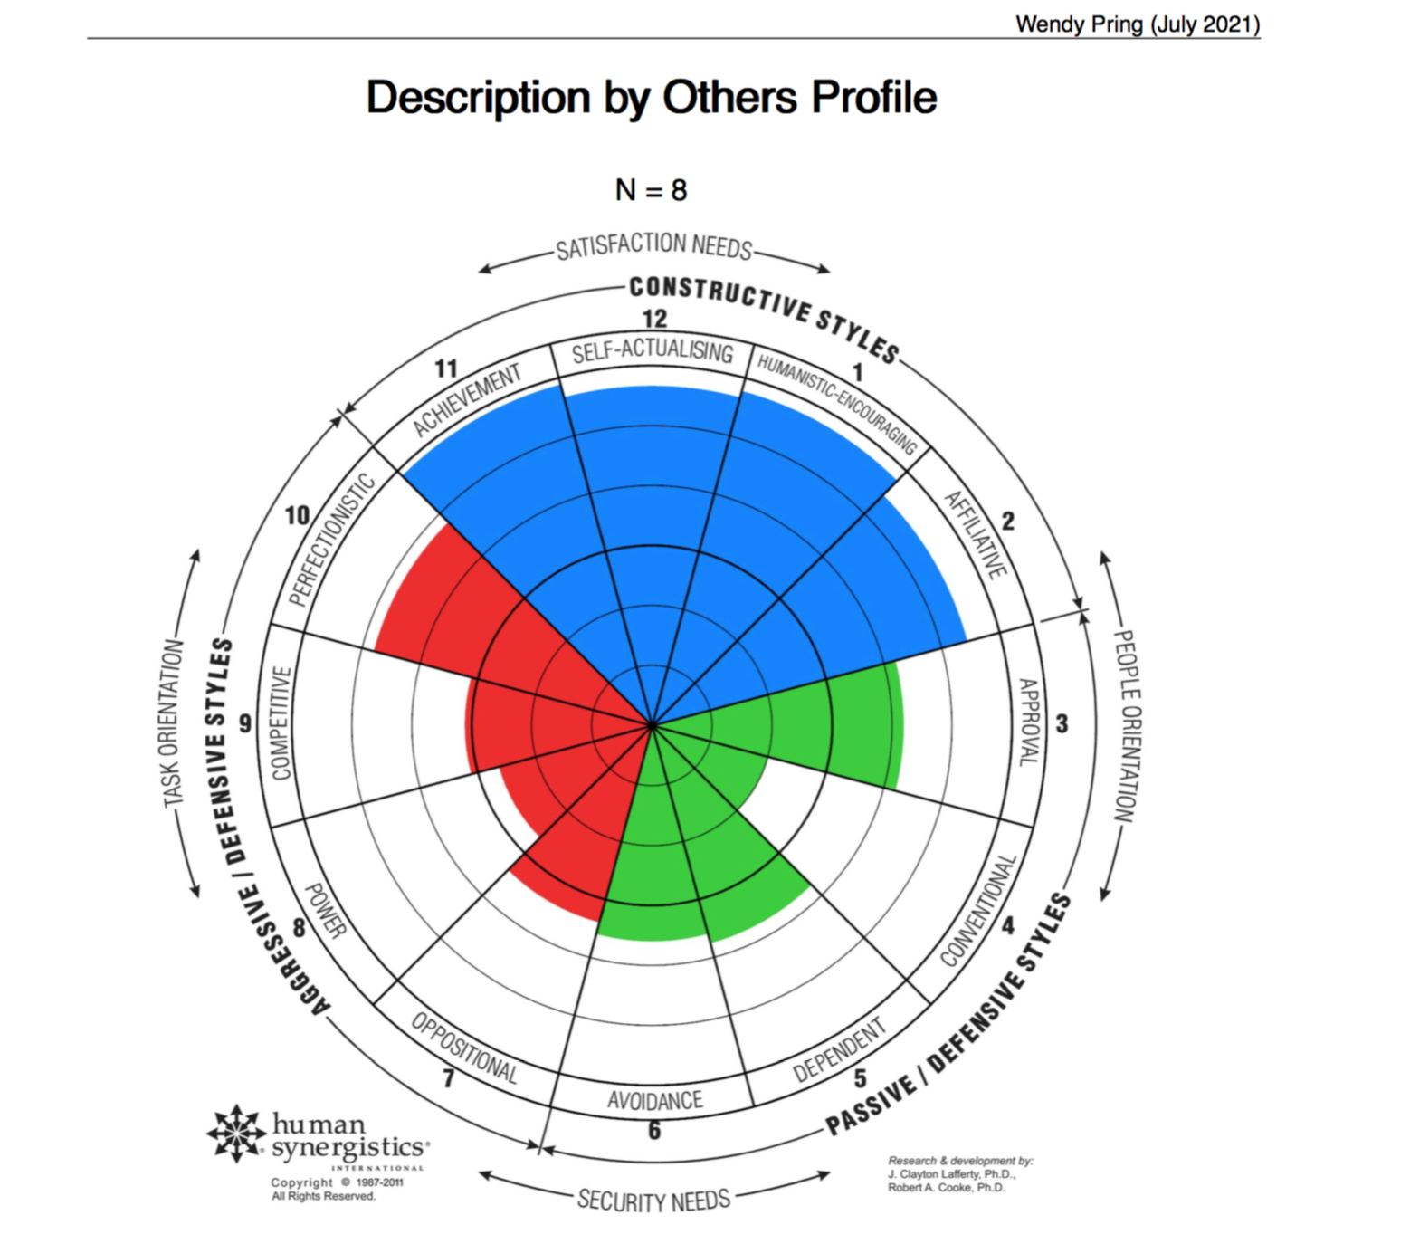

“Life is short let’s have fun…with shiny happy people who want to live in harmony , and we get to plan it and change what better looks like for all people and all of the planet!”
A full 360!

Slide 5
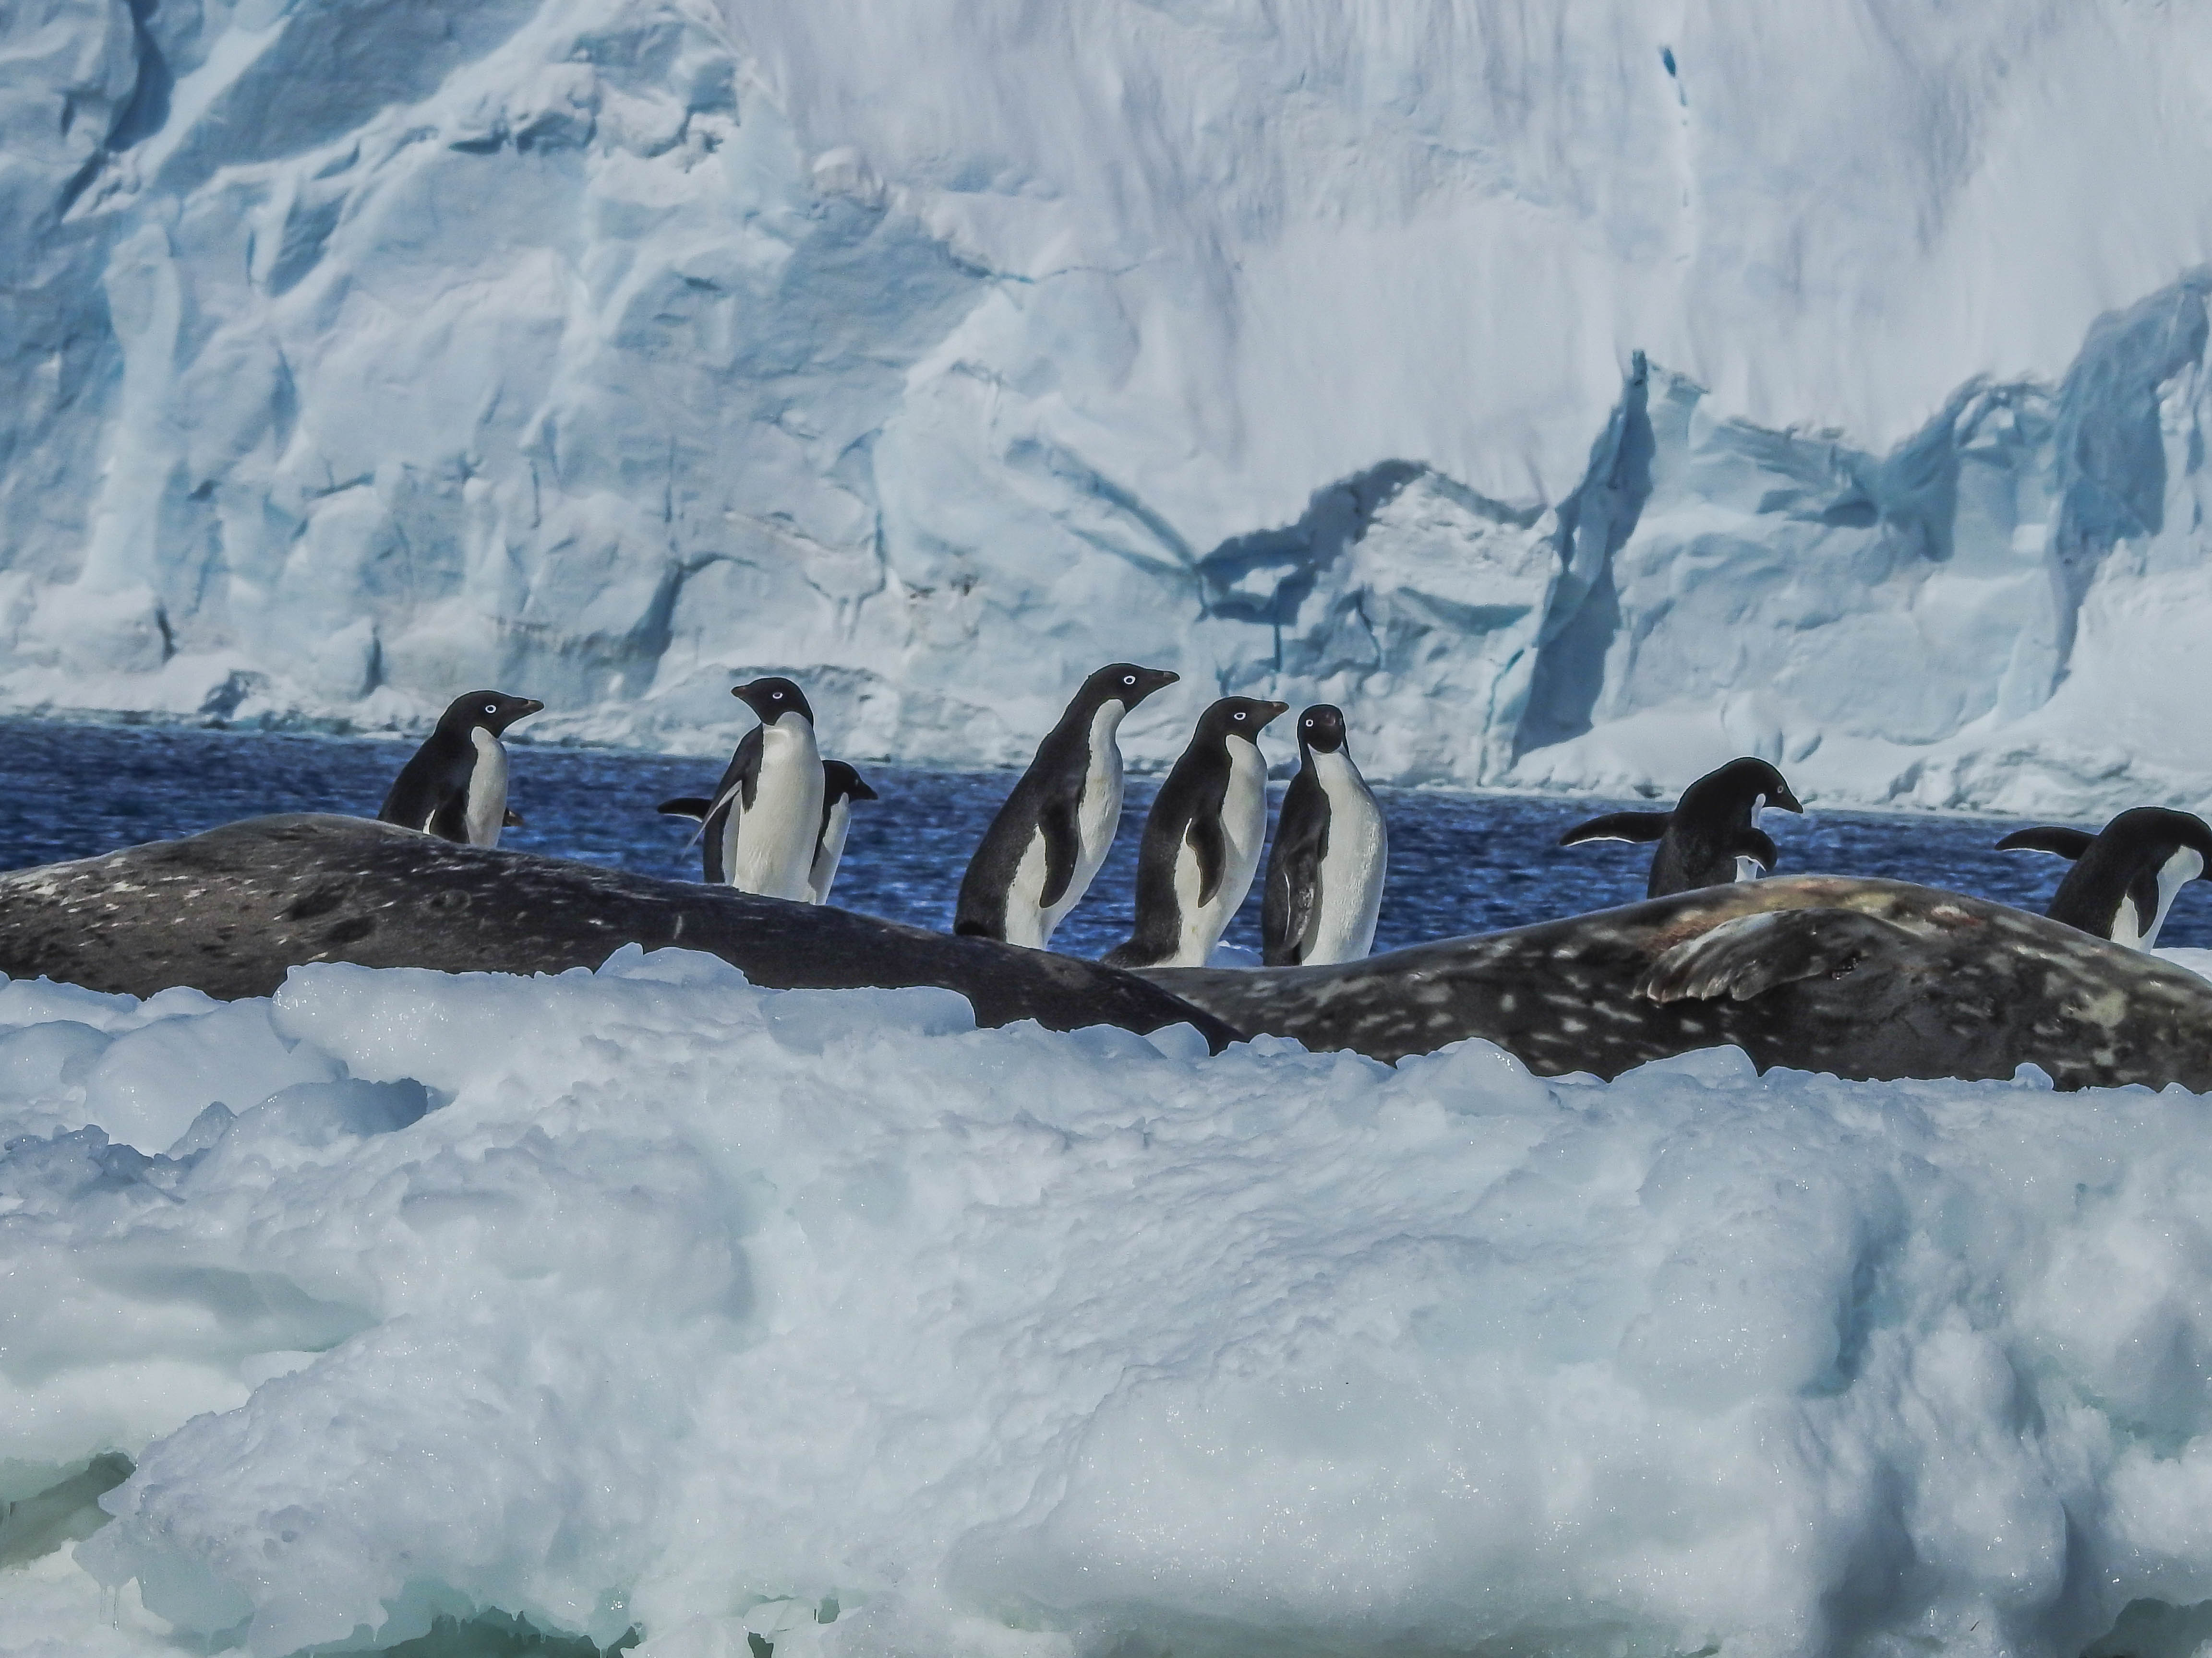
Can anybody be a leader?
Can you learn to be a leader?
Is it important to be a good leader?
Do you think its easy?
Why?
In your groups chat through these points – but introduce yourselves one person feeding back to the room and giving me a summary of who you are and what you think of entrepreneurship!

Slide 6
If everyone is moving forward together, then success takes care of itself.
Henry Ford
“You can’t make decisions based on fear and the possibility of what might happen.”
Michelle Obama

Slide 7
“ECOPRENEUR”
In partnership with Dumfries & Galloway, Ayrshire and South Lanarkshire colleges.
In the book Merging Economic and Environmental Concerns Through Ecopreneurship, written by Gwyn Schuyler in 1998, ecopreneurs are defined as follows:
"Ecopreneurs are entrepreneurs whose business efforts are not only driven by profit, but also by a concern for the environment. Ecopreneurship, also known as environmental entrepreneurship and eco-capitalism, is becoming more widespread as a new market-based approach to identifying opportunities for improving environmental quality and capitalizing upon them in the private sector for profit. "^{[1]}

Slide 8
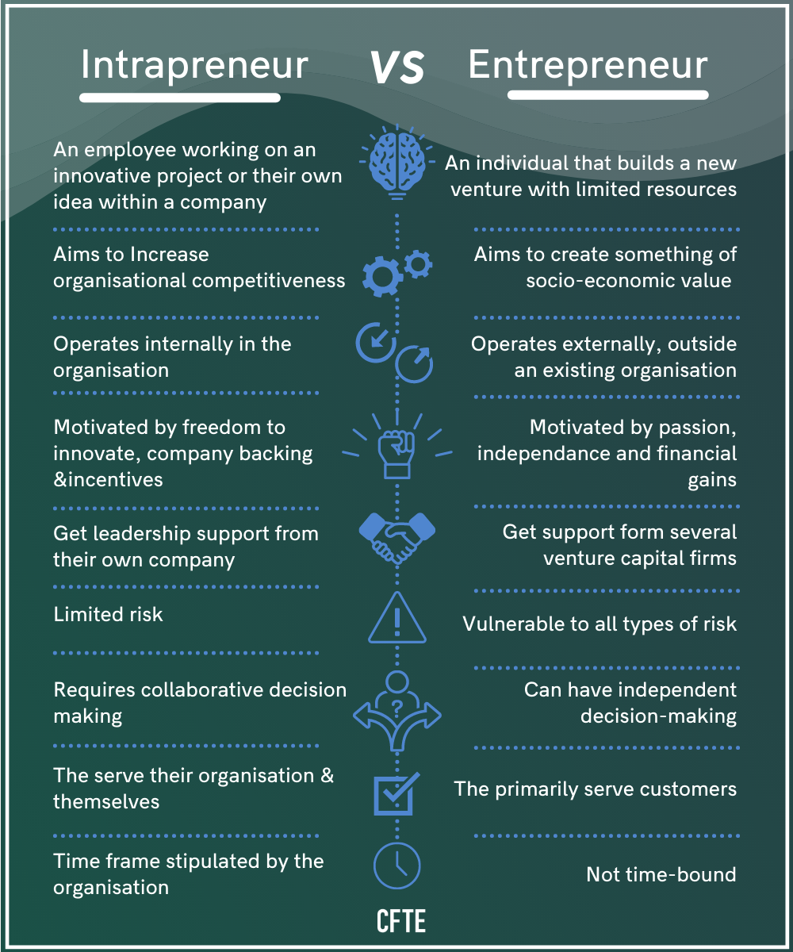
Entrepreneur V’s Intrapreneur
Entrepreneurship sparks innovation, drives employment, fuels economies, and offers solutions to a range of environmental and societal challenges. But before those sparks and drivers ignite, an entrepreneurial mindset must be in place as a catalyst.
3 traits of an entrepreneurial mindset | MIT Sloan
Entrepreneurial Mindset

Slide 9
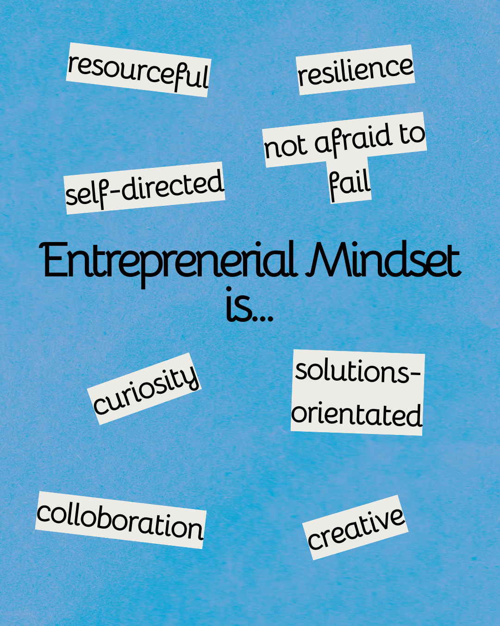
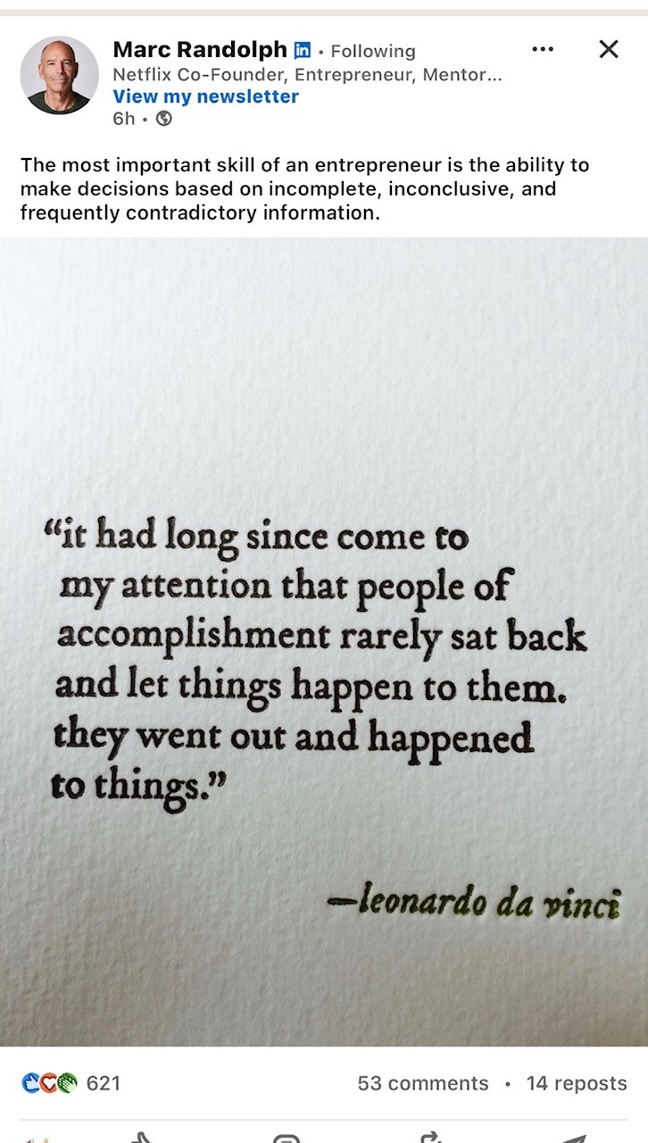
An entrepreneurial mindset is resilient, resourceful, and solutions-oriented — even when the conditions say otherwise. People with these mindsets are lifelong knowledge-seekers who are curious and creative, and they are critical thinkers, Barrett said.
“They're self-directed, action-oriented, highly-engaged,” Barrett said. “They have optimistic interpretations of adverse events” and see problems as potential opportunities.
“They're about looking to others, and the value you can create for others by solving problems for others, and they surround themselves with an intentional community of positive influence and critical guidance,” Barrett said.
Entrepreneurial mindsets understand that pursuing and following through on something can lead to unforeseen opportunities.

Slide 10
Growth Vs Fixed Mindset:
“Tendency to see ability, intelligence and talent as something that can be grown (growth mindset) or that is fixed (fixed mindset)”
(Dweck, 2017)

Slide 11
Growth Vs Fixed Mindset: Characteristics
Growth Mindset | Fixed Mindset
Belief that intelligence can grow | Belief that intelligence is fixed
Belief in hard work | Belief in natural talent
Hard work makes you smart | If you have to work hard it means you are not all that good
Uncomfortable challenges welcome as opportunities to learn | Uncomfortable challenges avoided for fear of failure
Focus on doing one’s best with little or no consideration of how one is perceived by others | Focus on what others think. Trying to look good at all costs (including cheating, lying, avoiding, blaming)
Failing means you are not there yet, must try again | Failing means you ARE a failure, must give up
Leads to self-improvement and resilience | Leads to stop trying or not trying hard enough
(Dweck, 2017)

Slide 12

The organizations that treat leadership development as a core capability and proactively address the needs of both existing and aspiring leaders can raise their overall resilience and substantially improve the odds that they will be able to withstand disruption—whatever it is, and whenever it appears next.
What do you think are some leadership qualities?
The new rules of leadership for the 21st century | McKinsey

Slide 13
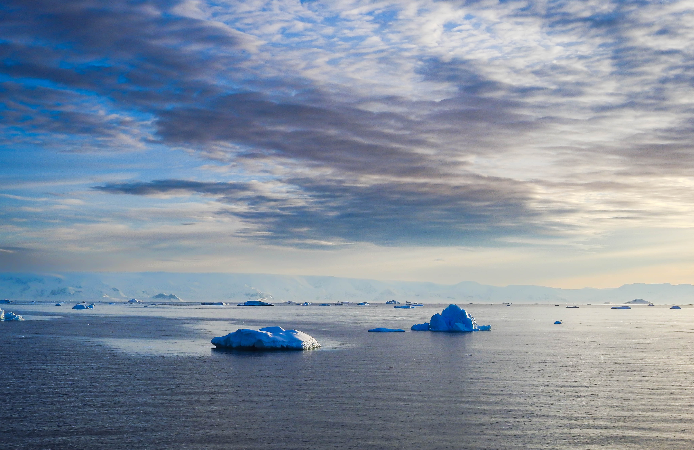
Positive energy, personal balance, and inspiration … workforce is looking for more connection, more authenticity, and more inspiration from their leaders…
Levity. The high-performing leaders we’ve observed recognize that it’s important to bring humor to their conversations,
Grit and resilience They don’t disappear when times get tough. They calmly analyse the root cause of a situation, adjust behaviours, depersonalize, and bounce forward
Servant and selfless leader’s…care about the organization’s mission, deep purpose, and positive impact
Continuous learning and humble mindset The highest-performing leaders we’ve observed never consider themselves to be the highest expert or the smartest person in the room. Their superpowers are their humility and willingness to be vulnerable
Stewardship…and the tasks of leadership will evolve as the organization does
And authenticity among leaders isn’t just nice to have; it’s expected by employees, customers, and almost everyone along the value chain.

Slide 14
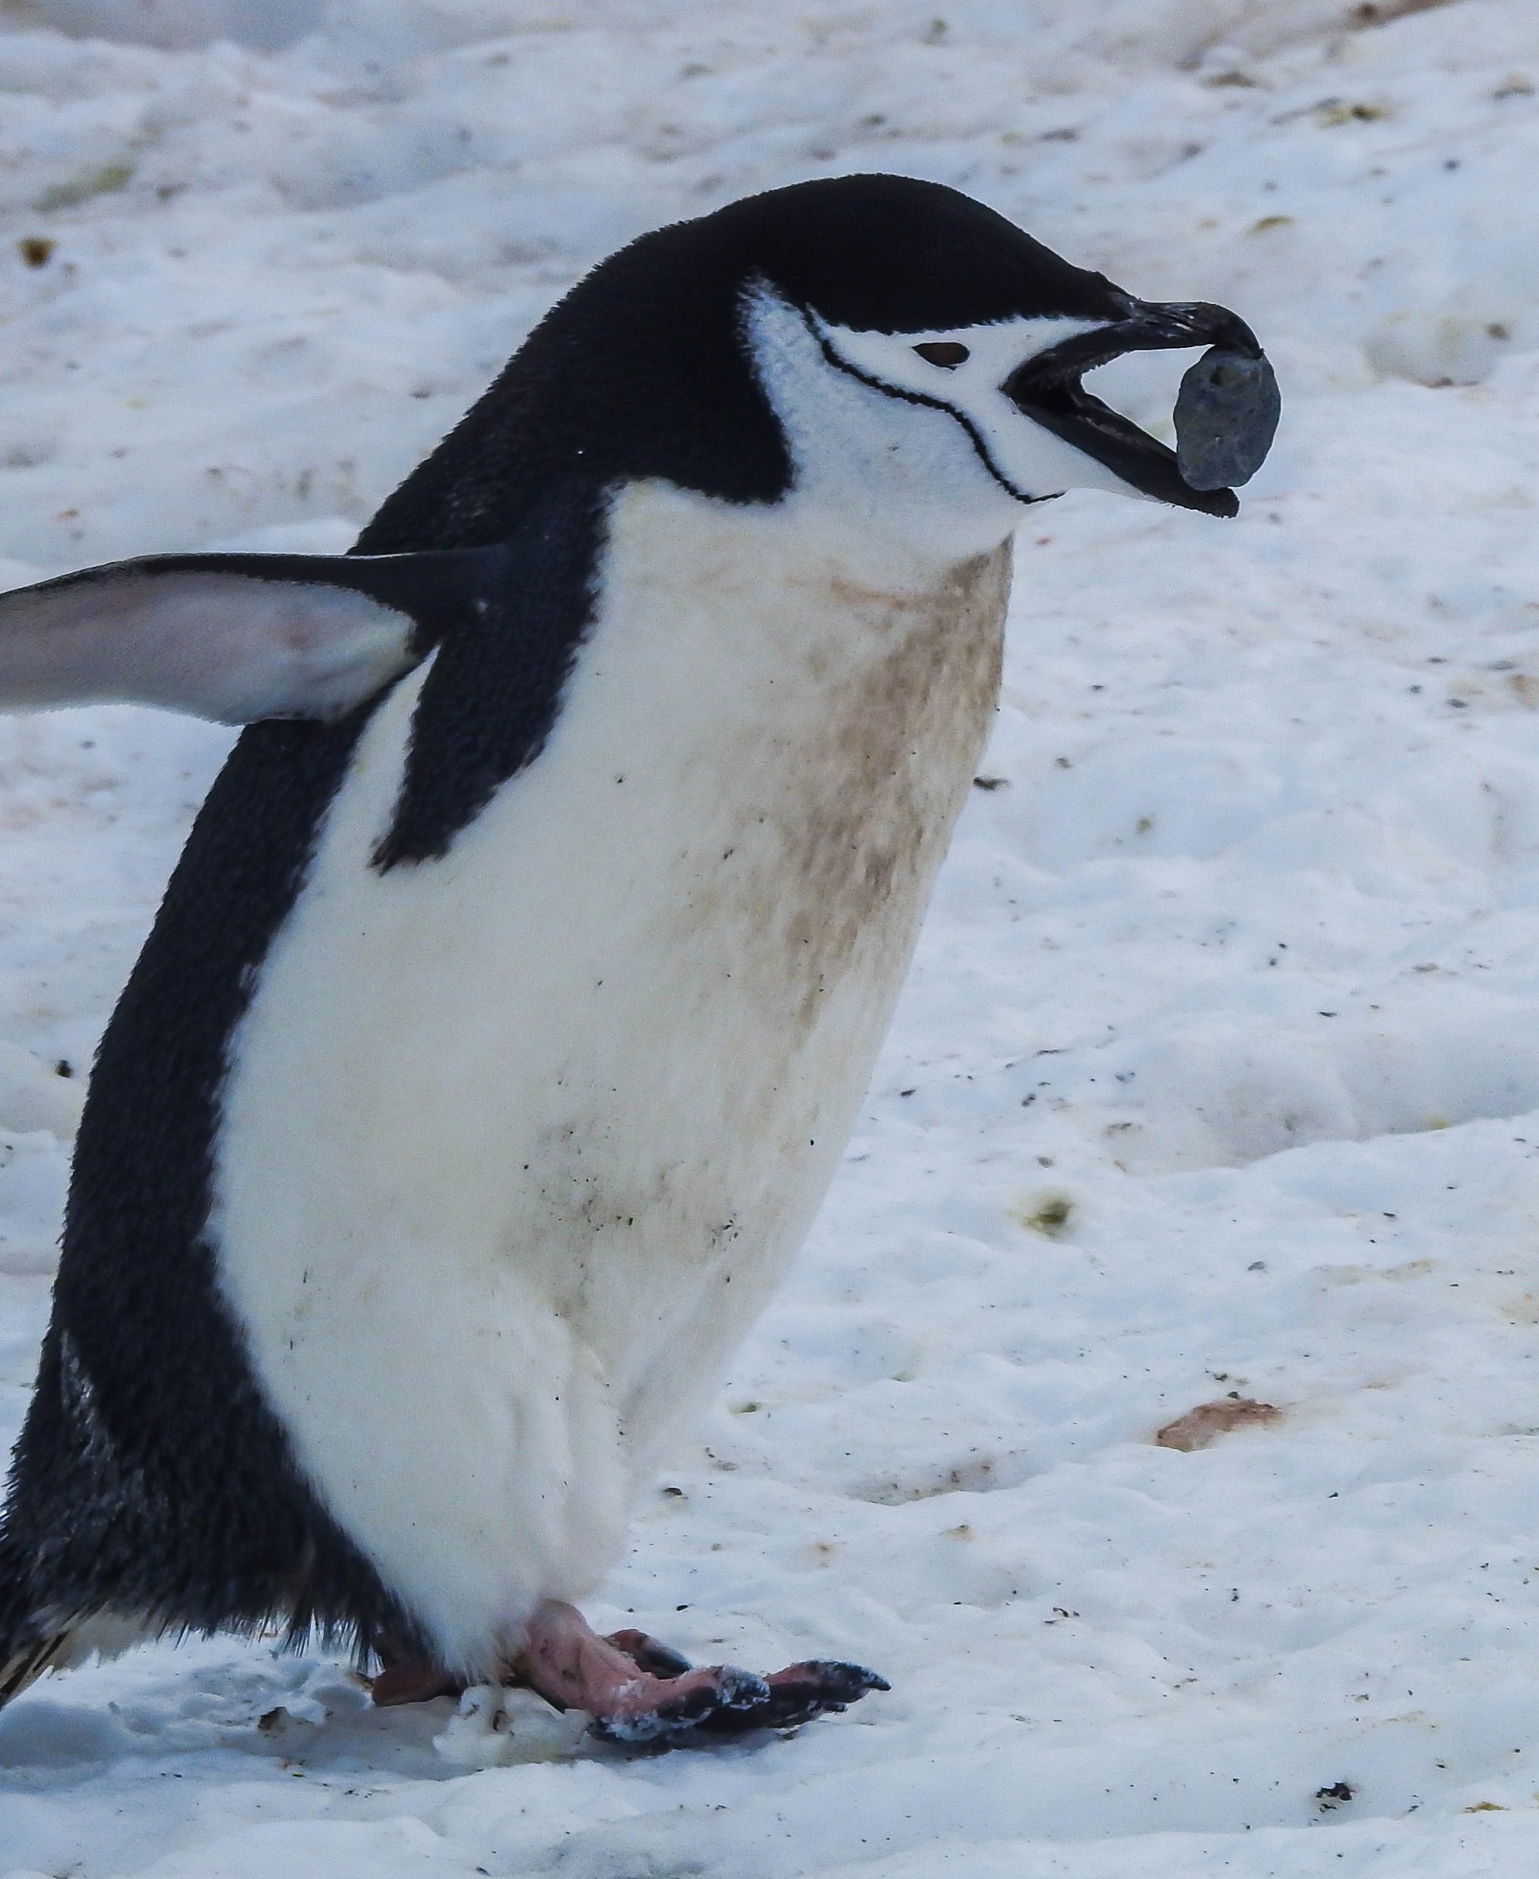
Task 1-Discovering your shape!

Slide 15
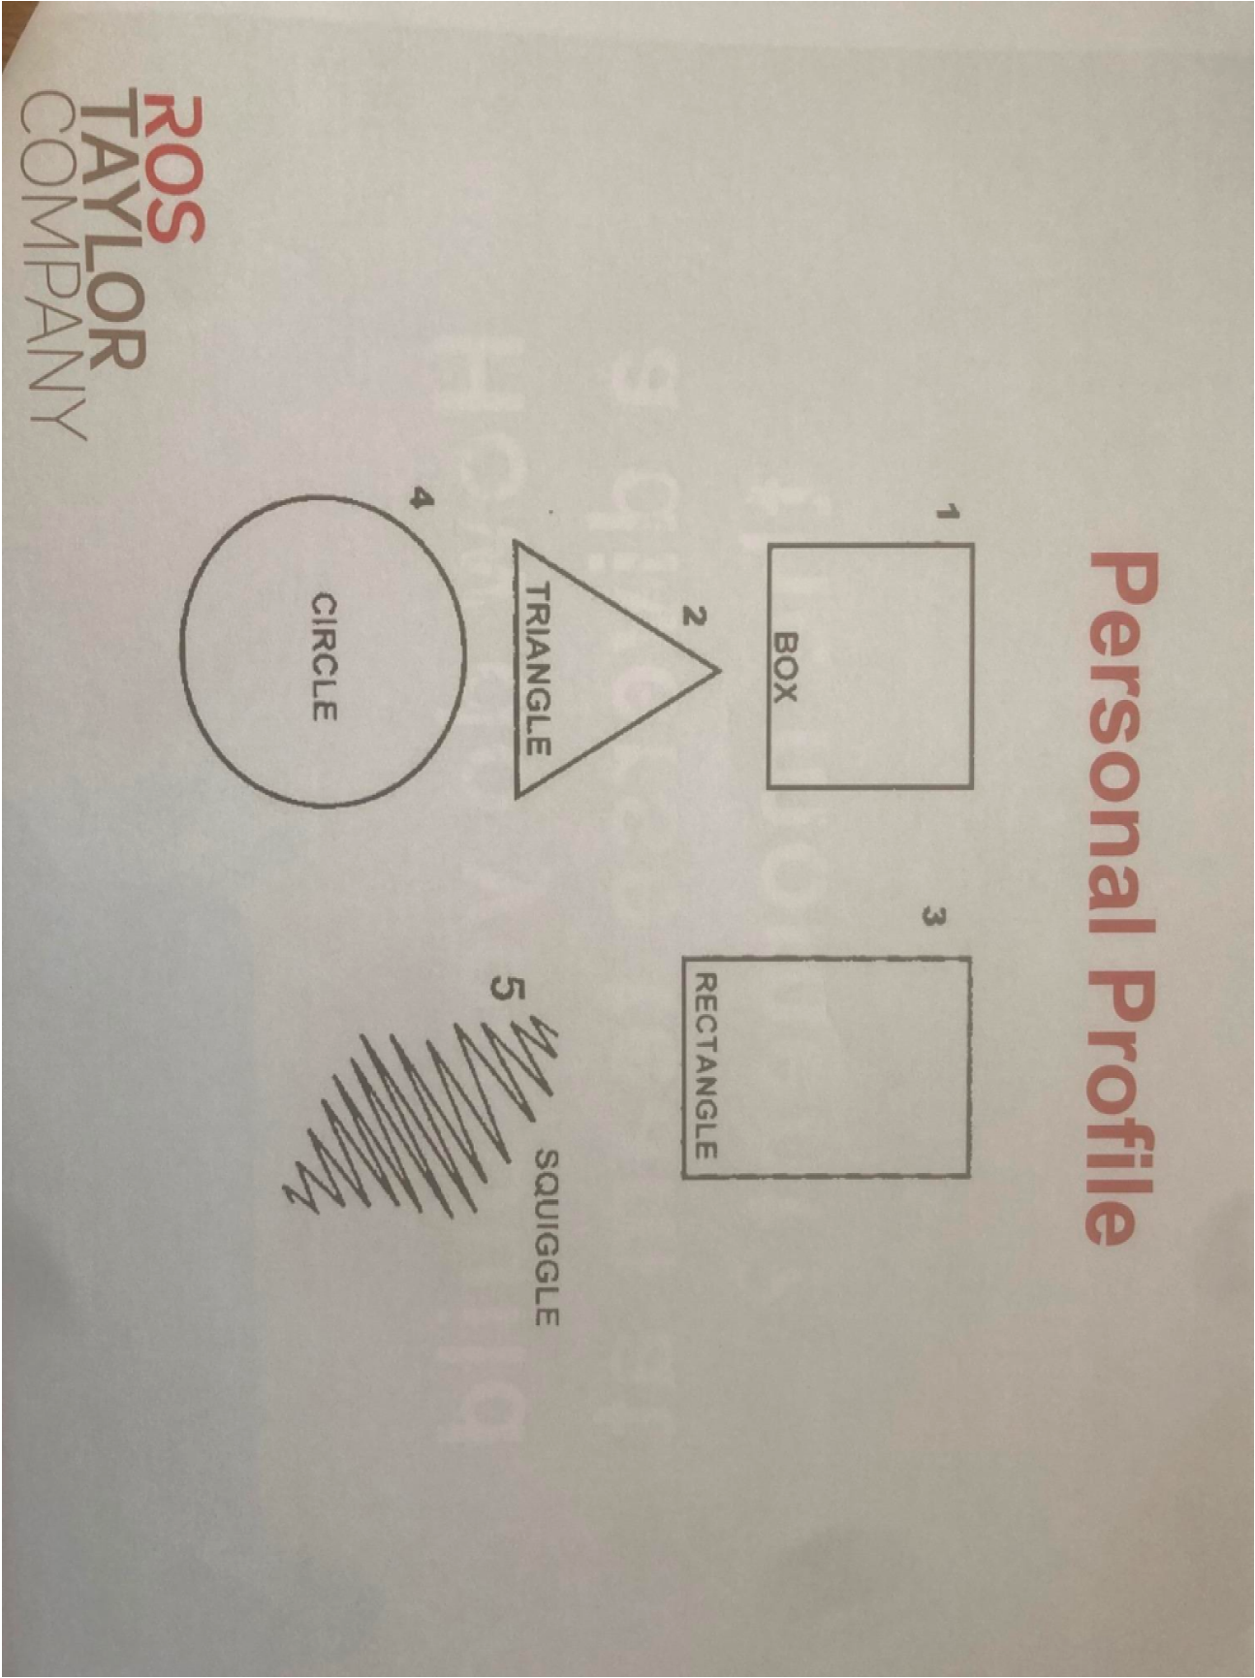

Slide 16

Leadership doesn’t always come naturally. Even the most capable leaders need to review performance and improve their skills. To become a better leader, work on modelling the qualities that you would like to see in your team members.
SWOT – assess your skills, your strengths and weaknesses. Once you recognise your weak points, you can start to look at how to do better. Regular feedback from your team can help create a transparent culture and maintain good habits.
Set goals and regularly review them – think both long-term and short-term to keep focussed on your goals.
Communication skills – being able to clearly communicate with your team is vital to organisational success. Listen to colleagues’ views and communicate effectively to inspire, motivate and recognise the achievements of your team. Be approachable and build trust by delivering on promises.
Learn from your failures – build confidence in decision making by recognising why something went wrong and learn from it through feedback and by reviewing decisions to see how things could have been done differently.
Collaborate – place trust in your colleagues to create an engaged workforce.
Be a role model – live the organisation’s values and culture.
Positivity – be optimistic and resilient in the face of challenges.
Innovate – encourage creative problem-solving, seek new ways to inspire, motivate, and reward group members.
Motivate your followers – by being passionate and recognising contributions.

Slide 17
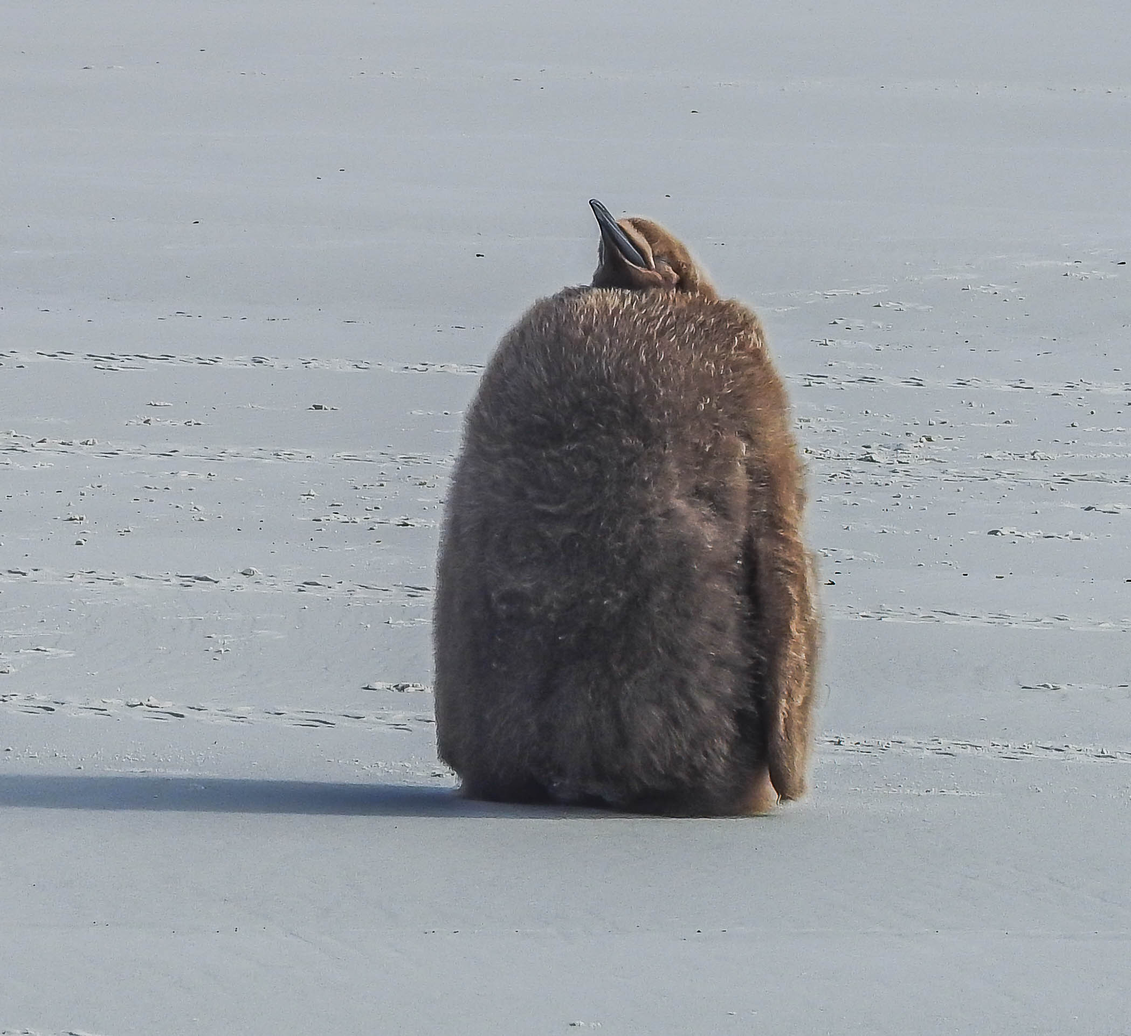
Diversity of thought – what is this?
“There's Not Enough Talk On How Weird Neurotypicals Are” Fern Brady Discusses Autism | The Last Leg

Slide 18
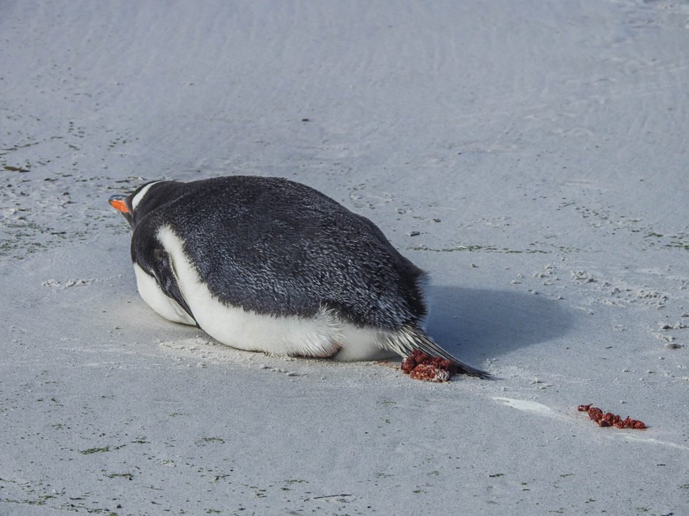
Sometimes you can have a really ****** day but it doesn’t need to be a week or month or forever.

Slide 19
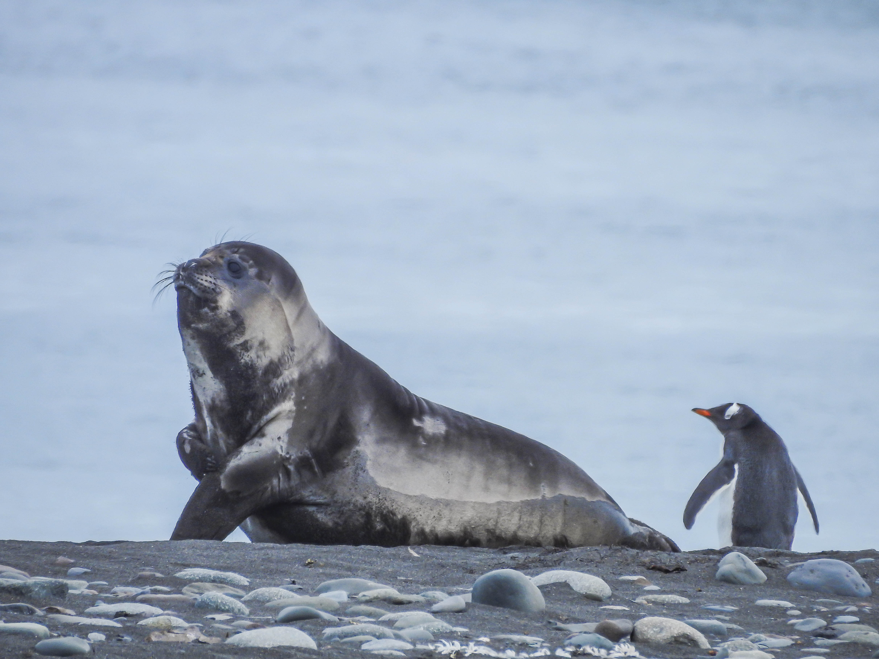
Other days you’re hanging out with anyone!
So here comes the first hurdle…how can you lead people if they keep behaving differently or turning up distracted or sad or ecstatic?!! ☺
There are ways we can choose to lead through this and the more we learn to see where we are then the more we can lead others!

Slide 20
CHANGE. Some ways people will try to delay or sabotage something…
Ignore it
See it coming and dodge
Scorn it
Laugh it off
Praise it to death
Mention that it has never been tried
Prove that it isn't new
Observe that it doesn't fit with organisation policy
Mention what it will cost
Oh, we've tried that before
Cast the right aspersion
Find a competitive idea
Produce twenty good reasons why it won't work
Modify it out of existence
Damn it by association of ideas
Try to chip bits off it
Make a personal attack on the originator
Score a technical knock-out
Postpone it
Let a committee sit on it
Offer to take lead responsibility for developing the idea
Encourage the author to look for a better idea
Break down or refuse to live company values…?
Recognising T-Break Terrorists?
(Darwin, J. et al., 2002)

Slide 21

How else can it be framed?
People may not understand the opportunity
Or may think the solution will not work
It may have unacceptable personal costs to them
Or insufficient personal rewards
They may be afraid of how they’ll cope
They may feel they will lose influence or control
They may prefer a different solution
Or just not be willing to change
Risks destroying social network
Reduces political power and career opportunities
Low shared values / high distraction interest
Or….?
Source: Adapted from various authors

Slide 22
Outstanding Leadership
Outstanding Leadership is not just how good a leader you are but how many leaders you develop....
The difference between Management and Leadership
Outstanding Managers drive individuals to perform at the highest level they are capable of, which is very much about control
and
Leaders inspire individuals to do it for themselves, which is more about freedom
Leaders & Managers

Slide 23









Being an effective change leader means taking people on a journey
Disruption of thinking, feeling
and behaving!
Shock
(False) Optimism
Commitment
Denial
New Ways of Working
Self Confidence
Self Esteem
Perceived Effectiveness
Frustration & Confusion
The cycle and reaction to change is normal and most people will go through all of these stages. Your job is to take people through the journey to the stage of commitment and the new.
Testing
Anger & Strong Feelings
Adapting, Exploring New Ideas
Resistance & Sabotage
Bargaining
Acceptance
Low
OVER TIME
Adapted from Adams, Hayes and Hopson (1976) and Kubler Ross (1969)
Notes:
Based on the Dr Elisabeth Kubler Ross 5 Stage Coping Model - From On death and dying- RECOGNISE WHERE YOU ARE ON THIS U CURVE IN RELATIONS TO YOUR TEAM- WHAT CHALLEMGES MAY THIS BRING??
A great film to watch is ‘Up in the Air’ featuring George Clooney. This movie is a great illustration of this journey. Allow time for people to get used to the idea/change before acceptance happens. As leaders you are further along the curve than your staff as you have had more time to accept / formulate the change.

Slide 24
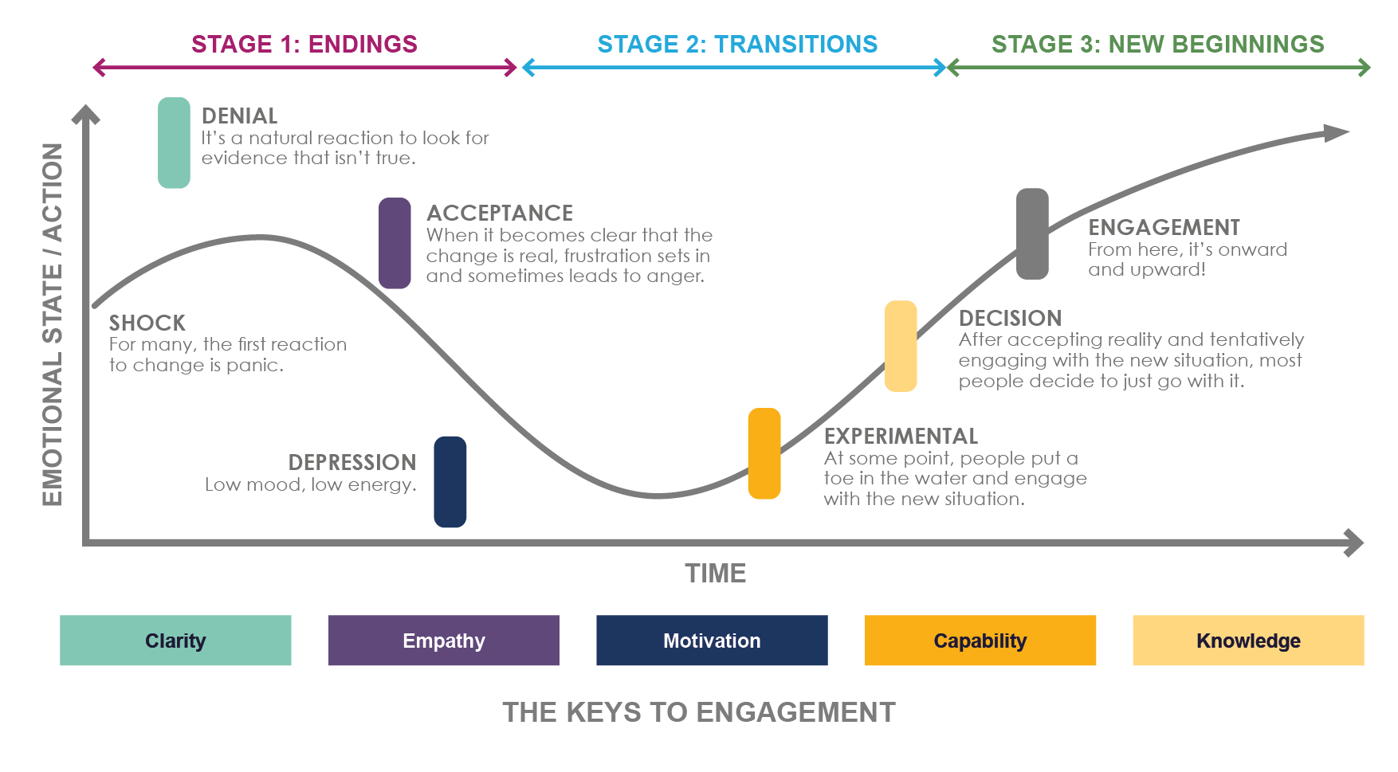
People Move through This Transition Curve in Times of Change
Maybe you have personal experiences of this?
Source: https://newsfeed.mosswarner.com/change-management-communications/
Notes:
Notes for Speakers
Encourage participants to open up about their own experiences and also to think about what would have helped them move forward.
A great film to watch is ‘Up in the Air’ featuring George Clooney. This movie is a great illustration of this journey. Allow time for people to get used to the idea/change before acceptance happens. As leaders you are further along the curve than your staff as you have had more time to accept / formulate the change.

Slide 25
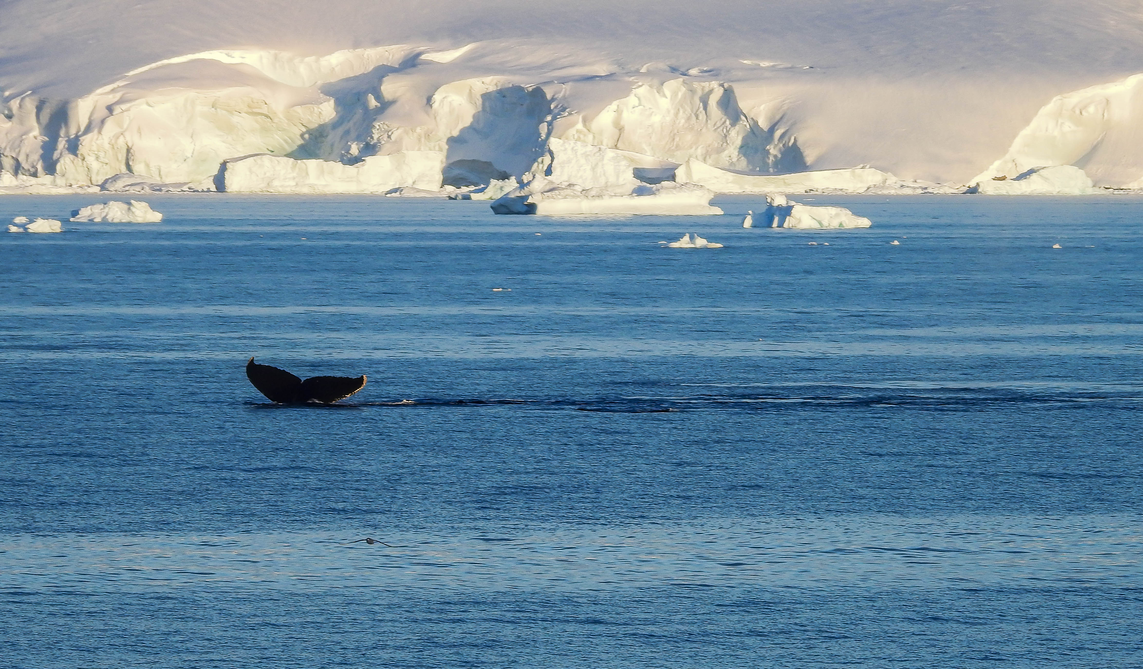
Nigel Risner is a performance coach suggested that people can be divided into 4 groups depending on their communication style
TASK 2- Discovering our animal!

Slide 26




ZOO HEADS
Monkeys are dynamic, creative and energetic. They can inject liveliness and humour into the dullest of situations. Because of this, others sometimes feel they don’t take things seriously enough. They often have trouble with timekeeping. When talking with Monkeys be enthusiastic, tap into their ideas and give them space to think flexibly and change their minds.
Dolphins are very supportive and perceptive of others’ emotions. They are excellent at building rapport and are often also skilled in handling detail. People can perceive them as being weak or over-emotional. When talking with Dolphins, pay attention to social and personal aspects as well as the task and remember they find change unsettling.
Lions are straight-forward, tenacious and purposeful. They make visionary leaders and love to be in charge. They are excellent at making tough decisions and meeting deadlines. People can perceive them as being stubborn, impatient and uncaring. When talking with Lions, be brief and focus on the task in hand. Make a point of honouring all agreements to the letter.
Elephants are capable, analytical and often more sensitive and vulnerable than they let others see. They are extremely reliable and value clarity, gentleness and quiet. They have difficulty expressing themselves and people can see them as overly formal and fussy. When talking with Elephants, allow them to save face and be prepared for lots of questions about detail.

Slide 28
“Life is short let’s have fun…with shiny happy people who want to live in harmony , and we get to plan it and change what better looks like for all people and all of the planet!”
A full 360!

Slide 29
Break- 5 minutes

Slide 30
ALIGNING VISION,PURPOSE & PROBLEM SOLVING
Vision, Mission and Values
Internal Culture
Value Pyramid

Slide 31

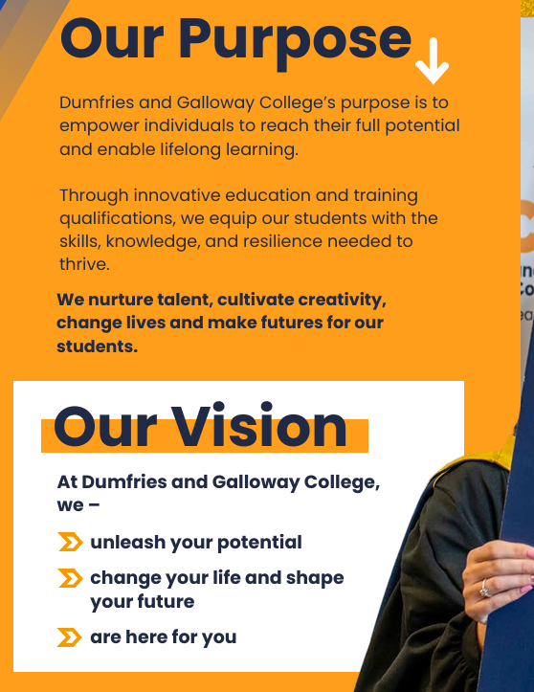
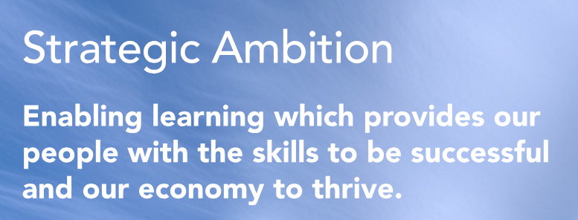

The Golden Circle

Slide 32
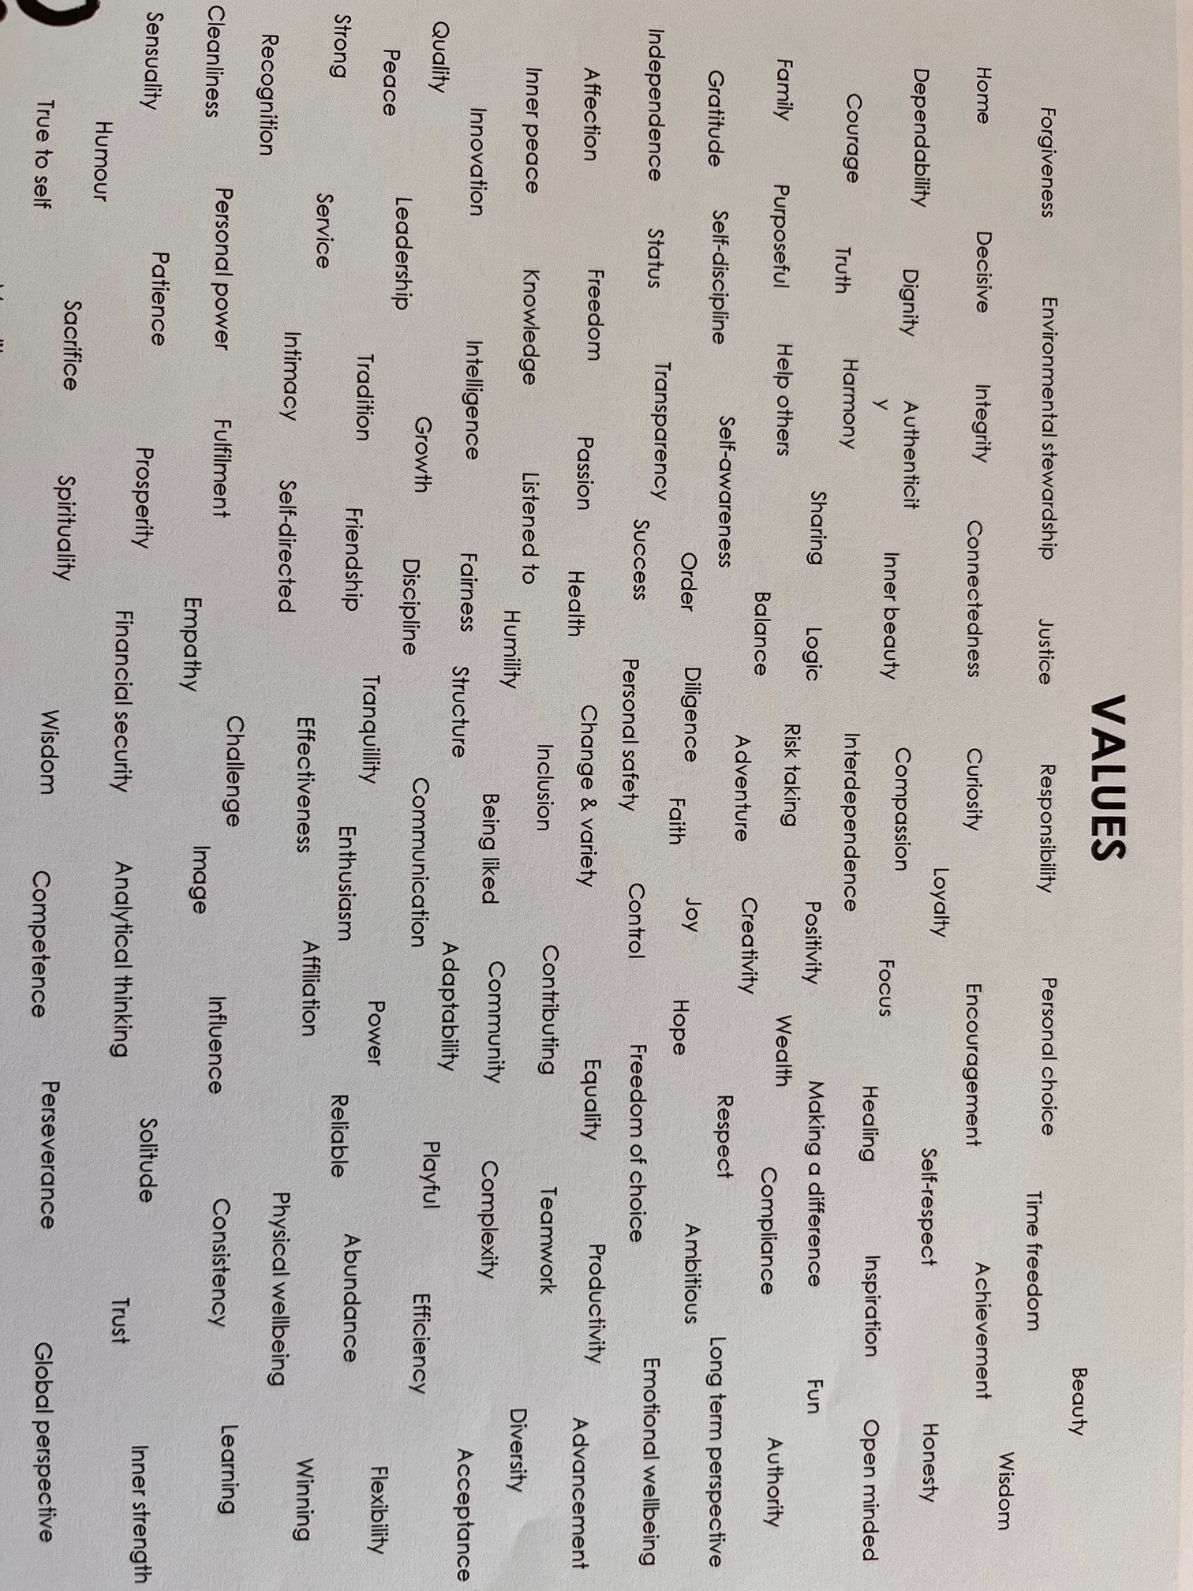

Slide 33
Individual Activity:
Part 1
Choose up to 10 values –think of the question What core value is critical for me to demonstrate to be my best self? What patterns can you see?
Use the Brene Brown template to provide details of 2 that are the strongest.
Part 2
Now discuss the values of your college with the rest of your group…how do they resonate with you?
Feedback to the room

Slide 34
CULTURE
Leading with Values
Lets just discuss what we believe these could be and give illustrations of how these are being conveyed internally and externally?
An organisation’s culture is shaped and influenced by their mission, vision and values.
It is ‘the way we do things around here.”
Deal & Kennedy (1982)
“Our core values are the cornerstones of our internal culture – they are the way in which we want our employees to think and behave.”
Yohn (2019)

Slide 35

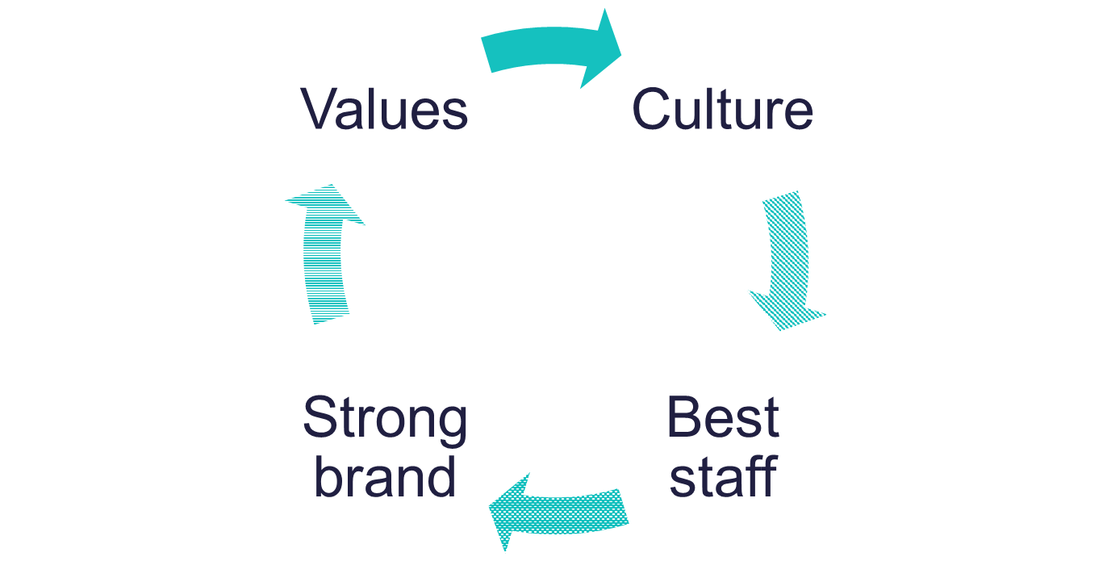
Components of Internal Culture
Observable symbols, stories, slogans, behaviours and physical settings.
Weak vs Strong culture
Underlying beliefs, espoused values, assumptions, attitudes and feelings
Roper & Fill (2012)
Schein (1999)
Notes:
So we can observe things like the brands, advertising etc. but what we don't see is the corporate culture that underpins this.
There are observable elements of culture such as buildings, symbols, logo, stories and the organisation’s behaviour (above the water on the iceberg) and then the underlying beliefs values and assumptions which lie below the water and are not observable from an external perspective.
Above the water line – heritage, organisation history and other examples above, although easy to observe some of these could be difficult for an outsider to interpret and understand.
Below the water line – espoused values are the informal ways of working or principles that guide decision making and or behaviour but are not explicitly spoken about. They may be on the organisation’s website or marketing materials and are represented in the company’s strategies and objectives. Assumptions are the deeper elements of the internal culture and further below the water level in the metaphor. They are not referred to by employees or stakeholders but have strong influence on decisions around priorities. They normally grow from the company values into an embedded way of working.
Weak vs strong to culture within organisations - obviously more difficult to change the culture when strong culture - strong relies on informal but deeply embedded ways of doing things which are less visible and thus more difficult to change. Weak cultures tend to rely on bureaucracy and formal rules which make it easier to change but encourages resistance. Resistance is more likely in weak cultures and less likely in strong cultures - this can be important for innovative organisations.
Roper and Fill (2012) talk about Marks and Spencer being complacent and some of the reasons they are difficult to change is because of the strong culture - less agile and easy to adapt to the changing environment. A strong culture is effective in delivering the value proposition and brand promise but inherently becomes difficult to change and less flexible.

Slide 36
1. Culture is created by the behaviours you tolerate. If you will tolerate bad behaviour, people will learn they can get away with it. That doesn’t mean you have to be mean about it, but create a culture of "open and honest" feedback, and make sure it goes both ways.
2. Change starts at the top. Often, the leader will not be open to change, and it can be in their body language or becoming defensive when someone disagrees with them, etc. You can’t expect your people to change if you’re not willing to change first.
3. The leader needs to recognizes that they are ‘a voice’ around the table, not ‘the voice.’ This is a huge challenge, as leaders often see themselves as the only person capable and authorized to make decisions. While it’s true that they need to make the decisions, they also need to listen honestly and without showing impatience for other people’s opinions. Some call it the obligation to dissent, but whatever you call it, make sure people feel validated for their opinions, and when you make a decision, take those opinions into account.
Culture is one of those intangibles that is very hard to define but needs to be designed and implemented -- and never by default.
Think about the culture within your company…
What are the ‘artefacts’ – symbols, physical settings?
Identify your visible (espoused) values’.
Are there ‘assumptions’?
Is your culture strong or weak?
Does it represent how you want customers to see you and your value proposition?
Watch out for T Break Terrorists!!!
Notes:
Breakout activity two - There is a worksheet for this activity within the workbook.

Slide 37
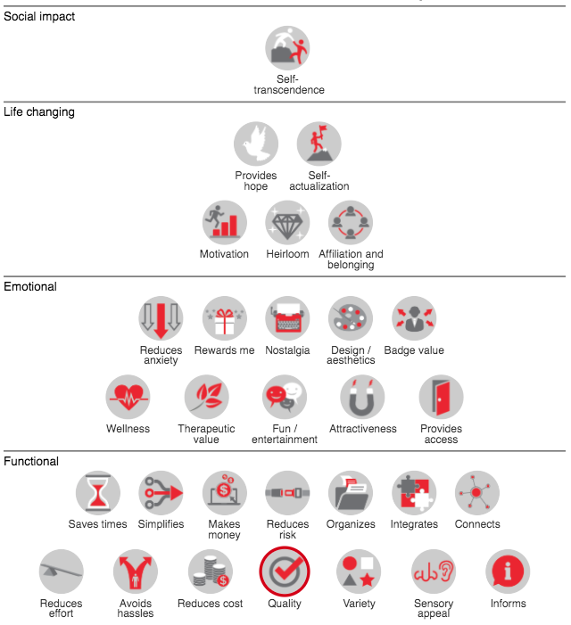
There are structured ways of thinking about what people value
Explore the B2C Elements of Value Pyramid | Bain & Company
What else might you be giving?
List all elements that you provide- that people value from you…and how do you know?
And…what value might a small construction company have?
The original source for this piece of research is found at Bain and Co, which provides an interactive version of the chart shown here – I’ll explain it via some example
https://media.bain.com/elements-of-value/
Used with permission from Bain & Company: https://media.bain.com/elements-of-value/#

Slide 38

Entrepreneurial Mindsets in Business
VMV
Culture
Value Pyramid
Strategy & Innovation

Slide 39
MISSION: why we exist and what we do NOW
VISION: what we want to be IN THE FUTURE
VALUES: the guiding principles AT THE HEART OF OUR BUSINESS

Slide 40
VISION
To create a better everyday life for the many people
VALUES
Togetherness
Caring for people and planet
Cost consciousness
Simplicity
Renew and improve
Different- with a meaning
Give and take responsibility
Lead by example.

Slide 41

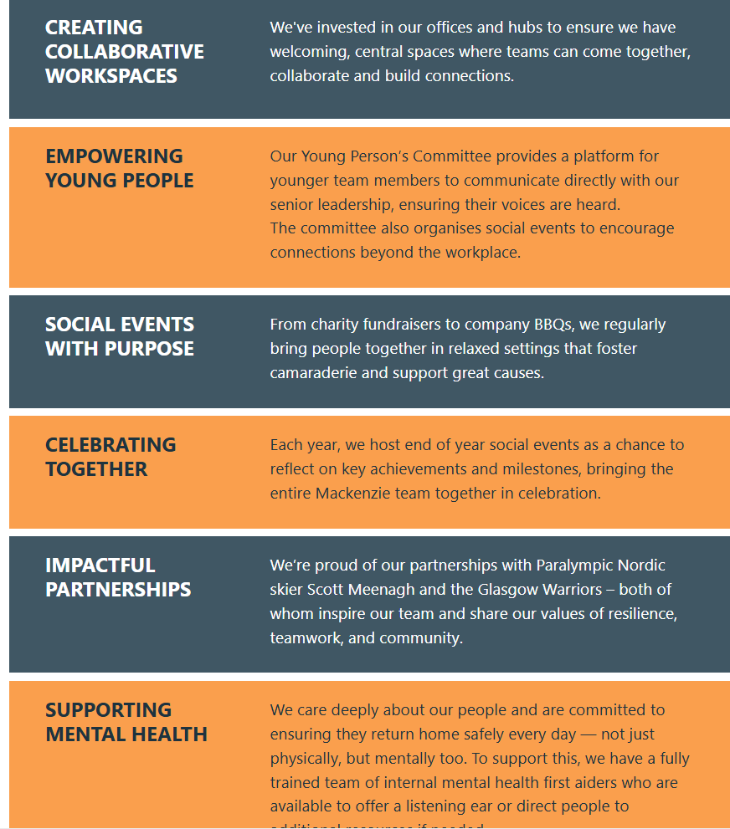
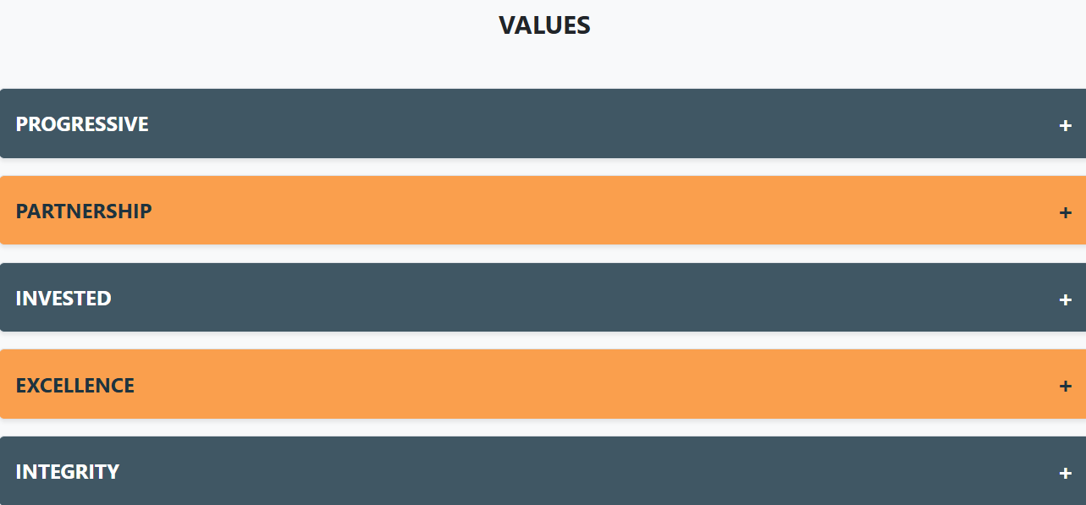
What Industry do you think this is?

Slide 42
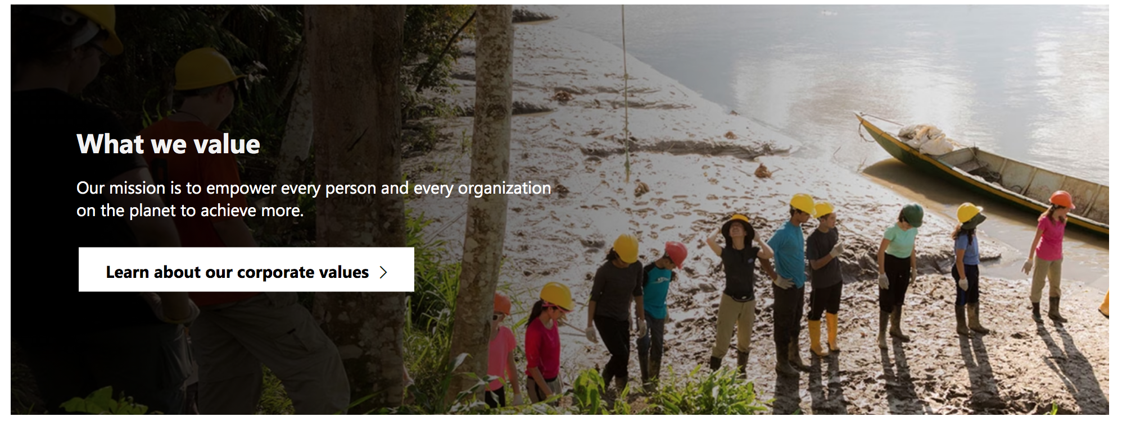
MICROSOFT
Respect
Integrity
Accountability

Slide 43
NASA- put humans on the moon
Culture
Across Disney, we cultivate, value, and encourage curiosity, collaboration, and creativity from everyone and we strive to build supportive environments that inspire optimism and drive innovation. We work to create a culture that is welcoming to all, celebrates our unique perspectives, and promotes respect for one another, regardless of identity or background
The mission of The Walt Disney Company is to entertain, inform and inspire people around the globe through the power of unparalleled storytelling
PURPOSE: At Disney, we are committed to creating a better world.

Slide 44
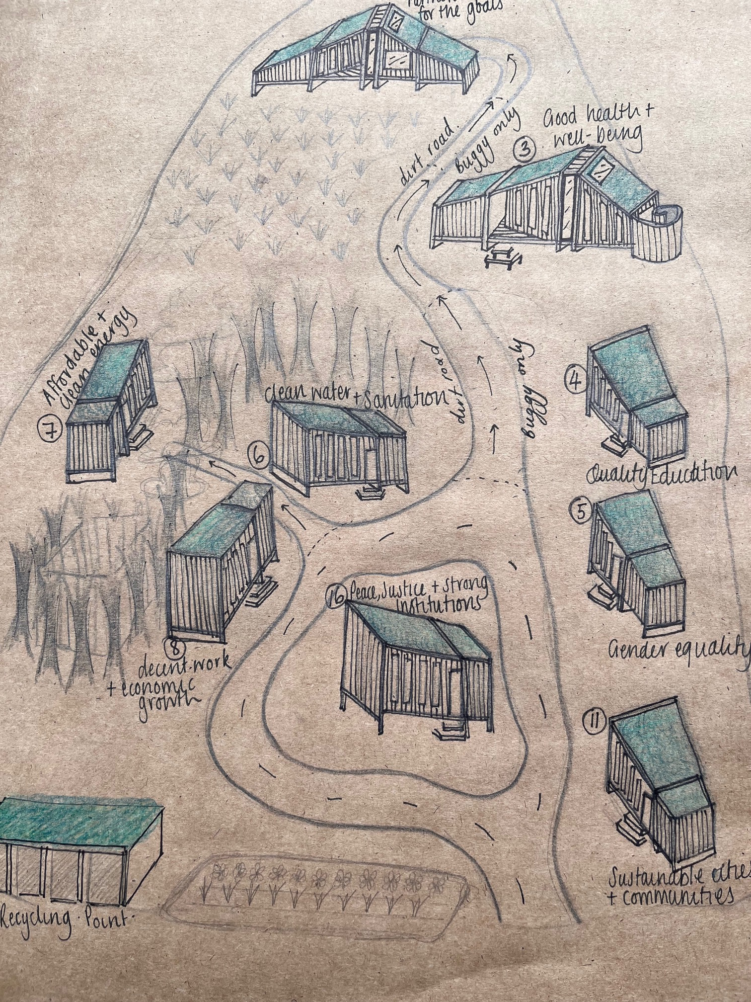
Our Value Proposition:
To provide real life retail theatre & gamification to support your sustainable choices through specialised play all across the world!
Our Values:
Supporting Choice
Playful Curiosity
Transparent Communication Always Circular
Our Vision
By 2045 we aim to have inspired; empowered; supported and nudged over 10- million unique customers to raise their biodiversity footprints and lower their carbon footprints
Our Mission
We will achieve our vision through experiential vacations; gamification; retail theatre and through The Carbon Shift- for you and I- the consumers-locally and globally in our (rural) natural capital, by framing the 17SDG’s in all that we do.

Slide 45
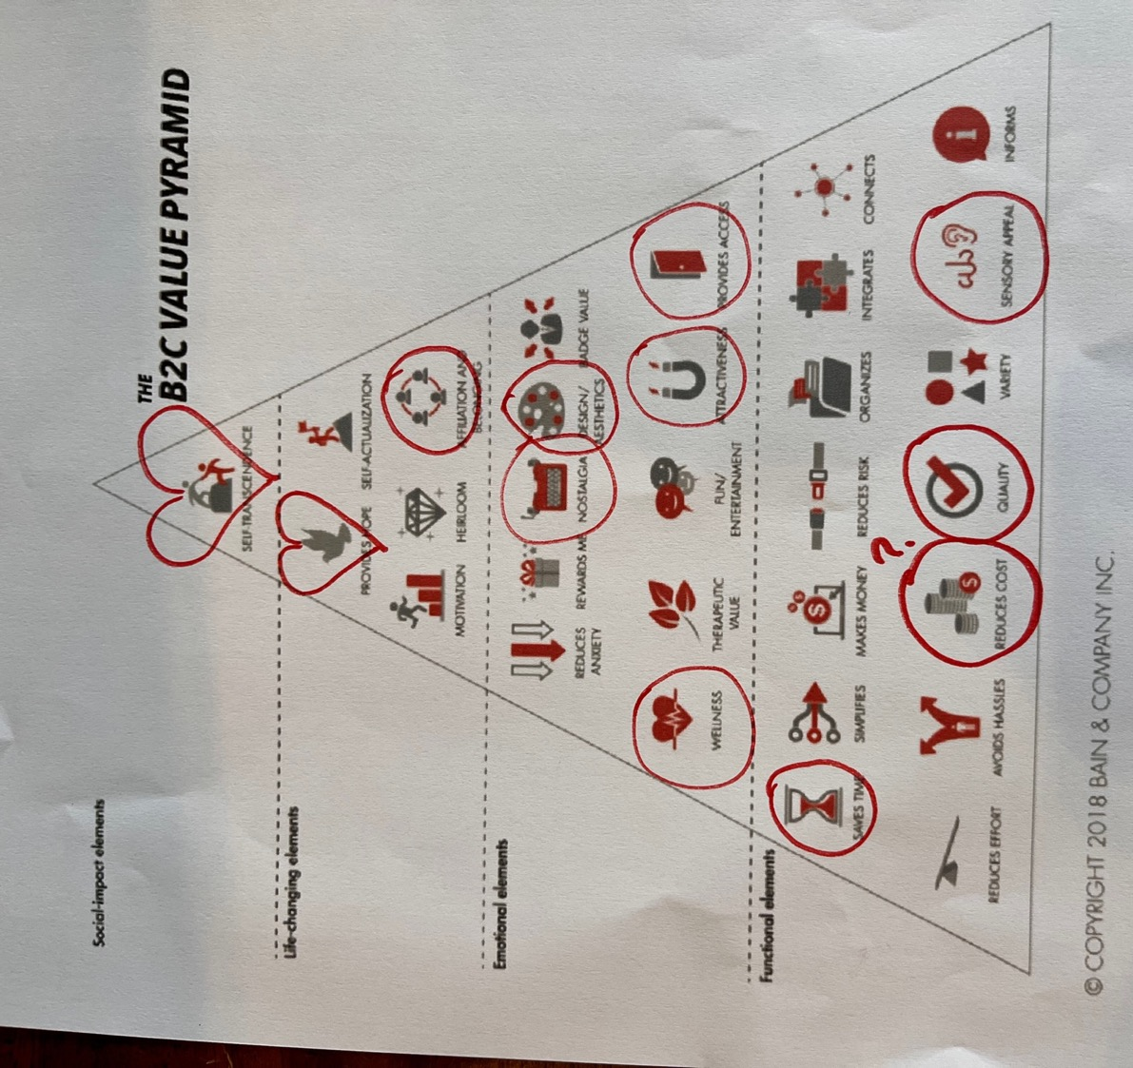
https://media.bain.com/elements-of-value/
There are structured ways of thinking about what people value
https://media.bain.com/elements-of-value/
Used with permission from Bain & Company: https://media.bain.com/elements-of-value/#

Slide 46

Vision
Moving the needle on Monday Morning Tasks to reach 10 Million people by 2045
Mission
We don’t just teach a shift on carbon- we engineer action from it!
We debunk myths…show you how to avoid greenwashing and try to make a serious, difficult subject…fun & part of your business strategy
Values
Always Circular
Supporting Choice
Transparent Communication
Playful Curiosity
Brought to you by

Slide 47
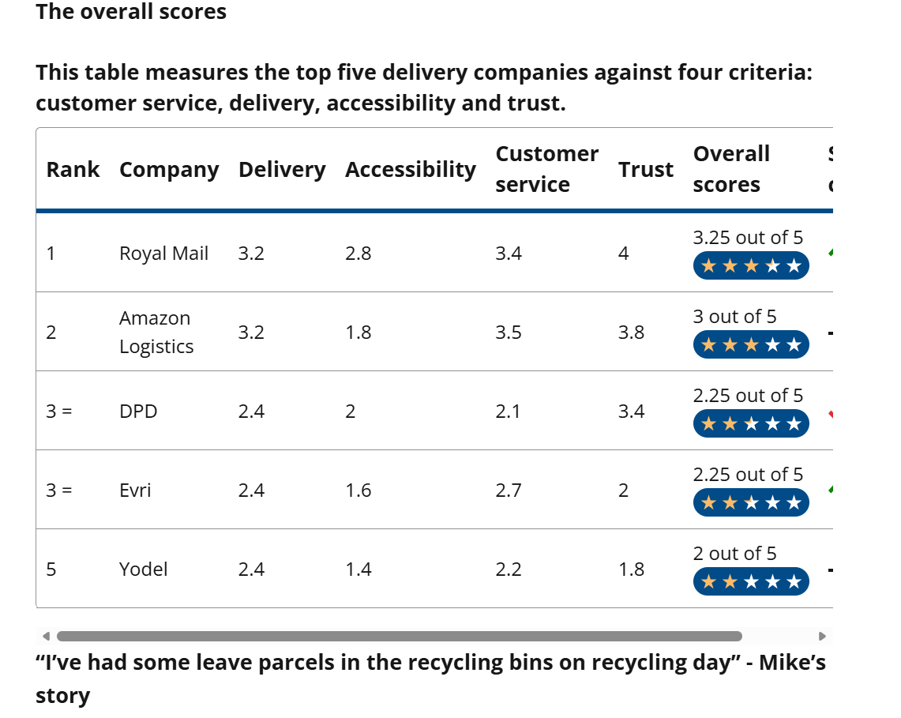
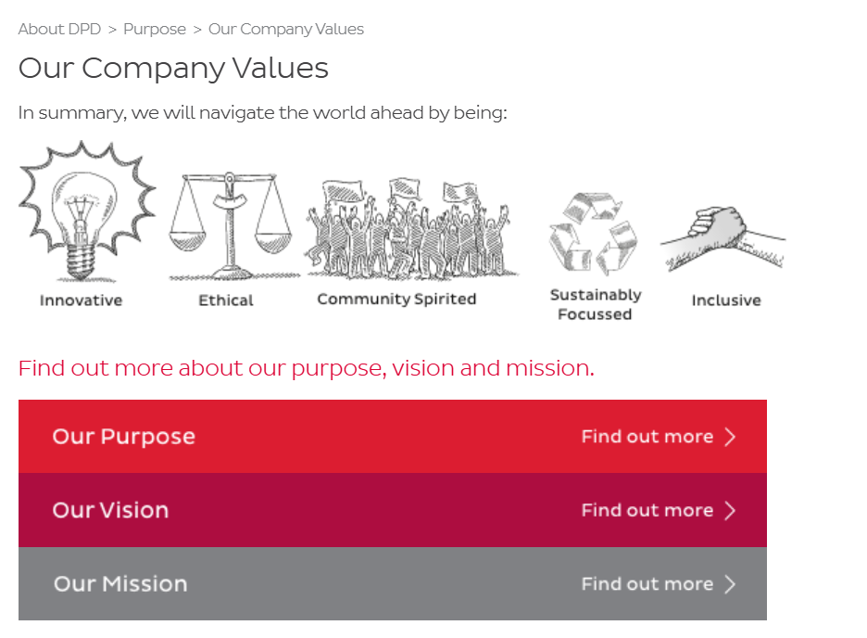
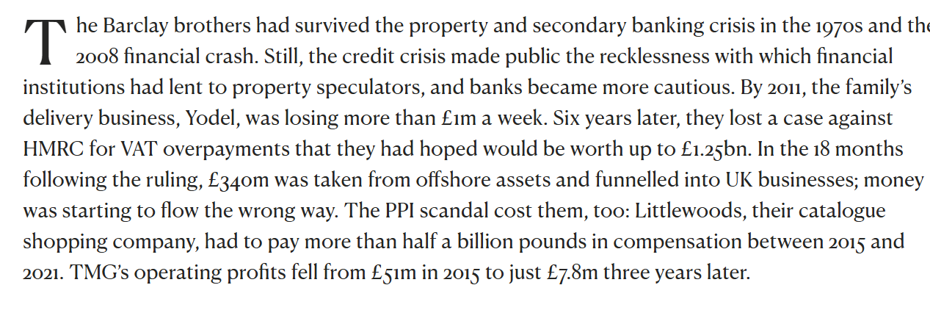

Slide 48
When the mission statement is not right – think FED EX
We aim to be the best telecommunications organisation in the world.
Our purpose is to provide the best solution to our customers’ communications needs.
To become the most respected and profitable insurance company in the United States.
What do you think happens when these are not clear or consistent?

Slide 49
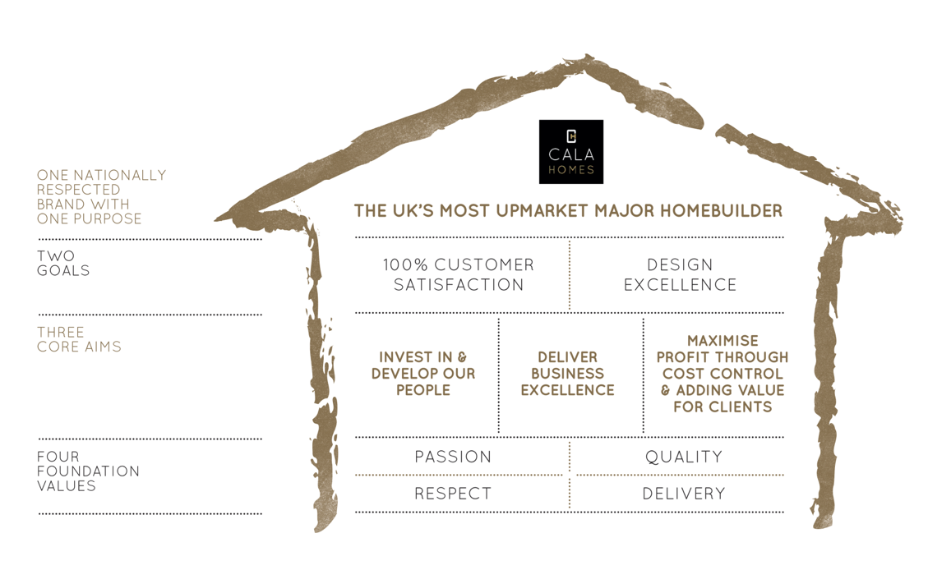
Notes:
KPIs

Slide 50
What is a Value Proposition
In a nutshell, your value proposition is a succinct explanation or illustration of why a customer should do business with you
The value a company promises to deliver to customers should they choose to buy their product or service.
The reason customers choose one company over another.
A bundle of products and services delivering BENEFITS
What problem are you solving?
What need are you meeting?
What is getting done for your customers?

Slide 51
Task Group Activity
Consider the examples of business vision and mission statement- what do you think makes a good mission statement?
Discuss YOUR OWN- 5 minutes
& then pick a local SME- name them check their webs/socials- list anything you see is it correct is it true how do they make you feel? -5 minutes
Draft a business purpose Vision, Mission & Values(outwards looking, customer-focused, motivational, emotional, responsible) for their business. 10 mins
Specify the implications you think this purpose would have for operations, customer services, marketing and human resources functions.
The main difference between a mission statement and a value proposition is that one is internal, and one is for your customer.
Do they both align?
Notes:
There will be a worksheet for this activity – within the workbook. The activity will be completed during the Webinar and then available as a resource to draw upon in completing the rest of the workbook.

Slide 52
LETS FOCUS ON WHAT AN SME IS AND HOW THIS LOOKS LIKE FROM A PRIVATE BUSINESS PERSPECTIVE.
WHAT MIGHT BE HARDER?

Slide 53

Contribution of businesses to overall number of enterprises, employment, and turnover in the United Kingdom in 2025, by enterprise size
Contribution of businesses to overall enterprises, employment, and turnover UK 2025
3
Description: In 2025, although just 0.2 percent of businesses in the UK were large-sized enterprises, they accounted for 40 percent of employment, and almost half of overall business turnover. Read more
Note(s): United Kingdom; 2025
Source(s): GOV.UK

Slide 54
Number of small and medium-sized enterprises (SMEs) in the United Kingdom from 2010 to 2025, by size (in 1,000s)
Number of SMEs in the UK 2010-2025, by size
4
Description: In 2025, there were approximately 5.68 million small and medium-sized enterprises operating in the United Kingdom. Micro-sized enterprises that employ up to nine people constitute the majority of SMEs in the UK, at over 5.4 million. Enterprises that have between 10 and 49 employees are classed as small enterprises, and numbered around 220,090 in the UK, while there were 38,440 medium-sized enterprises. Read more
Note(s): United Kingdom; 2010 to 2025
Source(s): GOV.UK

Slide 55



Number of small and medium-sized enterprises in the United Kingdom in 2024, by sector
Number of SMEs in the UK 2024, by sector
Number of SMEs
5
Description: In 2024, there were approximately 870,040 small and medium-sized enterprises (SMEs) in the construction sector in the United Kingdom, the most of any sector in that year. The sector with the second-highest number of SMEs was the Professional, Scientific and Technical activities sector, at 754,520 SMEs. Read more
Note(s): United Kingdom; 2024
Source(s): GOV.UK; UK Department for Business, Energy and Industrial Strategy

Slide 56
WHY DOES ALL THIS MATTER

Slide 57
Responsible Leadership
Ethical business practice
Business with purpose
Beyond financial objectives
Responsibility to society and communities
Ruck (2019)
Demonstrating and enabling sustainable behaviours
Values at the heart of your business culture – relationship to reputation
The articulation of vision, mission and purpose in relation to a brand
Equality, diversity and inclusivity as elements of your business culture for both consumers and employees

Slide 58
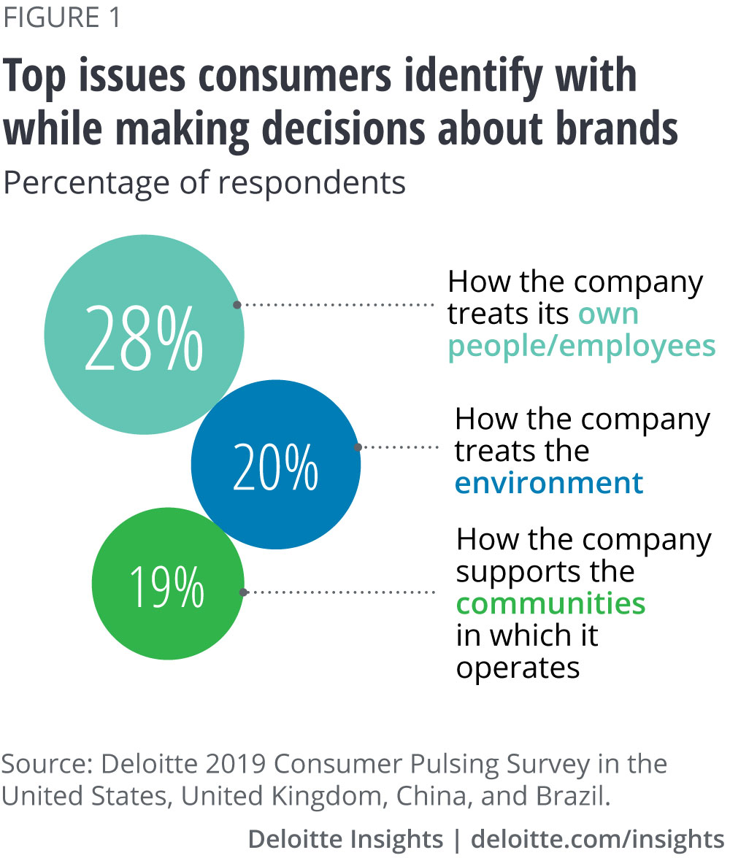
Why do we need to consider these factors?
Purpose
People (are the strongest influence on the adoption of purposeful practices by business?)
Planet

Slide 59
Businesses can no longer operate with the sole aim of making profits at the expense of the environment, society, economy, consumers and employees. Companies need to consider how they can give back to society, and this can help you attract customers and keep your best employees. Customer satisfaction and employee retention are the keys to any successful business, after all. Forbes Nov 2020
A business’s purpose is its reason for being-defining, guiding and driving all of its activities. (and appropriate for your size market and stage on your business journey)
A vision of: By 2030 all businesses in Scotland will have become purposeful businesses which profit from finding solutions for people and planet.
3 Opportunities(themes) identified
Supporting Business with purpose
Financing Purposeful Business
Empowering Employees to drive purpose
Source: SCDI-Now is the Time for Purpose June 2022

Slide 60
They also state:
“On the reverse side, the risks for businesses that do not become more purposeful will increase further and will continue to be amplified by digital technologies and social media”

Slide 61
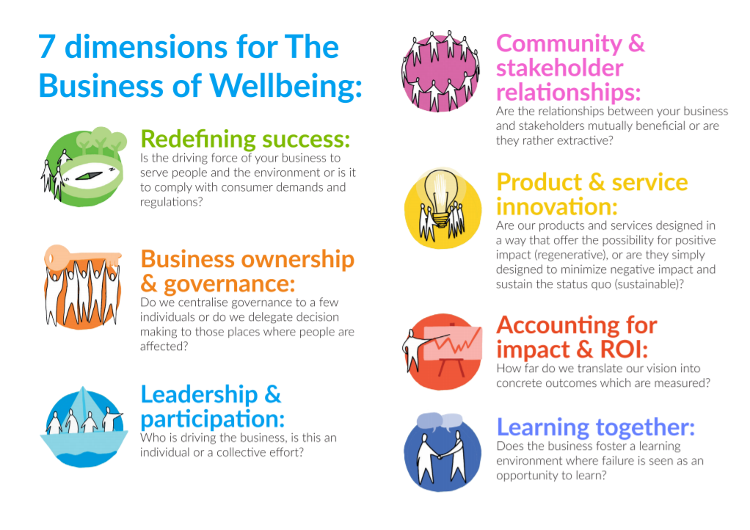

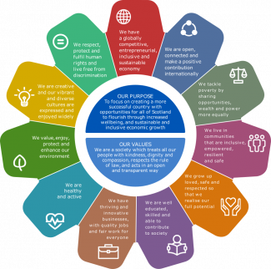


What are some Frameworks?
Wellbeing Economy Alliance
National Performance Frameworks
Community Wealth Building
UN17 SDG’s
B Corporation

Slide 62
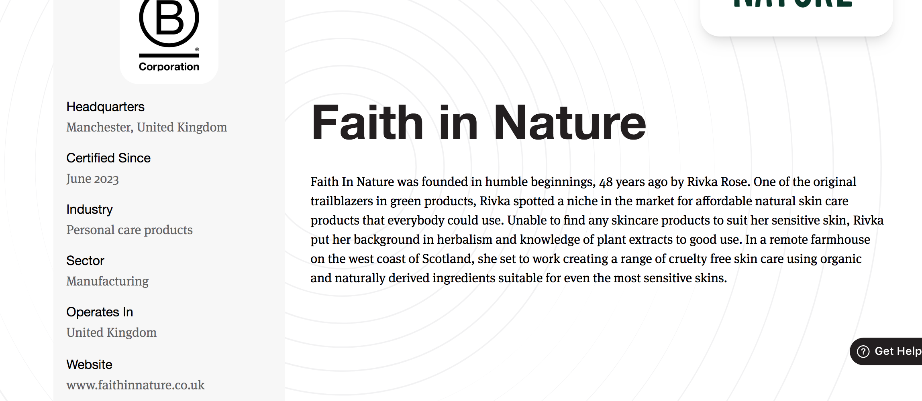
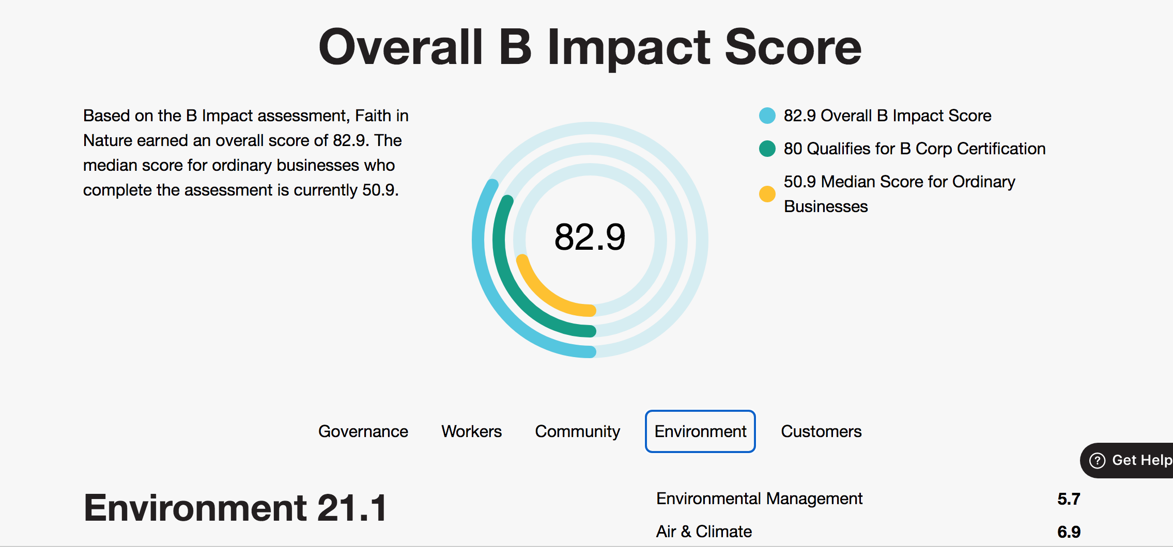
Mother Nature
Vs Faith In Nature!

Slide 63
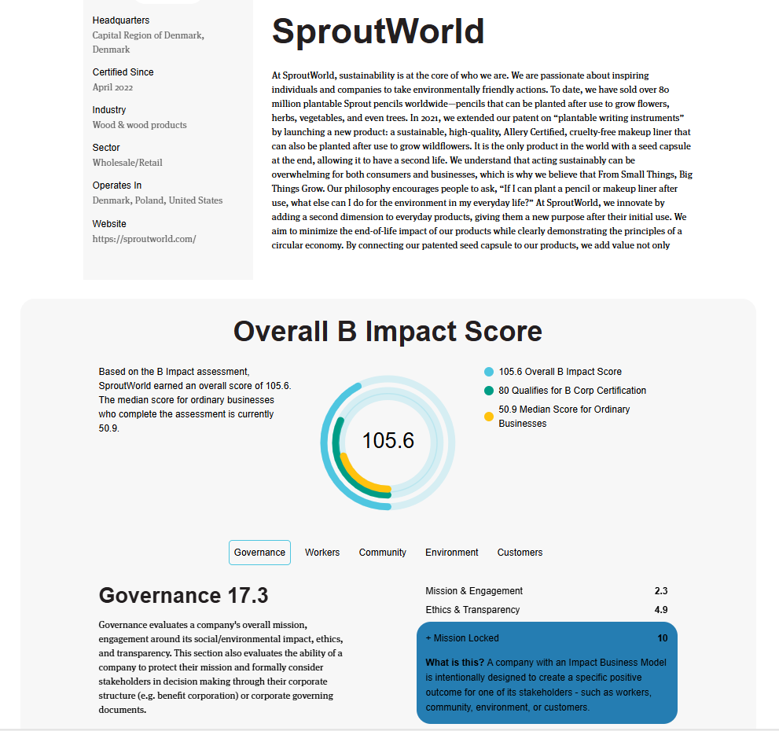
PENCILS

Slide 64

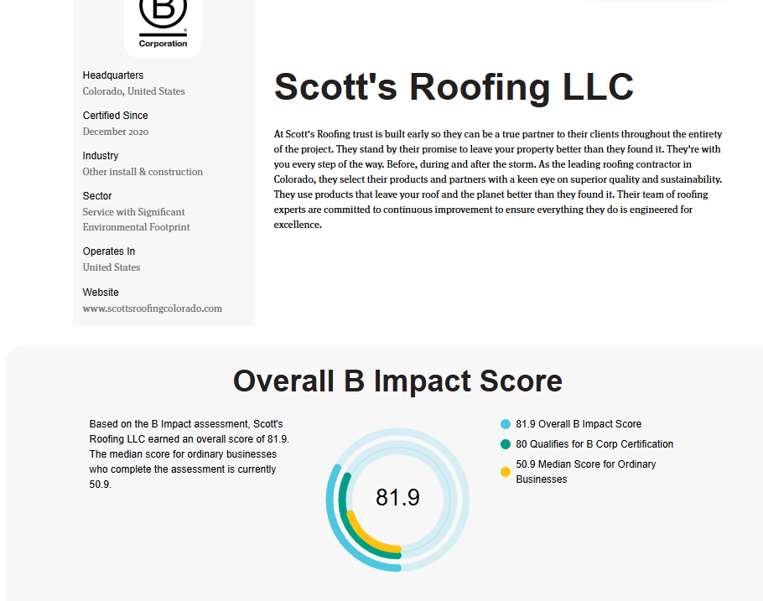

Slide 65
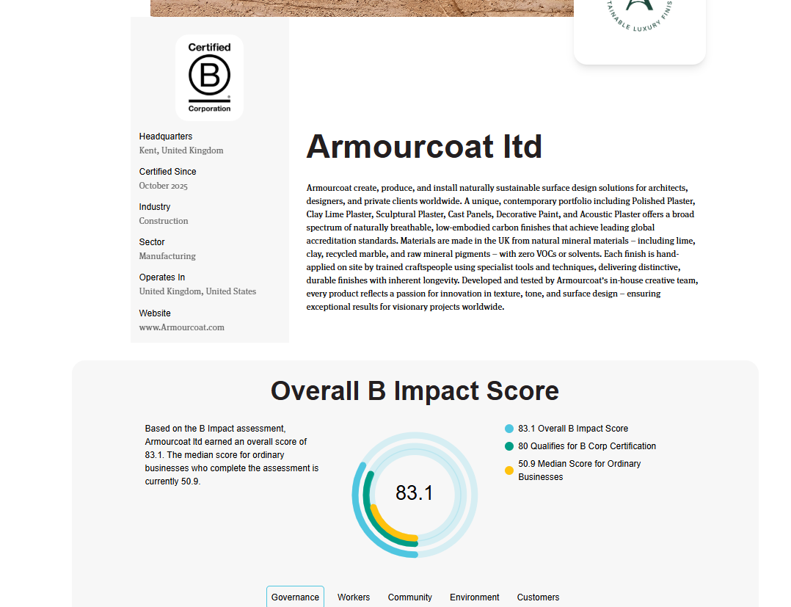
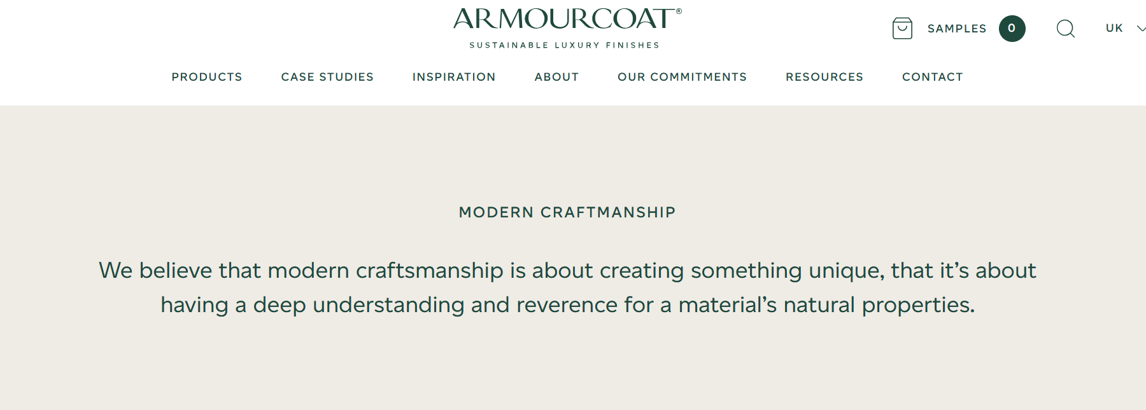

Slide 66
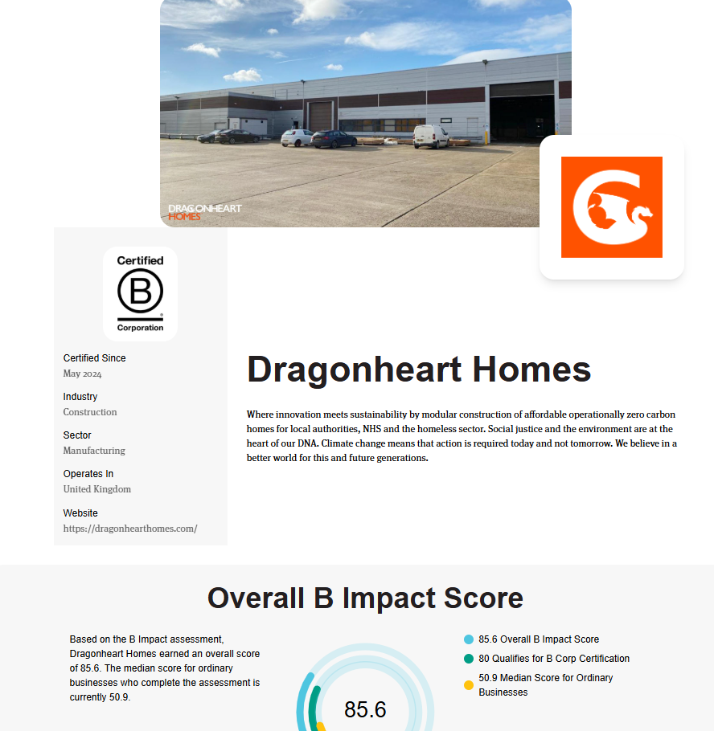
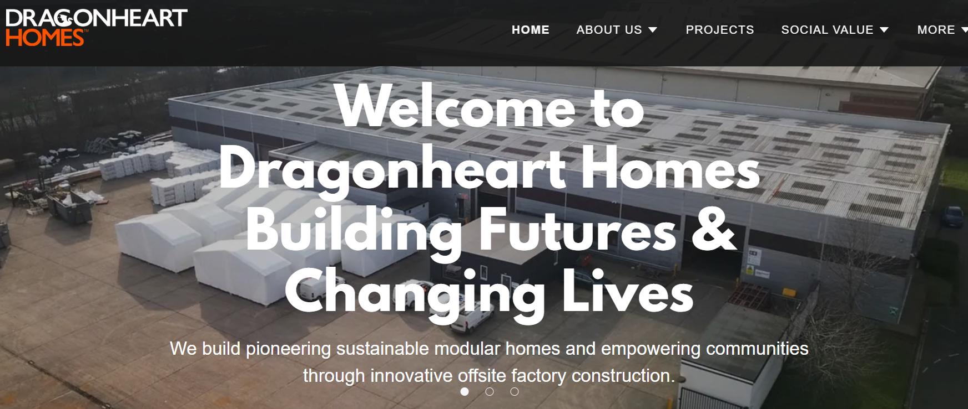

Slide 67
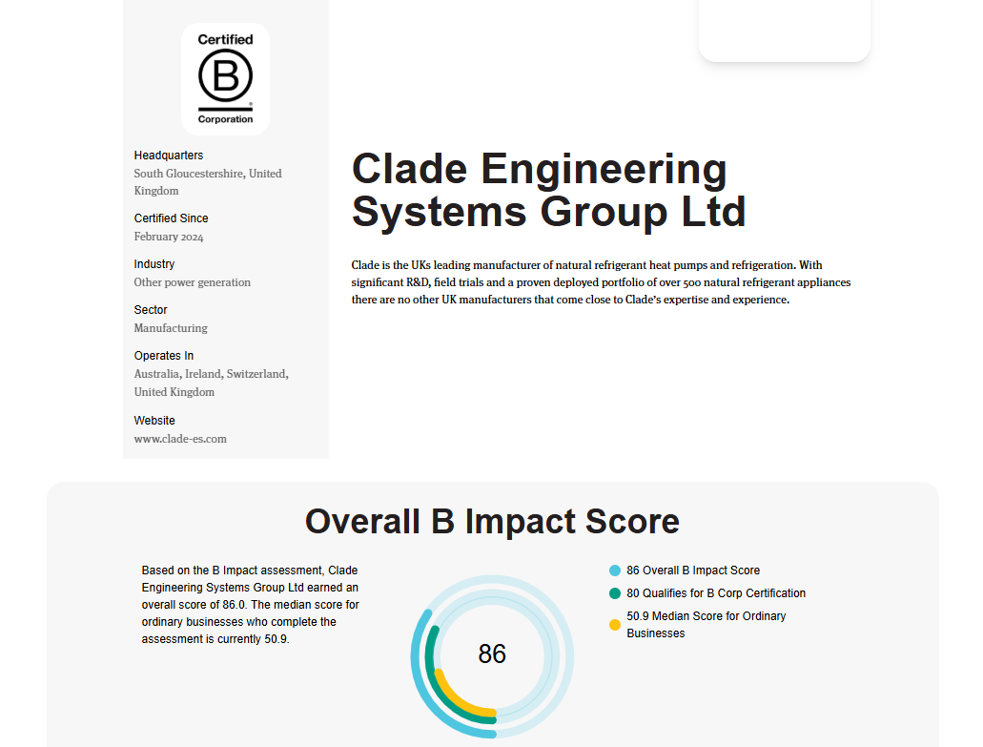
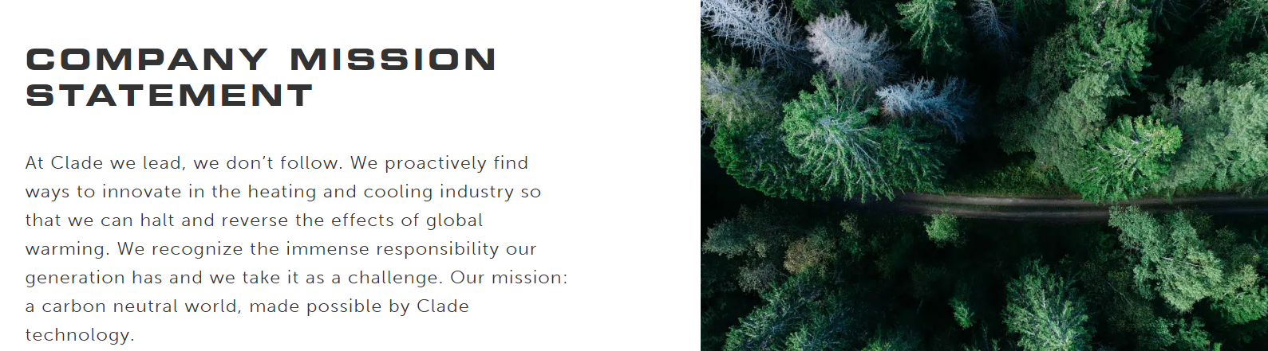

Slide 68
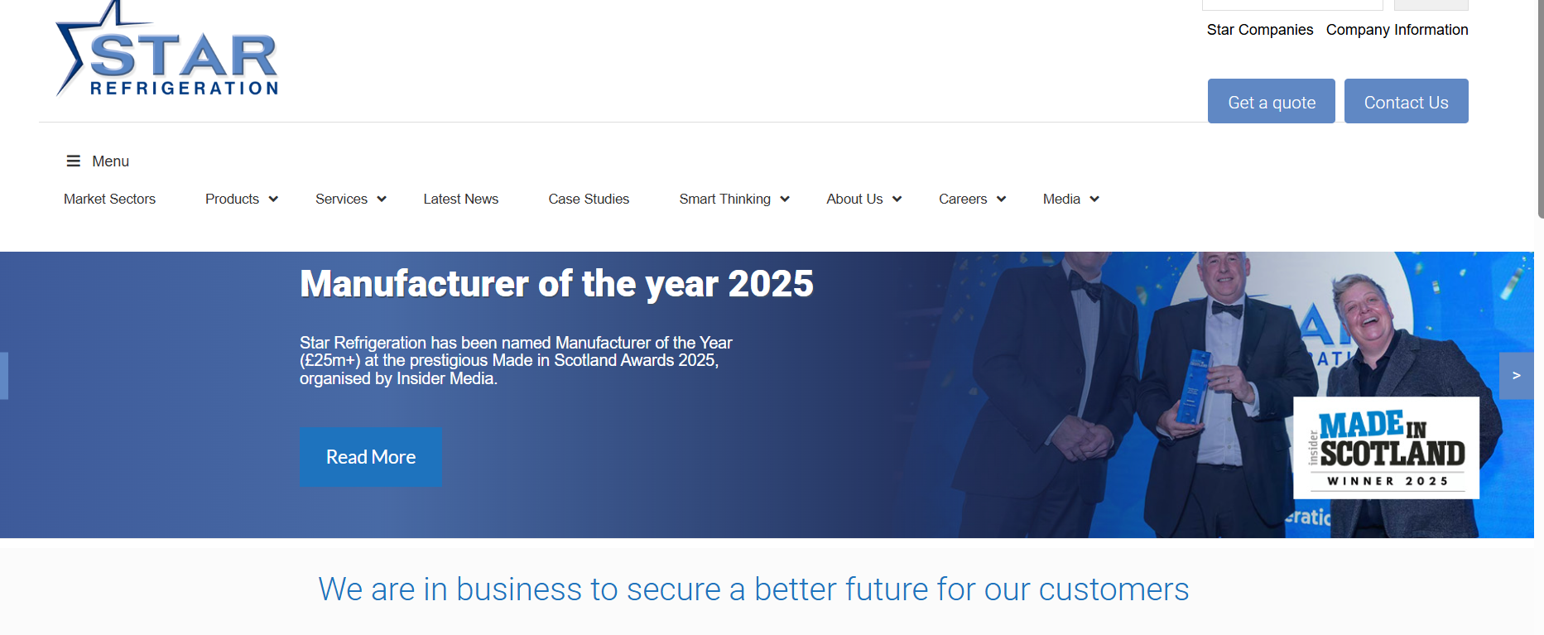
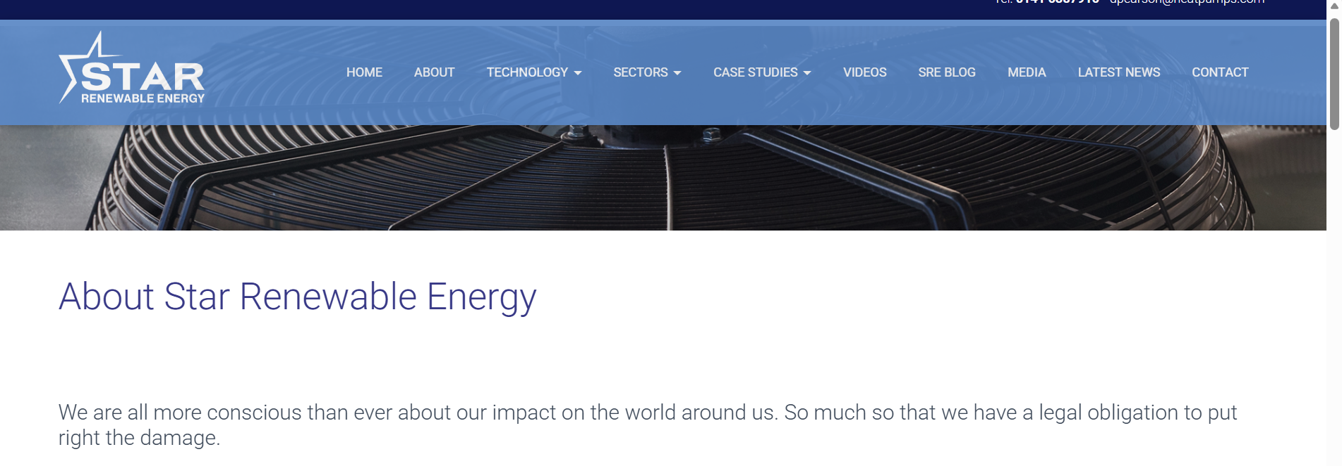

Slide 69
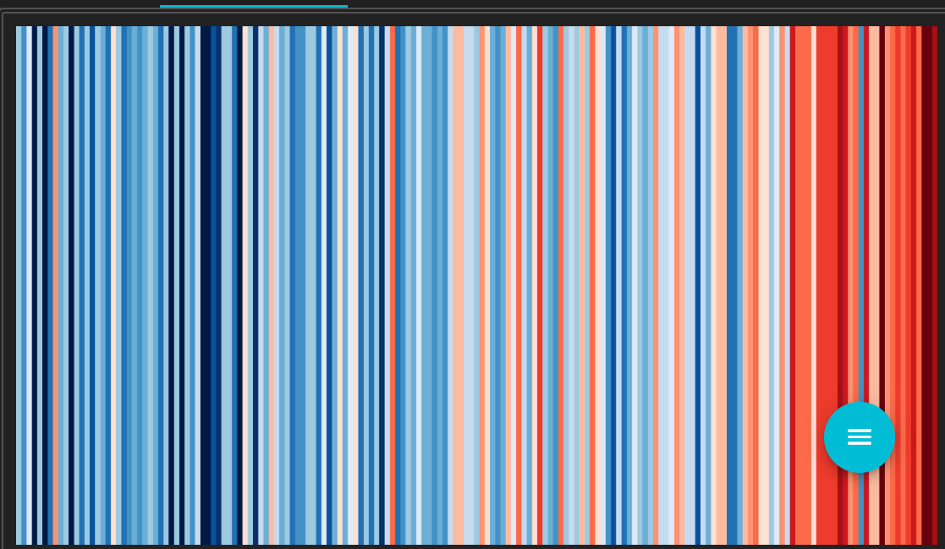
Introduction to innovation and strategy
#ShowYourStripes
The graphics have a CC-BY4.0 license, so can be used for any purpose as long as credit is given to Professor Ed Hawkins (University of Reading) and a link is provided to this website.

Slide 70
Strategy as a position…
“Strategy is the creation of a unique and valuable position involving a set of different activities.”
A critical analysis of those factors that will influence the long-term success of the organisation
Broad and long-term (contrast tactical thinking)
Often expressed in a strategic narrative or plan
Guided by the vision for the organization
Strategy is about delivering greater value to customers or comparable value at lower costs. It means being different to deliver a unique mix of value for the customer. Entrepreneurial Mindset “They're about looking to others, and the value you can create for others by solving problems for others
Strategy is about how to establish a difference that can be preserved over time to form a competitive advantage
Strategy is NOT simply about improvements in efficiency

Slide 71
Strategy as a pattern…
“Corporate Strategy is the pattern of decisions in a company that determines and reveals its objectives, purposes, or goals, produces the principal policies and plans for achieving those goals, and defines the range of business the company is to pursue, the kind of economic and human organization it is or intends to be, and the nature of the economic and non-economic contribution it intends to make to its shareholders, employees, customers, and communities.”
Andrews, K. 1987. The concept of corporate strategy. Homewood: Irwin.

Slide 72
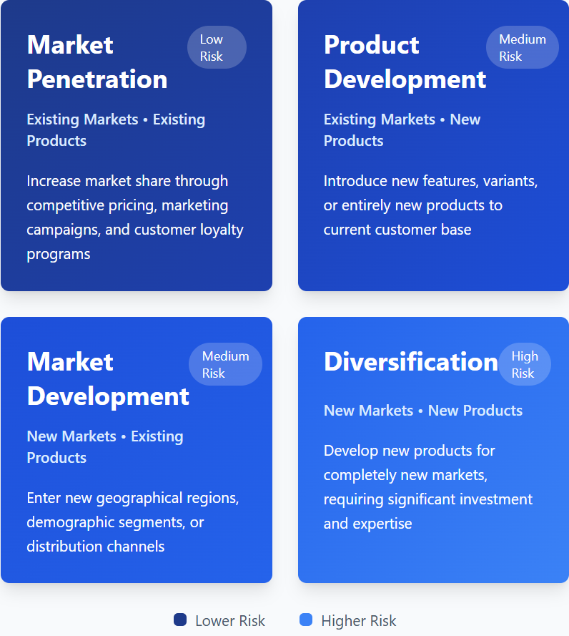
STRATEGIC OPTIONS
How can we compare opportunities and the associated risks?
Risk is an inevitable part of innovation.
The Ansoff Matrix shown here helps us map possible areas of growth for our current organisation – it helps structure our thinking and plan for the risks involved in new opportunities.
To use the matrix we ask two questions:
Is this opportunity aimed at a market which is new (to you) or at your existing market?
Does a new product/service need to be developed, or will your existing offer work?
Original source: ‘Strategies for Diversification’ (Harvard Business Review, September–October 1957

Slide 73
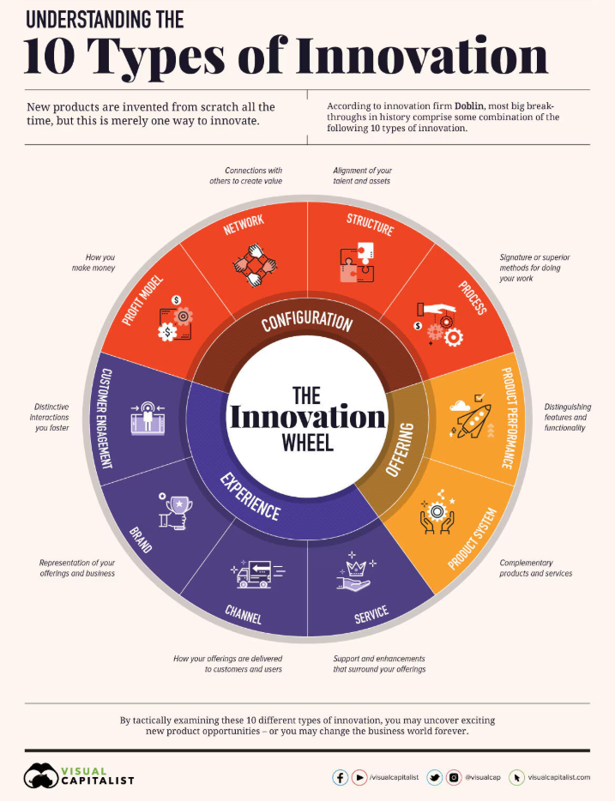
  Innovation doesn’t just happen – it is driven by entrepreneurship.
  This powerful mixture of energy, vision, passion, commitment, judgement and risk-taking – provides the engine behind the innovation process.
  It’s the same whether we are talking about a solo start-up venture or a key group within an established organization trying to renew its products or services.
  Innovation doesn’t happen simply because we hope it will – it’s a complex process which carries risks and needs careful and systematic management.
  Innovation isn’t a single event, like the light bulb going off above a cartoon character’s head. It’s an extended process of picking up on ideas for change and turning them through into effective reality. So what can you all do to make that happen?

Slide 74
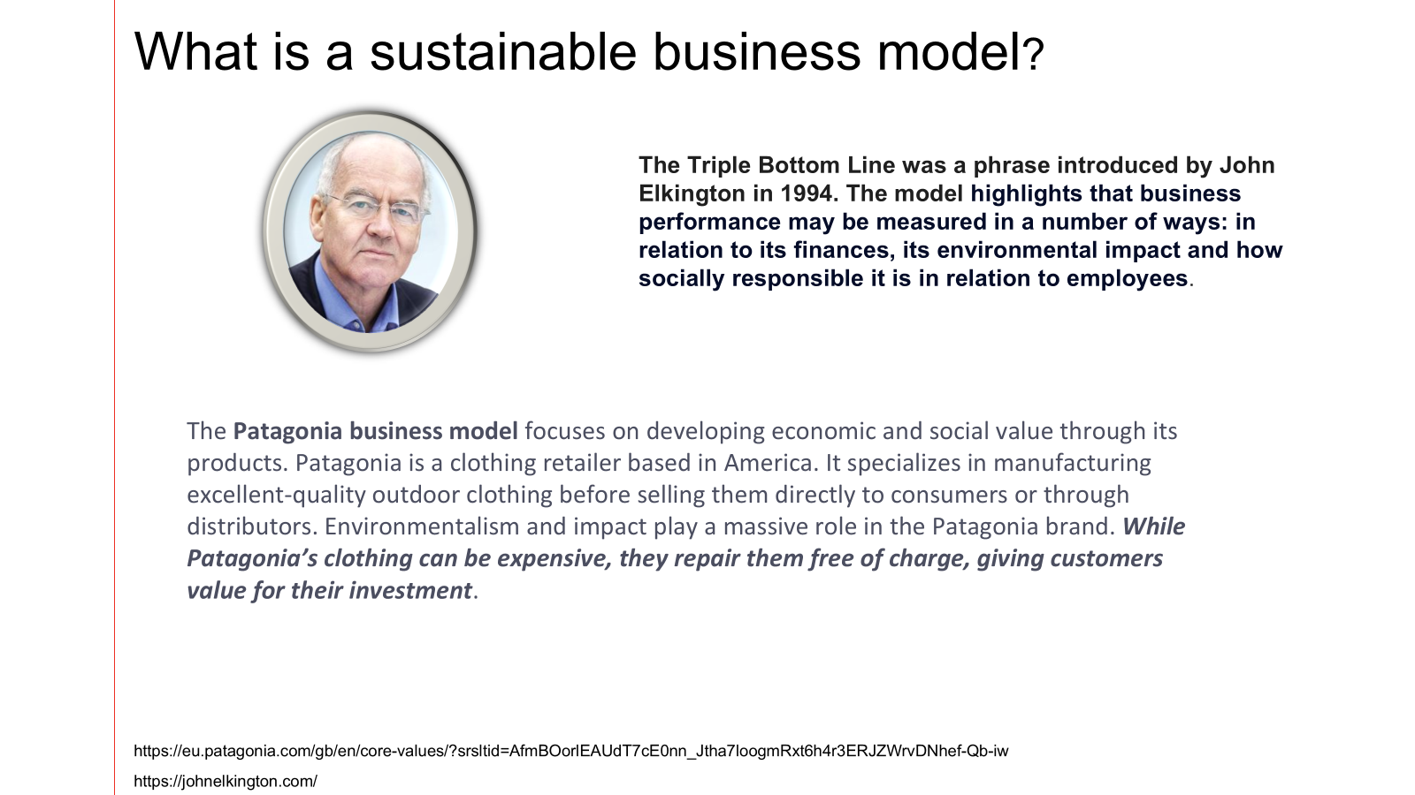


Slide 75
SDG ‘CAKE’
A TRIPLE BOTTOM LINE APPROACH
The illustration above is free to use under the Creative Commons license CC BY-ND 3.0. You are free to share — copy and redistribute the material in any medium or format. Credit: Azote for Stockholm Resilience Centre, Stockholm University CC BY-ND 3.0

Slide 76
This is a BMC that builds into it from the beginning social and environmental impact
Business Model Canvas Explained with Examples - 16 minutes long
Business Model Canvas Explained- how do we put everything together
Value Proposition Canvas Explained- what pain or gain are we creating
The Business Model Theatre

Slide 77
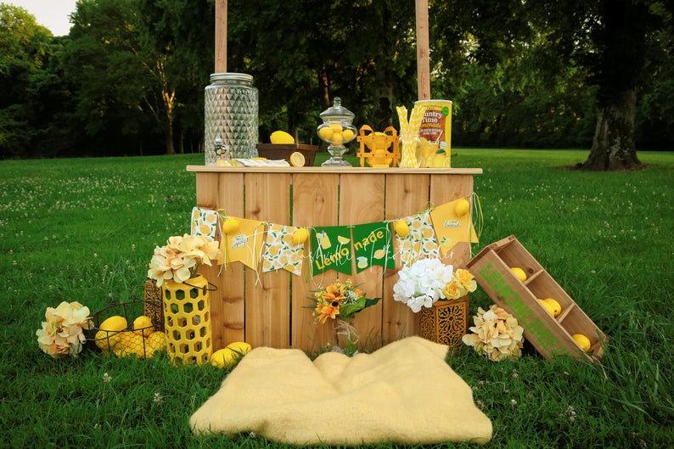
BMC Example: Lemonade Stand

Slide 78




Buying the lemons
Healthy (no additives)
Passers-by
Family
Local Authorities
Making
Personal
Dog Owners
Selling
Freshly squeezed
Families
Buying NRG drinks
Grocery store
Convenience
Lemons
Stand Sale
Local Deli
Stand
Relatively cheap
Cups
Selling skills
Direct Delivery
Athletes
Ingredient
Sales
Tips
Lemo-nade
Dog Treats
Sales
Equipment
NRG drinks

Slide 79


Business | Community | Education
Critical Thinking | Levelling Up | Quiet Quitting
Problem Solving | Fairer Platforms | Playful Curiosity
The Carbon Shift
-Providing critical thinking & problem solving to your carbon literacy journey
Wicked Problems need to be approached with a different mindset from the ones that created them

Slide 80



Triple-layered canvas

Slide 81
ACTIVITY
IN GROUPS YOU HAVE 30 MINUTES TO DO THE BMC BASED ON WHAT WE HAVE LEARNT TODAY
USE ALL YOUR OTHER TOOLS THAT YOU HAVE PREPEARED TODAY
Feed Back from each group will be around 3-5 minutes from each.

Slide 82

REFLECTIONS…
What are the key new market opportunities for your organisation?
Note down your main take-aways and ideas from this session. What will these mean for your organisation?
Note down some key actions that you need to take to put your ideas into practice.
Purpose : Reflect daily- Did you do needle moving work on your purpose- did you live the values? What action do you need to do daily to achieve this?

