Slide 1

Making Stratospheric
Change Strategically Circular

Slide 2
Taking Your Idea to Market
EiR- Session 2
South Lanarkshire/ Ayrshire and Dumfries & Galloway colleges

Slide 3
What we will cover today…
Productivity and Innovation- the conundrum!
Strategy- Frameworks and Curves
From Markets to Customers: market research; early adopters; dynamic purchaser; B2B; B2C; TAM; Beachhead markets;
Approach to Marketing: 4P’s; 10P’s; 4mm hole!; Start ups ; SME’s; STP; Disruption
Is social media marketing? Customer Personnas; passive revenue
Case Studies & Activity

Slide 4
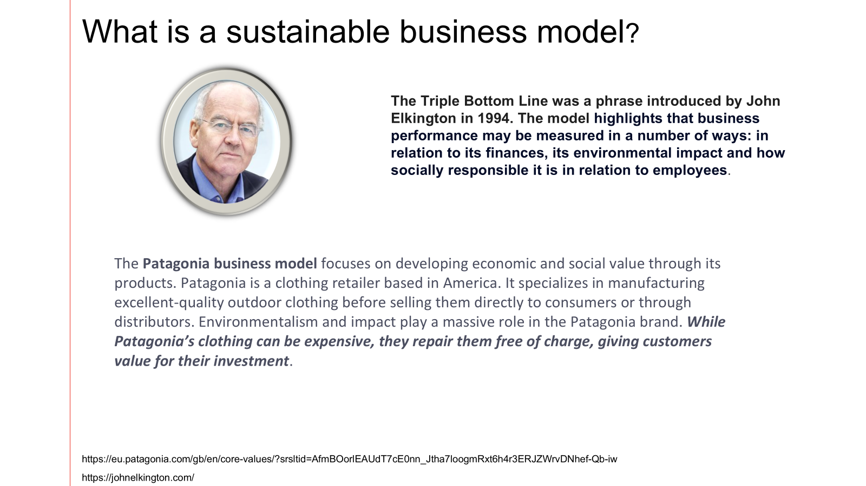


Slide 5
SDG ‘CAKE’
A TRIPLE BOTTOM LINE APPROACH
The illustration above is free to use under the Creative Commons license CC BY-ND 3.0. You are free to share — copy and redistribute the material in any medium or format. Credit: Azote for Stockholm Resilience Centre, Stockholm University CC BY-ND 3.0

Slide 6
This is a BMC that builds into it from the beginning social and environmental impact
Business Model Canvas Explained with Examples - 16 minutes long
Business Model Canvas Explained- how do we put everything together
Value Proposition Canvas Explained- what pain or gain are we creating
The Business Model Theatre

Slide 7
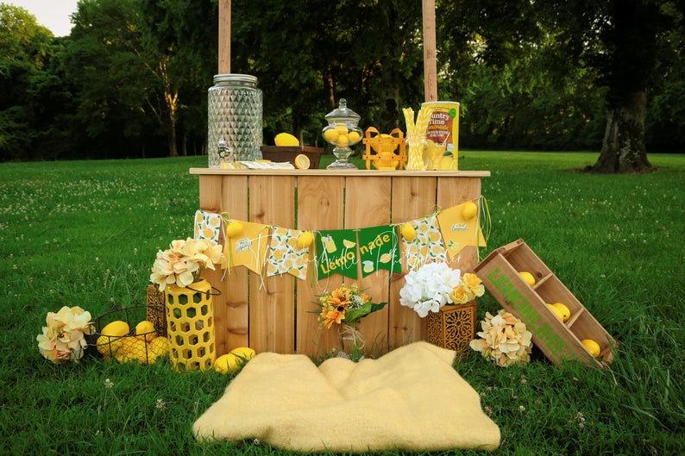
BMC Example: Lemonade Stand

Slide 8
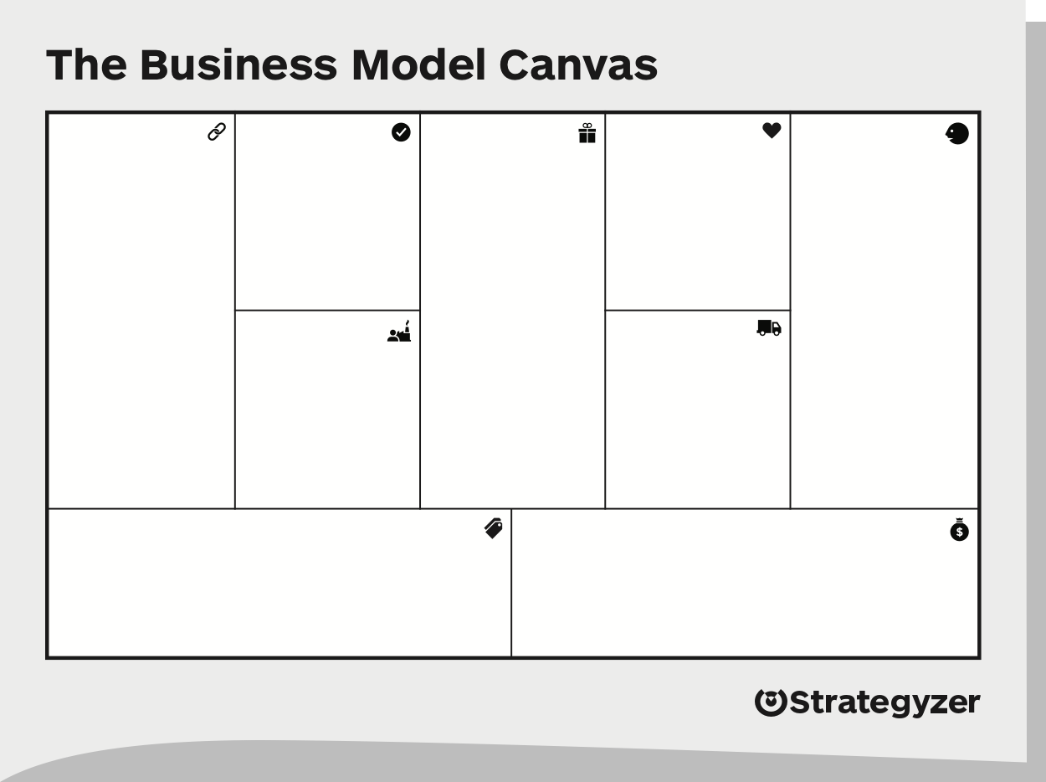



Buying the lemons
Healthy (no additives)
Passers-by
Family
Local Authorities
Making
Personal
Dog Owners
Selling
Freshly squeezed
Families
Buying NRG drinks
Grocery store
Convenience
Lemons
Stand Sale
Local Deli
Stand
Relatively cheap
Cups
Selling skills
Direct Delivery
Athletes
Ingredient
Sales
Tips
Lemo-nade
Dog Treats
Sales
Equipment
NRG drinks

Slide 9

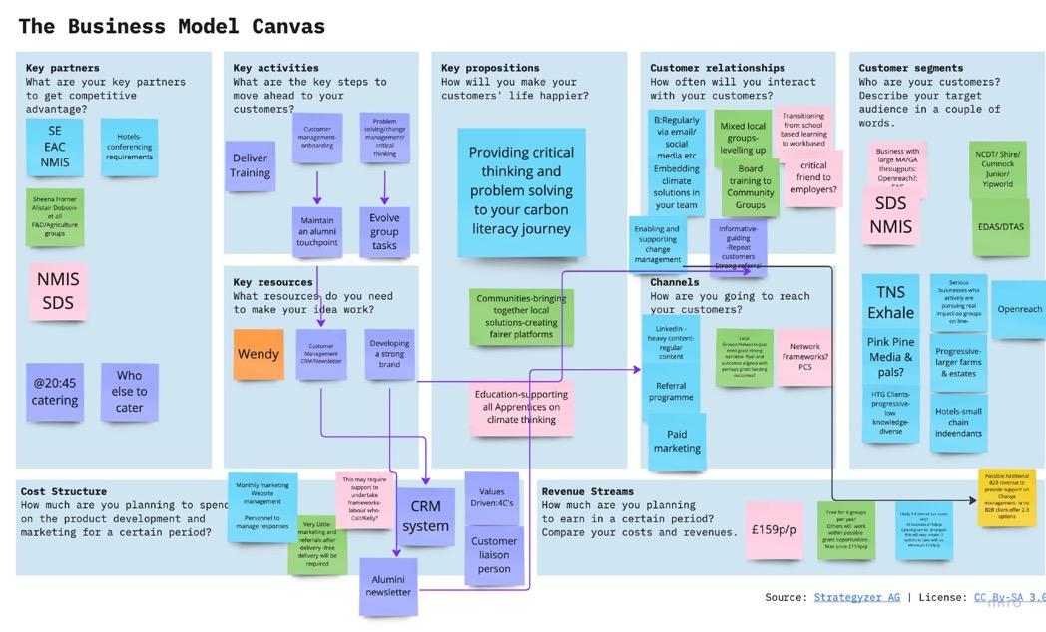
Business | Community | Education
Critical Thinking | Levelling Up | Quiet Quitting
Problem Solving | Fairer Platforms | Playful Curiosity
The Carbon Shift
-Providing critical thinking & problem solving to your carbon literacy journey
Wicked Problems need to be approached with a different mindset from the ones that created them

Slide 10
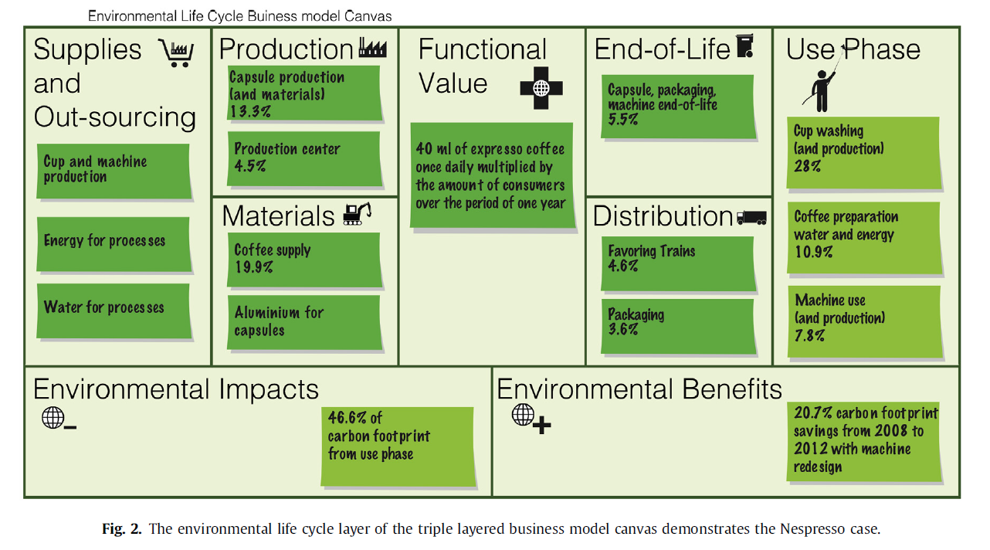
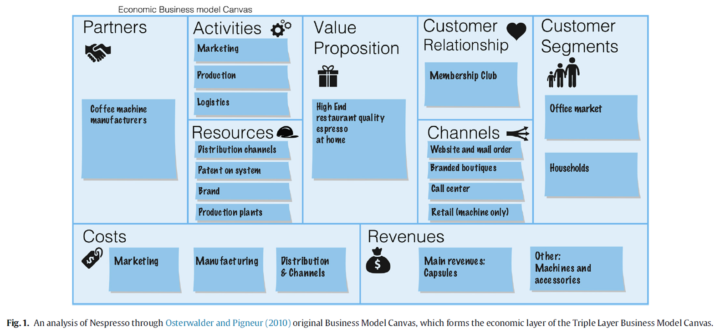
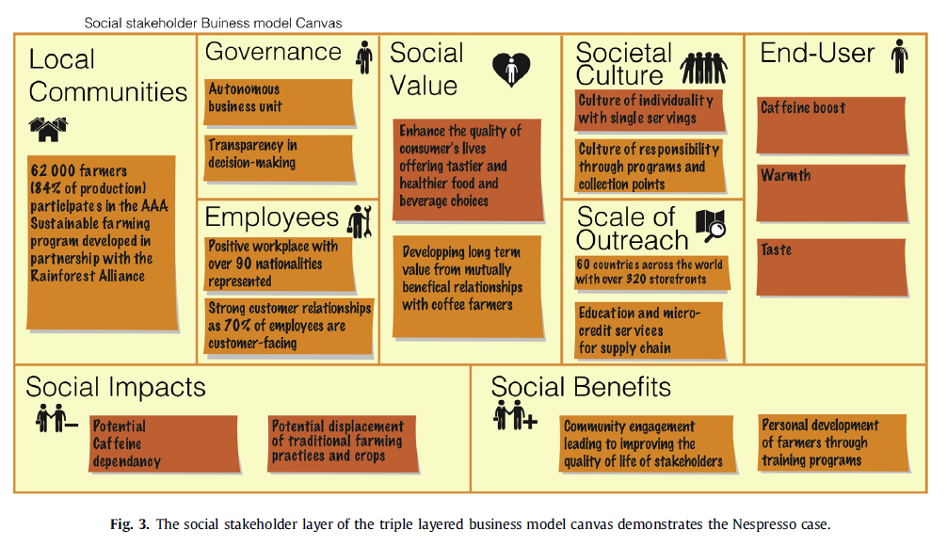
Triple-layered canvas

Slide 11
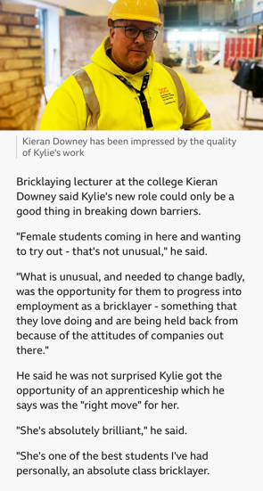
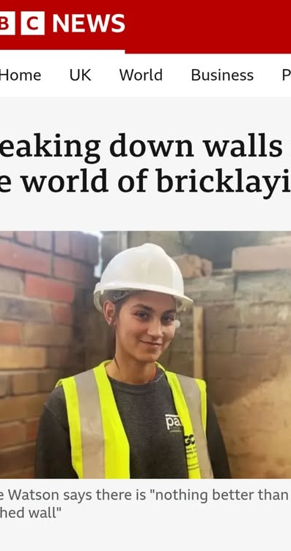
I WANT YOU TO GET INSIDE THE HEAD OF YOUR CHOSEN COMPANIES TODAY
How does it look from the outside ?
What does/ would your apprentices say?

Slide 12
ACTIVITY
IN GROUPS YOU HAVE 15 MINUTES TO REVIEW YOUR CHOSEN SME AND FILL IN THE FOLLOWING WITH SOME THOUGHTS:
VALUE PROPOSITON
CUSTOMER SEGMENTS
CUSTOMER RELATIONSHIP
CHANNELS
AND ONE IMPROVEMENT YOU CAN SEE
AND WHAT SUPPORT IF ANY DO THEY GIVE THE COLLEGE
Feed Back from each group will be around 3-5 minutes from each.

Slide 13
Triple-layered canvas

Slide 14

SESSION 1 REFLECTIONS…
What are the key new market opportunities for your organisation?
Note down your main take-aways and ideas from this session. What will these mean for your organisation?
Note down some key actions that you need to take to put your ideas into practice.
Purpose : Reflect daily- Did you do needle moving work on your purpose- did you live the values? What action do you need to do daily to achieve this?

Slide 15


DISCUSS
What was the customer pain?
What was the customer gain?
What were they trying to drive productivity in?
What did they identify as key skills and what did they do?
Did they succeed?
Vision & Mission - Aravind Eye Care System
Video: https ://youtu.be/3cjnNPua7Ag

Slide 16
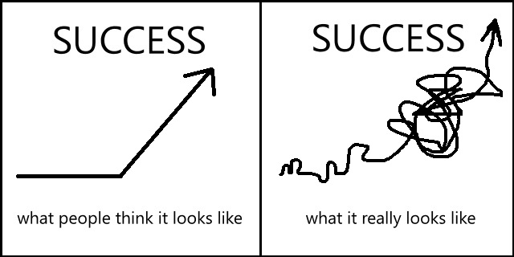
PRODUCTIVITY AND INNOVATION ARE KEY DRIVERS OF SUCCESS- TO CREATE THIS ENVIRONMENT REQUIRES A CLEAR STRATEGIC APPROACH.
What comes first?
Innovation does not also happen in a vacuum- it needs the right conditions.
Innovation is a driver of productivity- the 1st driver
2nd driver of productivity is skills, so creating innovation pathways.
Equally productivity fuels innovation and maintains the ‘S’ curve of innovation –selfsustaining.

Slide 17

  Innovation doesn’t just happen – it is driven by entrepreneurship.(or better put – by developing an entrepreneurial mindset!)
  This powerful mixture of energy, vision, passion, commitment, judgement and risk-taking – provides the engine behind the innovation process.
  It’s the same whether we are talking about a solo start-up venture or a key group within an established organization trying to renew its products or services.

Slide 18
Conditions to maximise Innovation
1.Empower teams- show them they can be innovative- clear direction- do you know the VMV?
2. Provide autonomy in tasks- so no micro managing and creating the space and environment to deal with failure= freedom
3. Culture-encourages risk taking we discussed the Intrapreneur and Entrepreneur- so provide space to do this- fail – try- fail again etc Google 20% on their own projects?
4. Continuous learning – lifelong learning- up to date skills- leads to empowerment and better confidence to try new things
5. Collaborative cross functional teams-diversity- inclusive perspectives- need space to brainstorm- less structure?
6. Tech to support efficiency and creativity-removing boring tasks – supports neurodivergent- develop critical thinking- what is the tech being used to do?
Strategic delivery and vision clearly articulated and a supportive culture that accepts failure
RSE-Prosper-AP-Productivity-The-Micro-Dimension-report.pdf
This is how we enable people to work more creatively and effectively not faster

Slide 19
Without an innovation strategy, different parts of an organization can easily wind up pursuing conflicting priorities—even if there’s a clear business strategy.
Sales representatives hear daily about the pressing needs of the biggest customers- what are their motivators and drivers? How can KPIs help pull everyone together?
Marketing may see opportunities to leverage the brand through complementary products or to expand market share through new distribution channels. Or if no marketing what is your purpose and values?
Business unit heads are focused on their target markets and their particular P&L pressures. Shared values-shared KPI’s?
R&D scientists and engineers tend to see opportunities in new technologies. –Innovation for Customer pain- or individual pleasure?
Diverse perspectives are critical to successful innovation. But without a strategy to integrate and align those perspectives around common priorities, the power of diversity is blunted or, worse, becomes self-defeating. Gender: Race; Culture; Religion…what perspectives do your customers have?

Slide 20
Why is innovation not easy?
Most innovations fail (ranging from 50% to 90% depending on the industry)
Seeing innovation as ideas, not managing the whole journey
Not recognizing the need for change;
Mindset and complacency – core competence becomes core rigidity;
Closed information network, insulated from new ideas.
Developing a Fast Fail Approach
  In 1876, William Orten was President of Western Union , which had a monopoly on the most advanced communications technology available, the telegraph. Orten was offered the patent on a new invention, the telephone, for $100,000 (worth about $2M in current dollars). He considered the whole idea ridiculous, and wrote directly to Alexander Graham Bell, saying, "After careful consideration of your invention, while it is a very interesting novelty, we have come to the conclusion that it has no commercial possibilities... What use could this company make of an electrical toy?" Two years later, after the telephone began to take off, Orten realized the magnitude of his mistake, and spent years (unsuccessfully) challenging Bell's patents.
Innovation failure: What we know and what is missing – ScienceDirect

Slide 21
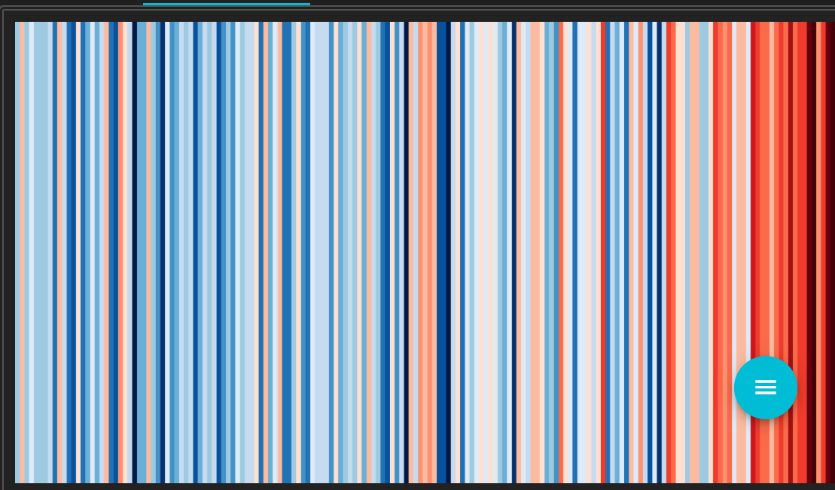
How is strategy developed?
To improve the chances of successful innovation, organisations should foster a culture that encourages experimentation, align teams around a common vision, and prioritise understanding customer needs. By addressing these common pitfalls, companies can enhance their innovation efforts and drive meaningful change
To develop your strategy you have to look at the resources you have and don’t have.
As well as where you are in a disruptive market- which then allows you to ‘pull’ the resources together- this is referred to as dynamic capability.
Mobilising, rearranging and organising of your skills as well as the strategic stretch
Which is -what do you need to ‘find’ to make it happen and where do you find it?
CREDIT: Graphics and lead scientist: Ed Hawkins, National Centre for Atmospheric Science, UoR.
Data: Berkeley Earth & ERA5-Land, NOAA, UK Met Office, MeteoSwiss, DWD, SMHI, UoR & ZAMG
#ShowYourStripes
Notes:
Describe my shop- no one doing it – it was a beautiful traduional protected building – we didn’t hide this we used it as part of our aesthetics and put a modern twist- to attract modern customers- most of the other shops looked liked they had been put together in the dark- we anted to attract a certain type of customer we knew they existed because w elived in the area
EMERGENCVY ONE – THEY HAVE SOFTWARE ENGINEERS- SO THEY USE ALL CAPACITRY
THINK ABOUT COLLGE AND SAY A SMALL D7G FIRM

