Slide 1

Making Stratospheric
Change Strategically Circular

Slide 2
External Factors & Creating Growth
EiR- Session 3A Pulling it all together!
South Lanarkshire/ Ayrshire and Dumfries & Galloway colleges

Slide 3
What we will cover today…
Applying PESTLE
Ethics, Stakeholders & Climate
Revenues
Pricing
BMC Group Presentation

Slide 4
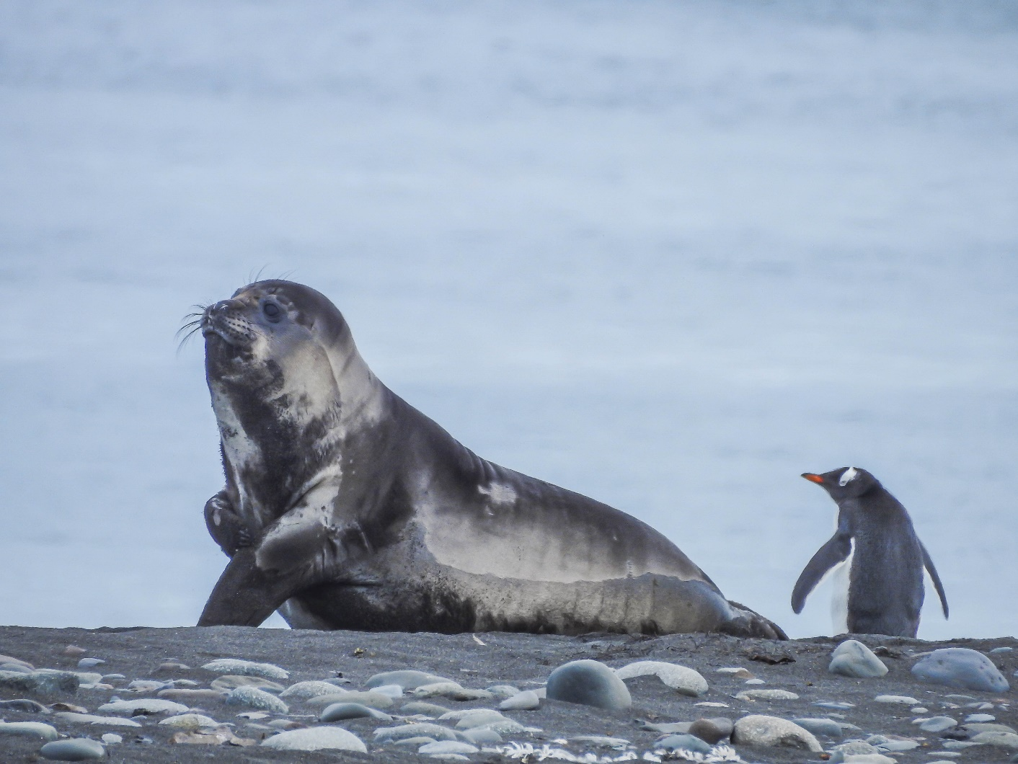
GROUP ACTIVITY- Customer Personna- Part 1
Where do my customers ‘hang out’?
Through what channels do they
communicate?
What messaging (how do your customer communicate with each other; what are they ‘in to’)?
Describe a clear summary of a customer that would buy from you!

Slide 5
ACTIVITY- Customer Personna- Part 2
I will allocate, in pairs, one of you as the CUSTOMER and one as the SME
You must respond as the SME thinking about their challenges and opportunities
You must play the part of the customer that you have previously defined as a group.
ROLE of SME: Selling your services- what do you sell?
ROLE of CUSTOMER: Ask questions- carefully taking the role of the customer that you have defined!
10 minutes

Slide 6
REFLECTION…
There are other external factors that affect how you offer your service and ultimately what your customer will pay for it.

Slide 7
What we will cover today?
What might change in the world?
Where is the change coming from just now locally, regionally and globally?
External Factors- PESTLE –Risks & Opportunities
Alignment of Strategy- Are we digging deep enough?
Revenue Models- linked to customers and profit
How do I price?

Slide 8
PESTLE
POLITICAL
Govmt policy/ political stability/ tax/industry regs/ global trade
ECONOMIC
Cost of Living/ labour costs/consumer spending/skills shortage in labour market
Pestle analysis is a strategic framework that examines six key external factors affecting an organisation.
SOCIETAL
Consumer trends/buying habits/lifestyle/work-life balance/population
TECHNOLOGICAL
Innovation, Automation, disruptive tech, social networks, robots, AI, security
LEGISLATIVE
Employment law; common law, local labour law, H&S…CSRD…SECR..CWB
ENVIRONMENTAL
Env restrictions, sustainable resources, ethical sourcing, procurement, supply chain , GHG,CSRv

Slide 9
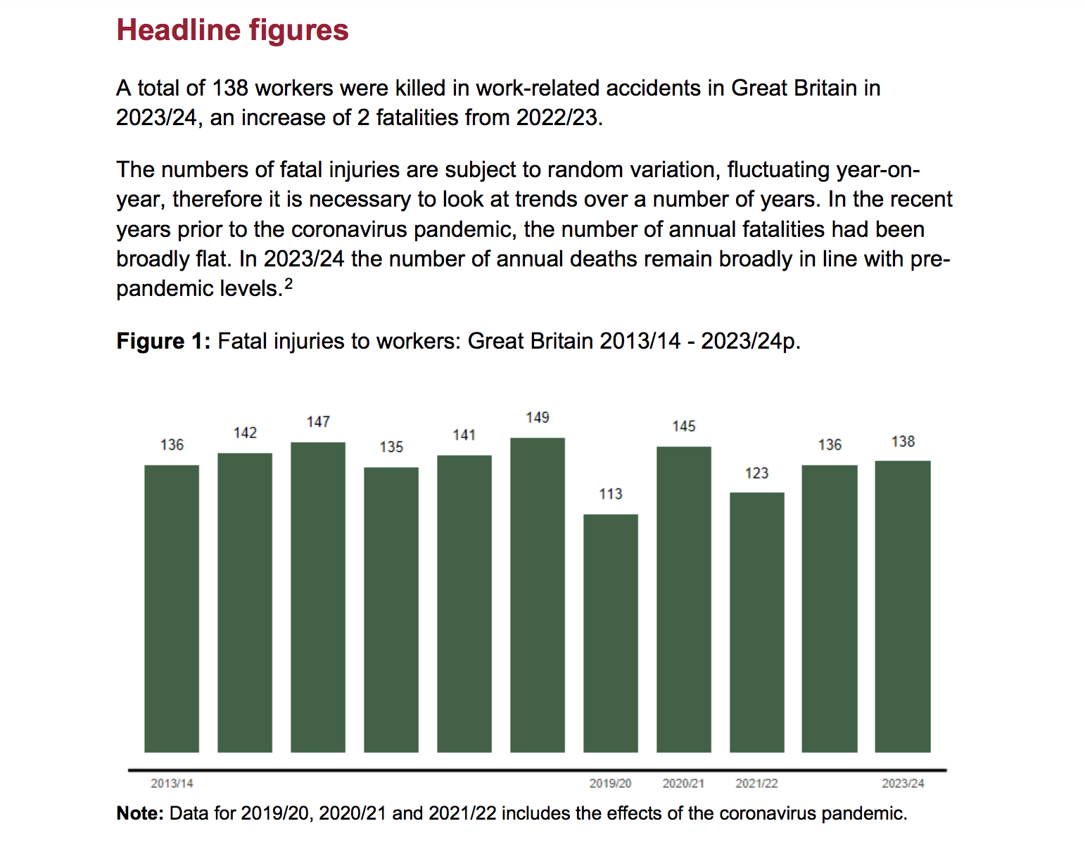
Let’s take a dive into the effect of behaviour change and legislation

Slide 10
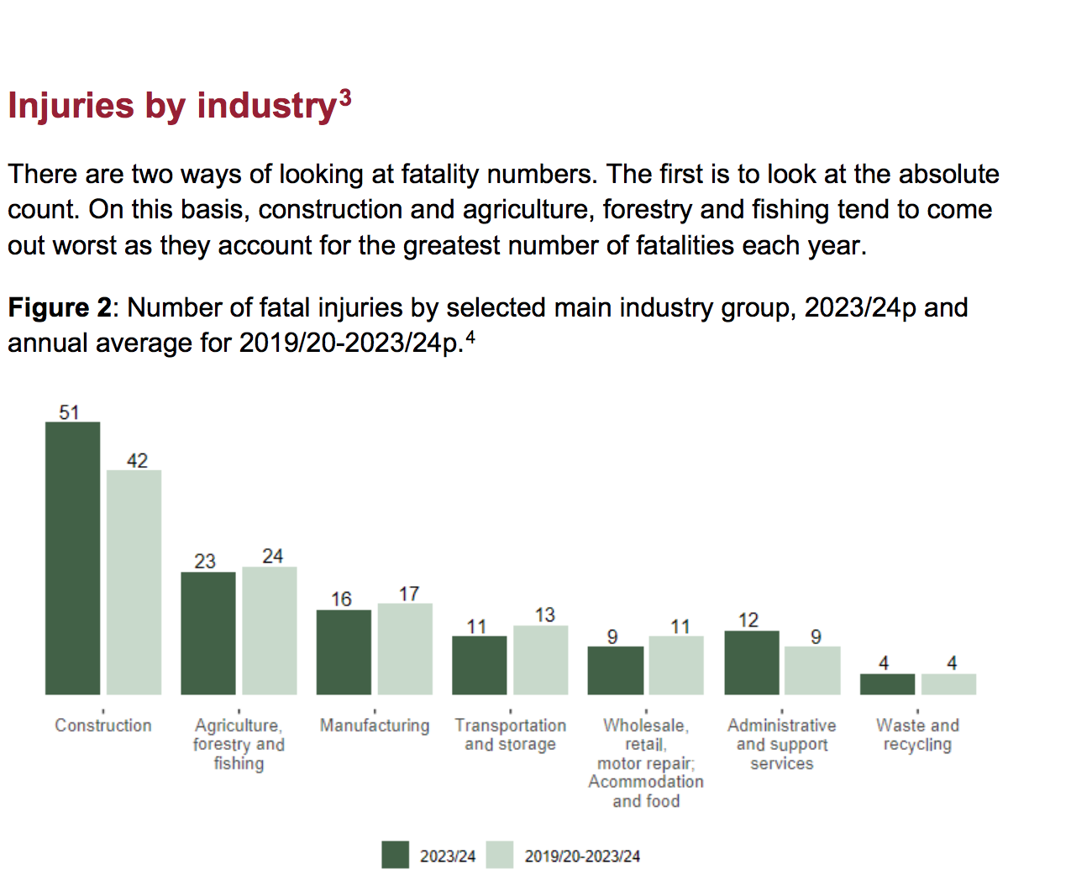

Slide 11
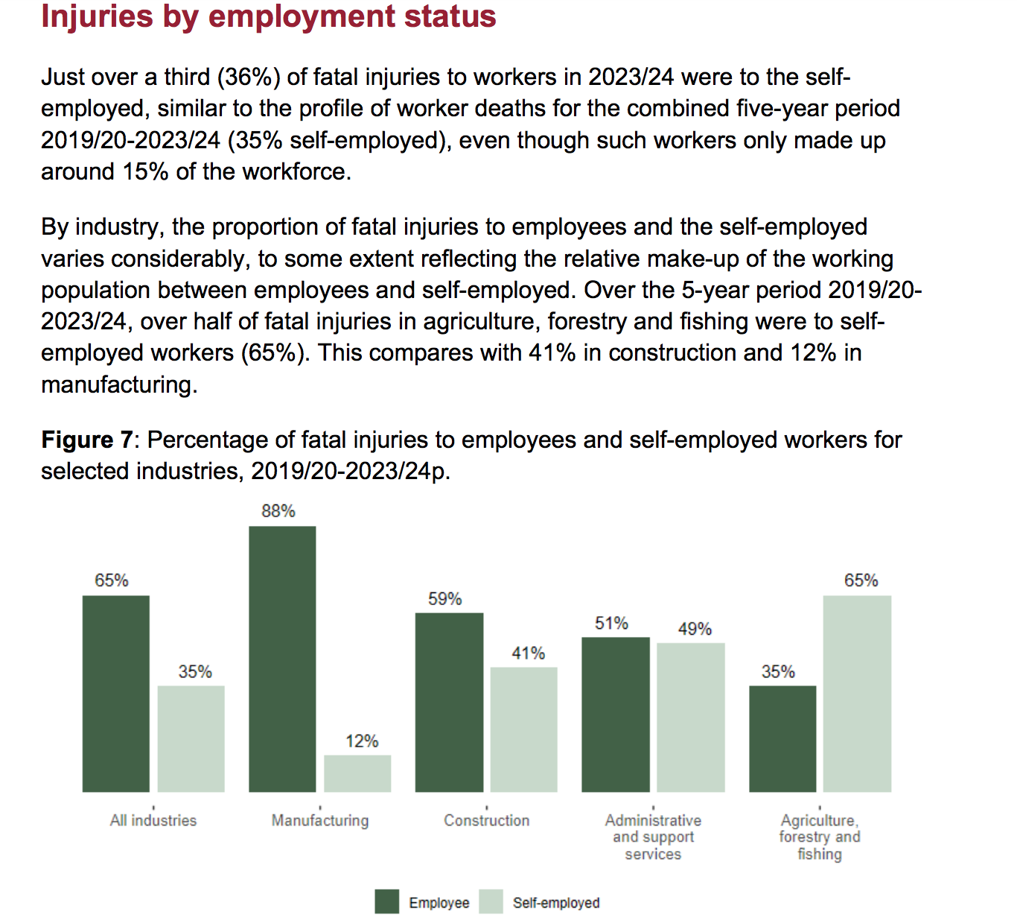

Slide 12
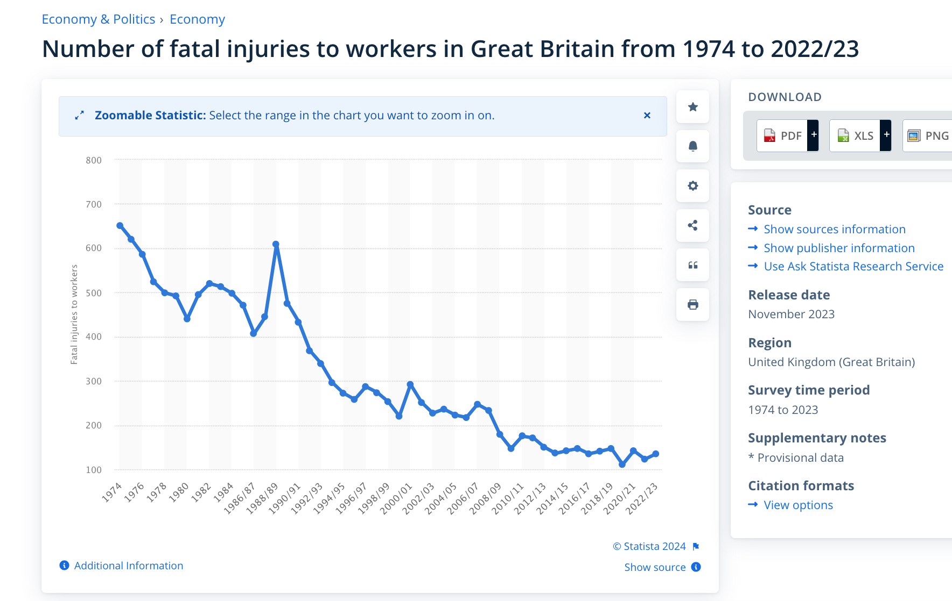

Slide 13
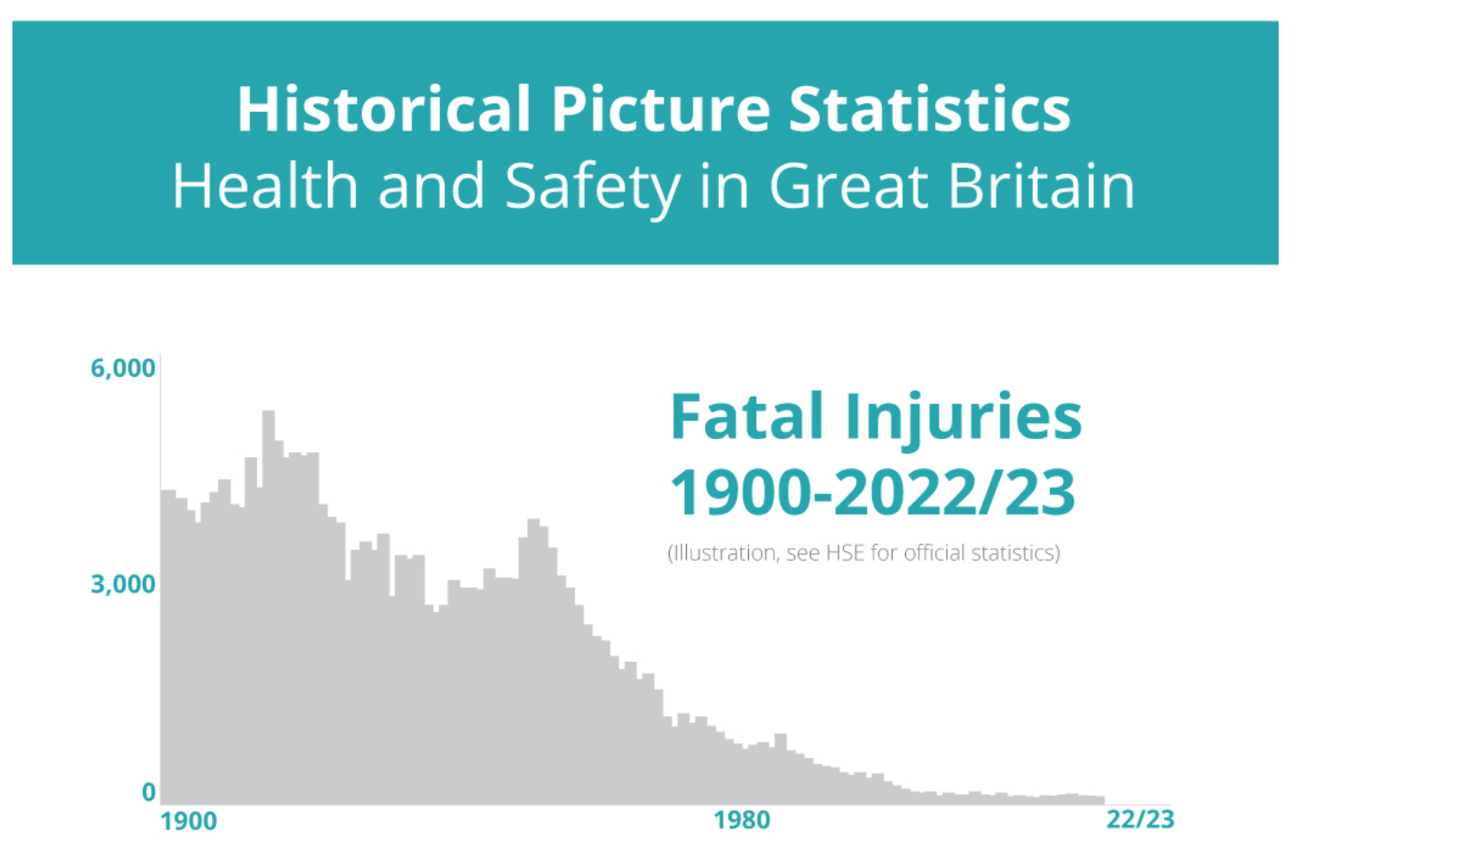

Slide 14
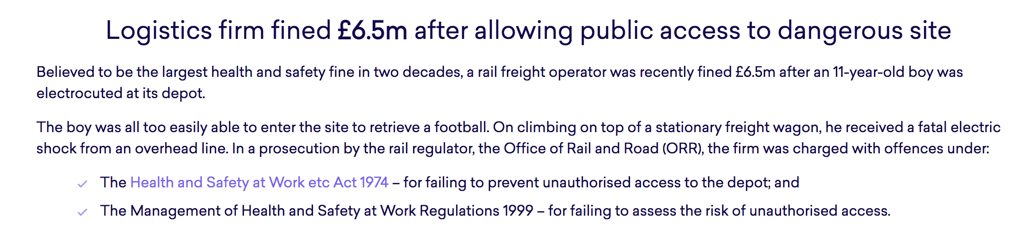
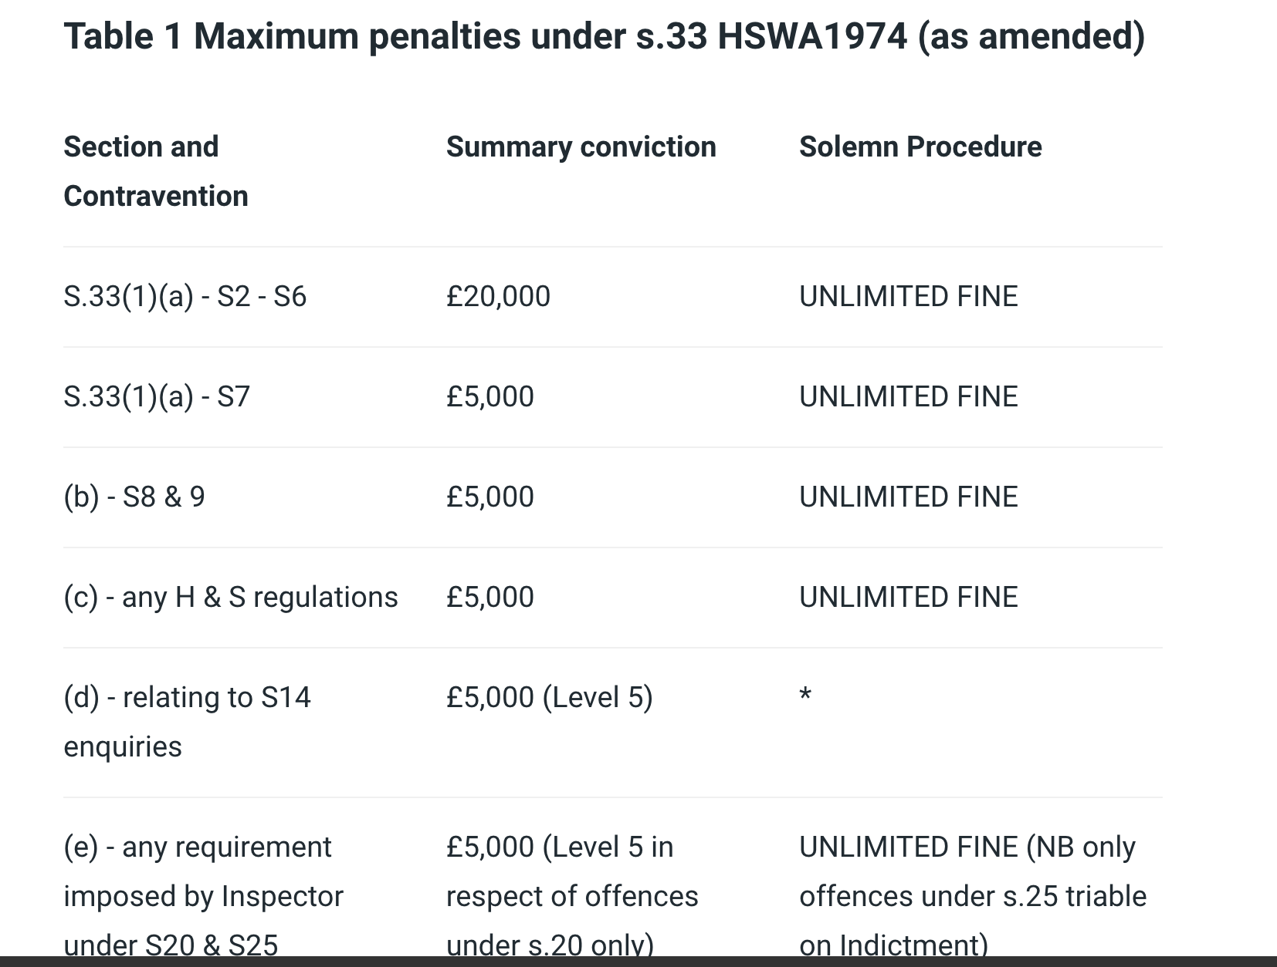
In addition to being fined £6.5 million, WH Malcolm Ltd (trading as the Malcolm Group) was ordered to pay full prosecution costs of £241,463. The judge said: “This fine must bring home to directors and board members the need to comply with health and safety legislation.” Reported in August 2021

Slide 15
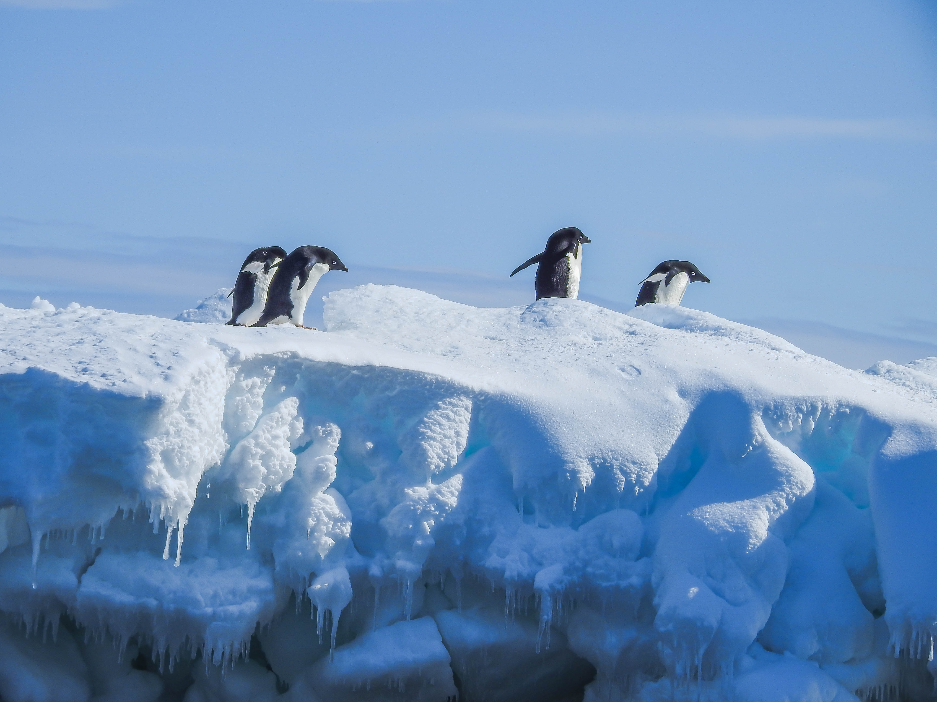
Fatalities from climate:
51,670 fatalities in England due to heat related from 1988 to 2022 average of 1522 fatalities every year over the last 34 years.
2186 in Wales over the same period.
https://www.lshtm.ac.uk/newsevents/news/2023/expert-comment-climate-related-mortality-england-and-wales-1988-2022
The Vulnerable Twenty (V20) Group of Ministers of Finance of the Climate Vulnerable Forum is a dedicated cooperation initiative of economies systemically vulnerable to climate change. The V20 works through dialogue and action to tackle global climate change.
New Health Data Shows Unabated Climate Change Will Cause 3.4 Million Deaths Per Year by Century End
https://www.v-20.org/new-health-data-shows-unabated-climate-change-will-cause-3.4-million-deaths-per-year-by-century-end

Slide 16
What Does It Have To Do With Business?

Slide 17
This is a BMC that builds into it from the beginning social and environmental impact
Business Model Canvas Explained with Examples

Slide 18
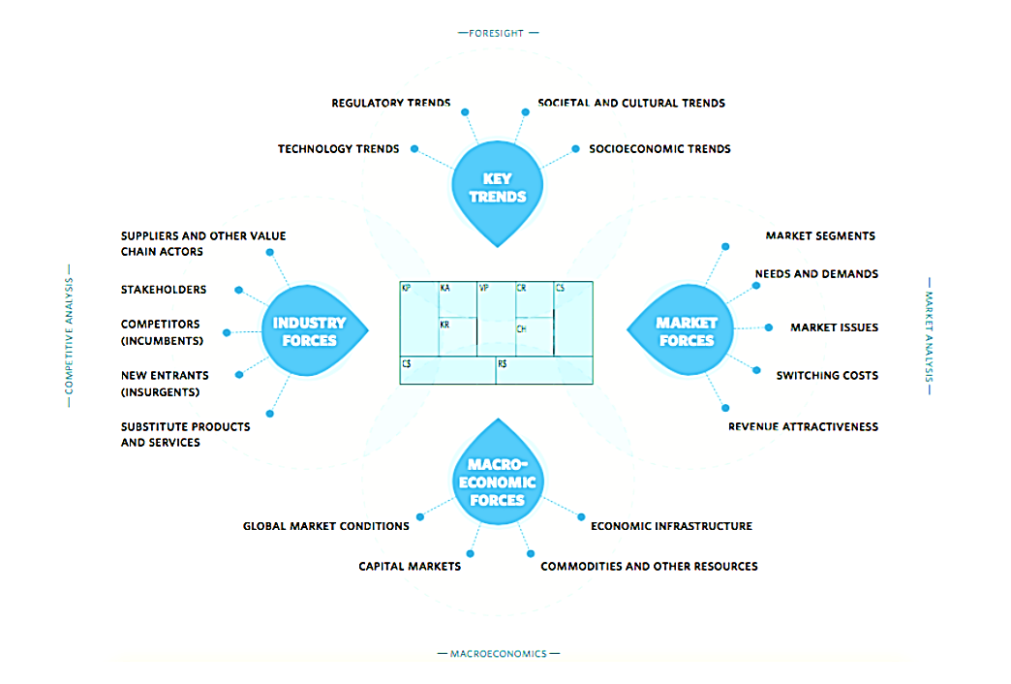
When and how do you think your organisation and that of a local SME will be aware of any direct impact on pricing?

Slide 19
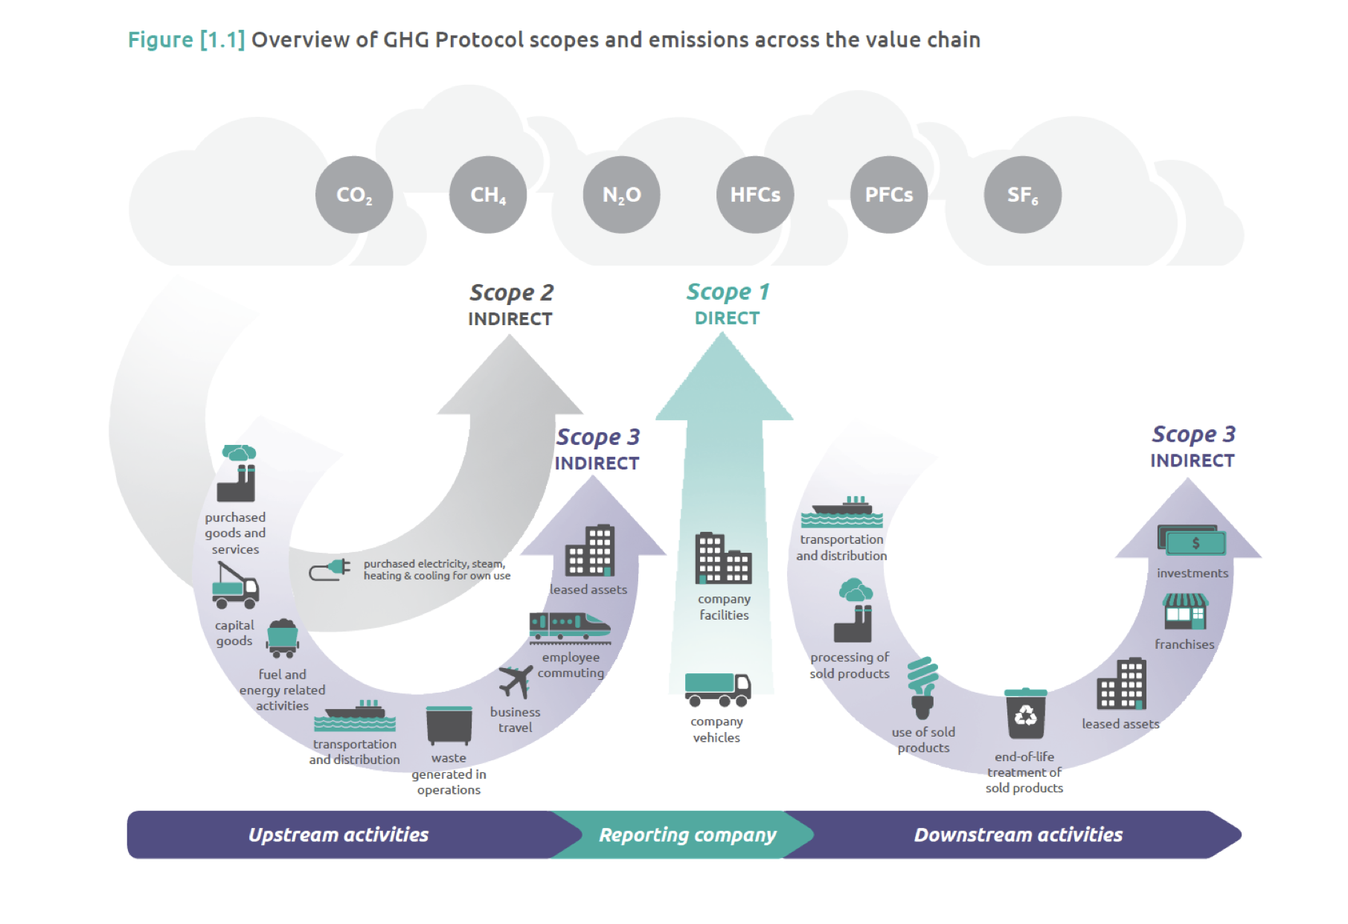
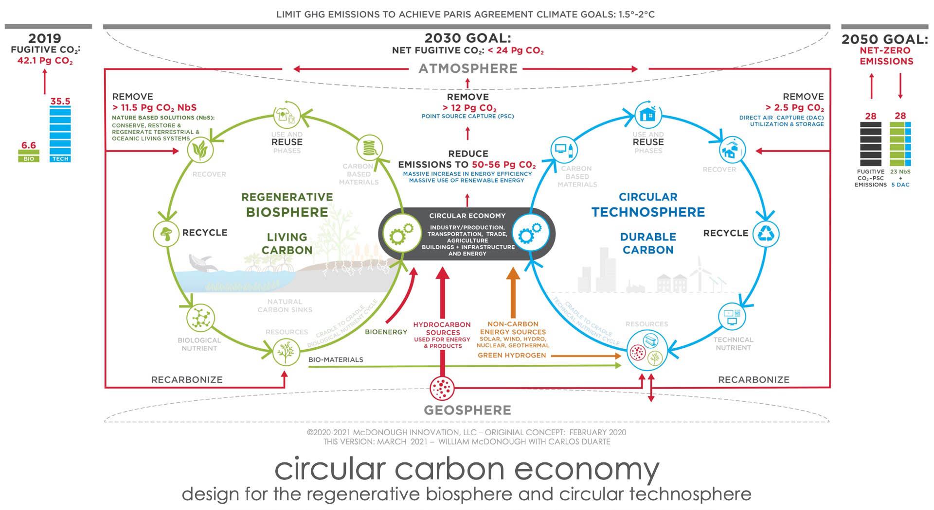
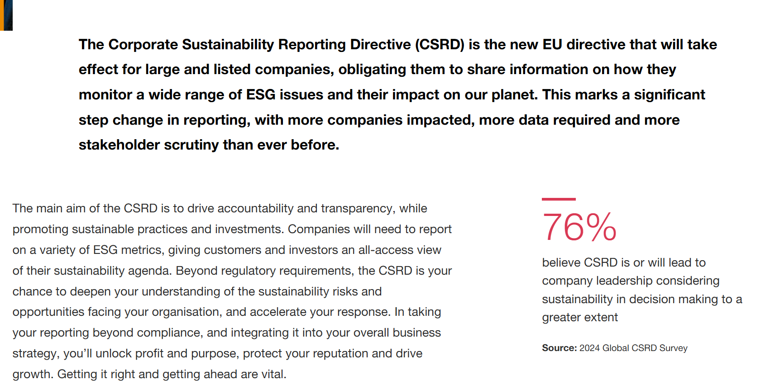
Value/Supply Chain
Environmental Approaches
New Governments… Ecocide Bill; Community Wealth Building Bill; Just Transition; Landfill Ban; SECR; Food Waste; Disruption to global supply chain; Taxes, National Insurances and more! SWIFT BRICKS! UK NET ZERO Building standards…
You do not exist in a vacuum.
©TWF2045
Notes:
Scope 3- energy needed to make all the STUFF

Slide 20
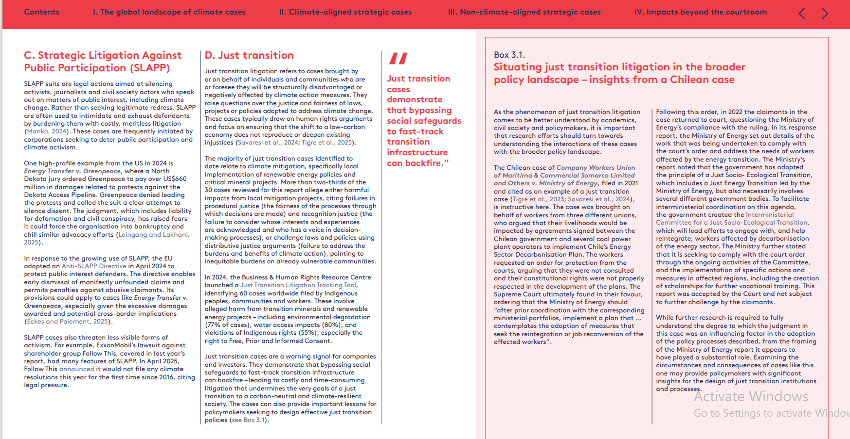
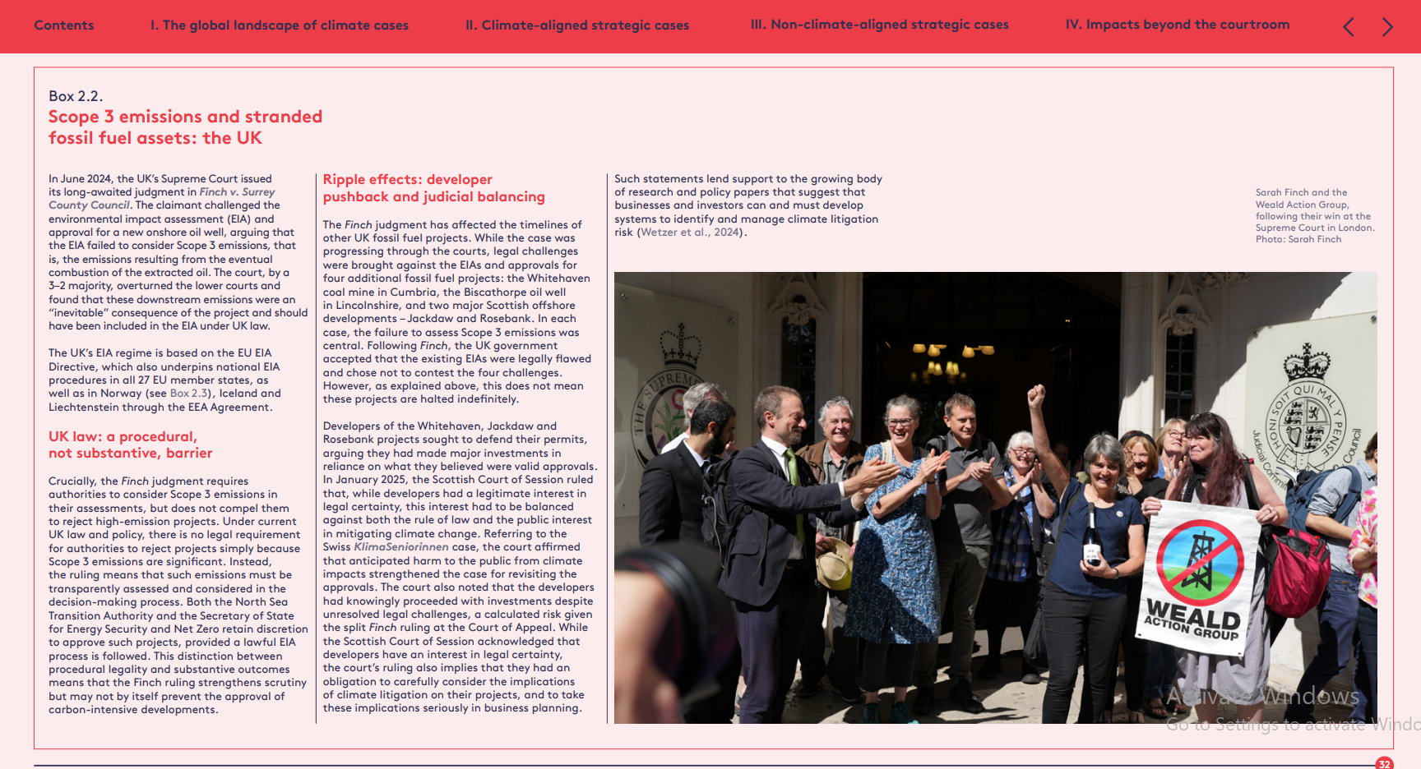
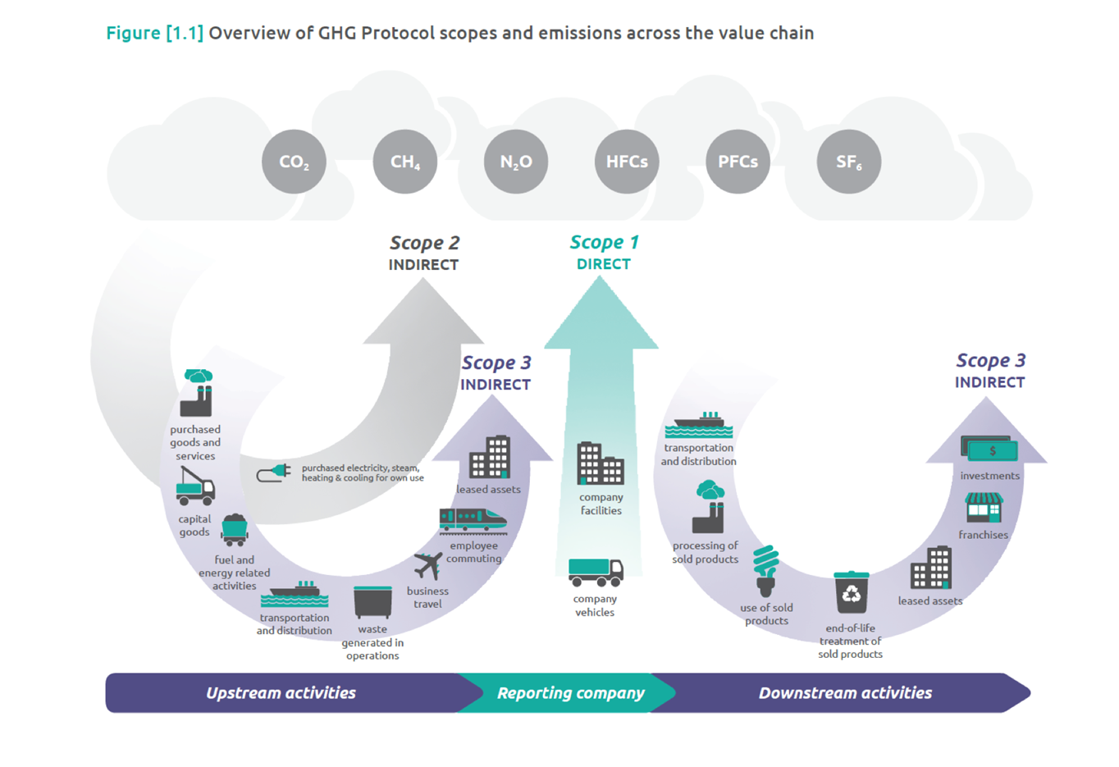

Slide 21
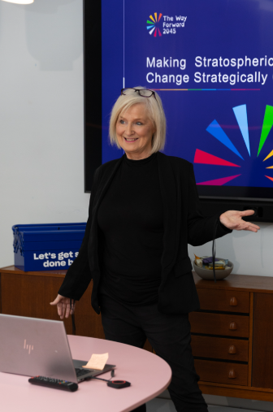
ACTIVITY
Thinking of your Value Proposition and customer demographics from last week.
Use the CIPD PESTLE sheet – do this task for each of the boxes.
Use online resources to source details or substantiate what you already know

Slide 22
How Do We Know This?

Slide 23
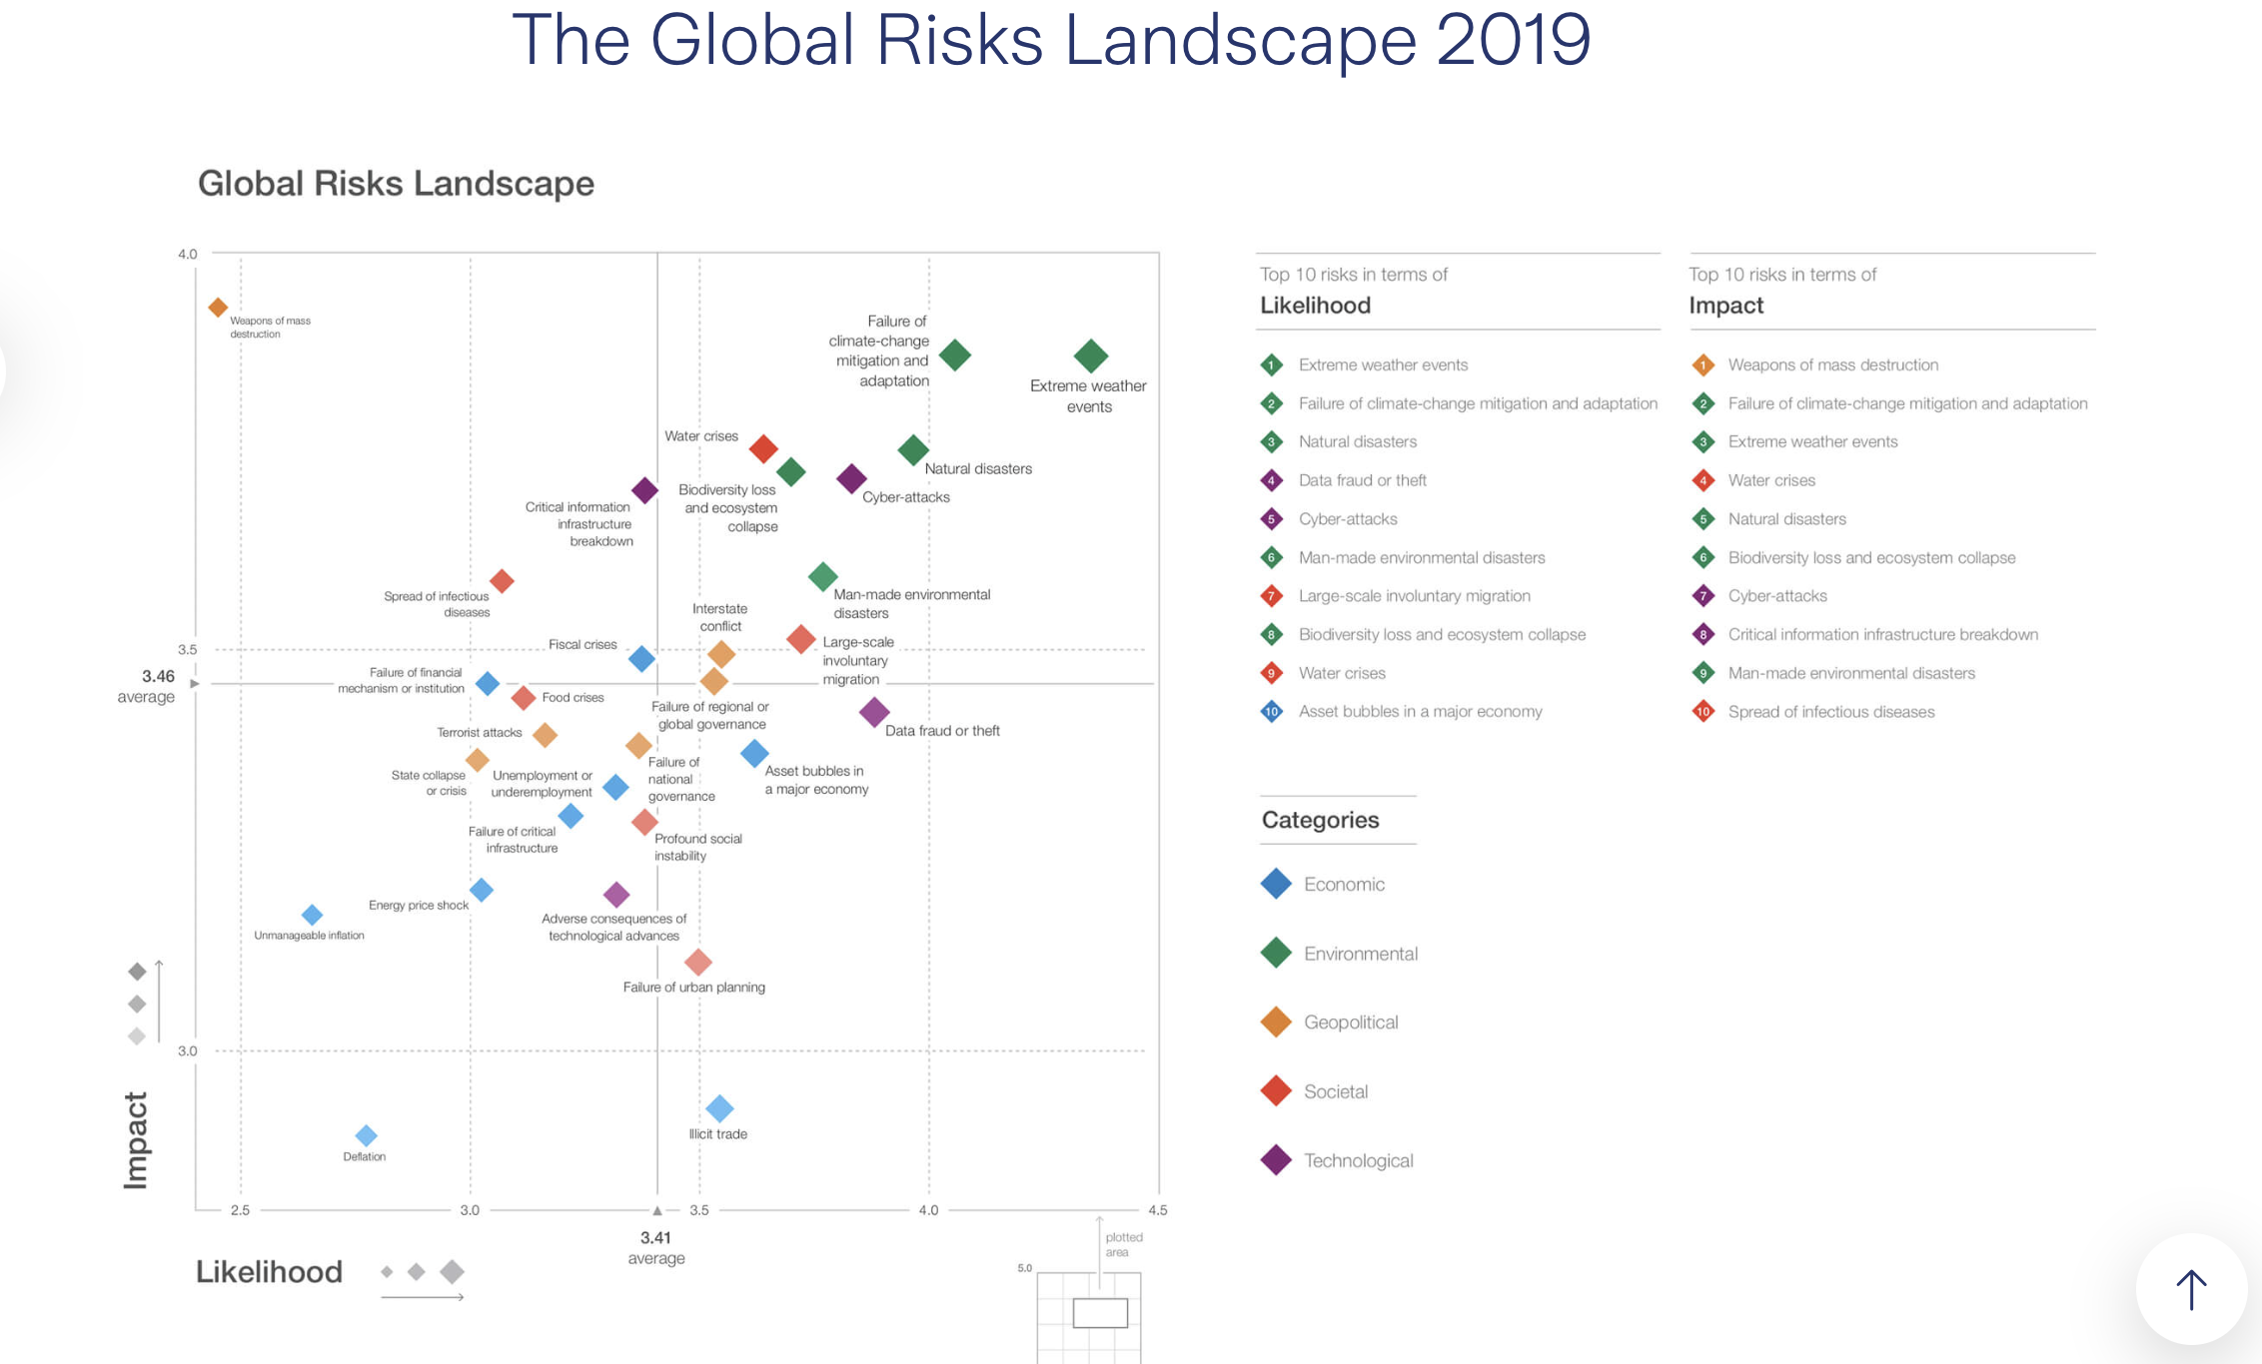
And sometimes they get it wrong!
https://www.zurich.com/en/knowledge/topics/global-risks/global-risks-landscape-and-risks-trends-interconnections-maps-2019

Slide 24
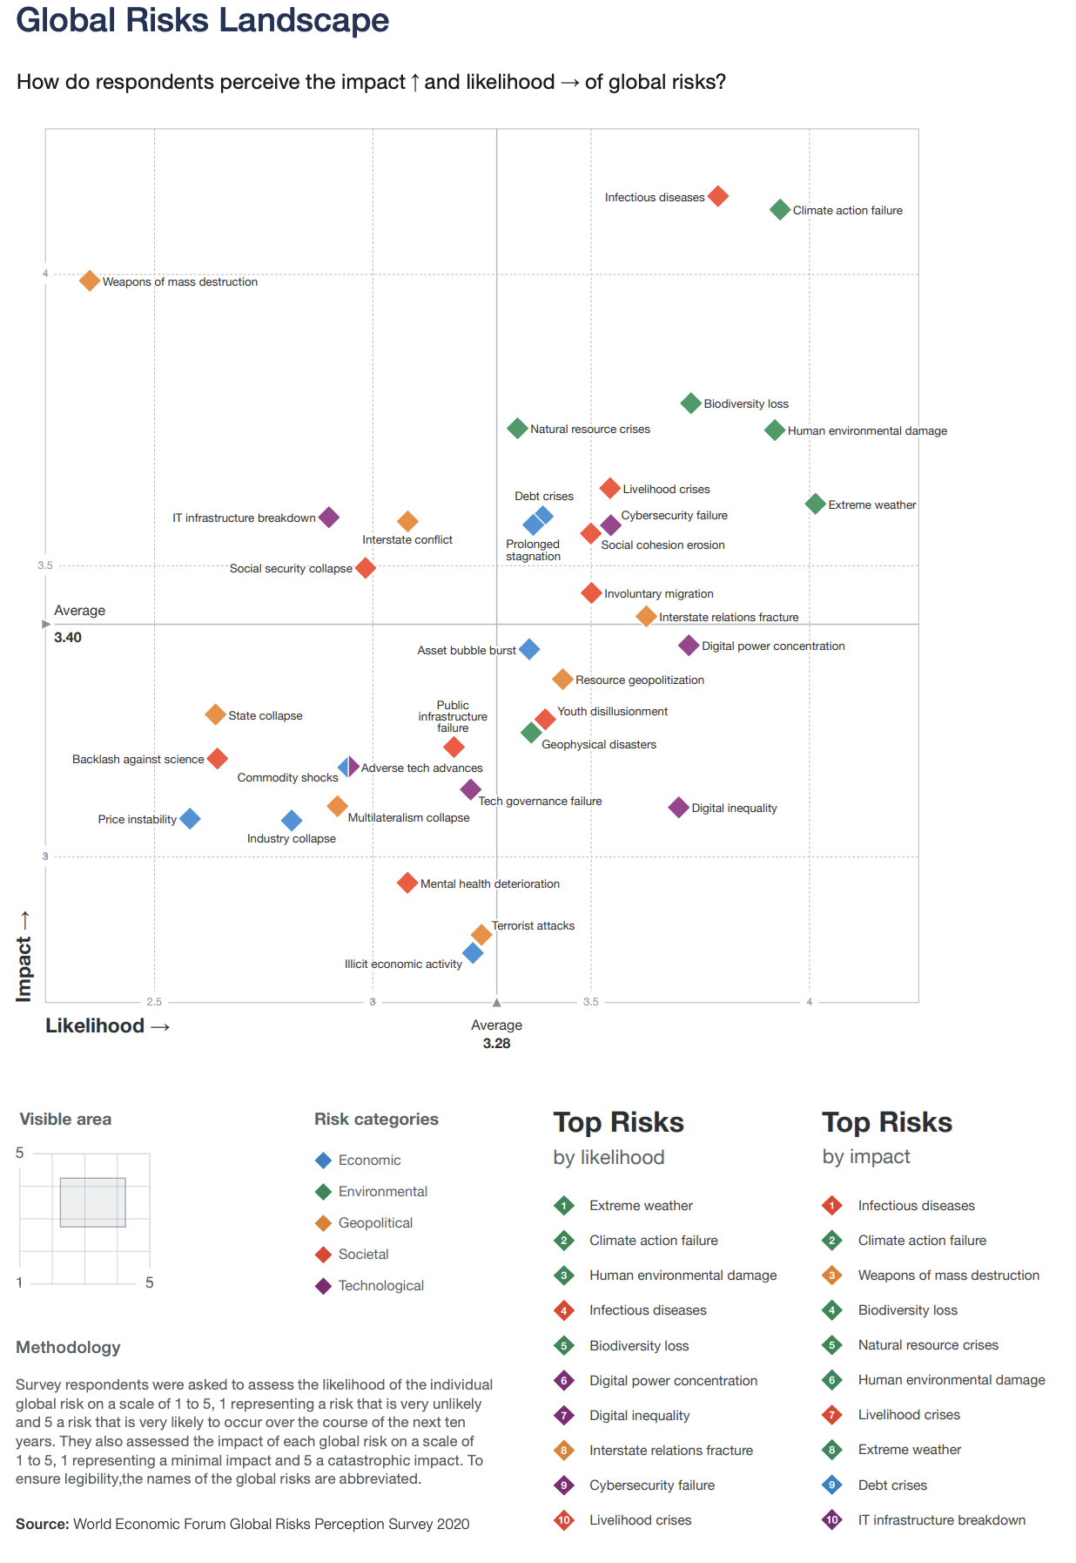
2021
Guess which one is infectious diseases?

Slide 25
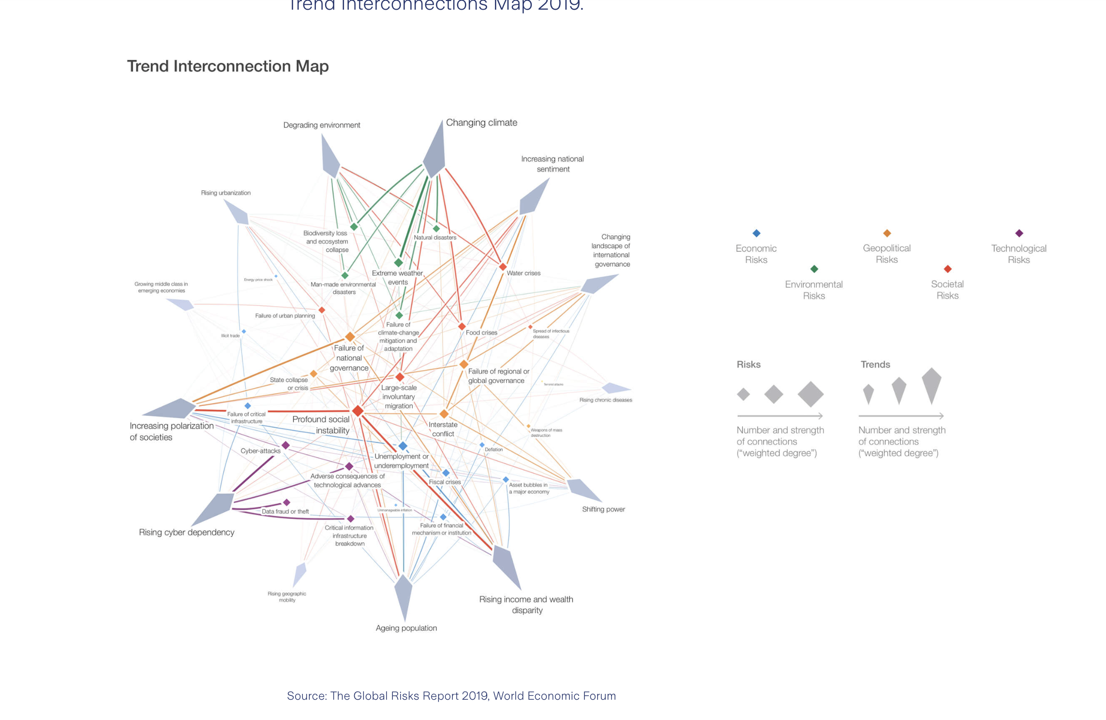
https://www.zurich.com/en/knowledge/topics/global-risks/global-risks-landscape-and-risks-trends-interconnections-maps-2019

Slide 26
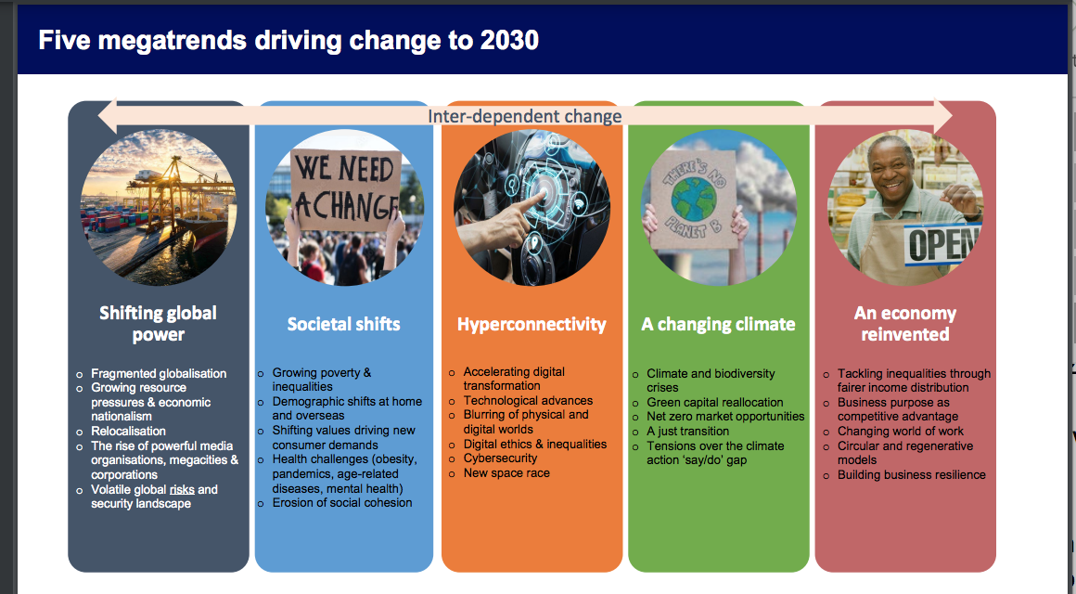
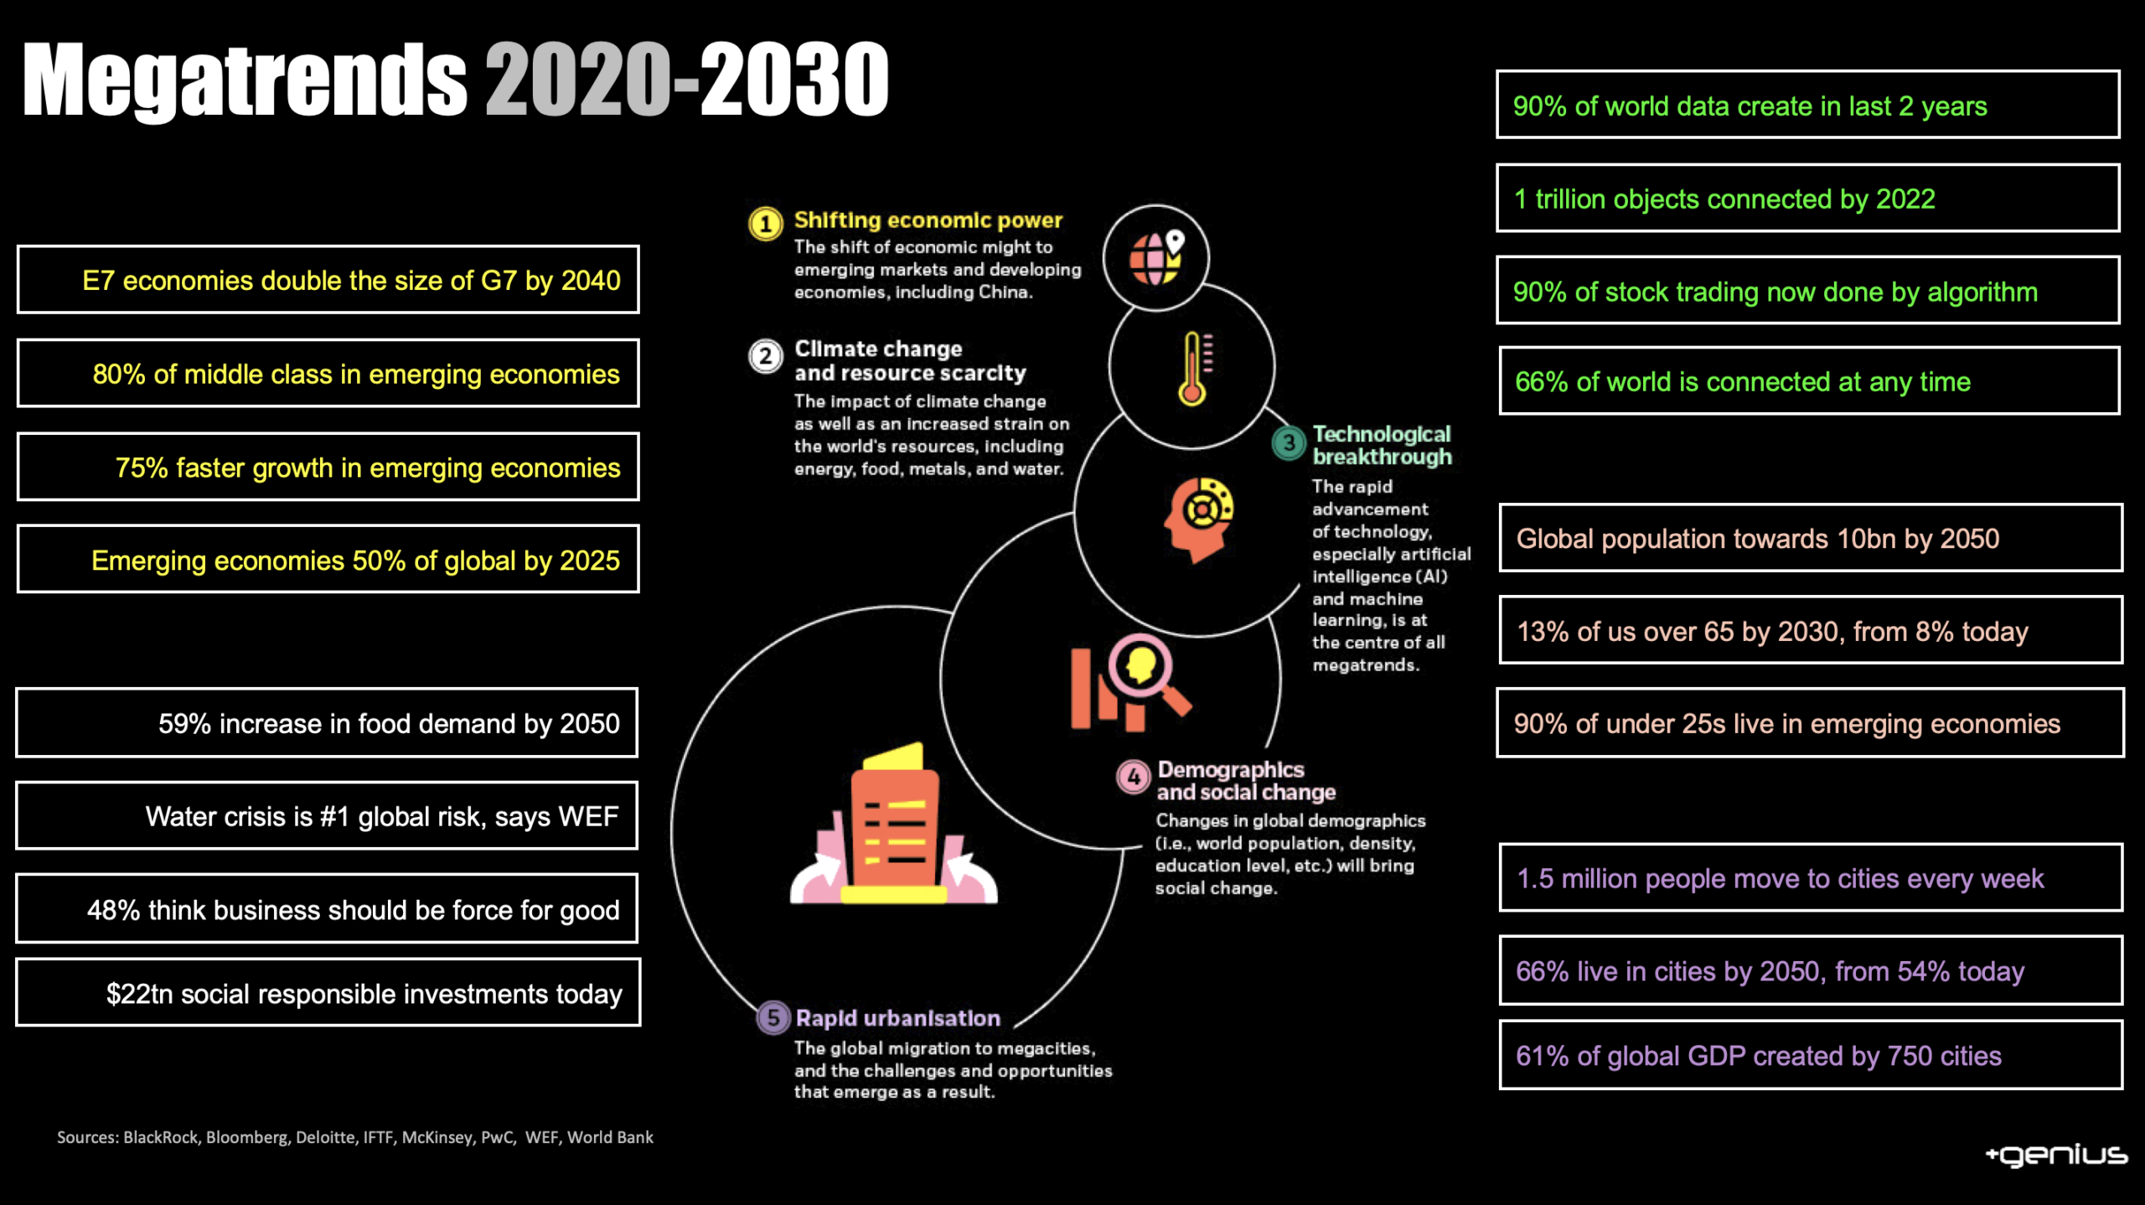
Global & National Pattern of Risks and Megatrends
https://www.scottish-enterprise.com/media/3hqid2vb/megatrends-implications-sept-2023.pdf

Slide 27
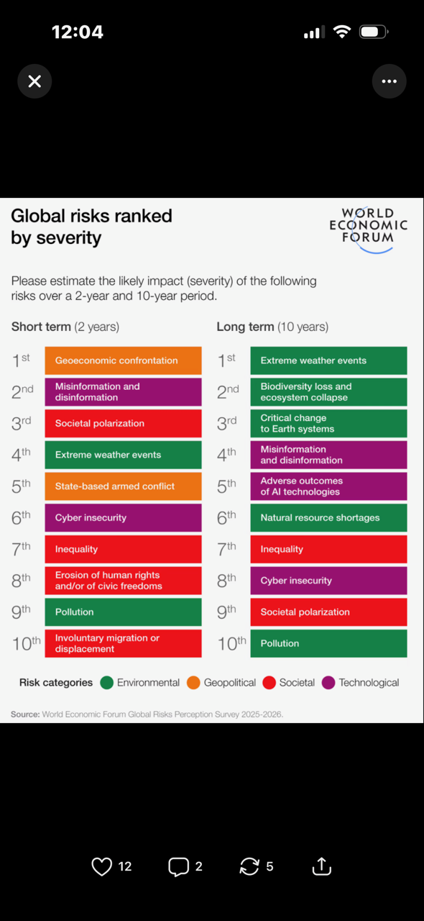
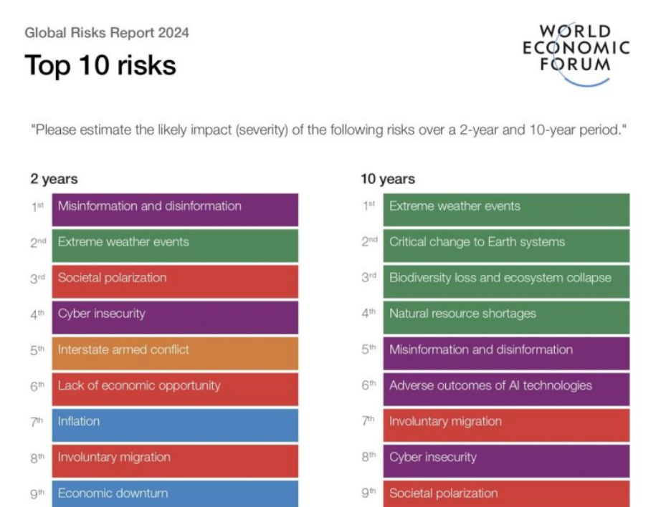
2025-2026
Timeline of changing risks…what impacts will affect your strategy

Slide 28
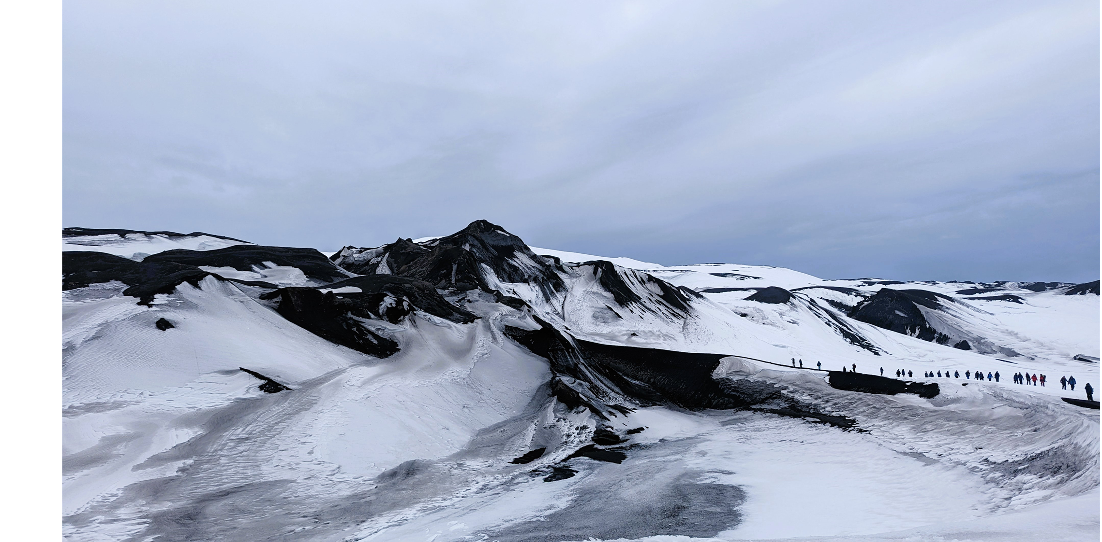
Are we digging deep enough when we are looking at the outcomes of our business models & our shared values? Who are our customers and our partners- are we aligned? Where are the opportunities to create stronger business models doing more progressive work?

Slide 29
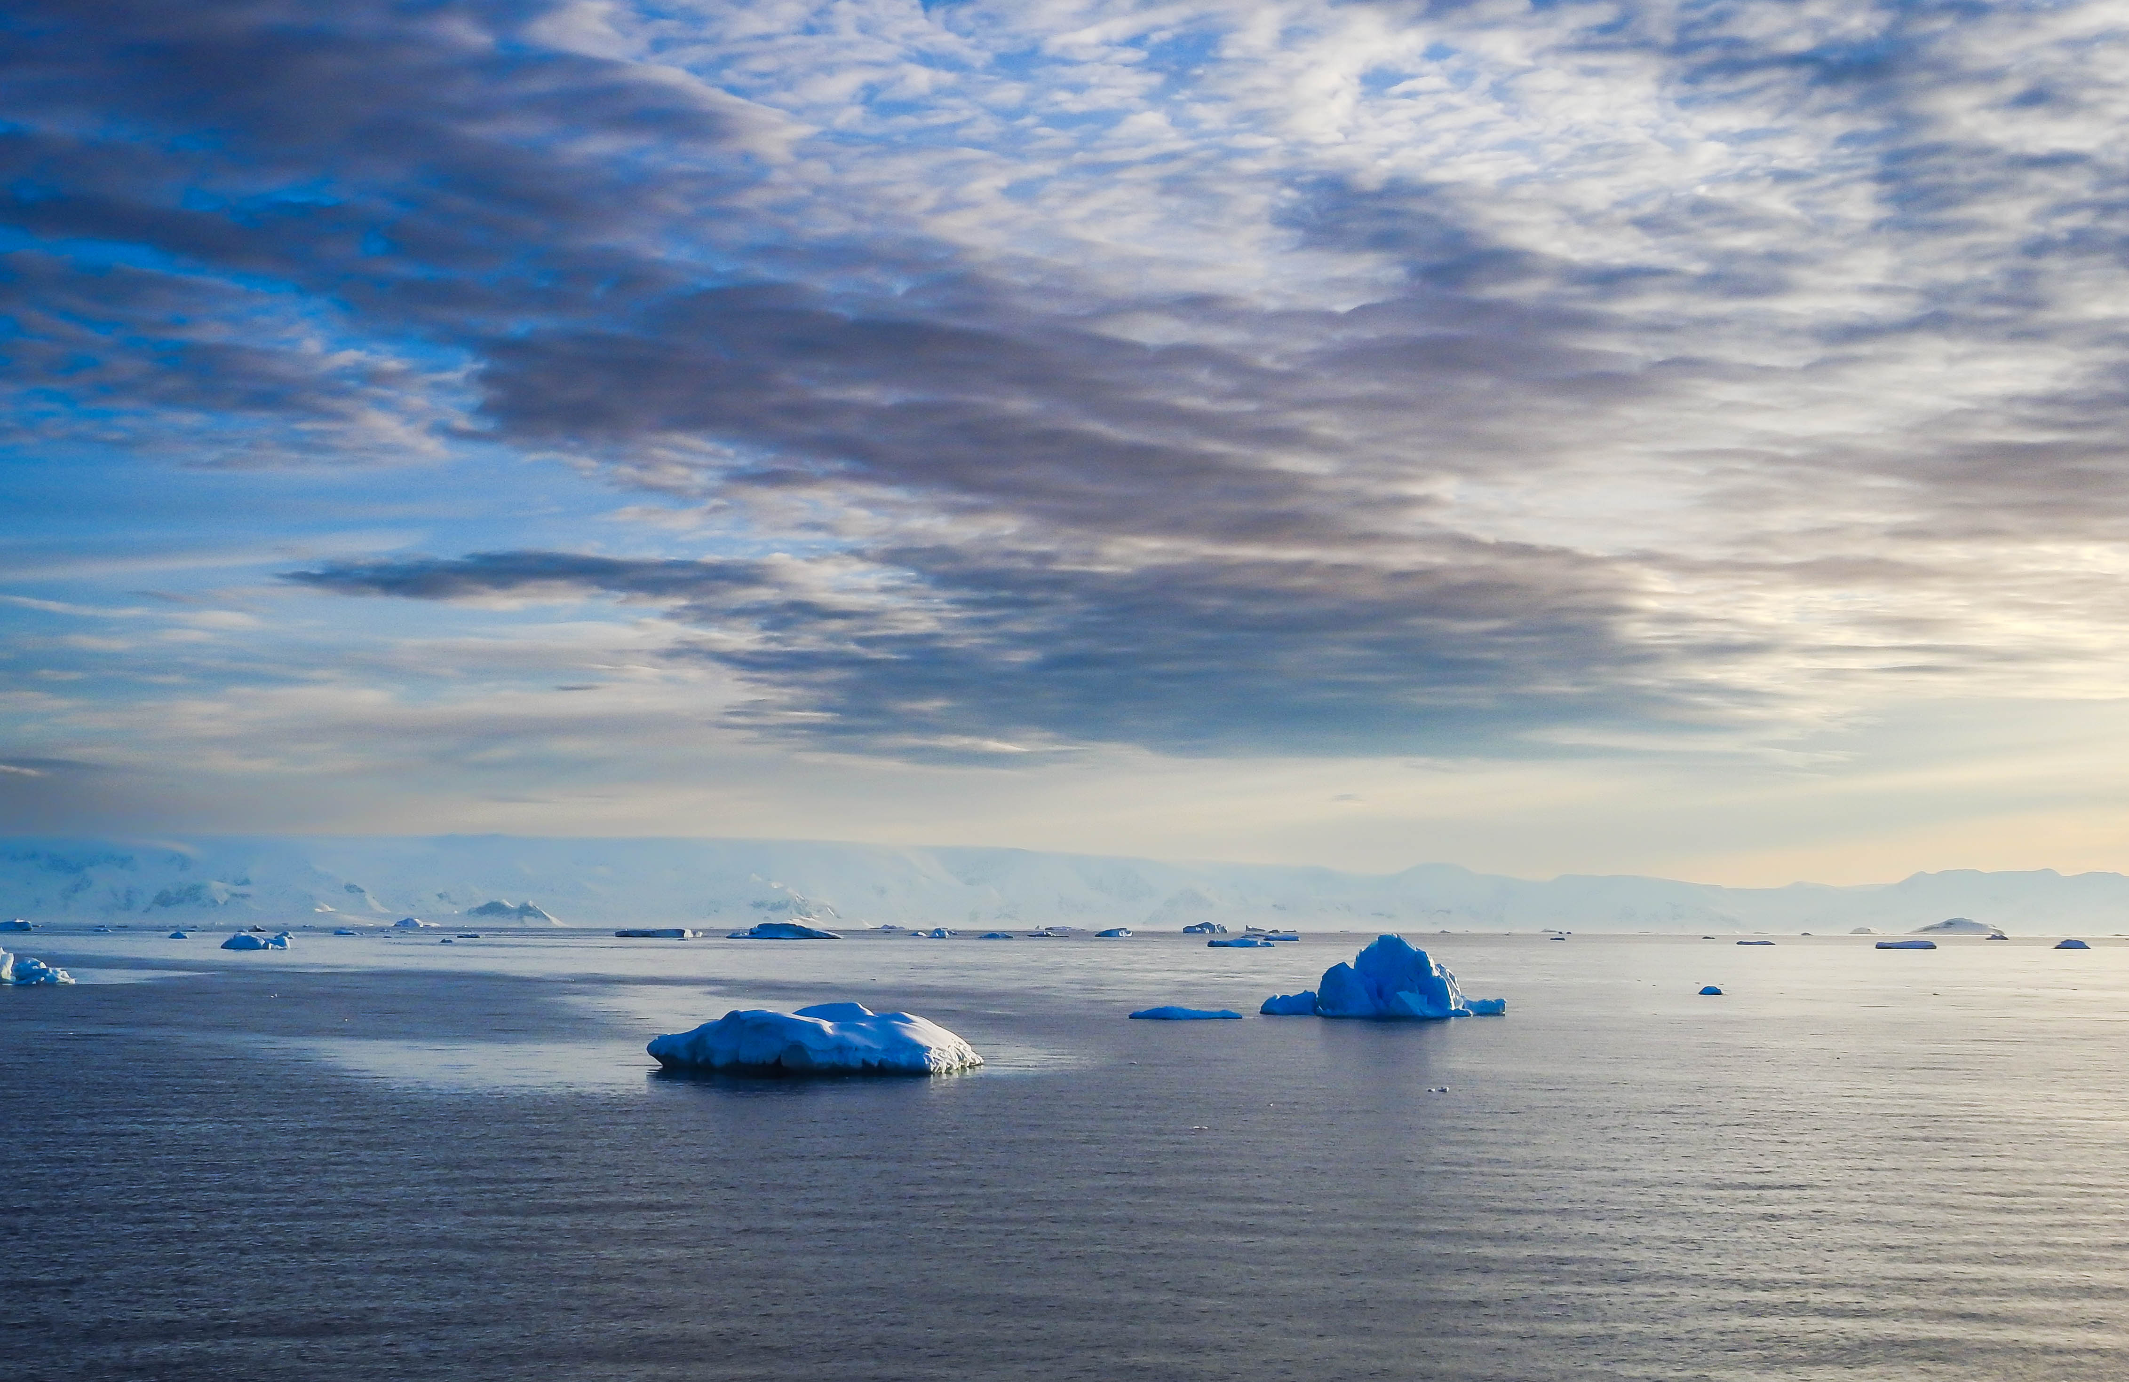
First…What does ‘bad’ look like? Who is doing it? Are they doing it deliberately…why?

Slide 30
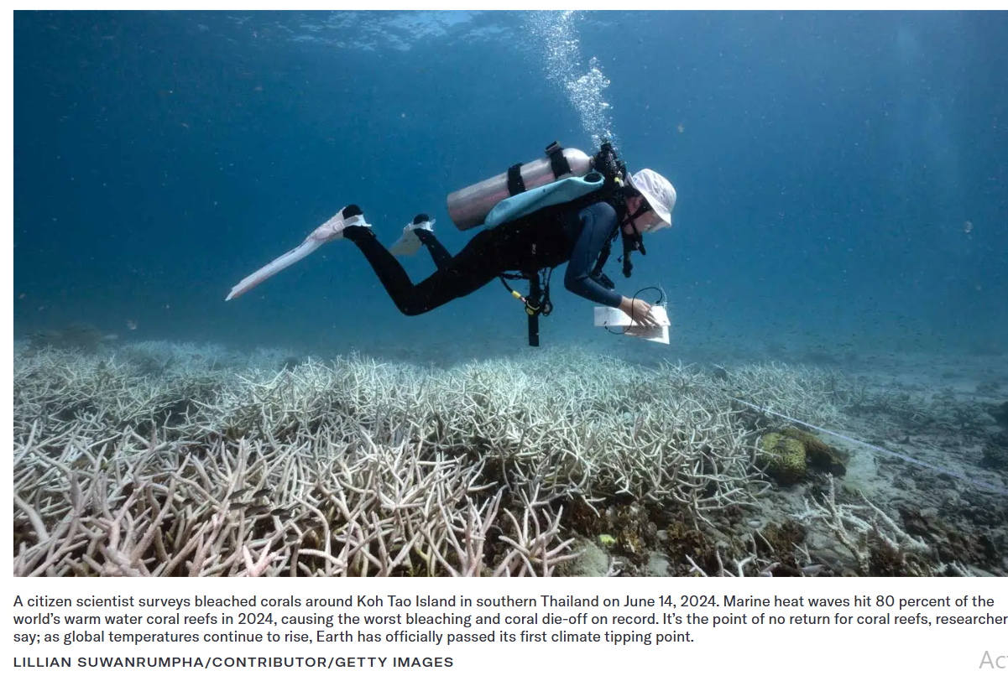
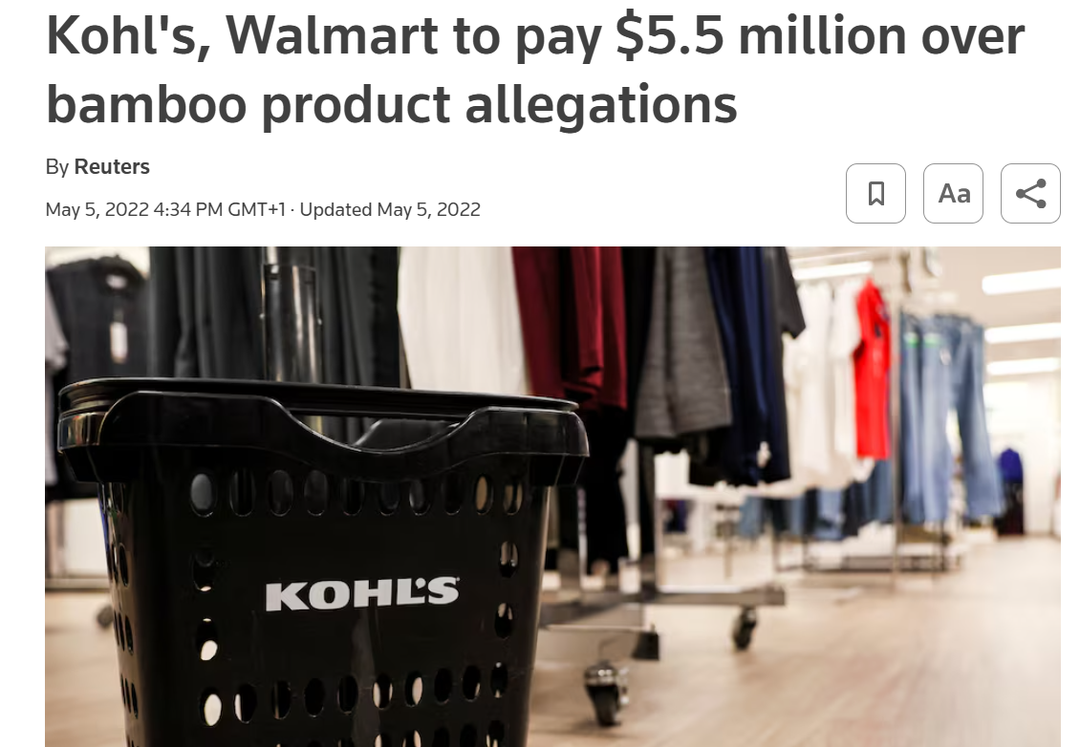
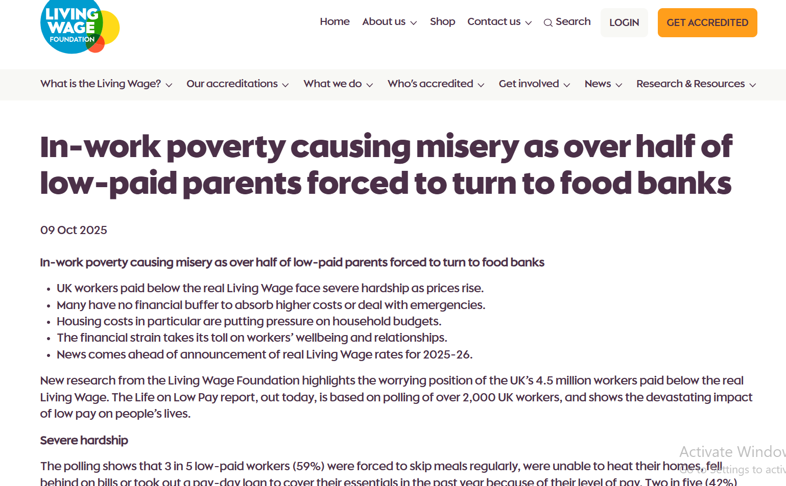
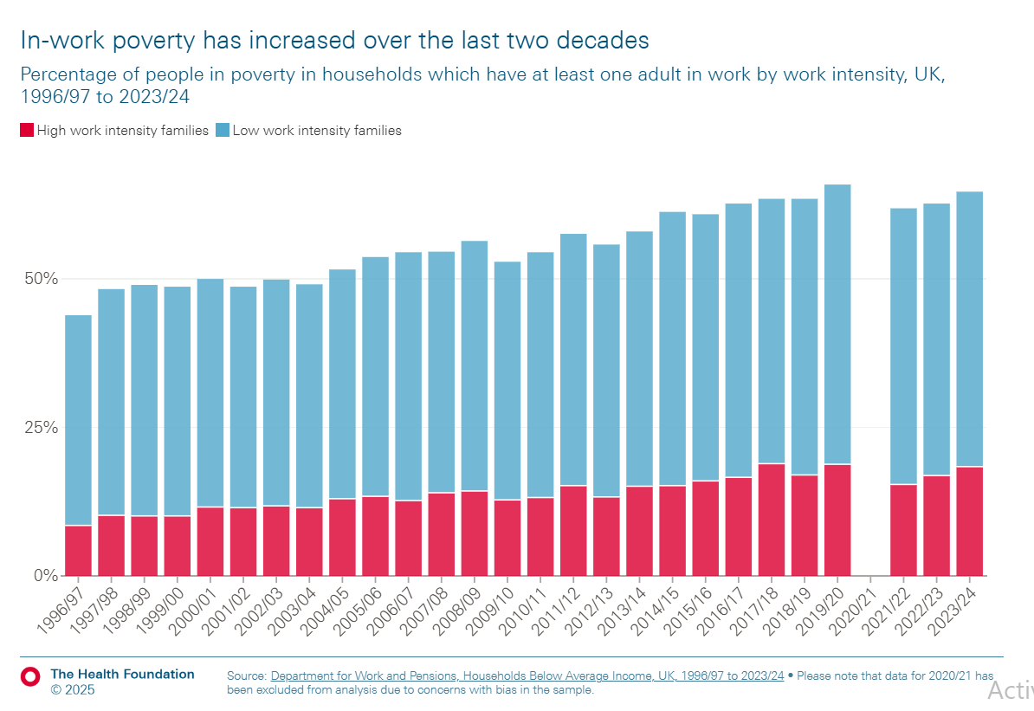
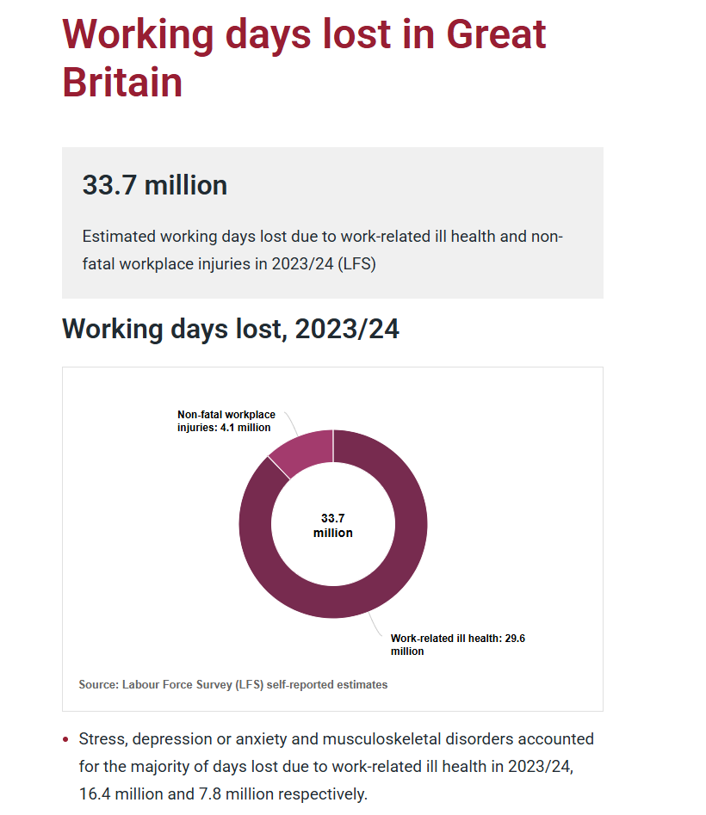
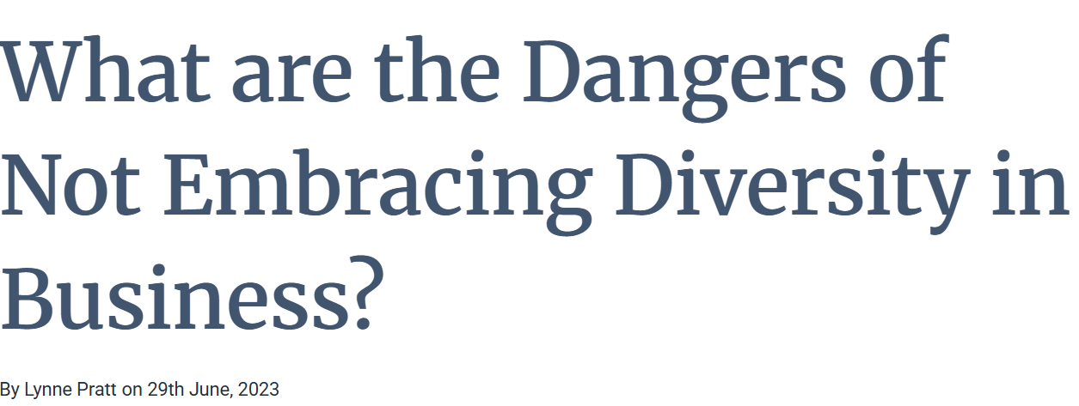
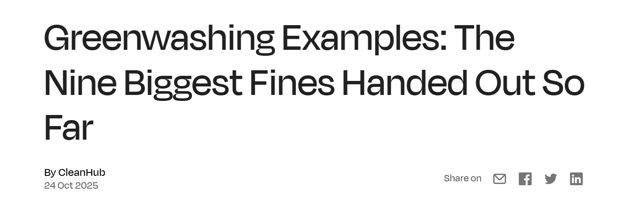
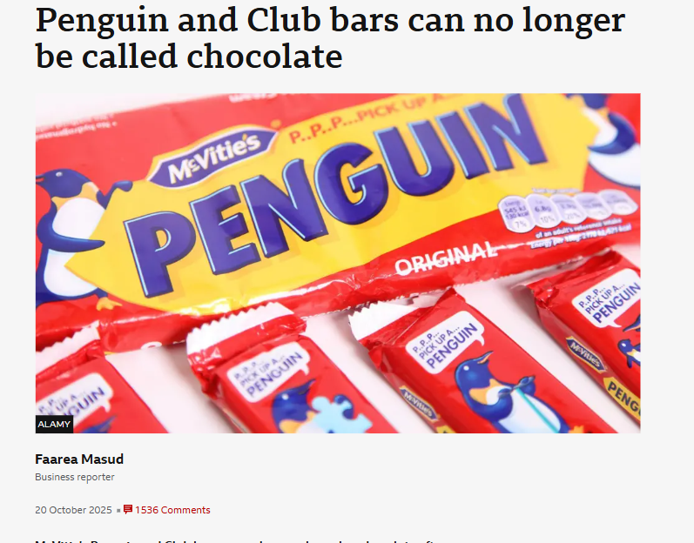
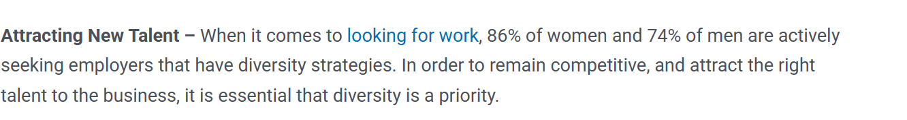

Slide 31
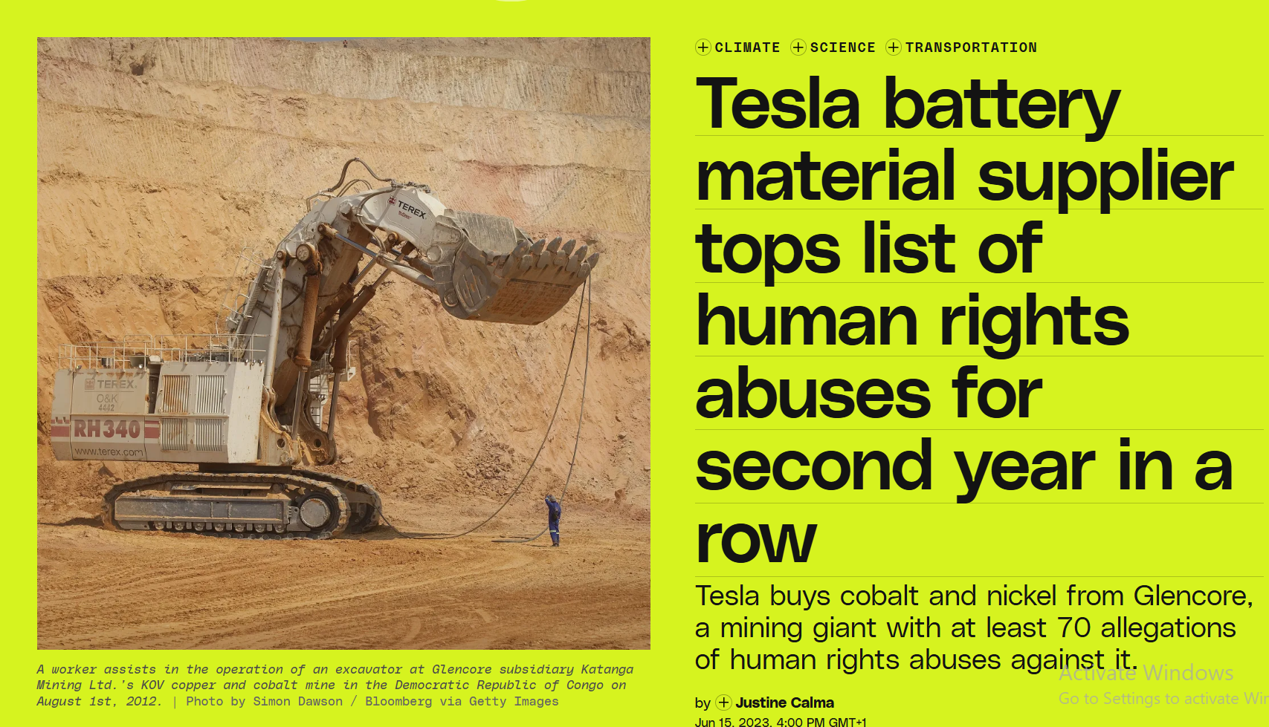
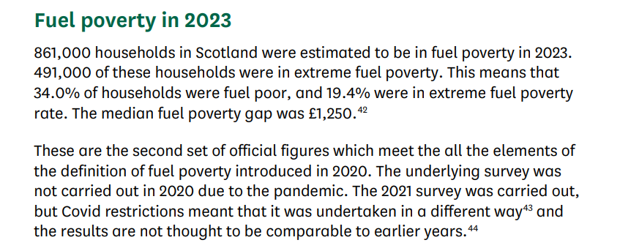

Slide 32
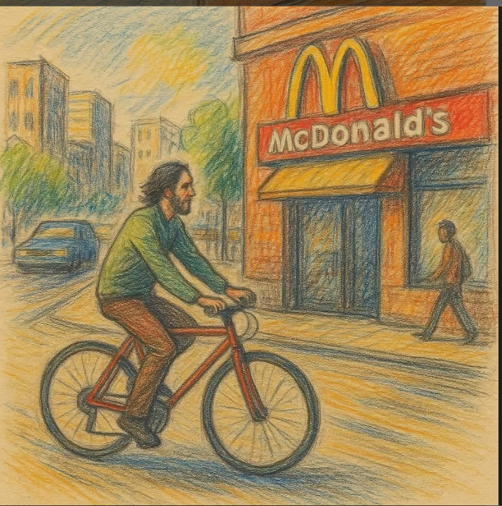
This quote is satire designed to expose the flaw in how we measure the economy (GDP).
A banker once described the bicycle as 'the slow death for the planet.'
“A cyclist is a disaster for the economy. He doesn’t buy a car or take out loans to pay for it. He doesn’t pay for car insurance. He doesn’t buy fuel. He doesn’t use paid parking or expensive repairs. He doesn’t cause major accidents. He doesn’t need highways built just for him. And worst of all — he stays healthy. Healthy people don’t buy as many medicines, rarely visit hospitals and don’t contribute to the GDP through sickness.”
Meanwhile, every new McDonald’s creates: 30 jobs, including 10 cardiologists, 10 dentists, 10 nutritionists, …and of course, the staff who serve the food.
So — choose wisely: the bicycle or McDonald’s? Sometimes, the things that are “bad” for the economy are exactly what’s good for the planet — and for us.
PS: Walking is even worse. Pedestrians don’t even buy bicycles!“
Source Unknown

Slide 33
What is good? What does it look like…why is it easy to share this?
What are your Priorities?

Slide 34
Nature on the Board
AVOCADO SEEDS!
Bartering, Values, small scale
https://find-and-update.company-information.service.gov.uk/company/SC068493/filing-history

Slide 35
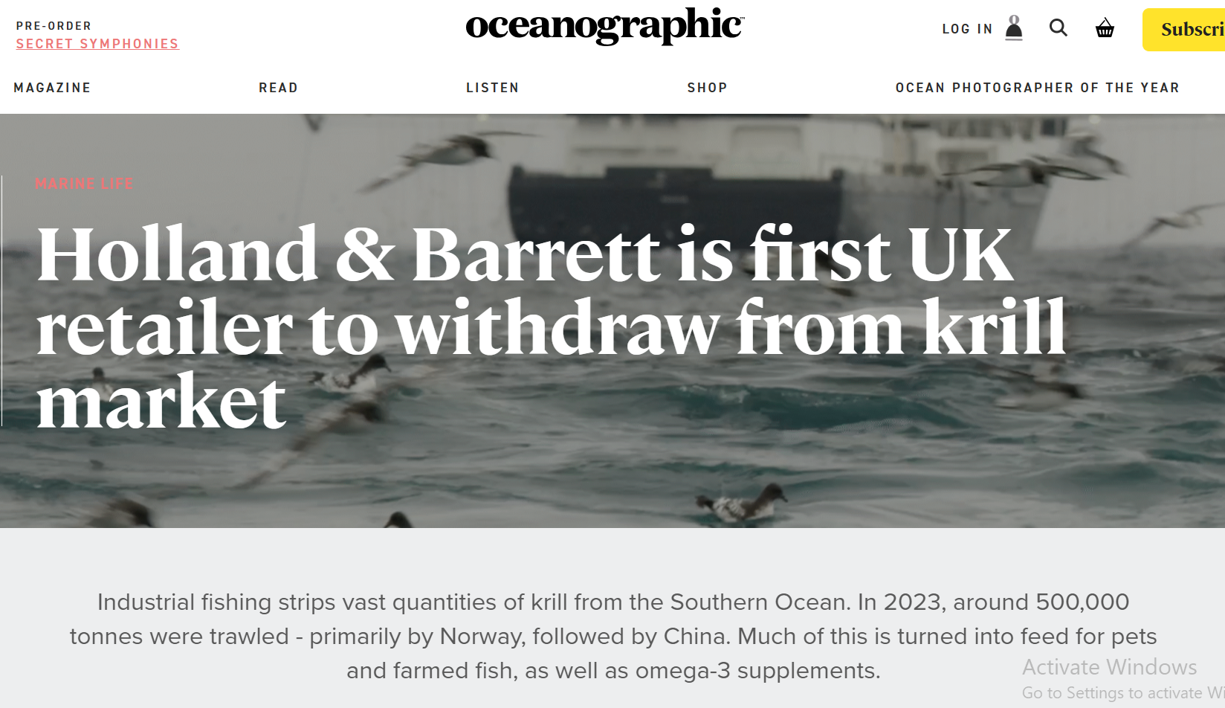
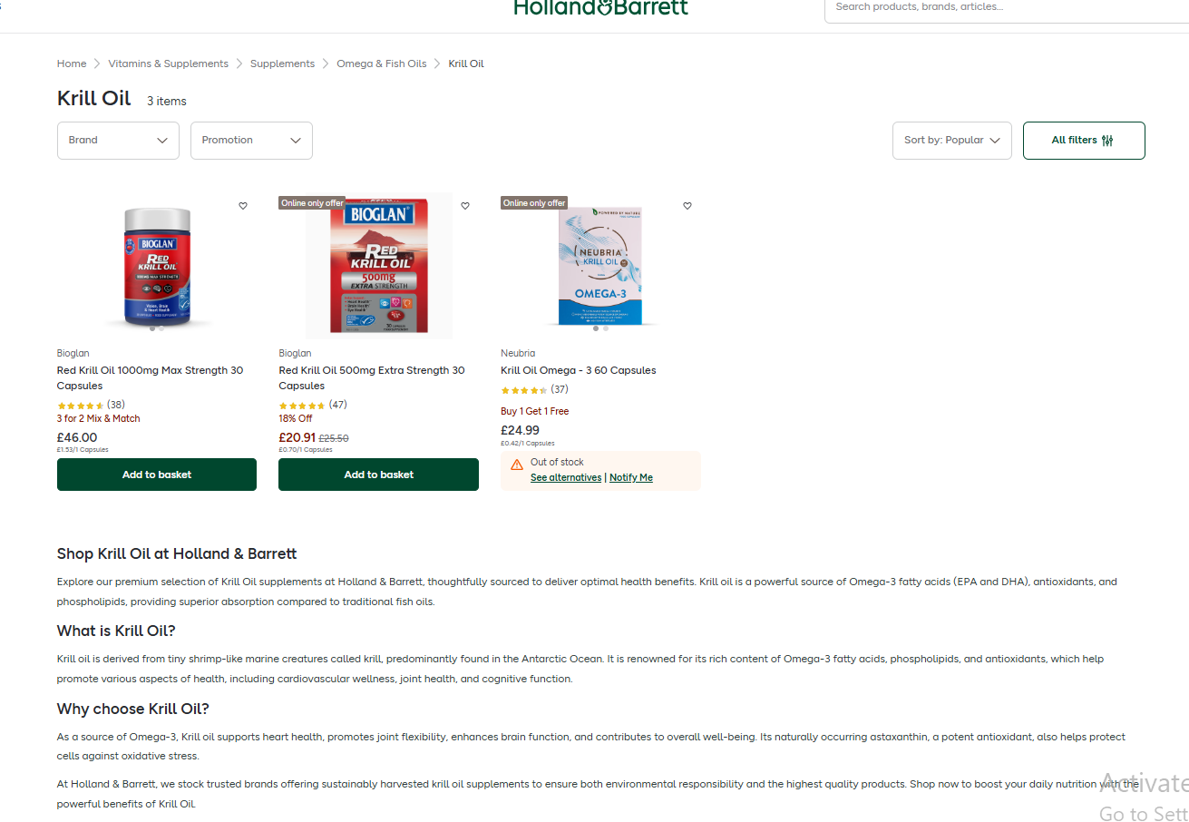

Slide 36
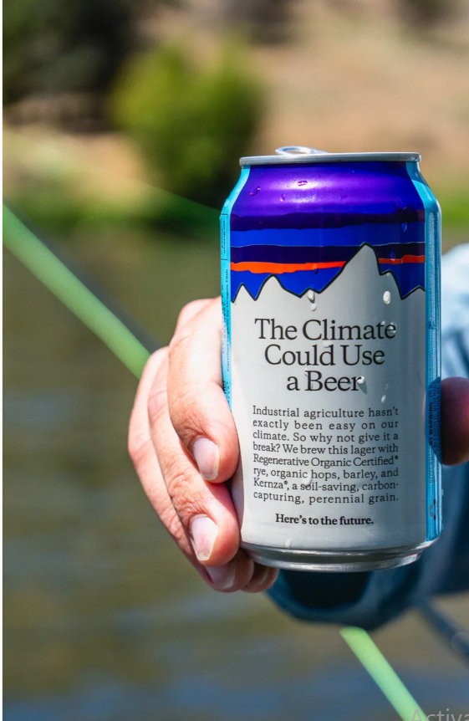
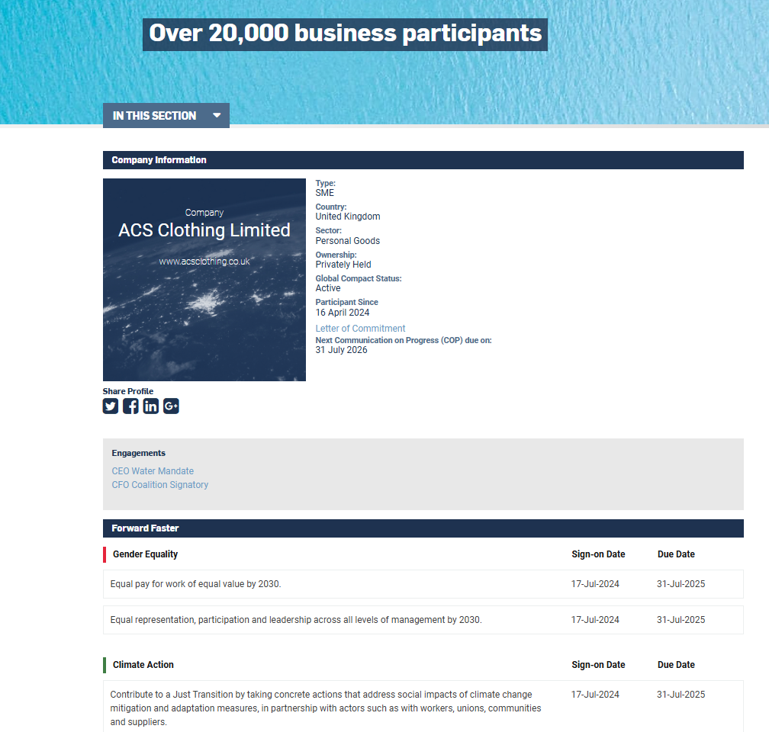

Slide 37
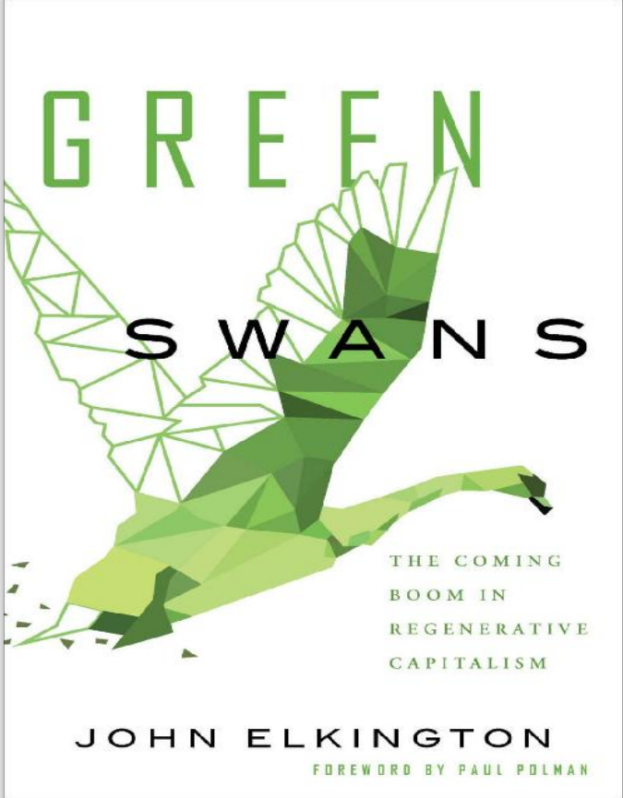
“The best leaders are willing to give up what is no longer working and commit to what is needed to succeed in a new, completely changed operating environment. When John Elkington issued a ‘product recall’ for his groundbreaking concept of the ‘triple bottom line,’ it was because he is that type of leader. If you want to be a leader that meets the demands of the 21st century, read Green Swans, and then become one.” —Jay Coen Gilbert, Co-Founder of B Lab, the organization behind the B Corporation movement
“Welcome to the new renaissance. John Elkington does not fall into the trap of painting a dystopian nightmare scenario that leaves us without hope. Instead, Green Swans makes us believe in miracles. Not metaphysical miracles, but those that seem impossible today because we look at their feasibility from a business-asusual perspective, defined by the status quo. Like John, I am realistically optimistic. Like him, too, I also say ‘neutrality be damned.’ I hope this brilliant book kickstarts new and honest conversations in boardrooms around the world. Conversations about what side of history we are on, and what steps we will now take to become ‘future fit leaders’. Read on to get a sense of where breakthrough mindsets and innovation will take us as we work to deliver the Global Goals. It always seems impossible until it’s done.” —Lise Kingo, CEO & Executive Director, United Nations Global Compact, the world’s biggest sustainable business platform
Green Swans: The Coming Boom In Regenerative Capitalism

Slide 38
How do we select the relevant frameworks and what value do they bring?

Slide 39

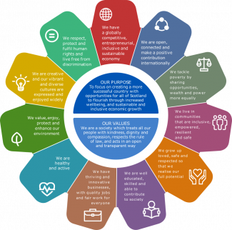
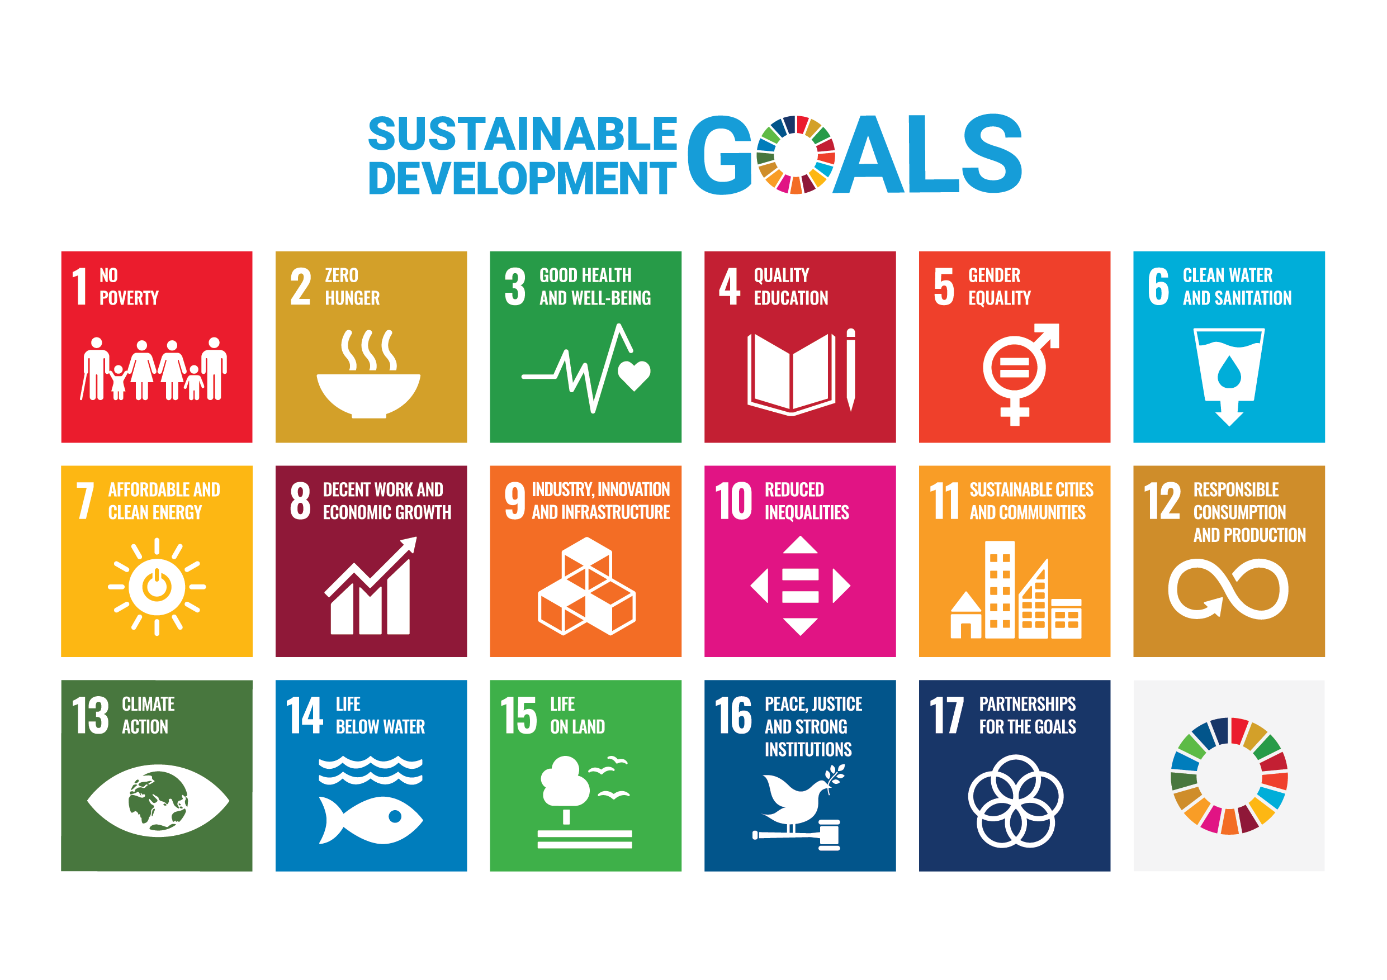
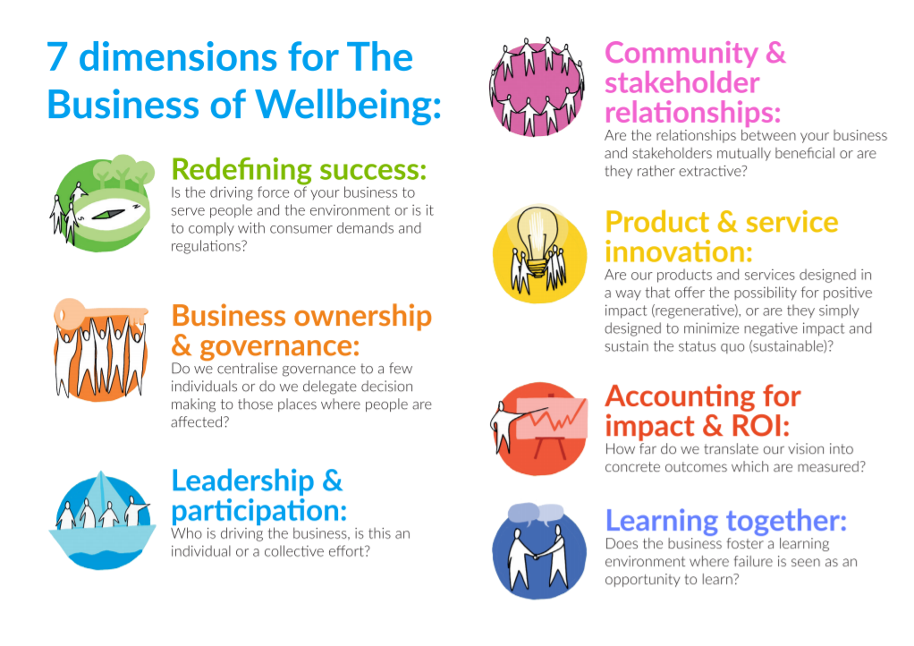

Other Frameworks/ Shared Value platforms/Aligning Metrics?
Wellbeing Economy Alliance
National Performance Frameworks
Community Wealth Building
UN17 SDG’s
BCorp
Notes:
Not needed

Slide 40
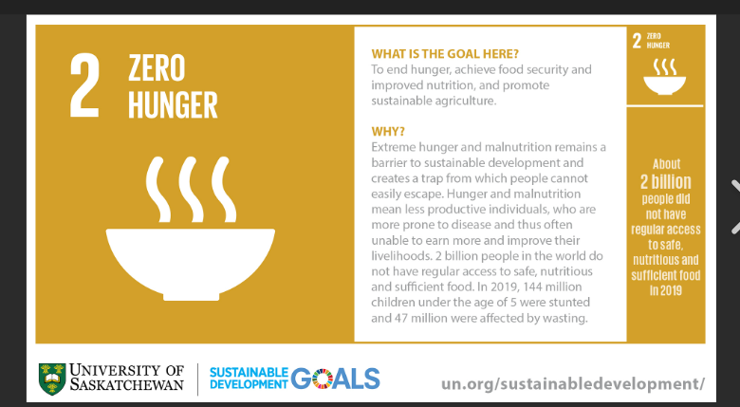
How many of you attend a foodbank?
Here is an example for using a framework to drive strategic decisions and shared values?
Large organisation 5000 staff 25,000 users, >225000 past users
What could you measure?
What information would this support?
What are possible solutions?
Why would they not do it?
Is there a strategic shared approach with stakeholders?
Thinking of many frameworks- but in particular where is the imbalance in power, urgency and legitimacy?

Slide 41
The SDG Cake or
The SDG Wedding Cake!
SDG Impact Assessment Tool
“supporting the process of prioritisation”
The SDGs wedding cake - Stockholm Resilience Centre
Photo creditAzote for Stockholm Resilience Centre, Stockholm University CC BY-ND 3.0:

Slide 42
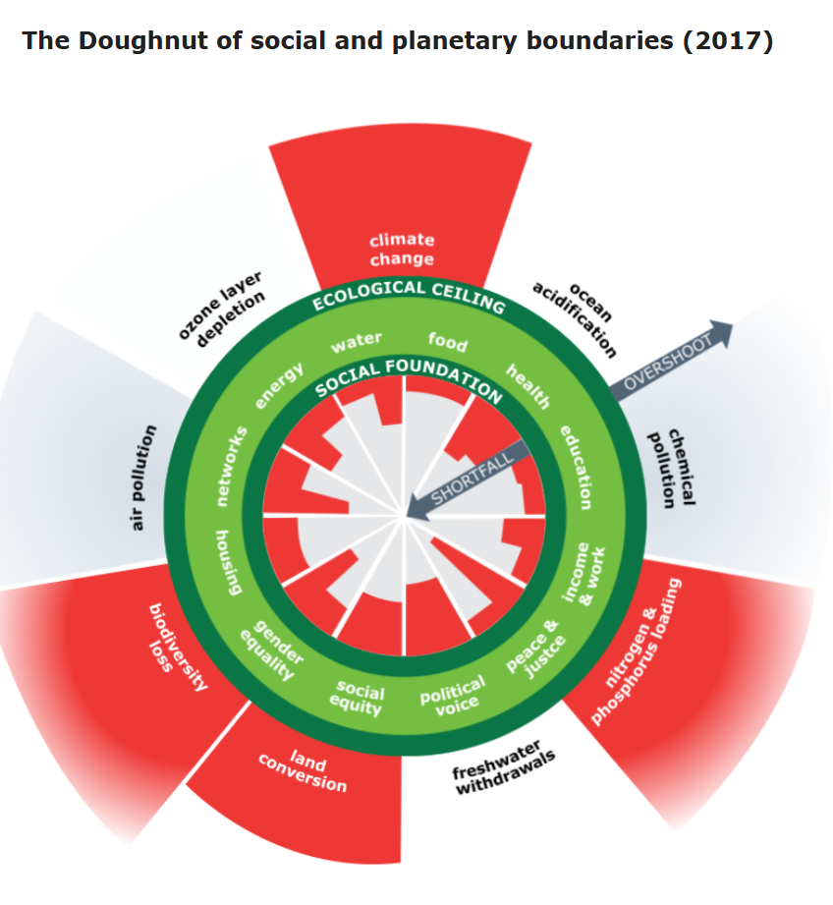
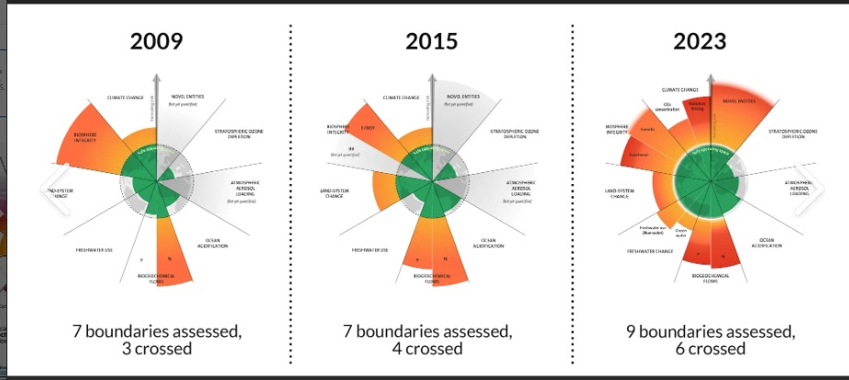
How the Dutch are reshaping their post-pandemic economy - BBC REEL

Slide 43
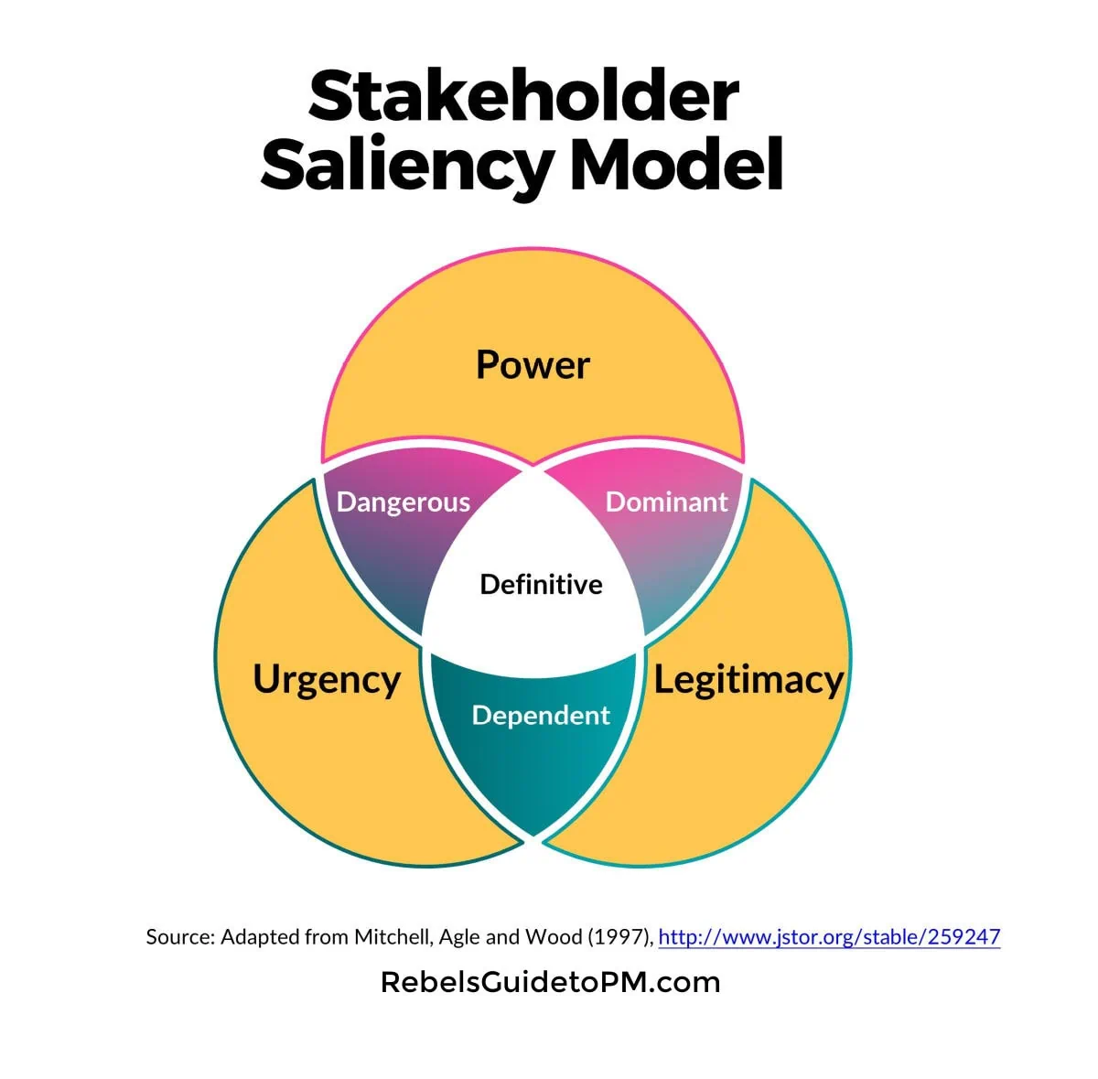
Group activity
Map all the stakeholders you have in the college- one post it note per stakeholder- use colours to separate where possible.
Now do the same for the ‘SME’ Construction Company (name it!)
Which stakeholders are also customers?

Slide 44
So How Do We Make This Happen In Our Organisations?

Slide 45
Revenue Models
How do you bring in money?

Slide 46




Revenue models for digital offerings
Digital intermediary platform model (such as sharing/gig economy platforms) have been able to cut operational costs by facilitating a distributed workforce = easier to scale
Freemium / feature release
The basic version of an offering is given away for free in the hope of eventually persuading the customers to pay for the premium version. The free offering is able to attract the highest volume of customers possible for the company. The generally smaller volume of paying ‘premium customers’ generate the revenue, which also cross-finances the free offering.
Transaction fee / commission
Pay per transaction = less commitment
Works well for services that allow customers themselves to generate revenue (transaction fee is relative to their income) e.g. double-sided models and intermediary platforms
Notes:
The freemium offer has to be suitably useful - Dropbox did it with storage limits

Slide 47



“If you are not paying for it, you're not the customer; you're the product”
Various
“Free’ is not a business model”
Bill Aulet

Slide 48





Revenue models for digital offerings
Gamification – in app purchases?
Building loyalty, FOMO, large user base, levels…-upselling happens in the physical world too…

Slide 49


Non Digital Revenue Models
Consumables- Grocery; Coffee pods; ink cartridges
Subscriptions- Vitamins; Grocery; Streaming Services
The basic product is cheap or given away for free.
Notes:
Vicky

Slide 50
REMINDER:
Consumables: example…now also have to consider how this contributes to overall sustainability?

Slide 51




How does construction workers get paid?
Is there a new way?

Slide 52

Boosting basic revenues-and what are the loss leaders?
Thinking about the cost responsiveness Framework which includes Speed, Quality, Flexibility, Dependability & Cost…You don’t need to excel on all 5 dimensions!
Where do your customers expect you to be?
What other tool could you use?
Budget Airline
Luxury Airline
Cost Responsiveness Framework: The Cost Responsiveness Framework: Driving Business Growth in a Competitive Market - FasterCapital

Slide 53
Budget Airline
cost
Operations Strategic Decisions
Speed
Dependability
Market Requirements
Low prices
Reliability
Basic service
Stripped-down service
Cheap airport locations
Fast turnaround
Regular service
Add on costs
Quality
Flexibility

Slide 54
Luxury Airline
“Travel isn’t just about the destination it’s how you get there”
Operations, Strategic Decisions
Market Requirements
Privilege
Intimacy
Convenience
cost
Luxurious service
Bespoke service
Personal touch
High cost
Experiences
Speed
Dependability
Quality
Flexibility

Slide 55
CUSTOMERS - what if the pain or the gain you are solving?
Understanding what your customers likes and dislikes are alongside knowing where your costs needs to be and increasing responsiveness- another way to think about what you can eliminate or add to your value proposition
(499) Ryanair Challenge: How would you make money if your business model is free? - YouTube
When do you want a Hot Dog or a Greasy Burger?
at a football game vs during a corporate lunchbreak?
Watch this video and then discuss in your groups what revenues could be like- for the college and for the MA employers. So what are the skills that we can all learn to develop revenue diversity?

Slide 56
How do I price?
Once you’ve figured out how your revenue models fit in your value proposition, how do you price your offering?
Notes:
Wendy

Slide 57
Three approaches to pricing an offering
Cost-based pricing- straightforward…?
Competition-based pricing
Value-based pricing
The answer is usually somewhere in between!

Slide 58
Which is why knowing your customer becomes really critical!
Describe a situation where price does not influence your choice?
Natural tendency of customers to use price as a signal to interpret quality
Low price = cheap / low value
Price not always the pivotal factor
  E.g. furniture: design more important than price
  Lower prices may not increase sales
Competitors will react to your low prices
  Risk of a price war with industry giants
Only offer lower prices than your competitors if your costs are lower
Tight profit margins = less room for error
New companies unlikely to have the economies of scale to reduce costs
Low profit margins mean low cash cushion
  - Limited investment/ innovation
Cost increases hard to implement
  - Low prices attract disloyal bargain hunters
  - Can alienate customers

Slide 59

Cost-plus pricing – are you future fit?
Demonstrating a unit cost with integrated fixed costs
This is a credible approach for this product because the actual direct material cost of coffee is low compared to the fixed costs (premises, staff)
When considering sustainability in each of these layers what might increase?
And where in the image can things be improved? And what would be the double materiality- think penguin biscuits?
What happens when the person serving isn’t aware of the price of the raw materials?
Alternative Materials
Cup & lid=12p
Coffee beans:36p
Milk= 29p
Staff 69p
Rent 27p
Utilities 12p
Tax 0.30p
Waste?
Total 2.15 /2.58
62p profit =
484 coffees
gives £300 profit= 100 coffees per day
Upselling
Notes:
Cups stirrers napkins- own coffee cup- see why its not important to the retailer?

Slide 60
Competition-Based Pricing- what is the market paying and why?
Uses competitors’ prices for similar products/services. Benchmarking against this
Market-driven instead of cost-driven
Might be difficult to do in low-competition market spaces (not much to compare to)
Consideration given not only to what competitors charge, but how customers expect to pay
Example of Day Rate-disrupting industry expectations
Eliminate:
Excess high margin 3rd party disposal
Transparency in pricing:
Raise:
Reporting format
Customer service and engagement- through continuous feedback
Is there a market leader in your sector? If so, use this as a starting point for comparison.
Identify other direct/nearest price competitors to benchmark against
What pricing strategies are they using?
Determine what position to pursue relative to competition
Reduce:
Repeat routine maintenance – share infrastructure maintenance solutions:
Create
Digital platform for CCTV
Future Proofing of infrastructure design
How To Scan Your Business Model Environment For Disruptive Threats And Opportunities

Slide 61

Value based Pricing
Presenting different service packages:
Claude AI
Influencer- construction costs Customer service
Real living wage- what decisions what strategy do you employ?
My carbon Literacy- lunch – follow up integration

Slide 62
Activity: Developing new opportunities for your SME
In your Groups:
Complete the BMC- Right hand side
Develop new Value Proposition- if necessary
Identify what value / pain or gain you are solving for your chosen customers
How will you find them - where do they hang out
What is your relationship and messaging
What is the Total Available Market
What are likely revenue models
What does this allow you to improve on
Where are the Eco-social benefits and do these link to PESTLE outputs
Tools You Have
Value Curve ERCR
Customer persona's
PESTLE
Value Pyramid
Cost Responsiveness
Pricing Models/ Subscriptions
Saliency Model
BMC
FEED BACK TO THE ROOM USING THE BMC AND REFERENCING HOW YOU GOT TO THESE ASSUMPTIONS

