Slide 1

Making Stratospheric
Change Strategically Circular

Slide 2
Building operational excellence & what it looks like from a young persons perspective
EiR- Session 5
South Lanarkshire/ Ayrshire and Dumfries & Galloway colleges

Slide 3
Top 10 Golden Rules!
What did your research find out?

Slide 4
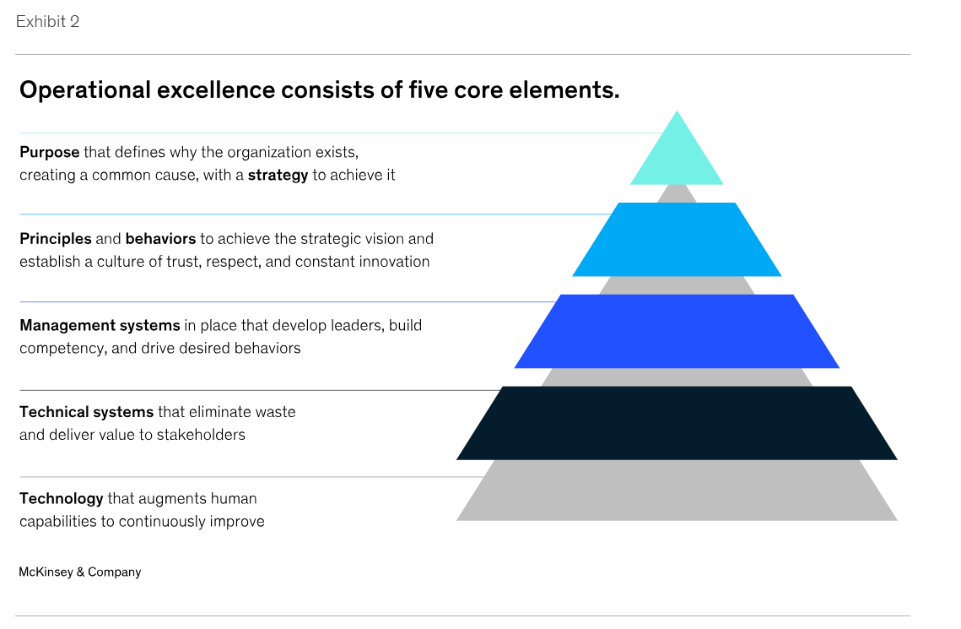
What Is Operational Excellence? | IBM
The future of operational excellence | McKinsey

Slide 5
WORD SALAD-OPERATIONAL EXCELLENCE!
STARTS WITH A CULTURE SHIFT
You can’t improve what you can’t see…?
Why would you want to maximise value?
Keep going…
Lean manufacturing
Toyota Production System
Kaizen
Muda
5S –Sort Set in Order Shine Standardise Sustain ( Red tag!)
JIT
Value Stream Mapping
TIMWOODS
Kanban
Circular Economy
Life Cycle Assessment
Continuous Improvement
14001:2026
Digital Twin
SMART
Plan-Do-Check-Act
4D’s
Triple Bottom Line….and so on!
Systemic customer centric approach to maximising value
Industrial system aimed at eliminating waste by designing for reuse repair refurbishment
To eliminate non value add activities- customer service think about that…?
Cradle to grave methodology used to evaluate the environmental impacts of a product process or service- raw material extraction to disposal.
Notes:
Smart=specific measurable achievable relevant time bound Do diarise delegate and dump TIMWOODS- transportation Inventory Motion Waiting Overproduction Overprocessing Defects Skills- unused

Slide 6
Process Mapping/ Value Stream
Before we blame people, lets look at the process they are trapped in”
Map the process of making and selling a hot drink in your groups.
Write the steps to making a hot drink- as many as you can think of- 10 minutes- so anyone can take up the task
Now making the same hot drink using only 5 steps- 2 minutes
This dad follows his kid's PB&J sandwich instructions very literally
While watching this – write down aspects of this that could be a challenge on site/in a business?

Slide 7
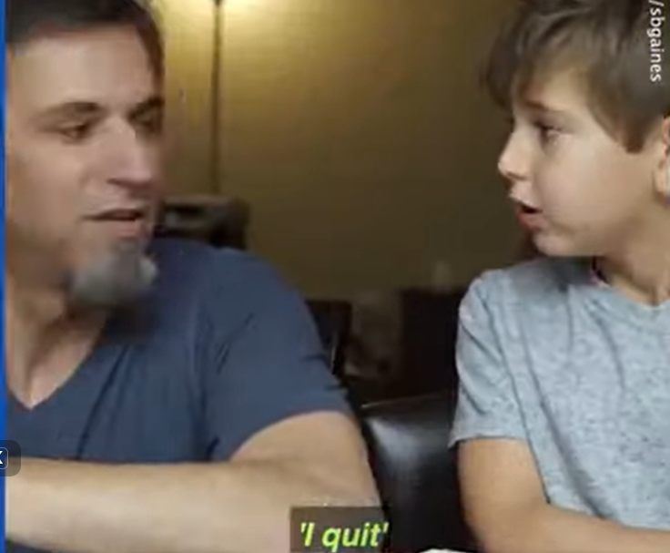
Same Task. Different Outcomes. Chaos Ensues.
Everyone was trying to do the right thing
Nobody agreed what the process actually was
Assumptions filled the gap
When work isn’t made visible
Steps get missed
People wait, redo or workaround
Effort increases- results don’t
This is why process tools exist
Not to complicate things
To make flow visible and shared
Skills alone aren’t enough- people also need to understand how work moves
When we teach apprentices just the skill, we prepare them to cope. When we teach them how the work flows, we prepare them to improve

Slide 8
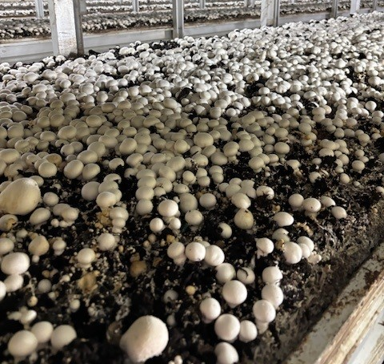
Real Life Tangible Improvements
Process Mapping small processes- value stream mapping takes us beyond our individual silo.
Maintaining Efficient Sustainable Growth
= 2 years improved river quality

Slide 9
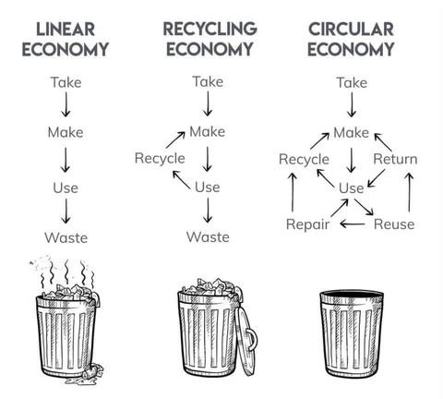

Sustainability as an improvement strategy…
“The circular economy is a system where materials never become waste and nature is regenerated.” Ellen MacArthur Foundation
4.
2. Transformation Activities
1. Inputs
3. Outputs
5.
Feedback / Circular Loop:
Repair, recycle, re-use, return, fair pay, data, etc...
The Circular Economy | Definition & Model Explained | Ellen MacArthur Foundation
FinalStraw

Slide 10
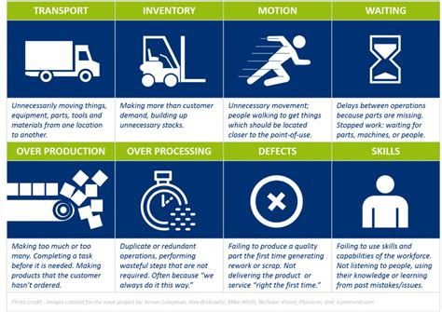
Session 7 *
OPERATIONS-ALIGNED WITH STRATEGY
PROCESSES
FLOW- VALUE STREAM MAPPING (VSM)
MONEY MONEY MONEY
MEASUREMENT
IMPLEMENTATION
DYNAMIC CAPABILITES
TIMWOODS
This is also a sustainability strategy- how do you showcase as a continuous improvement plan?

Slide 11
Another feedback loop…what happens if you don’t understand where your customer complaint exists in your process?
What are the processes surrounding these complaints?
What are the top 3 complaints from your customers or colleagues?

Slide 12
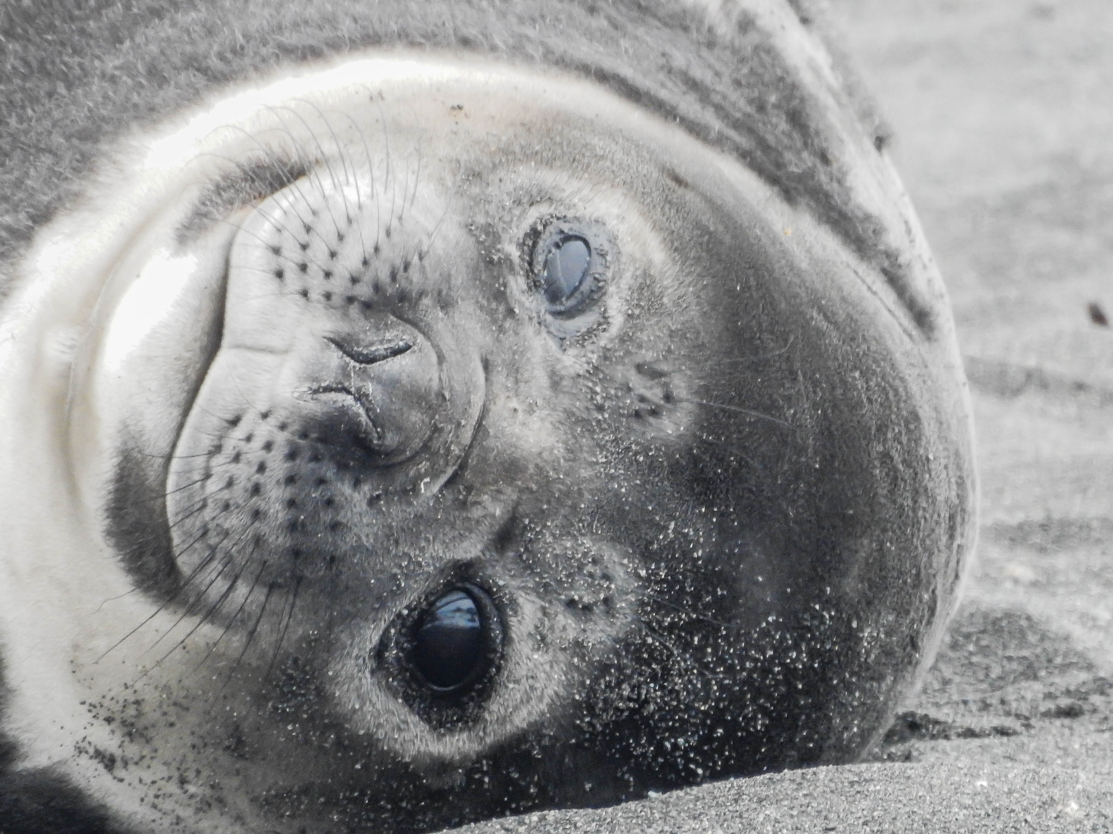
Feedback is a gift deliver it that way.

Slide 13
Value Chain Model- what one thing on here could be a measures of success?
Dynamic Capabilities
Managerial Capabilities
Operational Capabilities
Competitive Advantage Strategy
Proactive Top Team
Fast-Follower Technology Adoption
Requisite Agility / Innovation
Conceptualising Product / Service Offer
Targeted Marketing
Sales Effectiveness
After Sales Care
Profit Margin
Productive Ecosystem
Operational
Excellence
Operations are a key component of an Enterprise’s Value Chain
Comprehensive Performance Measures
Fit-For-Purpose Organisation
Can-Do: Will-Do Culture
Industry-Specific Assets
Dynamic capability is “the firm’s ability to integrate, build, and reconfigure internal and external competences to address rapidly changing environments” (David J. Teece, Gary Pisano, and Amy Shuen). ITS ABOUT CHANGE!
© The 14 Box Model is from Step-by-Step Competitive Strategy (2nd Edition) by D L Francis 2023 (in print). Based on an original model by Michael Porter.
Notes:
The presenter can introduce this Value Chain module by drawing attention to the need for all of the 14 key components to be effective, integrated and effective, so as to provide the range of dynamic, managerial and operational capabilities that are needed to compete effectively and provide an adequate profit margin. Drivers of Dynamic Capabilities are (1) a clear strategy for gaining competitive advantage in market segments that can provide an adequate profit margin; (2) a capable and proactive top management team that has all of the competencies required and works together effectively; (3) policies to adopt helpful technologies early so as to gain full advantage from them and (4) the capacity to be agile and innovative in ways that are beneficial or requisite. Drivers of Managerial Capabilities are (5) performance measures that enable managers to ‘take the pulse of the company’ quickly so as to recognise problems early; (6) an organisation structure that is capable of performing all of the tasks required; (7) a culture and achievement-orientated capability to welcome and effect change; (8) the necessary hard and soft assets needed to be able to be competitive in the relevant industries and (9) having a supportive ecosystem (suppliers, logistics, advisers, specialist services, partners etc.) Drivers of Operational Capabilities are (10) the capability to create ‘winning’ products or services; (11) competence in making the products or services offered; (12) marketing that conveys the superiority of the offers of the enterprise; (13) an ability to win profitable sales and (14) care taken to ensure that customers get good value from their purchases. The overall aim is to make a superior profit margin shown as an arrow head.
Many of the components of this version of the Value Chain module have been covered in Help to Grow. For example:
Direction and Competitive Strategy – Module 1
Technology Adoption & Utilisation – Module 2
Marketing – Module 4
Value Proposition – Module 5
Organisation – Module 7
Finance & Management Metrics – Module 11
Further reading
Porter, M. E. (1985) Competitive Advantage: Creating and Sustaining Superior Performance. New York: The Free Press.
Scuotto, V. et al. (2020) ‘A repositioning organizational knowledge dynamics by functional upgrading and downgrading strategy in global value chain’, Journal of International Management. Elsevier, 26(4), p. 100795. doi: 10.1016/j.intman.2020.100795.

Slide 14
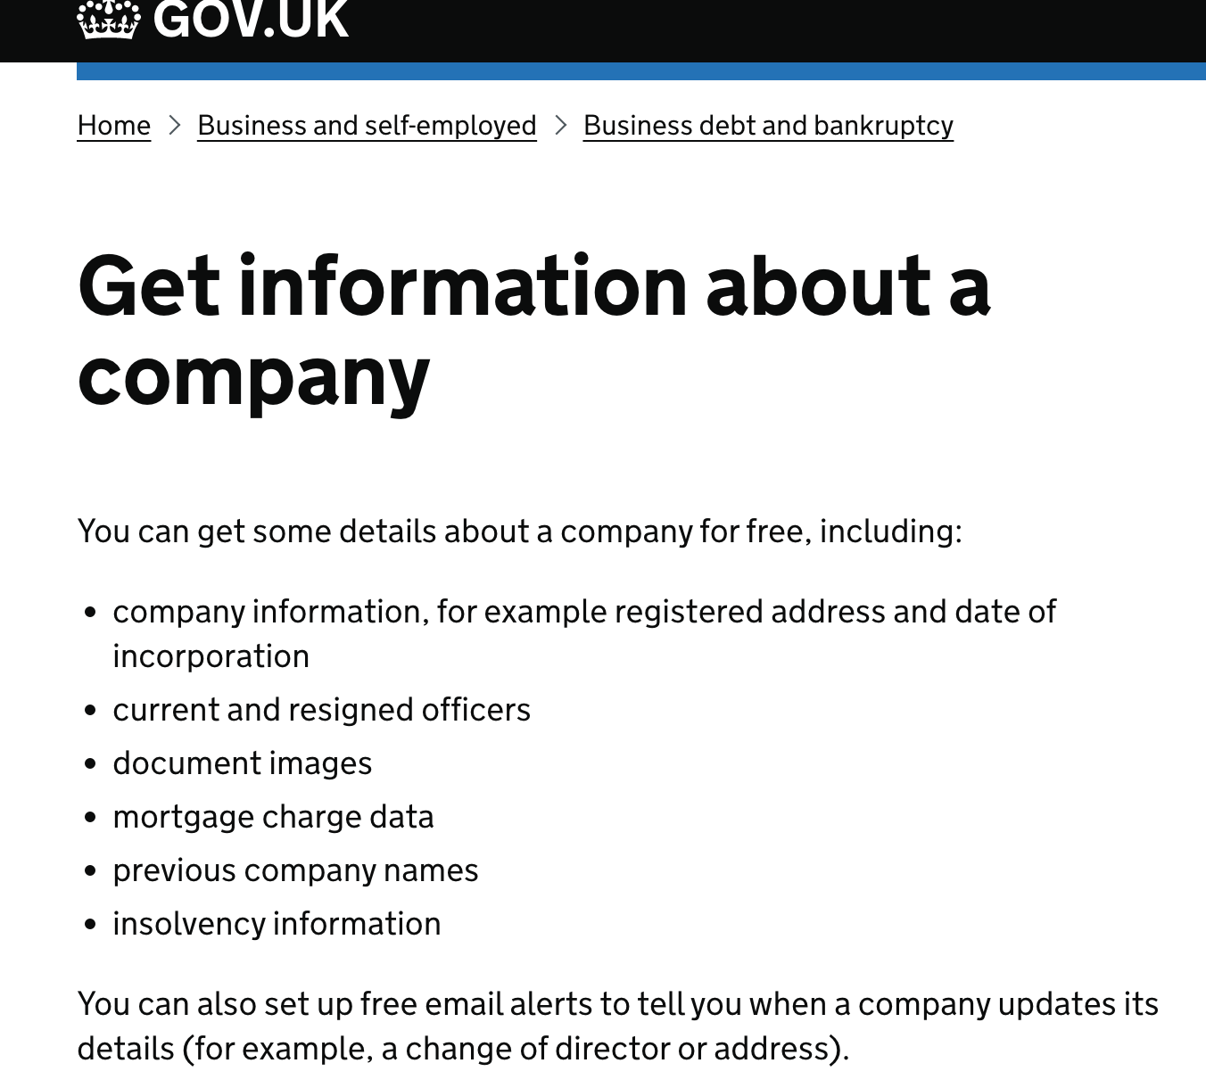
Checking your Supply Chain- upstream and downstream
Where can you go to check out a company's financial status?
Does it matter who the directors are?
Where can you check the sustainability credentials at the same time?
What do you do if you think there is a problem with directors?
Why do you think people don’t check these details?

Slide 15


Slide 16
FUTURE OPERATONS MANAGEMENT
What Changes in Operations Management Will Affect Companies like Yours?
- What is Possible?
Take a few minutes and imagine that it is 7 years in the future. Which of the Change Drivers listed below may significantly change your Operations Management?
Advanced Robotics replaces skills from driving vehicles to painting rooms.
Artificial Intelligence replaces many forms of intellectual labour.
Biometrics Identification makes it easier to verify individuals’ identity.
Blockchains provide comprehensive, cheap, transparent record keeping.
Cloud Technologies make sharing and storing information far easier.
Hybrid Collaboration enables people to work effectively in offices or elsewhere.
Internet of Things provides the information for a revolution in making systems smarter.
Mobile Internet enables people to work and communicate from anywhere
Virtual Reality enables people to be present without being co-located.
3D printing replaces spare parts and speed prototyping and building.
Notes:
The presenter can give comments on these 10 areas (see notes below)
Advanced robots use smart sensor technologies to interact with the real world and make decisions based on the circumstances of the moment.
Artificial Intelligence enables a machine to learn from experience and adapt its behaviour. For example, analysing patterns in large amounts of data for making predictions about future states.
Biometrics Identification allows individuals to be identified by machines from their physical characteristics.
Blockchain provides greatly enhanced traceability and integrity so participants in a chain can confirm transactions themselves.
Cloud Technologies enable multiple users to access (and sometimes amend) the same data.
Hybrid Collaboration permits people to interact together even though some may not be physically present.
Internet of Things enables items such as equipment, products and appliances to share information and become ‘smart’, perhaps taking decisions without human intervention.
Mobile Internet permits people to have access to internet services wherever they are.
Virtual reality uses computer technology to create simulated environments that enable people to interact with others and with ‘objects’ remotely.
Advancements in technology can help businesses become more sustainable, especially in operations.

Slide 17
WHAT CAN A FINANCIAL / NON-FINANCIAL DASHBOARD LOOK LIKE?
What are you measuring?
What then is success if its T/O as a metric?
Does a T/O of £100k impress you?
What impresses you as a financial metric?
What else is a good measure of success and how would you measure it?

Slide 18
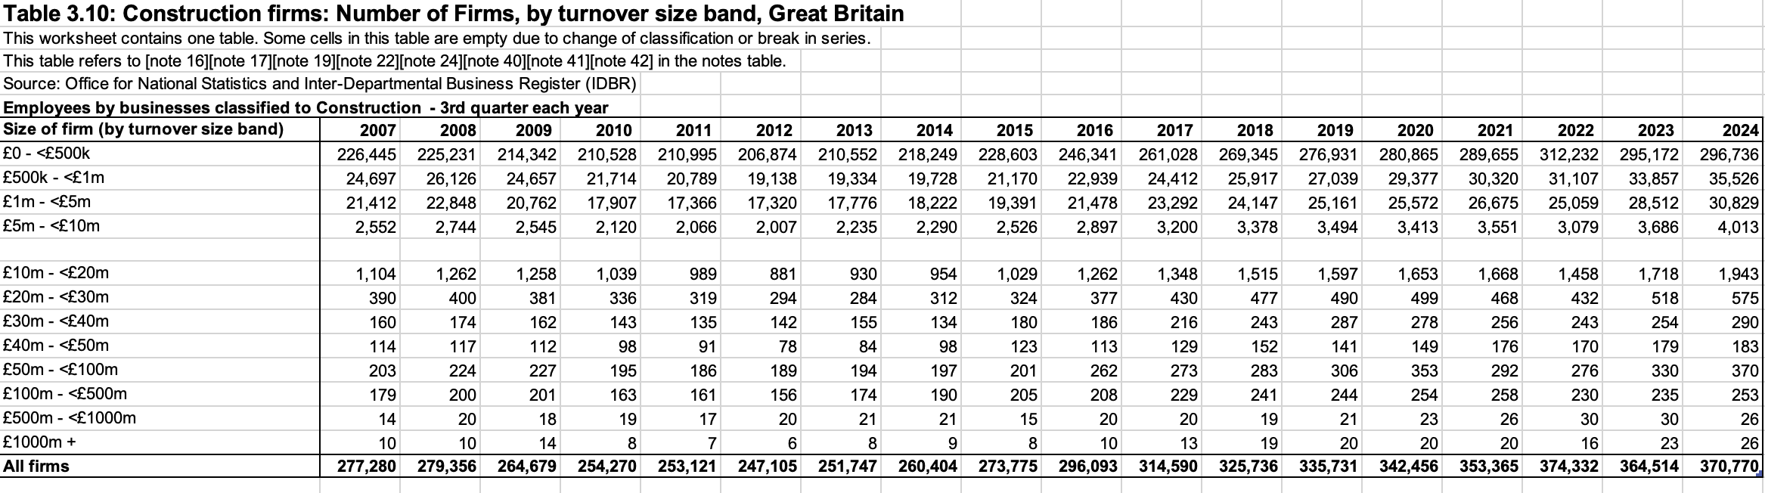
Construction Firms by T/O: 99% of businesses have a turnover of less than £10M
Construction firms by T/O < than £500,000 = 80%
Construction Firms by Employee: 60% <24 employees or 18.6% have more than 300

Slide 19
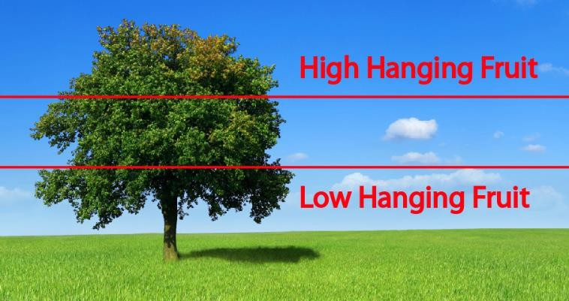
Why do efficient and effective processes matter? Let’s discuss options increase sales- reduce costs and refine operational excellence- which yields the greatest return for the same effort – BUSY FOOL ☺?
Finance/ Accounting Option
Marketing Option
OM
Option
Increase Sales Revenue 50%
Reduce Finance Costs 50%
Reduce Production Costs 20%
Current
Sales | £100,000 | £ 150,000 | £ 100,000 | £ 100,000
Cost of Goods | – 80,000 | – 120,000 | – 80,000 | – 64,000
Gross Margin Finance Costs | 20,000 – 6,000 | 30,000 – 6,000 | 20,000 – 3,000 | 36,000 – 6,000
Subtotal Taxes at 25% | 14,000 – 3,500 | 24,000 – 6,000 | 17,000 – 4,250 | 30,000 – 7,500
Contribution | £ 10,500 | £ 18,000 | £ 12,750 | £ 22,500

Slide 21
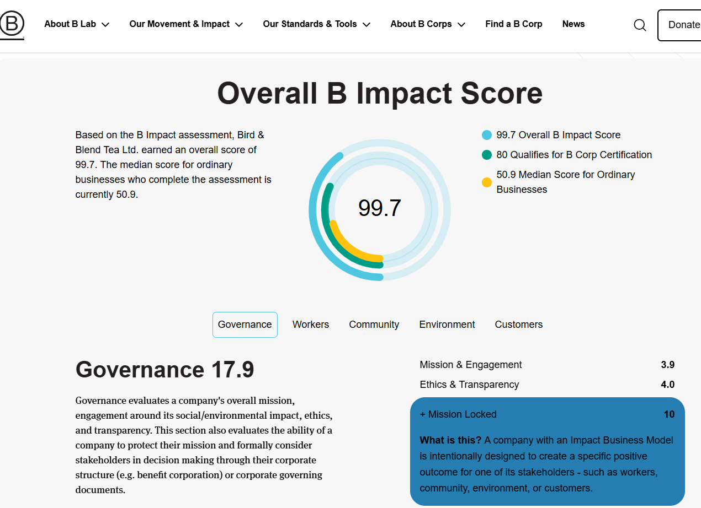

Slide 22
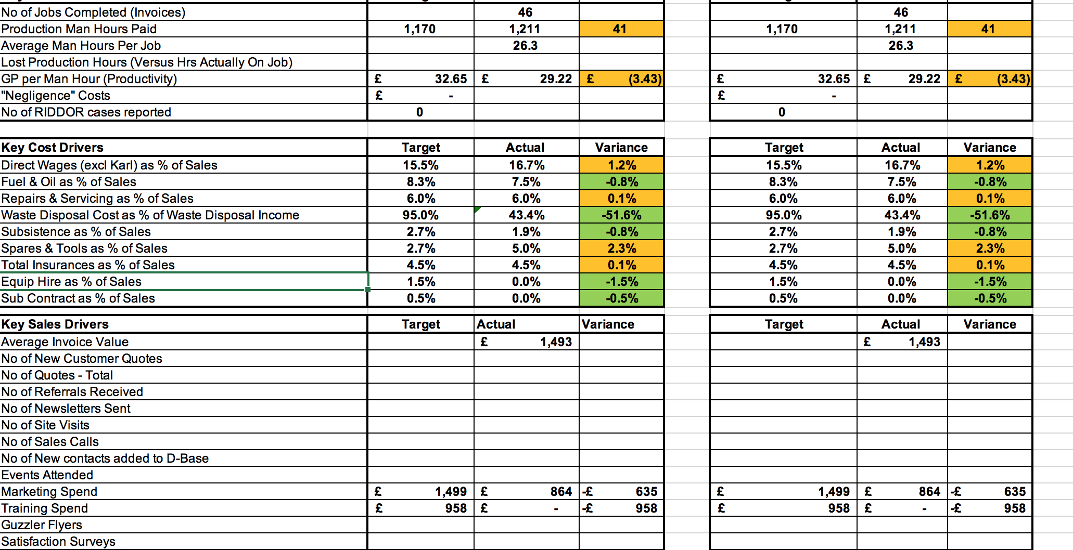

Slide 23
The SDG cake!
Localising SDGs
What is relevant or not relevant and how can you start to embed these objectives and motivators in your business model?
©TWF2045

Slide 24
Finally…when we talk about greening your supply chain or making it more lean …what do we really mean?
There are four distinct elements that typically make up your Supply Chain.
These are Integration, Operations, Purchasing & Procurement and Distribution & Logistics. Lean thinking can be applied to every element.
Lean Supply Chain
In Lean supply chain management, the focus is on the relentless elimination of non-value added time and consequent reduction of lead time at every step of the supply chain from the manufacturing of raw materials by suppliers to the delivery of finished goods to the end user.
Green manufacturing
Green Manufacturing is a method of manufacturing that minimizes waste and pollution. Lean manufacturing is the system which aims in elimination of the waste from the system with a systematic and continuous approach.
https://txm.com/what-is-lean-supply-chain-management/

Slide 25
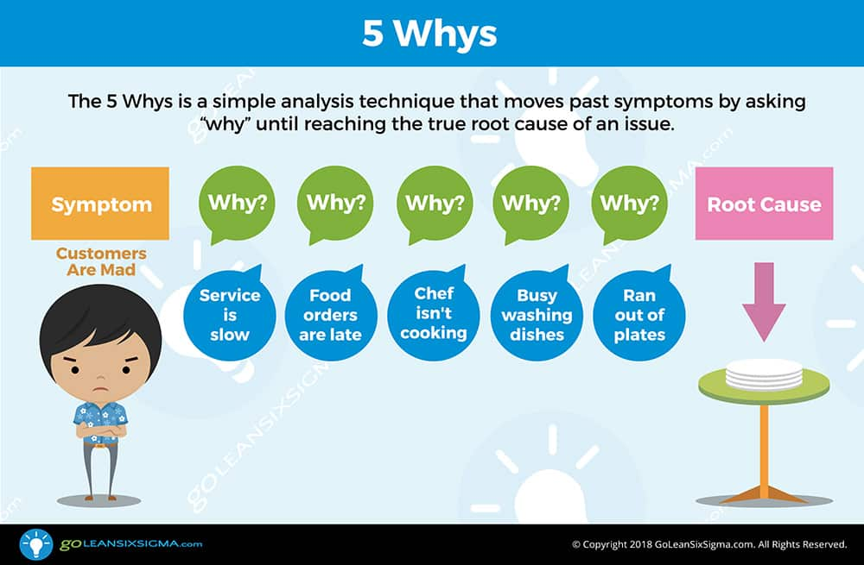
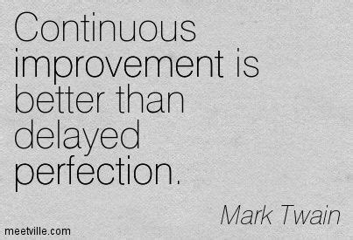
Money is like gasoline during a road trip. You don’t want to run out of gas on your trip, but you’re not doing a tour of gas stations.” — Tim O’Reilly, founder, and CEO of O’Reilly Media

Slide 26
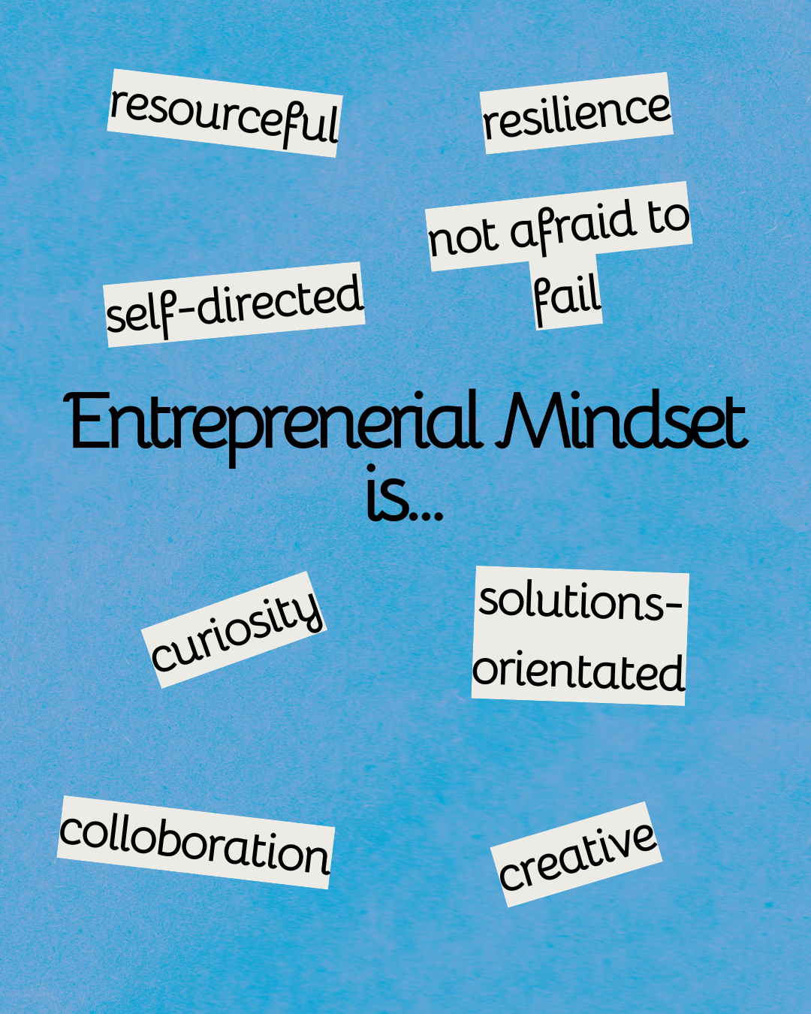
An entrepreneurial mindset is resilient, resourceful, and solutions-oriented — even when the conditions say otherwise. People with these mindsets are lifelong knowledge-seekers who are curious and creative, and they are critical thinkers, Barrett said.
“They're self-directed, action-oriented, highly-engaged,” Barrett said. “They have optimistic interpretations of adverse events” and see problems as potential opportunities.
“They're about looking to others, and the value you can create for others by solving problems for others, and they surround themselves with an intentional community of positive influence and critical guidance,” Barrett said.
Entrepreneurial mindsets understand that pursuing and following through on something can lead to unforeseen opportunities.

Slide 27
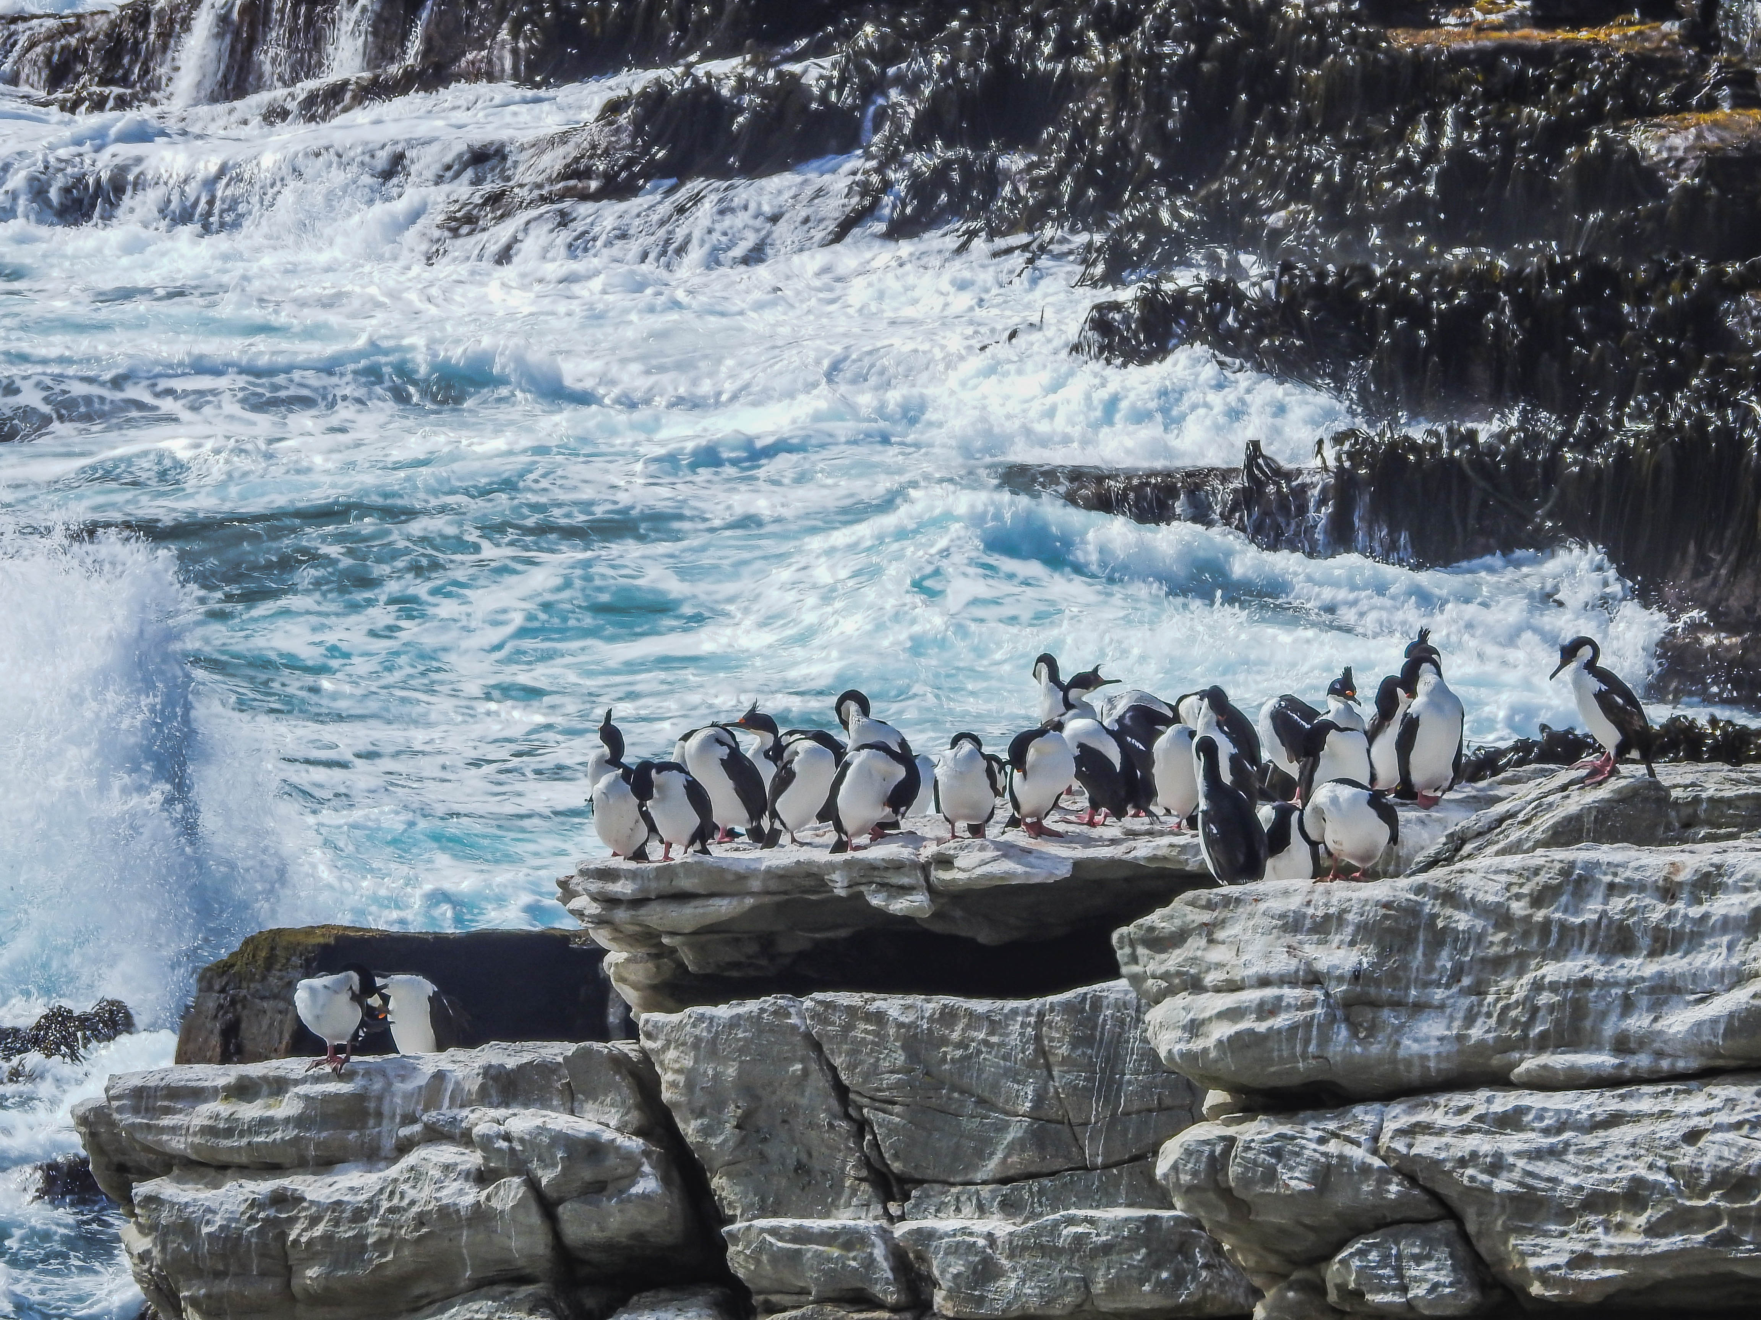
Activity
Today we have a Playbook to work through with outputs to be shared across the class
Each section on the playbook has indicative times associated with it – so we can see achieve a completed output
These sections are clearly marked for individual and group tasks- this is not an exam- however be mindful that some prefer silence when under pressure to deliver value!

