Slide 1

Making Stratospheric
Change Strategically Circular

Slide 2
Customers:People:Innovation:Resilience
EiR- Session 6
South Lanarkshire/ Ayrshire and Dumfries & Galloway colleges

Slide 3

Agenda for Today- Final Session 6
PART 1-HOW OTHERS DO IT
Customers are key!
BMC revision & Value Proposition Canvas Plenary
Create a strong BMC- future facing
Break
PART 2- HOW WE DO IT?
Money Money Money!
Building a Future Fit Business Model
PRESENTATIONS & GRADUATION
10-15minutes and Q&A
Final Ceremony & Pledges

Slide 4
HOW OTHERS DO IT
What is the concept behind a concept store?
A concept store is a shop that sells a carefully curated and unique selection of products that connect to an overarching theme.
Often they evoke a lifestyle that appeals to a specific target audience – they are inspirational. Handpicked products are pulled together from different brands and designers, and they usually span different lines, such as fashion, beauty and homewares. In addition, the display mixes these lines and products together in an attractive fashion.
Concept stores are about discovery and experience. So the products and design tend to change regularly to keep telling that story in new and interesting ways.
Many of them offer extra experiential elements such as a café or events space, which help build a community around the lifestyle they embody.
GYMSHARKS CUSTOMER EXPERIENCE
What do their customers want?
What problems is Gymshark solving for their customer?

Slide 5
How others do it?
Gymshark Discussion
Do they have a strategy?
Are they living their values?
How has the structure of the company had to change?
Money & People – whats his view?
Whats unique about his customer onboarding and retention.

Slide 6
REFRESHER: THE BUSINESS MODEL CANVAS
Your value proposition can be a full company value proposition or a project; a new development.
Alignment with company values and growth should be consistent
https://www.lucidchart.com/blog/quick-and-dirty-guide-to-the-business-model-canvas

Slide 7
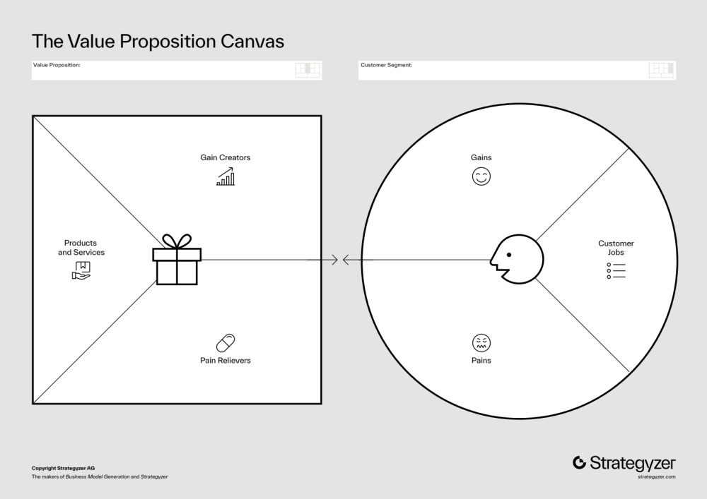
The Value Proposition Canvas fits in to the BMC very neatly- it’s a different tool to go more in depth with what your are offering and why your customer will buy it!

Slide 8
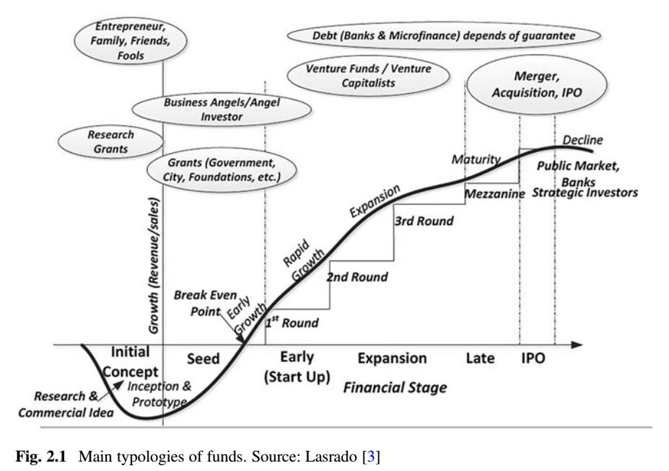

Slide 9




Our Goal: Transform the banking system in alignment with decarbonizing the economy, staying below a 1.5°C global temperature increase, and creating the conditions for resilient ecosystems and the societies and economies within them
https://www.climatesafelending.org/
Our banking and financial services are for individuals and organisations who want to change the world for the better. As one of the world’s most sustainable banks, we have over 740,000 customers who are already playing their part in our positive movement.
https://www.triodos.co.uk/
The UK’s largest angel syndicate of investors committed to fighting climate change
Climate change is both the biggest threat and the biggest investment opportunity in history. Green Angel Syndicate members use our specialist backgrounds and experience to select and invest in the best companies with the technologies and systems needed to fight climate change.
Is your money being used to fund climate chaos?
https://bank.green/sustainable-eco-banks
https://greenangelsyndicate.com/

Slide 10
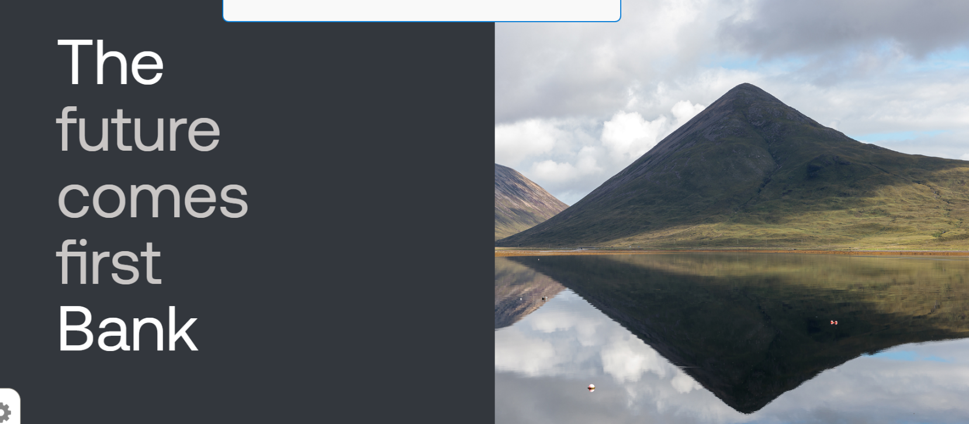
The Bank was launched in November 2020 as a development investment bank for Scotland, delivering patient, mission impact investment to the Scottish economy.
The Bank provides patient (long term) capital to businesses and projects throughout Scotland to support the development of a fairer, more sustainable economy.
The Bank's ambition is to not only invest its allocated public capital, but to encourage additional private capital to invest alongside it, to support the delivery of our missions.
You have to have been refused finance TWICE- before they give you money-what does that tell you?
https://www.thebank.scot/

Slide 11
Part 1
Parc Construction:
Building your Value Proposition
Build your BMC-30 minutes

Slide 12
BREAK (15 minutes)

Slide 13
PART 2- How do we build on this to maintain our customer solutions
Who are your partners who needs to be aligned with you in synch with you?
Colloboration - what is needed?

Slide 14
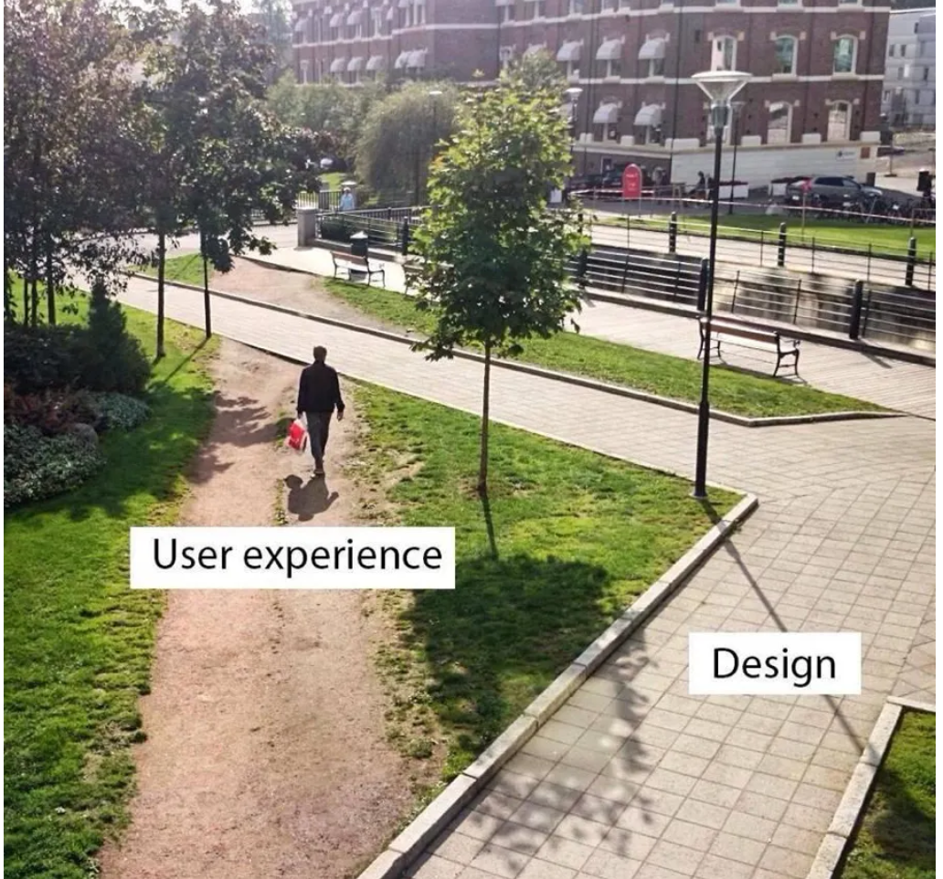
What part does the construction industry play?

Slide 15
You Were Selected
Because You're Ready.
Now go build something brilliant.
· Apprentice to Asset 2026 · The Way Forward 2045

Slide 16
Thank you and Congratulations!
For being part of the Pilot Programme to build capacity into the college curriculum!
Apprentice to Asset!

