Slide 1

META-PRENEUR | SESSION 1
COMMUNITIES PEOPLE & SOLUTIONS
WELCOME, INTRODUCTION
HOW PEOPLE IN SCOTLAND MAKE A DIFFERENCE
META-PRENEUR | Session 1

Slide 2







TODAY'S 2-HOUR JOURNEY
0:00
Welcome
0:50
☕ Break
0:10
Introduction to Meta-preneur & 12 Meta Skills
1:00
Over to you – about you
0:25
What is a Community – real problems communities face
1:10
META Skills in action – Real Communities, Real Problems, Real Solutions
0:40
About Me (The Lecturer)
1:55
Reflection & Close
META-PRENEUR | Session 1

Slide 3
TODAYS SESSION
In this session you will:
Read about real places and real people in Scotland
Talk about problems and solutions
Share your own experiences and ideas
You do not need to know about Scotland to join in.
Your experience from your own country is valuable here.
META-PRENEUR | Session 1

Slide 4











THE 12 META-SKILLS — SDS SKILLS 4.0 FRAMEWORK
Timeless, higher-order skills that help you adapt and succeed — whatever the future brings.
SELF-MANAGEMENT
SOCIAL INTELLIGENCE
INNOVATION
How you manage yourself
How you connect with others
How you generate new ideas
Focusing
Communicating
Curiosity
Diagnosing faults methodically
Plain-language customer explanations
Asking why a fault keeps recurring
Integrity
Feeling
Creativity
Being honest about job costs
Reading a stressed customer
Finding a workaround when the fix won't work
Adapting
Collaborating
Sense-making
Changing plan when parts unavailable
Sharing a complex job with a colleague
Reading diagrams to build the full picture
Initiative
Leading
Critical thinking
Flagging a safety issue unprompted
Stepping up when the supervisor is off
Weighing repair vs replace options
META-PRENEUR | Session 1

Slide 5
KEY WORDS – IMPORTANT VOCABULARY
Community
Charity
A group of people who live in the same place or share something in common
An organisation that helps people and does not make a profit
Organisation
Solution
A group of people who work together for a purpose
A way to fix a problem
Volunteer
Initiative
Someone who works without being paid, to help others
Doing something helpful without being told to
Social enterprise
Mindset
A business that helps people or the community, not just makes money
The way a person thinks about things
META-PRENEUR | Session 1

Slide 6
WHAT IS A COMMUNITY? - COMMUNITIES IN SCOTLAND
2 DIFFERENT AREAS
West Lothian
A council area near Edinburgh
Towns: Livingston, Bathgate, Linlithgow
Around 185,000 people
Mix of housing, industry, and countryside
Livingston is a 'new town' – built in the 1960s for people from overcrowded cities
Many people moved here for work and a better life.
Scotland
Part of the United Kingdom
About 5.5 million people
Cities: Edinburgh, Glasgow, Aberdeen, Dundee
Known for: hills, lochs, history, and strong communities
Scotland has many people who bring new ideas and skills.
META-PRENEUR | Session 1

Slide 7
WHAT PROBLEMS DO COMMUNITIES FACE?
Every community has problems. This is normal. The important thing is how people respond.
Some common problems in Scottish communities:
Old buildings that need repair
People who feel lonely or isolated
Not enough money for services
People who cannot find work
Language barriers for new arrivals
Mental health problems
Lack of transport in rural areas
Quick question: What problems did you see in your home country? What about here in Scotland?
META-PRENEUR | Session 1

Slide 8
THINK AND TALK – PROBLEMS AND SOLUTIONS
What is one problem in your local area here in Scotland?
Is there a similar problem in your home country?
Who usually tries to fix community problems – the government, local people, or organisations?
Have you ever helped to fix a problem in your community? What did you do?
There are no wrong answers. All experiences are welcome.
META-PRENEUR | Session 1

Slide 9
KEY WORDS – IMPORTANT VOCABULARY
Problem solving
Curiosity
Finding a way to fix something that is not working
Wanting to learn and understand new things
Communication
Initiative
Sharing information clearly with other people
Deciding to do something helpful without being asked
Teamwork
Resilience
Working well with other people to achieve a goal
Being able to keep going when things are hard
Adaptability
Empathy
Being able to change when things are different or difficult
Understanding how other people feel
META-PRENEUR | Session 1

Slide 10
☕
BREAK
BACK SHARP
META-PRENEUR | Session 1

Slide 11
What if entrepreneurship isn't who you are… but how you learn, adapt, and respond?
META-PRENEUR | Session 1

Slide 12
ENTREPRENEUR JOURNEYS
META-PRENEUR | Session 1

Slide 13
Kirsty Thomson-Gillespie
Social Entrepreneur
Entrepreneur In Residence
Founder – The Circle
Founder – More Than Profit
META-PRENEUR | Session 1

Slide 14
KIRSTY THOMSON-GILLESPIE – SOCIAL ENTREPRENEUR
Background in Psychology and Academic Research
Over 20 years working in and with charities and social enterprises
Founded 2 social enterprises and a charity
Set up Along Came Kirsty (2012) and ACK Third Sector Consultants CIC (2013)
Founded The Circle (Circle Scotland CIC) in 2015, launched 2016
Merged 2 CICs in 2019; set up a charity to train social entrepreneurs in 2022
SCQF Level 7 Award in Social Entrepreneurship
Exec Director, Non-Exec Director, Advisory Board Chair & Trustee
Merged with Shopmobility Charity in 2023
Raised over £15 million in funding in career to date
Professor in Practice, University of Dundee School of Business
Entreprenuer In Residence (EiR) at West Lothian, Edinburgh and Forth Valley Colleges
META-PRENEUR | Session 1

Slide 15
ABOUT KIRSTY
I didn't grow up thinking "I want to be an entrepreneur"
I didn't have role models who ran their own business or social enterprise
I didn't set out to build organisations.
I was motivated by people, problems, and fairness
META-PRENEUR | Session 1

Slide 16







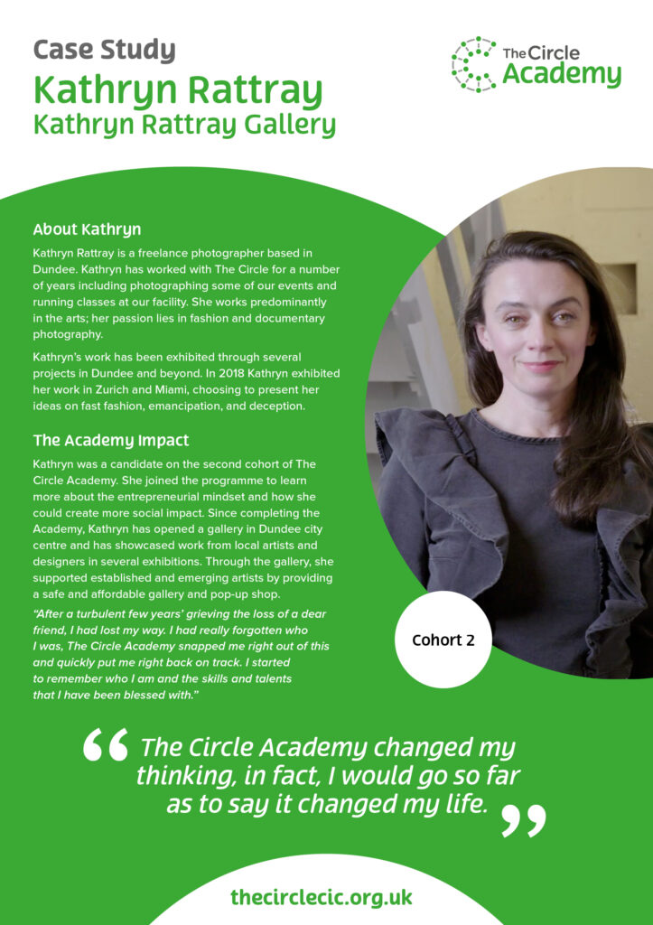
SQUIGGLY CAREER – Non-linear progression, continuous learning, individualised journeys, proactive ownership
.
META-PRENEUR | Session 1

Slide 17
CELIA HUDSON
HEY GIRLS – SOCIAL ENTERPRISE
META-PRENEUR | Session 1

Slide 18
CELIA HODSON OBE – FOUNDER HEY GIRLS
Founder of Hey Girls, a UK-based social enterprise focused on tackling period poverty and promoting menstrual health education.
The organisation was launched in 2018 and has become a prominent advocate for period dignity across the UK.
Celia talks about her passion for tackling period poverty stemming in part from her own experience of financial hardship. Stating how raising a family on benefits gave her firsthand experience of the difficultly that low-income families face in affording essential items, including menstrual products.
She has turned lived experience into a sustainable business model that addresses a major social issue.
She had a varied career before founding Hey Girls, including – working as an advisor to community businesses, cooperative development work, Social Enterprise expansion and lobbying, international projects in countries including India & Brazil.
The enterprise adopted a"Buy One, Donate One" model, where every product purchased helps provide another product to someone in need. The organisation combines product sales with education and advocacy to reduce stigma around menstruation and improve access to period products
Helped to create My period App – which helps people find free period products nearby
Celia Hodson has been recognized for her work with numerous awards and was awarded an OBE in 2024 for services to promoting period dignity and raising awareness of free period products in Scotland.
META-PRENEUR | Session 1

Slide 19
HOWARD SCHULTZ
STARBUCKS
META-PRENEUR | Session 1

Slide 20
HOWARD SCHULTZ – STARBUCKS
Grew up in a poor housing project in Brooklyn, New York, where his family struggled financially and his father worked low- paying jobs without benefits. He became the first person in his family to attend University.
Before Starbucks, Schultz worked in sales at Xerox and later became a manager for Swedish housewares company Hammarplast.
In 1982, Schultz joined Starbucks as Director of Retail Operations and Marketing. At the time, Starbucks sold coffee beans and equipment but did not operate as the coffeehouse chain we know today
A trip to Italy in 1983 proved transformational. Schultz was inspired by Milan's coffeehouse culture and envisioned creating similar community-focused coffee shops in the United States
When Starbucks' founders were reluctant to pursue his vision, Schultz left and launched his own coffee business, Il Giornale, in 1985. In 1987, with investor backing, he acquired Starbucks and merged it with his company – showing real vision and entrepreneurship.
Starbucks grew from a small regional coffee retailer into the world's largest coffeehouse chain. Starbucks expanded internationally and helped shape modern coffee culture worldwide.
One of his most influential ideas was creating Starbucks as a"third place" between home and work, where people could meet, relax, and build community
Although Starbucks is a for-profit corporation rather than a social enterprise, Schultz incorporated significant social responsibility initiatives including Employee Welfare, Ethical Sourcing and Philanthropy – establishing the Schultz Family Foundation, which focuses on supporting military veterans and addressing youth unemployment.
META-PRENEUR | Session 1

Slide 21
WHAT THEY ALL HAVE IN COMMON
1
Didn't start with confidence.
2
Started by solving problems - many of which were significant social problems.
3
Learned about burnout and boundaries, many initially failed with the challenges & barriers they faced.
4
Adapted and built partnerships.
Developed sustainable business models.
5
6
Meta-skills changed everything.
META-PRENEUR | Session 1

Slide 22
YOUR MOTIVATIONS
What drives you? What problems do you want to solve?
META-PRENEUR | Session 1

Slide 23
ACTIVITY – WHAT MOTIVATES YOU?
Think about why you do things. What makes you want to help others?
Write down THREE things that are important to you (e.g. family, fairness, helping people)
Write down ONE problem you would like to help fix – here in Scotland or in your home country
Share with a partner: Why does this problem matter to you?
Whole group: Can anyone spot a connection between your motivations and the problems you named?
'I was motivated by people, problems, and fairness.' What motivates you?
META-PRENEUR | Session 1

Slide 24
ORGANISATIONS MAKING A DIFFERENCE – WEST LOTHIAN
Carmondean Community Centre
VOCAL – Voice of Carers Across Lothian
Livingston, West Lothian
Edinburgh & West Lothian
A community hub where local people meet, learn, and get support.
Supports unpaid carers – people who look after ill or disabled family members.
Who they help:
Who they help:
Families, older people, young people, people who are isolated
Carers who often feel tired, isolated, and unsupported
Challenge:
Challenge:
Old building with heating problems and high energy costs
Many carers do not know support exists for them
META-PRENEUR | Session 1

Slide 25
ORGANISATIONS MAKING A DIFFERENCE – WEST LOTHIAN
Linlithgow Day Centre
West Lothian Food Bank
Linlithgow, West Lothian
Multiple locations, West Lothian
Provides activities and social contact for older adults.
Provides food parcels to families and individuals in crisis.
Who they help:
Who they help:
Older people who live alone and may feel lonely
People who cannot afford food – including working families
Challenge:
Challenge:
Transport – people struggle to get there without a car
Growing demand and not enough volunteers
META-PRENEUR | Session 1

Slide 26
ORGANISATIONS MAKING A DIFFERENCE – SCOTLAND
The Yard Scotland
The Edinburgh Remakery
Edinburgh (and beyond)
Edinburgh
An outdoor adventure play centre for children with disabilities.
Repairs and reuses furniture, electronics, and other items.
Who they help:
Who they help:
Children who cannot use ordinary play parks, and their families
People on low incomes who cannot afford new items
Challenge:
Challenge:
Needs specialist equipment and trained staff
Many people do not know how to repair things – skills are being lost
META-PRENEUR | Session 1

Slide 27
THINK & TALK – ORGANISATIONS NEAR YOU
Have you visited or used any organisation like these in West Lothian or Scotland?
Are there similar organisations in your home country? How are they the same or different?
In your home country, who usually helps people in need – the government, family, religious groups, or community organisations?
What do you think is the biggest need in West Lothian right now?
Different countries have different ways of helping communities. Both can teach us something.
META-PRENEUR | Session 1

Slide 28
REAL PROBLEMS IN COMMUNITY BUILDINGS
Building problems:
Leaking roofs
Damp walls (wet inside the walls – can cause health problems)
Old heating systems – expensive to run
Poor lighting in corridors
Not wheelchair accessible
Accessible = easy for everyone to use, including people with disabilities.
Practical problems:
No plans or diagrams of the building
Old electrical systems
Outdoor areas not safe in bad weather
High energy costs
Extension leads used as permanent wiring
Many community organisations use old buildings because they cannot afford new ones.
META-PRENEUR | Session 1

Slide 29
ACTIVITY – YOU ARE CALLED TO HELP
A community centre in Livingston has a problem. They need your help.
Read the problem on the next slide with your group
Discuss: What is the most urgent problem?
Think about: Who could help? What skills are needed?
Share your ideas with the class
Bonus: Has anyone in your group seen or solved a problem like this before?
Think about skills you or your community already have. Skills from your home country are useful here too.
META-PRENEUR | Session 1

Slide 30
THE SCENARIO – COMMUNITY CENTRE, LIVINGSTON
A scenario is an imaginary situation based on real life.
The situation:
A community centre runs a food bank, a homework club, and events for older people
They are hosting a big outdoor event for 150 people next week
It has been raining. The outdoor area has flooded.
The heating is broken. It is cold inside.
The lights in the main hall keep switching off.
They have a very small budget – not much money.
Your task:
In groups – discuss what you would do first. Give reasons for your answer.
META-PRENEUR | Session 1

Slide 31
TWO WAYS TO RESPOND TO A PROBLEM
❌ Person A says:
"That is not my problem."
"Someone else should fix it."
"I will wait for someone in charge."
"The instructions are wrong.“
This person does not take responsibility. They wait for others.
✅ Person B says:
"Let's find out what is happening."
"Who can we ask for help?"
"Let's try a different approach."
"What do we have that could help?“
This person shows initiative and problem-solving. They take action.
META-PRENEUR | Session 1

Slide 32
THINK AND TALK – MINDSET AND REAL LIFE
In your experience, when something goes wrong in a community, who usually takes action?
Is it easy or difficult to take initiative in a new country? Why?
Have you ever been in a situation where you wanted to help but did not know how?
What is one skill or idea you have brought from your home country that could help a community here?
Moving to a new country takes enormous courage and resilience. These are meta-skills.
META-PRENEUR | Session 1

Slide 33
YOUR IDEAS, YOUR SOLUTIONS - BRINGING VALUABLE SKILLS TO SCOTLAND
When people move to a new country, they often underestimate what they bring with them.
Skills and experiences that are valuable:
Languages – speaking more than one language is a great skill
Community knowledge – understanding how communities organise and support each other
Practical skills – building, cooking, teaching, farming, caring, repairing
Professional qualifications from other countries
Cultural knowledge that helps organisations serve diverse communities
Experience of overcoming challenges – resilience
Scotland needs people with these skills.
Many organisations actively want to involve people with international experience.
META-PRENEUR | Session 1

Slide 34
ACTIVITY – YOUR SKILLS AND EXPERIENCE MAP
In pairs or small groups, think about what you bring to your community here.
Write your name in the middle of a piece of paper
Around it, write: one skill, one experience, one language you speak, one thing you care about
Share with your group: How could one of these things help a community organisation in West Lothian?
Write one idea for how you could get involved in your local community
You do not have to be fluent in English to make a difference. Many organisations need multilingual volunteers.
META-PRENEUR | Session 1

Slide 35
HOW TO GET INVOLVED IN WEST LOTHIAN
Ways to connect with your community:
Volunteer with a local charity or food bank
Join a community group or committee
Attend local council meetings – they are open to the public
Use your local community centre
Take part in local events
Useful starting points:
West Lothian Council website – has a list of community groups
Volunteer Scotland – volunteering.scot
Your local library – often has noticeboards with local opportunities
Community Learning and Development (CLD) – ask at your college
You can ask your tutor for help finding local opportunities.
META-PRENEUR | Session 1

Slide 36
REFLECTION & CLOSE
💭
What is one thing you learned today that surprised you today?
💭
Name one organisation in West Lothian that you want to find out more about?
💭
Name one meta skill you already have?
📱 YOUR HOMEWORK CHALLENGE
Stop and reflect when at home, think about when you are putting meta skills into practice.
META-PRENEUR | Session 1

Slide 37
KEY WORDS – IMPORTANT VOCABULARY
Community
Initiative
A group of people who live in the same place or share something in common
Doing something helpful without being told to
Charity
Resilience
An organisation that helps people and does not make a profit
Keep going when things are hard
Volunteer
Mindset
Someone who works without being paid, to help others
The way a person thinks about things
Social enterprise
Meta-skills
A business that helps people or the community, not just makes money
Skills like communication, teamwork, problem solving that help you in any job or situation
META-PRENEUR | Session 1

Slide 38
Thank You
Your ideas today could help solve real community challenges in West Lothian and beyond.
Communities are built by people who care enough to get involved.
META-PRENEUR | Session 1

Slide 39
Session 1 Complete | See you next time.
META-PRENEUR | Session 1

