Slide 1

META-PRENEUR | SESSION 2
Problems
&
Opportunities
META-PRENEUR | Session 2

Slide 2








TODAY'S 2-HOUR JOURNEY
0:00
Welcome Back & Reset
1:00
Problem Deep Dive (Groups)
0:10
That's Annoying! Warm-Up
1:25
Share Back & Build Confidence
0:25
Core Concept: Problems = Opportunities
1:40
META Skills Debrief
0:35
Real-Life Challenge Scenario
1:50
Reflection & Close
0:55
☕ Break
META-PRENEUR | Session 2

Slide 3


WELCOME BACK — CHECK-IN
What stuck with you from last session?
Q1
Did you notice any problems or frustrations this week?
Q2
Any moment where you had to figure something out on the spot?
Q3
Automotive students: fault-finding IS entrepreneurial thinking — name it!
META-PRENEUR | Session 2

Slide 4










THE 12 META-SKILLS — SDS SKILLS 4.0 FRAMEWORK
Timeless, higher-order skills that help you adapt and succeed — whatever the future brings.
SELF-MANAGEMENT
SOCIAL INTELLIGENCE
INNOVATION
How you manage yourself
How you connect with others
How you generate new ideas
Focusing
Communicating
Curiosity
Diagnosing faults methodically
Plain-language customer explanations
Asking why a fault keeps recurring
Integrity
Feeling
Creativity
Being honest about job costs
Reading a stressed customer
Finding a workaround when the fix won't work
Adapting
Collaborating
Sense-making
Changing plan when parts unavailable
Sharing a complex job with a colleague
Reading diagrams to build the full picture
Initiative
Leading
Critical thinking
Flagging a safety issue unprompted
Stepping up when the supervisor is off
Weighing repair vs replace options
META-PRENEUR | Session 2

Slide 5
META-SKILLS IN YOUR TRADE — REAL EXAMPLES
🔧 AUTOMOTIVE
Focusing
Self-Mgmt
Working through a diagnostic checklist without jumping to the first answer that comes to mind.
Critical thinking
Innovation
Deciding whether to repair or replace a part — weighing cost, safety, warranty and the customer's budget.
Communicating
Social Intel
Writing a plain-language report so a customer actually understands what was wrong with their car.
Curiosity
Innovation
Researching why the same fault keeps recurring on a specific model rather than just fixing it each time.
Initiative
Self-Mgmt
Spotting a safety issue (worn brake pad, cracked tyre) during a service you weren't asked to check.
META-PRENEUR | Session 2

Slide 6



THAT'S ANNOYING! — WARM-UP ACTIVITY
AT COLLEGE
AT HOME
IN COMMUNITY
Workshops, canteen, car parks,
timetabling, getting in...
Internet, parking, neighbours,
appliances, deliveries...
Transport, shops, local services,
roads, accessibility...
Frustration 1:
Frustration 1:
Frustration 1:
Frustration 2:
Frustration 2:
Frustration 2:
Frustration 3:
Frustration 3:
Frustration 3:
Step 1: Individual (3 min) ▶ Step 2: Pairs — circle shared ones (5 min) ▶ Step 3: Share with the group (7 min)
*Handout 1 META-PRENEUR | Session 2

Slide 7
THE CORE CONCEPT
PROBLEMS = OPPORTUNITIES
Spot It
Improve It
Own It
Every great business started with someone noticing a problem others ignored.
You don't need to invent something new — making something better is enough.
Employers pay a premium for people who think proactively, not reactively.
META-PRENEUR | Session 2

Slide 8
REAL-LIFE CHALLENGE — THE SCENARIO
The Situation
An elderly man in your community relies on his car to get to hospital appointments and buy groceries. Recently, his car has developed problems:
The brakes are worn
The tyres are below the legal limit
A warning light is on
He cannot afford repairs right now, but continues driving because he has no other way to travel.
META-PRENEUR | Session 2

Slide 9
REAL-LIFE CHALLENGE — THE SCENARIO
The Problem
This creates a community safety issue:
His car is dangerous to drive
He could cause an accident
Other road users are at risk
He risks fines or losing his licence
META-PRENEUR | Session 2

Slide 10
REAL-LIFE CHALLENGE — THE SCENARIO
Your role
You are part of a college team running a free vehicle safety check.
You must:
Inspect the car and identify faults
Clearly explain the risks to the driver
Suggest low-cost or urgent repair options
Help him understand what must be fixed immediately vs late
META-PRENEUR | Session 2

Slide 11
REAL-LIFE CHALLENGE — THE SCENARIO
The Challenge
The driver says:
“I know it’s not perfect, but I need the car. I can’t stop driving.”
What advice do you give?
What is your responsibility for public safety?
How do you balance empathy and safety?
META-PRENEUR | Session 2

Slide 12
REAL-LIFE CHALLENGE — THE SCENARIO
Questions
Should he continue driving the car? Why or Why Not?
What repairs are most urgent and why?
How can communities support people who can’t afford repairs?
What would you do if he ignores your advice?
META-PRENEUR | Session 2

Slide 13
GROUP DISCUSSION — DIG DEEPER
What are the ACTUAL problems here?
1
Try to list at least 5 — look past the obvious ones
Who else is affected?
2
Think beyond the person
What could YOUR trade do about this?
3
Automotive — where's your specific angle?
What makes these hard to fix?
4
Willingness? Cost? Awareness? Attitude? Regulation? All of the above?
META-PRENEUR | Session 2

Slide 14
☕
BREAK
BACK SHARP
META-PRENEUR | Session 2

Slide 15
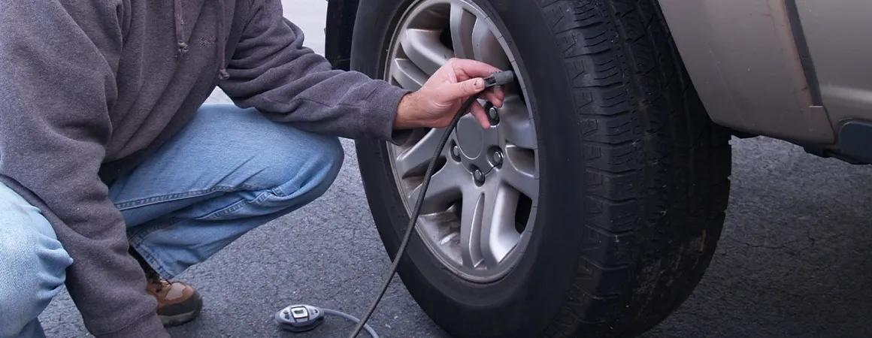
REAL-LIFE CHALLENGE — THE SCENARIOS
Poor Vehicle Maintenance Awareness
Many drivers don’t know:
  How to check oil
  Tyre pressure
  Legal limits
  Basic safety checks
META-PRENEUR | Session 2

Slide 16
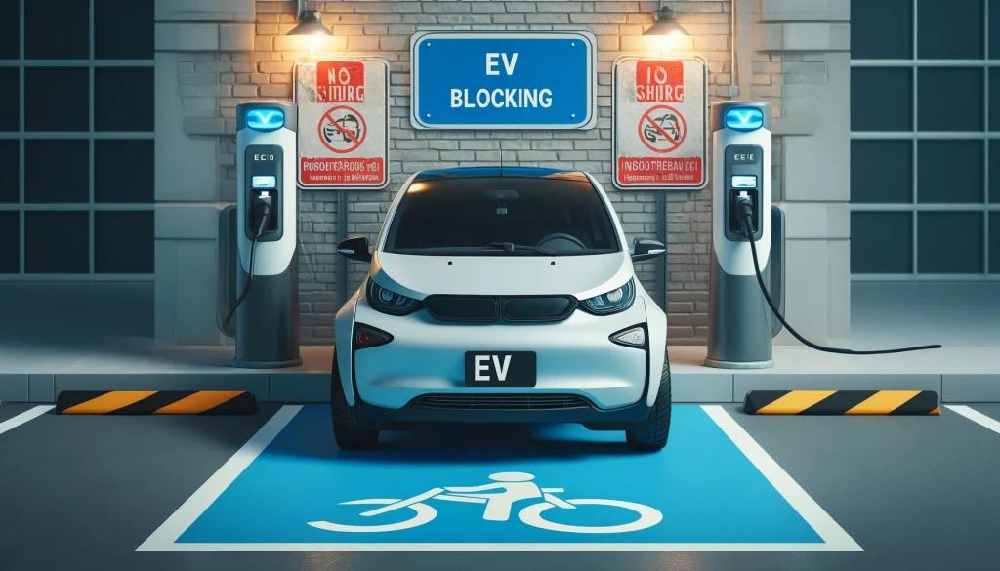
REAL-LIFE CHALLENGE — THE SCENARIOS
EV Charging points
Charging points are:
  Blocked
  Too few
  Hard to access
META-PRENEUR | Session 2

Slide 17
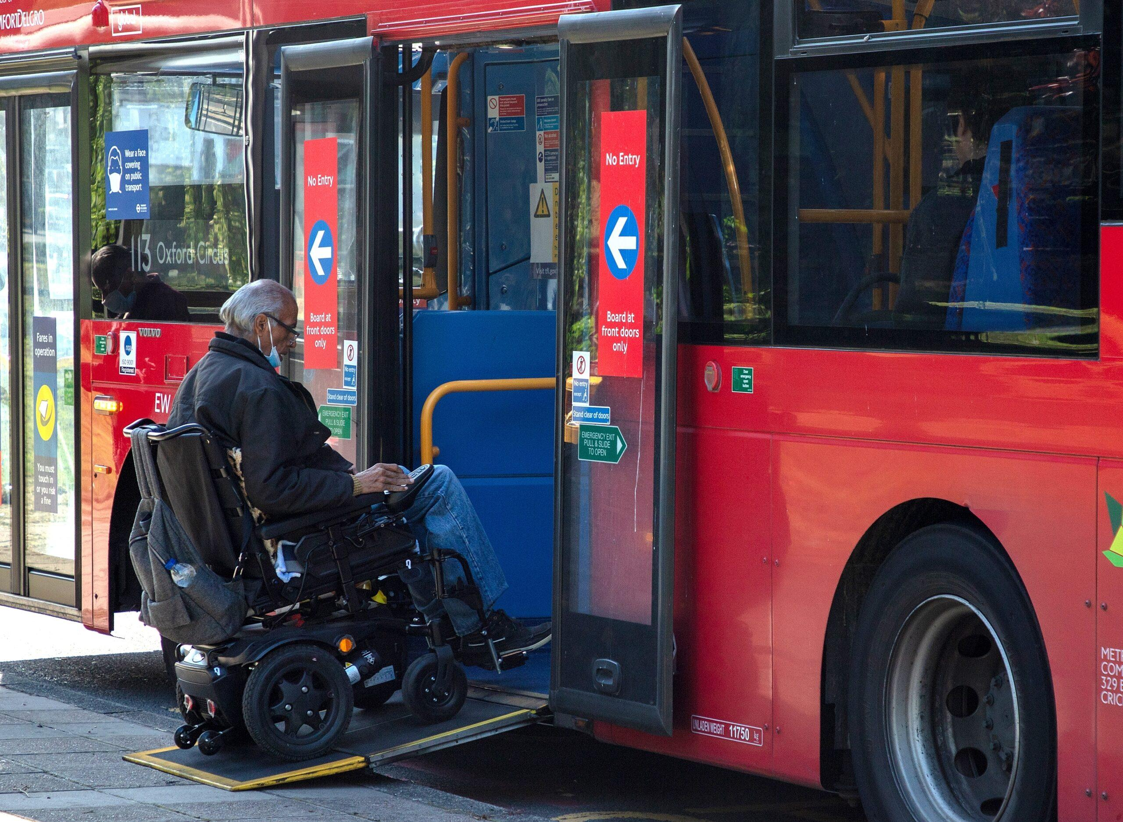
REAL-LIFE CHALLENGE — THE SCENARIOS
Lack of Transport for Vulnerable People
Buses are:
Late or cancelled
Too infrequent (long waits)
Bus stops may:
Have no shelter or seating
Accessibility issues:
Wheelchair users or elderly passengers struggle to
get on/off
Rural areas may have:
Very limited or no service at all
META-PRENEUR | Session 2

Slide 18
REAL-LIFE CHALLENGE — THE SCENARIOS
Questions
What is your problem? (1–2 sentences)
Who is affected by this issue?
Why does this problem matter?
What could happen if it is not fixed?
What is your best idea to solve it?
*Handout 2 META-PRENEUR | Session 2

Slide 19
SHARE BACK — BUILD CONFIDENCE
Each group presents:
1
2
3
Their problem (1–2 sentences)
Why it matters
Their best idea
META-PRENEUR | Session 2

Slide 20
THE META SKILLS — WHAT DID YOU JUST USE?
COMMUNICATION
TEAMWORK
PROBLEM SOLVING
CREATIVITY
CONFIDENCE
Explain ideas clearly, listen actively, present back
Build on ideas, manage opinions, work across trades
Ask why, dig past the obvious, find root causes
Generate 3 different ideas, think sideways
Speak up, share ideas without needing right answers
In your next interview: "Give me an example of problem solving" — THIS SESSION is your answer.
*Handout 3 & 4
META-PRENEUR | Session 2

Slide 21
REFLECTION & CLOSE
💭
What did you learn about HOW you think today?
💭
Is there a problem you've been ignoring that might be worth exploring?
💭
What will you notice differently this week?
📱 YOUR HOMEWORK CHALLENGE
Notice 3 problems before next session — big or small, linked to your trade or not. Write them down.
META-PRENEUR | Session 2

Slide 22
Session 2 Complete | See you next time.
META-PRENEUR | Session 2

