Slide 1

META-PRENEUR | SESSION 2
Think differently
Work as a team and help to spot problems and opportunities
META-PRENEUR | Session 2

Slide 2





TODAY'S JOURNEY
0:00
Welcome Back & Check in
0:55
Spotting Problems
0:10
Team work
1:10
Being detectives – problem spotting game
0:40
☕ Break
1:55
Reflection & Close
META-PRENEUR | Session 2

Slide 3












THE 12 META-SKILLS — SDS SKILLS 4.0 FRAMEWORK
Timeless, higher-order skills that help you adapt and succeed — whatever the future brings.
SELF-MANAGEMENT
SOCIAL INTELLIGENCE
INNOVATION
How you manage yourself
How you connect with others
How you generate new ideas
Focusing
Communicating
Curiosity
Diagnosing faults methodically
Plain-language customer explanations
Asking why a fault keeps recurring
Integrity
Feeling
Creativity
Being honest about job costs
Reading a stressed customer
Finding a workaround when the fix won't work
Adapting
Collaborating
Sense-making
Changing plan when parts unavailable
Sharing a complex job with a colleague
Reading diagrams to build the full picture
Initiative
Leading
Critical thinking
Flagging a safety issue unprompted
Stepping up when the supervisor is off
Weighing repair vs replace options
META-PRENEUR | Session 2

Slide 4
WELCOME BACK — QUICK CHECK-IN
How are you feeling today?
Show with your hands, thumbs up, down or sideways
Q1
What is one super power you have?
Anyone can shout out no right or wrong answer!
Q2
Did you use your superpowers at home?
Would anyone like to share an example with me of when they used their superpower?
Q3
META-PRENEUR | Session 2

Slide 5

TEAM WORK
THE TOWER CHALLENGE - HANDOUT RESOURCES
Heroes never work alone! This week is all about working together as a team. Great teams listen to each other, share ideas, and use everyone's strengths. When we work together, we can do things we could never do on our own!
META-PRENEUR | Session 3
META-PRENEUR | Session 2

Slide 6
☕
BREAK
BACK SHARP
META-PRENEUR | Session 2

Slide 7
SPOTTING PROBLEMS
Look at these problems. Which one do you want to help with?
Every hero needs to know where help is needed. Lets put on our detective hats and look for problems that real people face. Problems are everywhere — and spotting them is the first step to making things better! Lets play the problems detective game. (use handout).
Older people feel lonely
Dogs bored in shelters
Some older people don't see many friends or family. They may feel alone and wish they had someone to talk to.
Dogs in shelters spend lots of time waiting. They need play, exercise, and love — but help is limited.
Struggling to carry things
Students bored at break
Some people find it very hard to carry heavy bags, especially if they have a disability or feel unwell.
Sometimes at break, students don't know what to do. They feel left out because there aren't enough activities.
META-PRENEUR | Session 3
META-PRENEUR | Session 2

Slide 8
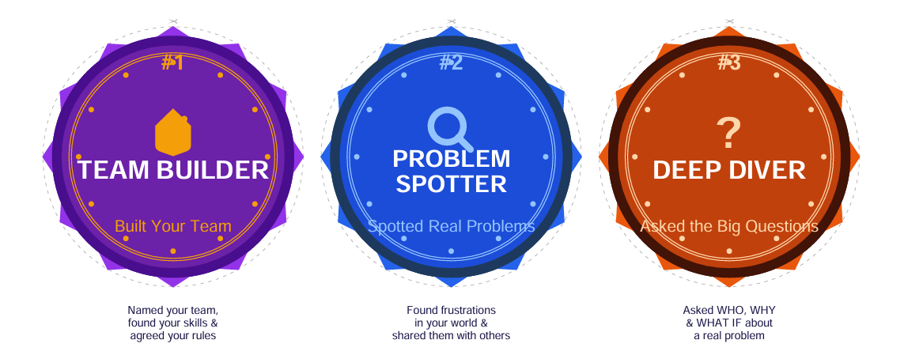

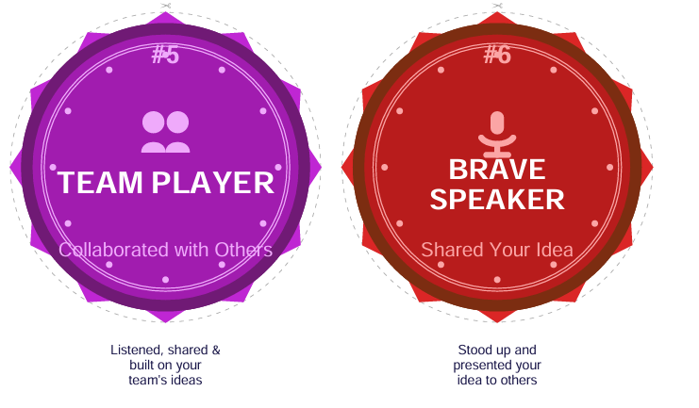
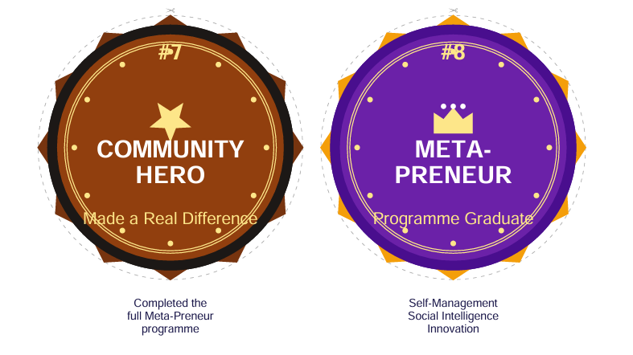
BADGES – HAVE YOU EARNED ANY TODAY?
META-PRENEUR | Session 2

Slide 9
WELL DONE, COMMUNITY HEROES!
TODAY YOU…
Worked together as a team
Played detective and spotted some real life problems
Shared back with the group
Look for problems in everyday life and bring ideas to the next session. Share the problem and one idea on how to fix it. Tell me all about it next week.
META-PRENEUR | Session 3

Slide 10
Session 2 Complete | See you next time.
META-PRENEUR | Session 2

