Slide 1

META-PRENEUR | SESSION 3
Building Teams
Today we are building teams and helping Animals
🐶 🐱 🐾 🐰 🦜 🐠 🐴
META-PRENEUR | Session 3

Slide 2





TODAY'S JOURNEY
0:00
Warm up – check in and get our brains going!
0:55
Share back – tell the group your best idea
0:10
Lets build teams
1:05
☕ Break
0:30
Animal problems – real problems animals face
1:15
Badges –see which badges you earned today
🐾
0:40
Ideas – come up with ideas to help
1:20
Reflection & Close
META-PRENEUR | Session 3

Slide 3












THE 12 META-SKILLS — SDS SKILLS 4.0 FRAMEWORK
Timeless, higher-order skills that help you adapt and succeed — whatever the future brings.
SELF-MANAGEMENT
SOCIAL INTELLIGENCE
INNOVATION
How you manage yourself
How you connect with others
How you generate new ideas
Focusing
Communicating
Curiosity
Diagnosing faults methodically
Plain-language customer explanations
Asking why a fault keeps recurring
Integrity
Feeling
Creativity
Being honest about job costs
Reading a stressed customer
Finding a workaround when the fix won't work
Adapting
Collaborating
Sense-making
Changing plan when parts unavailable
Sharing a complex job with a colleague
Reading diagrams to build the full picture
Initiative
Leading
Critical thinking
Flagging a safety issue unprompted
Stepping up when the supervisor is off
Weighing repair vs replace options
META-PRENEUR | Session 3

Slide 4
WELCOME BACK — QUICK CHECK-IN
How are you feeling today?
Show with your hands, thumbs up, down or sideways
Q1
What is your favourite animal?
Anyone can shout out no right or wrong answer!
Q2
Can you think of one problem an animal may have?
Think about animals at home, in a shelter or in the wild
Q3
META-PRENEUR | Session 3

Slide 5
LETS BUILD TEAMS
Today: before we tackle a challenge, we need to know who we are as a team
You've been assigned a team. But a team is just a list of names until you decide who you are together
This session: Lets build teams!
META-PRENEUR | Session 3

Slide 6
YOUR TEAMS
Your teams have been assigned. Today you make them real.
TEAM | SIZE | TEAM NAME / LOGO
Team A | Add (based on group size) | Add
Team B | Add (based on group size) | Add
Team C | Add (based on group size) | Add
Before the challenge lands — you need an identity. Build it today. Use Handout to help
META-PRENEUR | Session 3

Slide 7
WHO IS IN YOUR TEAM? — SKILLS CHECKER
Tick all the skills your team has between you. Every skill counts!
🔍 Problem Spotter Notices when something needs fixing | 💬 Good Communicator Explains things clearly to others | 🤝 Team Player Helps everyone work together
💡 Creative Thinker Comes up with new ideas | 📋 Organiser Plans and keeps things on track | 🎤 Brave Speaker Happy to present and share ideas
👂 Great Listener Really hears what others say | 🔧 Practical Builder Makes and builds things with their hands | 🌱 Care & Kindness Thinks about how others are feeling
META-PRENEUR | Session 3

Slide 8
YOU CHOSE PROBLEMS ANIMALS FACE
Look at these problems. Which one do you want to help with?
🐶
Dogs in shelters
feel lonely
🐱
Stray cats
have nowhere to go
Dogs in shelters wait a long time.
They need love, play and company.
Many don't get enough attention.
Stray cats live outside in the cold.
They struggle to find food and water.
They can get hurt or sick.
🐾
Pets get bored
at home alone
🦜
Wild animals
lose their homes
Some pets are left alone all day.
They get bored and sad.
This can make them unhappy.
Animals in the wild are losing
their natural homes.
They have nowhere safe to live.
META-PRENEUR | Session 3
META-PRENEUR | Session 3

Slide 9
CHOOSE YOUR ANIMAL MISSION
As a team, vote for the ONE problem you want to help with.
Look at these problems. Which one do you want to help with?
🐶
🐱
HOW TO VOTE
OUR ANIMAL MISSION
1
Read out each problem one at a time
🐾
Write it on your handout
2
Everyone puts their hand up for their favourite
🦜
3
Count the hands — most hands wins!
META-PRENEUR | Session 3
META-PRENEUR | Session 3

Slide 10
IDEA TIME!
Come up with 3 ideas to help your animal problem. Write them on your handout.
Think BIG
Think SMALL
Think SILLY
If you had loads of money
and help, what would you build
or create?
What is one small thing
someone could do RIGHT NOW
to make it a bit better?
What is the most wild,
funny or ridiculous idea
you can think of?
Examples: a big animal shelter, a charity, an app
Examples: a fundraiser, a local group, a poster
Silly ideas are OK — they often spark the best ones!
META-PRENEUR | Session 3

Slide 11
SHARE YOUR BEST IDEA
Each team tells the group: what is your animal problem and what is your idea to help?
1
1. What is the problem? 2. Who does it affect? 3. What is your idea?
ay: 1. What is the problem? 2. Who does it affect? 3. What is your idea?
2
Show your handout – point to what you wrote
3
Draw it on the board – a quick sketch is perfect
4
Just say it out loud – no wrong way just talk
5
Share it with a team mate and do it together
META-PRENEUR | Session 3

Slide 12
☕
BREAK
BACK SHARP
META-PRENEUR | Session 3

Slide 13
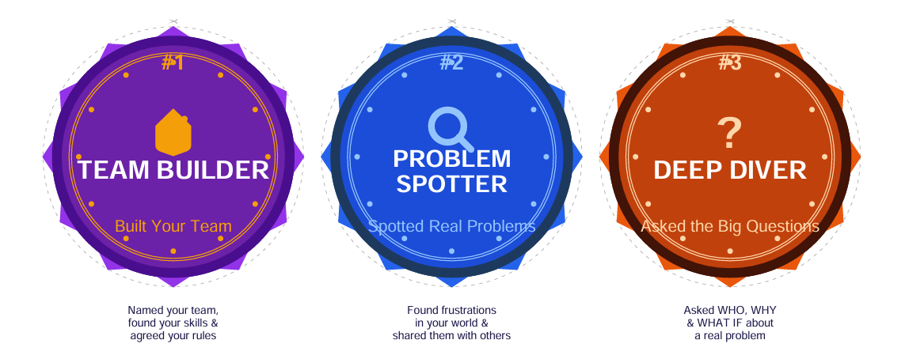
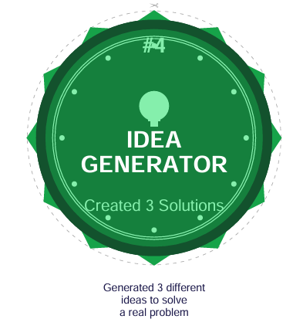
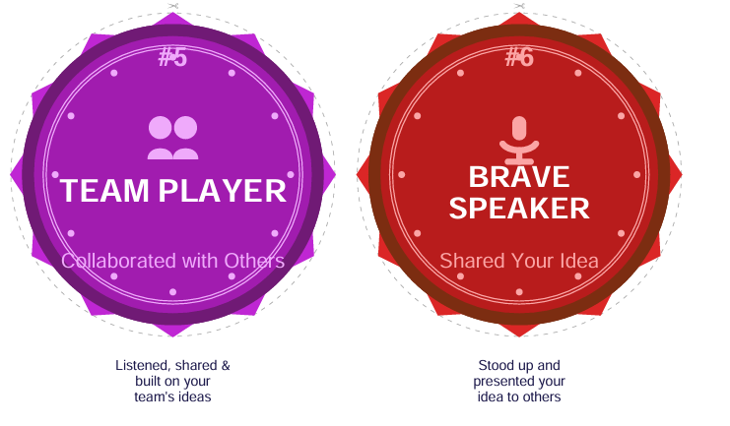

BADGES – HAVE YOU EARNED MORE TODAY?
META-PRENEUR | Session 3

Slide 14
WELL DONE, COMMUNITY HEROES!
TODAY YOU…
Spotted a real problem that animals face
Voted as a team and chose your mission
Came up with ideas to help
Shared your idea with the group
Before next time – Keep an eye out for animals that need help. Tell someone what your team is working on.
META-PRENEUR | Session 3

Slide 15
Session 3 Complete | See you next time.
META-PRENEUR | Session 3

