Slide 1

META-PRENEUR | SESSION 6
Presentation day 🎉
Today is the day you show the world your amazing ideas!
You’ve got this Community Heroes!
🐶 🐱 🐾 🐰 🦜 🐠 🐴
META-PRENEUR | Session 6

Slide 2





TODAY'S JOURNEY
0:00
Warm up – get ready and feel confident
1:35
Look back, reflect on what you have learned
0:20
Presentations – every team presents their pitch presentations
1:50
Certificates and Badges – collect your well earned rewards
1:00
Celebrate ideas – hear what was brilliant
2:00
Close
1:20
☕ Break
META-PRENEUR | Session 6

Slide 3
GET YOURSELF READY
Do these 3 things before we start presenting:
🤸
🎤
🌟
SHAKE IT OUT
SAY YOUR TEAM NAME LOUD
REMEMBER WHY YOU STARTED
Stand up and shake your arms and legs for 10 seconds! Let the nerves go.
Shout your team name out loud. Own it!
Think of the animal who needs your help. That’s who you are doing this for.
META-PRENEUR | Session 6

Slide 4
PRESENTATION TIME
Every team gets their moment to shine. Here’s how it works:
🐶
Each team presents their full pitch – slides and all
🐱
You have around 5 minutes per team
🐠
Everyone else listens with respect. No talking during the pitches
🐰
After each pitch the audience gives 2 stars and one wish
🦜
Big applause after every single pitch, ALWAYS!
META-PRENEUR | Session 6

Slide 5
YOUR TURN
Take a breath. Stand tall. Speak clearly.
You have worked SO hard for this moment
Problem → Idea → Why it works → What you need → Go! 🚀
META-PRENEUR | Session 6

Slide 6
TWO STARS & ONE WISH- FEEDBACK THAT HELPS
Reminder! After each team presents - we give feedback using these TWO rules
Look at these problems. Which one do you want to help with?
⭐
⭐
🌱
TWO STARS
ONE WISH
Tell them ONE thing that could be even better.
Be kind. Say it like a suggestion:
'It would be great if you also said...'
Tell them TWO things that were brilliant.
Be specific — not just 'it was good’!
Say WHAT was good and WHY.
META-PRENEUR | Sessio6 3
META-PRENEUR | Session 6

Slide 7
☕
BREAK
BACK SHARP
META-PRENEUR | Session 6

Slide 8
LOOK BACK
Think about everything you have done across all the sessions:
🐶
WHAT DID YOU LEARN
WHAT ARE YOU MOST PROUD OF
🌟
What do you know now that you didn’t know at the start?
It could be something you did, said or created?
❓
🚀
WHAT WAS HARD
WHATS NEXT
What challenged you?
It’s OK to say what was felt difficult.
Would you want to keep working on your idea? What could be your next step?
META-PRENEUR | Session 3
META-PRENEUR | Session 6

Slide 9









LOOK AT ALL THE SKILLS YOU USED!
ACROSS THE WHOLE PROGRAMME YOU SHOWED REAL META-SKILLS
SELF-MANAGEMENT
SOCIAL INTELLIGENCE
INNOVATION
SELF MANAGEMENT
SOCIAL INTELLIGENCE
INNOVATION
Focusing
Communicating
Curiosity
Adapting
Collaborating
Creativity
Showing Initiative
Leading your team
Finding real solutions to real problems
You did all this with confidence, showing you are a real community hero – you cared about animals and you tried to help – that is entrepreneurship. WELL DONE! YOU ARE A META PROGRAMME CHAMPION!
META-PRENEUR | Session 6

Slide 10
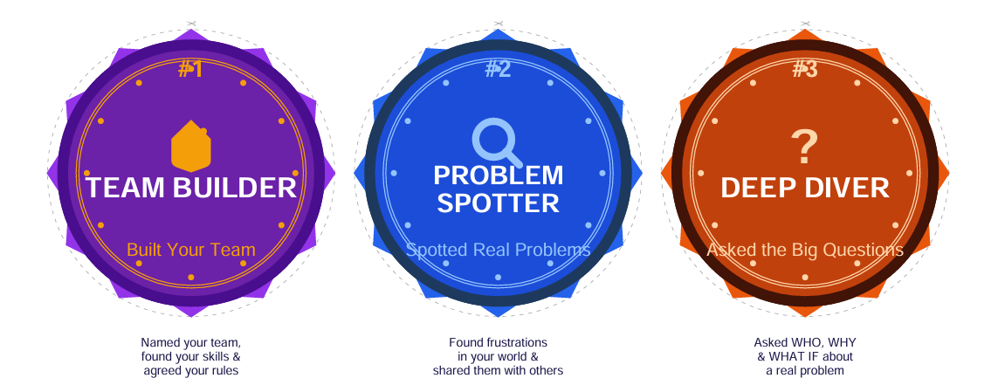

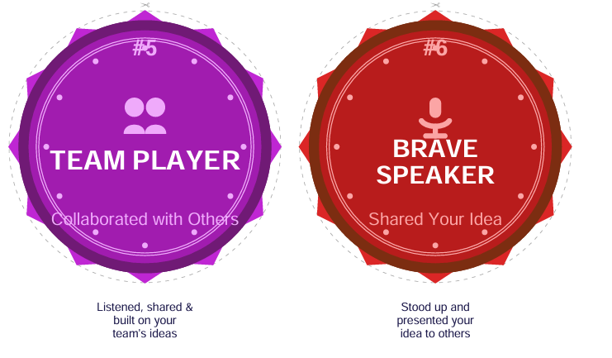
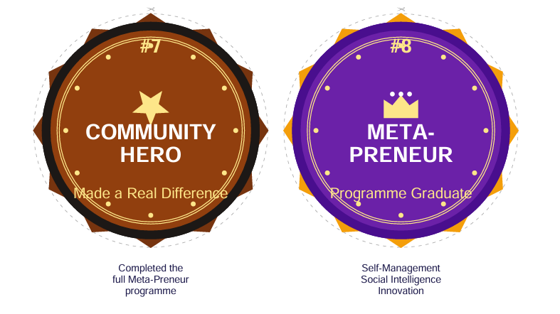
FINAL BADGES – FILL IN YOUR SCORECARD
META-PRENEUR | Session 6

Slide 11
🏆
🌟 CERTIFICATE TIME 🌟
★ ★ ★
Every one of you is receiving a certificate from
Edinburgh College, Forth Valley College and West Lothian College.
You are officially a META-PRENEUR! 🌟
🐶 🐱 🐾 🐰 🦜 🐠 🐴
META-PRENEUR | Session 6

Slide 12
WELL DONE COMMUNITY HEROES!
You spotted real problems
You came up with real ideas
You built an excellent pitch
You showed confidence & were really brave
You are real Meta-Preneurs!
Give yourselves a big round of applause!
META-PRENEUR | Session 6

Slide 13
Session 6 Complete, Well done!
META-PRENEUR | Session 6

