Slide 1

META-PRENEUR | SESSION 1
WHAT IS META-PRENEUR
WELCOME, INTRODUCTION TO META-PRENEUR
META-PRENEUR | Session 1

Slide 2







TODAY'S 2-HOUR JOURNEY
0:00
Welcome
1:00
About Me (The Lecturer)
0:10
Introduction to Meta-preneur
1:25
Over to you – about you
0:25
12 Meta Skills
1:45
META Skills in action
0:55
☕ Break
1:55
Reflection & Close
META-PRENEUR | Session 1

Slide 3
META-PRENEUR: THINK DIFFERENTLY
When you hear the word
entrepreneurship,
what are the first 3 words that come to mind?
1
2
3
META-preneur: Think Differently · Session 1 · Electrical Installation – Level 5
META-PRENEUR | Session 1

Slide 4
META-PRENEUR: THINK DIFFERENTLY
Money
Innovation
Business
Opportunity
Risk
Hard work
Boss
Freedom
Entrepreneurship is about spotting problems and creating solutions that people value.
META-PRENEUR | Session 1

Slide 5
META-PRENEUR: THINK DIFFERENTLY
Have You Heard of This Word?
INTRAPRENEUR
Someone who thinks like an entrepreneur – from inside an organisation.
META-PRENEUR | Session 1

Slide 6
AN INTRAPRENEUR IS SOMEONE WHO...
1
Works inside a company
2
But thinks like an entrepreneur
3
Improves systems
4
Finds better ways of doing things
5
Solves problems
Example: An apprentice redesigns the van tool layout. They didn't start a business – but they improved the business.
META-PRENEUR | Session 1

Slide 7
THE MINDSET
Entrepreneurs and intrapreneurs tend to share a similar mindset. They:
They:
This mindset helps people:
Notice problems
Improve workplaces
Ask questions
Start businesses
Look for better ways
Create opportunities
Take initiative
Learn from mistakes
Think about the customer
META-PRENEUR | Session 1

Slide 8
WHY THIS MATTERS FOR ELECTRICIANS
Technical Skills + Meta-Skills + Mindset
A great electrician needs three things:
Technical Skills
Meta-Skills
Mindset
Wiring & electrical systems
Problem solving
Curiosity
Safety and regulations
Communication
Initiative
Installation techniques
Teamwork
Responsibility
Testing & inspection
Adaptability
Thinking about improvement
When these combine, electricians can become: Supervisors · Business owners · Project leaders · Innovators
META-PRENEUR | Session 1

Slide 9
WHY THIS MATTERS FOR ELECTRICIANS
Electrical careers often include:
Self-employment
Running small businesses
Managing projects
Leading teams
Working with clients
Success in these roles requires more than technical skills – it requires meta-skills and mindset.
META-PRENEUR | Session 1

Slide 10
☕
BREAK
BACK SHARP
META-PRENEUR | Session 1

Slide 11
What if entrepreneurship isn't who you are… but how you learn, adapt, and respond?
META-PRENEUR | Session 1

Slide 12
ENTREPRENEUR JOURNEYS
META-PRENEUR | Session 1

Slide 13
Kirsty Thomson-Gillespie
Social Entrepreneur
Entrepreneur In Residence
Founder – The Circle
Founder – More Than Profit
META-PRENEUR | Session 1

Slide 14
KIRSTY THOMSON-GILLESPIE – SOCIAL ENTREPRENEUR
Background in Psychology and Academic Research
Over 20 years working in and with charities and social enterprises
Founded 2 social enterprises and a charity
Set up Along Came Kirsty (2012) and ACK Third Sector Consultants CIC (2013)
Founded The Circle (Circle Scotland CIC) in 2015, launched 2016
Merged 2 CICs in 2019; set up a charity to train social entrepreneurs in 2022
SCQF Level 7 Award in Social Entrepreneurship
Exec Director, Non-Exec Director, Advisory Board Chair & Trustee
Merged with Shopmobility Charity in 2023
Raised over £15 million in funding in career to date
Professor in Practice, University of Dundee School of Business
Entreprenuer In Residence (EiR) at West Lothian, Edinburgh and Forth Valley Colleges
META-PRENEUR | Session 1

Slide 15
ABOUT KIRSTY
I didn't grow up thinking "I want to be an entrepreneur"
I didn't have role models who ran their own business or social enterprise
I didn't set out to build organisations.
I was motivated by people, problems, and fairness
META-PRENEUR | Session 1

Slide 16

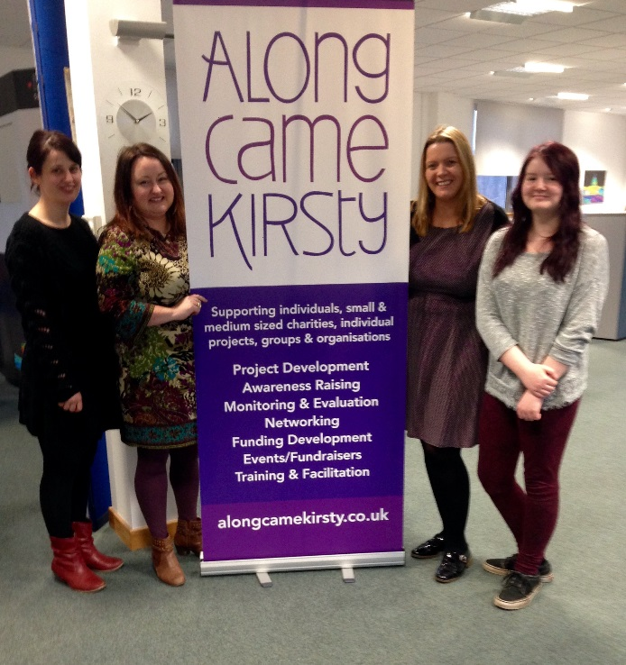





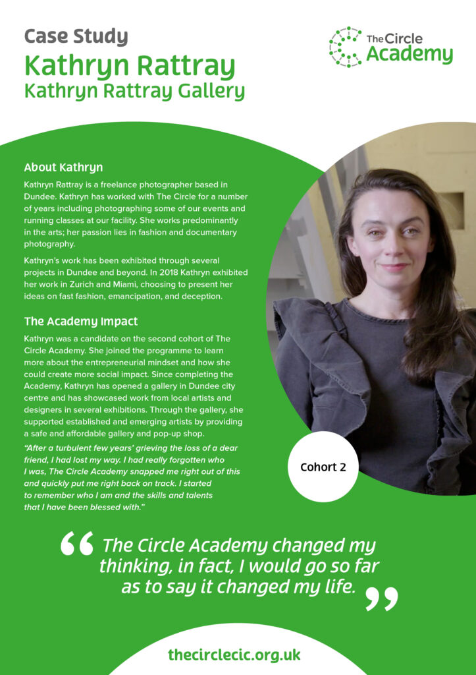
SQUIGGLY CAREER – Non-linear progression, continuous learning, individualised journeys, proactive ownership
.
META-PRENEUR | Session 1

Slide 17
CELIA HUDSON
HEY GIRLS – SOCIAL ENTERPRISE
META-PRENEUR | Session 1

Slide 18
CELIA HODSON OBE – FOUNDER HEY GIRLS
Founder of Hey Girls, a UK-based social enterprise focused on tackling period poverty and promoting menstrual health education.
The organisation was launched in 2018 and has become a prominent advocate for period dignity across the UK.
Celia talks about her passion for tackling period poverty stemming in part from her own experience of financial hardship. Stating how raising a family on benefits gave her firsthand experience of the difficultly that low-income families face in affording essential items, including menstrual products.
She has turned lived experience into a sustainable business model that addresses a major social issue.
She had a varied career before founding Hey Girls, including – working as an advisor to community businesses, cooperative development work, Social Enterprise expansion and lobbying, international projects in countries including India & Brazil.
The enterprise adopted a"Buy One, Donate One" model, where every product purchased helps provide another product to someone in need. The organisation combines product sales with education and advocacy to reduce stigma around menstruation and improve access to period products
Helped to create My period App – which helps people find free period products nearby
Celia Hodson has been recognized for her work with numerous awards and was awarded an OBE in 2024 for services to promoting period dignity and raising awareness of free period products in Scotland.
META-PRENEUR | Session 1

Slide 19
HOWARD SCHULTZ
STARBUCKS
META-PRENEUR | Session 1

Slide 20
HOWARD SCHULTZ – STARBUCKS
Grew up in a poor housing project in Brooklyn, New York, where his family struggled financially and his father worked low- paying jobs without benefits. He became the first person in his family to attend University.
Before Starbucks, Schultz worked in sales at Xerox and later became a manager for Swedish housewares company Hammarplast.
In 1982, Schultz joined Starbucks as Director of Retail Operations and Marketing. At the time, Starbucks sold coffee beans and equipment but did not operate as the coffeehouse chain we know today
A trip to Italy in 1983 proved transformational. Schultz was inspired by Milan's coffeehouse culture and envisioned creating similar community-focused coffee shops in the United States
When Starbucks' founders were reluctant to pursue his vision, Schultz left and launched his own coffee business, Il Giornale, in 1985. In 1987, with investor backing, he acquired Starbucks and merged it with his company – showing real vision and entrepreneurship.
Starbucks grew from a small regional coffee retailer into the world's largest coffeehouse chain. Starbucks expanded internationally and helped shape modern coffee culture worldwide.
One of his most influential ideas was creating Starbucks as a"third place" between home and work, where people could meet, relax, and build community
Although Starbucks is a for-profit corporation rather than a social enterprise, Schultz incorporated significant social responsibility initiatives including Employee Welfare, Ethical Sourcing and Philanthropy – establishing the Schultz Family Foundation, which focuses on supporting military veterans and addressing youth unemployment.
META-PRENEUR | Session 1

Slide 21
WHAT THEY ALL HAVE IN COMMON
1
Didn't start with confidence.
2
Started by solving problems - many of which were significant social problems.
3
Learned about burnout and boundaries, many initially failed with the challenges & barriers they faced.
4
Adapted and built partnerships.
Developed sustainable business models.
5
6
Meta-skills changed everything.
META-PRENEUR | Session 1

Slide 22
YOUR MOTIVATIONS
What drives you? What problems do you want to solve?
META-PRENEUR | Session 1

Slide 23
REAL PROBLEMS IN COMMUNITY BUILDINGS
⚡ Electrical
🏗️ Buildings
📋 Practical Management
Old fuse boards and outdated wiring
Damp near electrical areas
No building plans or electrical diagrams
Circuits not labelled
Poor lighting in corridors
Electrical boards blocked or inaccessible
Outdoor power not weatherproof
Old heating systems
Temporary extension leads used permanently
Sockets connected to unlabelled circuits
High energy costs
META-preneur: Think Differently · Session 1 · Electrical Installation – Level 5
META-PRENEUR | Session 1

Slide 24
REAL PROBLEMS IN COMMUNITY BUILDINGS
If you were the electrician called to help here…
Where would you start?
Take 2 minutes in pairs – list your first 3 actions.
1
2
3
META-PRENEUR | Session 1

Slide 25
‘ SHARED STRUGGLE BUILDS TRUST’
A Principle from The Circle
META-PRENEUR | Session 1

Slide 26
THE ELECTRICIAN MINDSET TEST
⚡ The Scenario
Two electricians arrive on the same job.
A problem appears – the lights won't work and the plans don't match what's in the wall.
How do they react?
META-PRENEUR | Session 1

Slide 27
THE ELECTRICIAN MINDSET TEST
⛔ Electrician A
"That's not my problem."
"The drawings are wrong."
"Someone else must have messed this up."
"I'll wait for the boss to deal with it."
META-PRENEUR | Session 1

Slide 28
THE ELECTRICIAN MINDSET TEST
✅ Electrician B
"Let's figure out what's going on."
"Let's test the circuit."
"Maybe the drawings changed."
"We could reroute this here."
META-PRENEUR | Session 1

Slide 29
WHY THIS MATTERS FOR ELECTRICIANS
Who would you rather work with? Who would you rather hire? Who is more likely to become a:
Supervisor
Business owner
Project manager
META-PRENEUR | Session 1

Slide 30
WHY THIS MATTERS FOR ELECTRICIANS
In pairs – think of a time something went wrong on a job, in a workshop, or while fixing something.
?
What did you do?
?
Did you react like Electrician A or Electrician B?
META-PRENEUR | Session 1

Slide 31
WHY THIS MATTERS FOR ELECTRICIANS
The Difference Is Mindset
Both electricians might have the same technical skills. The difference is mindset. A strong mindset includes:
Curiosity
Initiative
Problem solving
Responsibility
Communication
These are called Meta-Skills. They help people turn knowledge into action.
META-PRENEUR | Session 1

Slide 32
ROUND 1
WHAT MAKES A TOP ELECTRICIAN?
Each team lists 5 qualities. Bonus points for meta-skills!
META-PRENEUR | Session 1

Slide 33
META-PRENEUR: THINK DIFFERENTLY
Reliable
Good with customers
Problem solver
Works well with others
Shows initiative
Turns up on time
Can think for themselves
"These are called meta-skills."
META-PRENEUR | Session 1

Slide 34











THE 12 META-SKILLS — SDS SKILLS 4.0 FRAMEWORK
Timeless, higher-order skills that help you adapt and succeed — whatever the future brings.
SELF-MANAGEMENT
SOCIAL INTELLIGENCE
INNOVATION
How you manage yourself
How you connect with others
How you generate new ideas
Focusing
Communicating
Curiosity
Diagnosing faults methodically
Plain-language customer explanations
Asking why a fault keeps recurring
Integrity
Feeling
Creativity
Being honest about job costs
Reading a stressed customer
Finding a workaround when the fix won't work
Adapting
Collaborating
Sense-making
Changing plan when parts unavailable
Sharing a complex job with a colleague
Reading diagrams to build the full picture
Initiative
Leading
Critical thinking
Flagging a safety issue unprompted
Stepping up when the supervisor is off
Weighing repair vs replace options
META-PRENEUR | Session 1

Slide 35
META-PRENEUR: THINK DIFFERENTLY
What happens if an electrician has great technical skills but none of these?
Cannot explain problems to customers
✗
Panics when something unexpected happens
✗
Cannot work with other trades
✗
Cannot organise their time
✗
Cannot adapt on site
✗
META-PRENEUR | Session 1

Slide 36
‘MOST REAL ELECTRICAL WORK IS PROBLEM SOLVING, NOT JUST FOLLOWING INSTRUCTIONS.’
The meta-preneur principle
META-PRENEUR | Session 1

Slide 37
ELECTRICIANS DO MORE THAN INSTALL WIRING
Electricians help make spaces:
Safe
Usable
Reliable
Efficient
Protecting people from electrical hazards
Enabling the space to be used as intended
Keeping systems working around the clock
Reducing waste and running costs
Your skills help communities function.
META-PRENEUR | Session 1

Slide 38
TRADES IN THE COMMUNITY
Many charities and social enterprises rely on buildings and infrastructure. But they often operate with:
Small budgets
Older buildings
Limited technical support
This creates practical challenges that tradespeople are really good at solving.
META-PRENEUR | Session 1

Slide 39
CHARITIES & SOCIAL ENTERPRISES IN YOUR AREA
LOCAL ORGANISATIONS SLIDE – ADD YOUR EXAMPLES HERE
META-PRENEUR | Session 1

Slide 40
ELECTRICIANS IN THE COMMUNITY
What electrical problems might organisations like these face?
Shout out ideas.
Lighting issues
Outdoor power needs
Temporary wiring
Energy inefficiency
META-PRENEUR | Session 1

Slide 41
THINK LIKE AN ELECTRICIAN
Before installing anything, what questions might you ask?
Take 1 minute – write down your first 3 questions.
1
2
3
META-PRENEUR | Session 1

Slide 42
THINK LIKE AN ELECTRICIAN
Before installing anything, electricians ask:
👤
❓
⚠️
Who uses the space?
What is the real problem?
What risks exist?
META-PRENEUR | Session 1

Slide 43
ELECTRICIAN MINDSET
Professional electricians consider:
Safety
Protection
Reliability
Installation practicality
Maintenance
META-PRENEUR | Session 1

Slide 44
THE CALL-OUT
📋 The Scenario
You are electricians working for a local contractor.
A community organisation has an urgent problem.
Their outdoor electrical system has failed before an event.
META-PRENEUR | Session 1

Slide 45
THE SITUATION
The event needs power for:
Lighting
Speakers
Charging points
Food stalls
150 people attending
🌧 Rain expected
META-PRENEUR | Session 1

Slide 46
THE ELECTRICIAN CRISIS CHALLENGE
What questions might you ask?
Think about:
Materials
Practical solutions
Safe installation
How it stays safe in rain
META-PRENEUR | Session 1

Slide 47
ELECTRICIANS MAKE A DIFFERENCE
ELECTRICIANS DON’T JUST FIX FAULTS THEY:
DESIGN SOLUTIONS
IMPROVE SAFETY
SOLVE PRACTICAL PROBLEMS
SUPPORT COMMUNITIES
META-PRENEUR | Session 1

Slide 48
PROFESSIONAL RESPONSIBILITY
Electrical work affects:
People's safety
Public spaces
Community organisations
Everyday life
Good electricians always think ahead.
META-PRENEUR | Session 1

Slide 49
META-SKILLS IN ACTION
Which skills did you use today?
Problem solving
Teamwork
Communication
Creativity
Adaptability
META-PRENEUR | Session 1

Slide 50
REFLECTION & CLOSE
💭
What surprised you today?
💭
Where could electricians help the community?
💭
Which Meta Skills did you use?
📱 YOUR HOMEWORK CHALLENGE
Stop and reflect when at home, think about when you are putting meta skills into practice.
META-PRENEUR | Session 1

Slide 51
Session 1 Complete | See you next time.
META-PRENEUR | Session 1

