Slide 1

META-PRENEUR | SESSION 1
WHAT IS META-PRENEUR
WELCOME, INTRODUCTION TO META-PRENEUR
META-PRENEUR | Session 1

Slide 2







TODAY'S 2-HOUR JOURNEY
0:00
Welcome
1:00
About Me (The Lecturer)
0:10
Introduction to Meta-preneur
1:25
Your Motivations
0:25
Mindset & why it matters
1:35
META Skills in action – What makes a Top Engineer
0:55
☕ Break
1:55
Reflection & Close
META-PRENEUR | Session 1

Slide 3
META-PRENEUR: THINK DIFFERENTLY
When you hear the word
entrepreneurship,
what are the first 3 words that come to mind?
1
2
3
META-preneur: Think Differently · Session 1 · Electrical Installation – Level 5
META-PRENEUR | Session 1

Slide 4
META-PRENEUR: THINK DIFFERENTLY
Money
Innovation
Business
Opportunity
Risk
Hard work
Boss
Freedom
Entrepreneurship is about spotting problems and creating solutions that people value.
META-PRENEUR | Session 1

Slide 5
META-PRENEUR: THINK DIFFERENTLY
Have You Heard of This Word?
INTRAPRENEUR
Someone who thinks like an entrepreneur – from inside an organisation.
META-PRENEUR | Session 1

Slide 6
AN INTRAPRENEUR IS SOMEONE WHO...
1
Works inside a company
2
But thinks like an entrepreneur
3
Improves systems
4
Finds better ways of doing things
5
Solves problems
Example: An apprentice redesigns the workshop layout. They didn't start a business – but they improved the business.
META-PRENEUR | Session 1

Slide 7
INTRAPRENEURSHIP IN ACTION
Manufacturing Workshop
An engineering apprentice notices that technicians spend a lot of time searching for the correct tools and measuring equipment.
They design a shadow board tool system and labelled storage layout so every tool has a fixed place.
They didn't start a business – but they improved efficiency in the workshop.
That is intrapreneurship.
META-PRENEUR | Session 1

Slide 8
INTRAPRENEURSHIP IN ACTION
Production line improvement
A technician notices that parts are often damaged when being moved between machines.
They design a simple jig or protective transport tray that holds components securely during movement.
The company reduces waste and saves money.
That is intrapreneurship.
META-PRENEUR | Session 1

Slide 9
INTRAPRENEURSHIP IN ACTION
Workshop Safety Improvement
An engineer notices that workers sometimes trip over temporary cables in a workshop.
They design a cable management system or floor-mounted protection channel to keep cables organised and safe.
The workplace becomes safer.
That is intrapreneurship.
META-PRENEUR | Session 1

Slide 10
INTRAPRENEURSHIP IN ACTION
Design for Manufacture thinking
An engineer notices a product requires too many parts and complex assembly.
They redesign the component so it can be manufactured with fewer parts and simpler assembly.
Production becomes faster and cheaper.
That is intrapreneurship.
META-PRENEUR | Session 1

Slide 11
THE MINDSET
Entrepreneurs and intrapreneurs tend to share a similar mindset. They:
They:
This mindset helps people:
Notice problems
Improve workplaces
Ask questions
Start businesses
Look for better ways
Create opportunities
Take initiative
Learn from mistakes
Think about the customer
META-PRENEUR | Session 1

Slide 12
WHY THIS MATTERS FOR ENGINEERS
Technical Skills + Meta-Skills + Mindset
A great engineer needs three things:
Technical Skills
Meta-Skills
Mindset
Wiring & electrical systems
Problem solving
Curiosity
CAD and design
Communication
Initiative
Engineering principles
Teamwork
Responsibility
Safety & Standards
Adaptability
Thinking about improvement
Critical thinking
Willingness to test & learn
META-PRENEUR | Session 1

Slide 13
WHY THIS MATTERS FOR ENGINEERS
When these combine engineers can become:
Design Engineers
Project leaders
Engineering Managers
Product innovators
Manufacturing Engineers
Entrepreneurs or intrapreneurs
Success in these roles requires more than technical skills – it requires meta-skills and mindset.
META-PRENEUR | Session 1

Slide 14











THE 12 META-SKILLS — SDS SKILLS 4.0 FRAMEWORK
Timeless, higher-order skills that help you adapt and succeed — whatever the future brings.
SELF-MANAGEMENT
SOCIAL INTELLIGENCE
INNOVATION
How you manage yourself
How you connect with others
How you generate new ideas
Focusing
Communicating
Curiosity
Diagnosing faults methodically
Plain-language customer explanations
Asking why a fault keeps recurring
Integrity
Feeling
Creativity
Being honest about job costs
Reading a stressed customer
Finding a workaround when the fix won't work
Adapting
Collaborating
Sense-making
Changing plan when parts unavailable
Sharing a complex job with a colleague
Reading diagrams to build the full picture
Initiative
Leading
Critical thinking
Flagging a safety issue unprompted
Stepping up when the supervisor is off
Weighing repair vs replace options
META-PRENEUR | Session 1

Slide 15
☕
BREAK
BACK SHARP
META-PRENEUR | Session 1

Slide 16
What if entrepreneurship isn't who you are… but how you learn, adapt, and respond?
META-PRENEUR | Session 1

Slide 17
ENTREPRENEUR JOURNEYS
META-PRENEUR | Session 1

Slide 18
Kirsty Thomson-Gillespie
Social Entrepreneur
Entrepreneur In Residence
Founder – The Circle
Founder – More Than Profit
META-PRENEUR | Session 1

Slide 19
KIRSTY THOMSON-GILLESPIE – SOCIAL ENTREPRENEUR
Background in Psychology and Academic Research
Over 20 years working in and with charities and social enterprises
Founded 2 social enterprises and a charity
Set up Along Came Kirsty (2012) and ACK Third Sector Consultants CIC (2013)
Founded The Circle (Circle Scotland CIC) in 2015, launched 2016
Merged 2 CICs in 2019; set up a charity to train social entrepreneurs in 2022
SCQF Level 7 Award in Social Entrepreneurship
Exec Director, Non-Exec Director, Advisory Board Chair & Trustee
Merged with Shopmobility Charity in 2023
Raised over £15 million in funding in career to date
Professor in Practice, University of Dundee School of Business
Entreprenuer In Residence (EiR) at West Lothian, Edinburgh and Forth Valley Colleges
META-PRENEUR | Session 1

Slide 20
ABOUT KIRSTY
I didn't grow up thinking "I want to be an entrepreneur"
I didn't have role models who ran their own business or social enterprise
I didn't set out to build organisations.
I was motivated by people, problems, and fairness
META-PRENEUR | Session 1

Slide 21

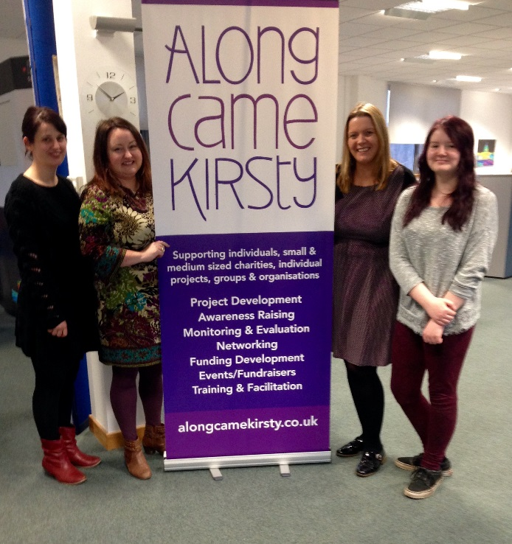

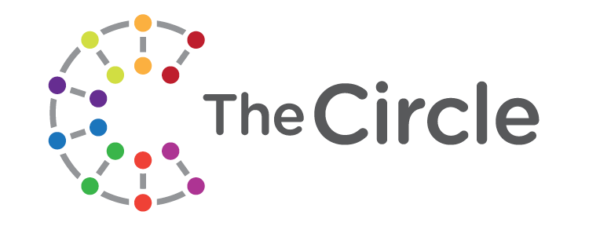



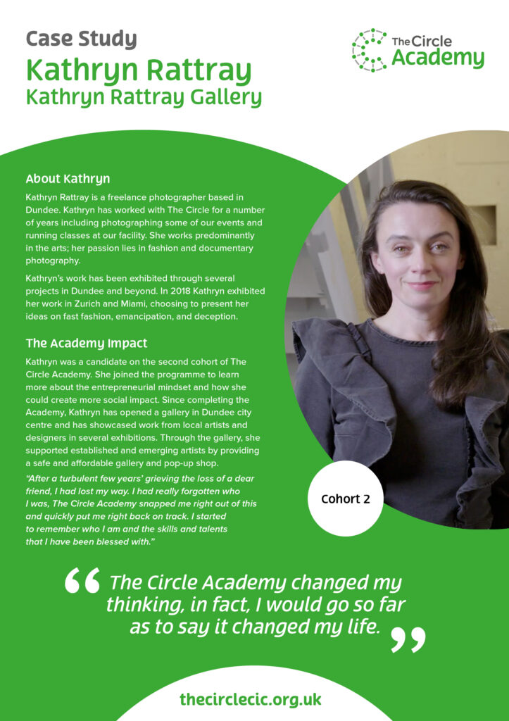
SQUIGGLY CAREER – Non-linear progression, continuous learning, individualised journeys, proactive ownership
.
META-PRENEUR | Session 1

Slide 22
CELIA HUDSON
HEY GIRLS – SOCIAL ENTERPRISE
META-PRENEUR | Session 1

Slide 23
CELIA HODSON OBE – FOUNDER HEY GIRLS
Founder of Hey Girls, a UK-based social enterprise focused on tackling period poverty and promoting menstrual health education.
The organisation was launched in 2018 and has become a prominent advocate for period dignity across the UK.
Celia talks about her passion for tackling period poverty stemming in part from her own experience of financial hardship. Stating how raising a family on benefits gave her firsthand experience of the difficultly that low-income families face in affording essential items, including menstrual products.
She has turned lived experience into a sustainable business model that addresses a major social issue.
She had a varied career before founding Hey Girls, including – working as an advisor to community businesses, cooperative development work, Social Enterprise expansion and lobbying, international projects in countries including India & Brazil.
The enterprise adopted a"Buy One, Donate One" model, where every product purchased helps provide another product to someone in need. The organisation combines product sales with education and advocacy to reduce stigma around menstruation and improve access to period products
Helped to create My period App – which helps people find free period products nearby
Celia Hodson has been recognized for her work with numerous awards and was awarded an OBE in 2024 for services to promoting period dignity and raising awareness of free period products in Scotland.
META-PRENEUR | Session 1

Slide 24
HOWARD SCHULTZ
STARBUCKS
META-PRENEUR | Session 1

Slide 25
HOWARD SCHULTZ – STARBUCKS
Grew up in a poor housing project in Brooklyn, New York, where his family struggled financially and his father worked low- paying jobs without benefits. He became the first person in his family to attend University.
Before Starbucks, Schultz worked in sales at Xerox and later became a manager for Swedish housewares company Hammarplast.
In 1982, Schultz joined Starbucks as Director of Retail Operations and Marketing. At the time, Starbucks sold coffee beans and equipment but did not operate as the coffeehouse chain we know today
A trip to Italy in 1983 proved transformational. Schultz was inspired by Milan's coffeehouse culture and envisioned creating similar community-focused coffee shops in the United States
When Starbucks' founders were reluctant to pursue his vision, Schultz left and launched his own coffee business, Il Giornale, in 1985. In 1987, with investor backing, he acquired Starbucks and merged it with his company – showing real vision and entrepreneurship.
Starbucks grew from a small regional coffee retailer into the world's largest coffeehouse chain. Starbucks expanded internationally and helped shape modern coffee culture worldwide.
One of his most influential ideas was creating Starbucks as a"third place" between home and work, where people could meet, relax, and build community
Although Starbucks is a for-profit corporation rather than a social enterprise, Schultz incorporated significant social responsibility initiatives including Employee Welfare, Ethical Sourcing and Philanthropy – establishing the Schultz Family Foundation, which focuses on supporting military veterans and addressing youth unemployment.
META-PRENEUR | Session 1

Slide 26
WHAT THEY ALL HAVE IN COMMON
1
Didn't start with confidence.
2
Started by solving problems - many of which were significant social problems.
3
Learned about burnout and boundaries, many initially failed with the challenges & barriers they faced.
4
Adapted and built partnerships.
Developed sustainable business models.
5
6
Meta-skills changed everything.
META-PRENEUR | Session 1

Slide 27
YOUR MOTIVATIONS
What drives you? What problems do you want to solve?
META-PRENEUR | Session 1

Slide 28
REAL PROBLEMS IN COMMUNITY BUILDINGS
The Circle was based in a building originally from the 1970s. Like many buildings from that era, it was not designed for accessibility or the wide range of community uses it now supports.
Today, thousands of people access activities, events, and support through The Circle each year, including:
People with disabilities
Carers
Families
Community groups
Social Enterprises
Staff
This creates real challenges: access, layout, safety, wayfinding, storage, and how different spaces can be used effectively by a wide range of people.
META-PRENEUR | Session 1

Slide 29
THE BUILDING LAYOUT
Long corridors
Many internal heavy doors
Complex room layouts
Limited accessible routes
Spaces not originally designed for community use
For some visitors, especially wheelchair users or people with mobility challenges, simply moving through the building can be difficult.
META-PRENEUR | Session 1

Slide 30
PRACTICAL ACCESSIBILITY ISSUES
Doors that are heavy or difficult to open
!
Corridors that make turning wheelchairs difficult
!
Limited accessible storage or equipment areas
!
Layouts that make it hard for carers to assist someone
!
Spaces designed decades ago for completely different uses
!
These are not just building problems – they are design problems.
META-preneur: Think Differently · Session 1 · Design for Manufacture
META-PRENEUR | Session 1

Slide 31
WHY ENGINEERS MATTER
Engineers and designers help organisations like The Circle think about:
How spaces can be redesigned
How systems can be improved for accessibility
How equipment can be installed safely
How solutions can be manufactured and installed efficiently
This is where engineering thinking and Design for Manufacture come in.
META-PRENEUR | Session 1

Slide 32
LINK TO DESIGN FOR MANUFACTURE
Engineers don't just fix problems. They design systems that are:
Easier to install
Easier to maintain
Safer to use
More efficient to manufacture and assemble
This is the thinking behind Design for Manufacture.
META-PRENEUR | Session 1

Slide 33
‘ SHARED STRUGGLE BUILDS TRUST’
A Principle from The Circle
META-PRENEUR | Session 1

Slide 34
ACTIVITY
WHAT MAKES A TOP ENGINEER
Each team lists 5 qualities. Bonus points for meta-skills!
META-PRENEUR | Session 1

Slide 35
META-PRENEUR: THINK DIFFERENTLY
Reliable
Good with customers
Problem solver
Works well with others
Shows initiative
Creative
Can think for themselves
"These are called meta-skills."
META-PRENEUR | Session 1

Slide 36
THE 12 META-SKILLS — SDS SKILLS 4.0 FRAMEWORK
Timeless, higher-order skills that help you adapt and succeed — whatever the future brings.
SELF-MANAGEMENT
SOCIAL INTELLIGENCE
INNOVATION
How you manage yourself
How you connect with others
How you generate new ideas
Focusing
Communicating
Curiosity
Diagnosing faults methodically
Plain-language customer explanations
Asking why a fault keeps recurring
Integrity
Feeling
Creativity
Being honest about job costs
Reading a stressed customer
Finding a workaround when the fix won't work
Adapting
Collaborating
Sense-making
Changing plan when parts unavailable
Sharing a complex job with a colleague
Reading diagrams to build the full picture
Initiative
Leading
Critical thinking
Flagging a safety issue unprompted
Stepping up when the supervisor is off
Weighing repair vs replace options
META-PRENEUR | Session 1

Slide 37
REFLECTION & CLOSE
💭
What surprised you today?
💭
Where could engineers help the community?
💭
Which Meta Skills did you use?
📱 YOUR HOMEWORK CHALLENGE
Stop and reflect when at home, think about when you are putting meta skills into practice.
META-PRENEUR | Session 1

Slide 38
Session 1 Complete | See you next time.
META-PRENEUR | Session 1

