Slide 1

Using AI
Supporting YOU to create YOUR business idea

Slide 2
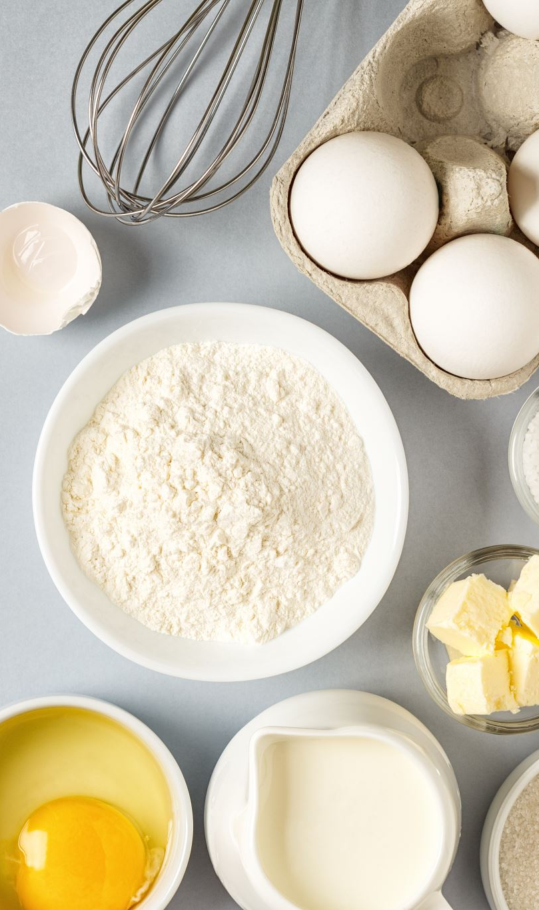
From Ingredients to Ideas
Using simple ingredients to create business ideas.
Ingredients → Recipe → Cake
You don’t need a perfect idea — just something worth testing.

Slide 3
How Business Ideas Form
Ingredients = inputs
Recipe = WHO / WHAT / WHY
Cake = real business
Decoration = AI helping refine the idea

Slide 4
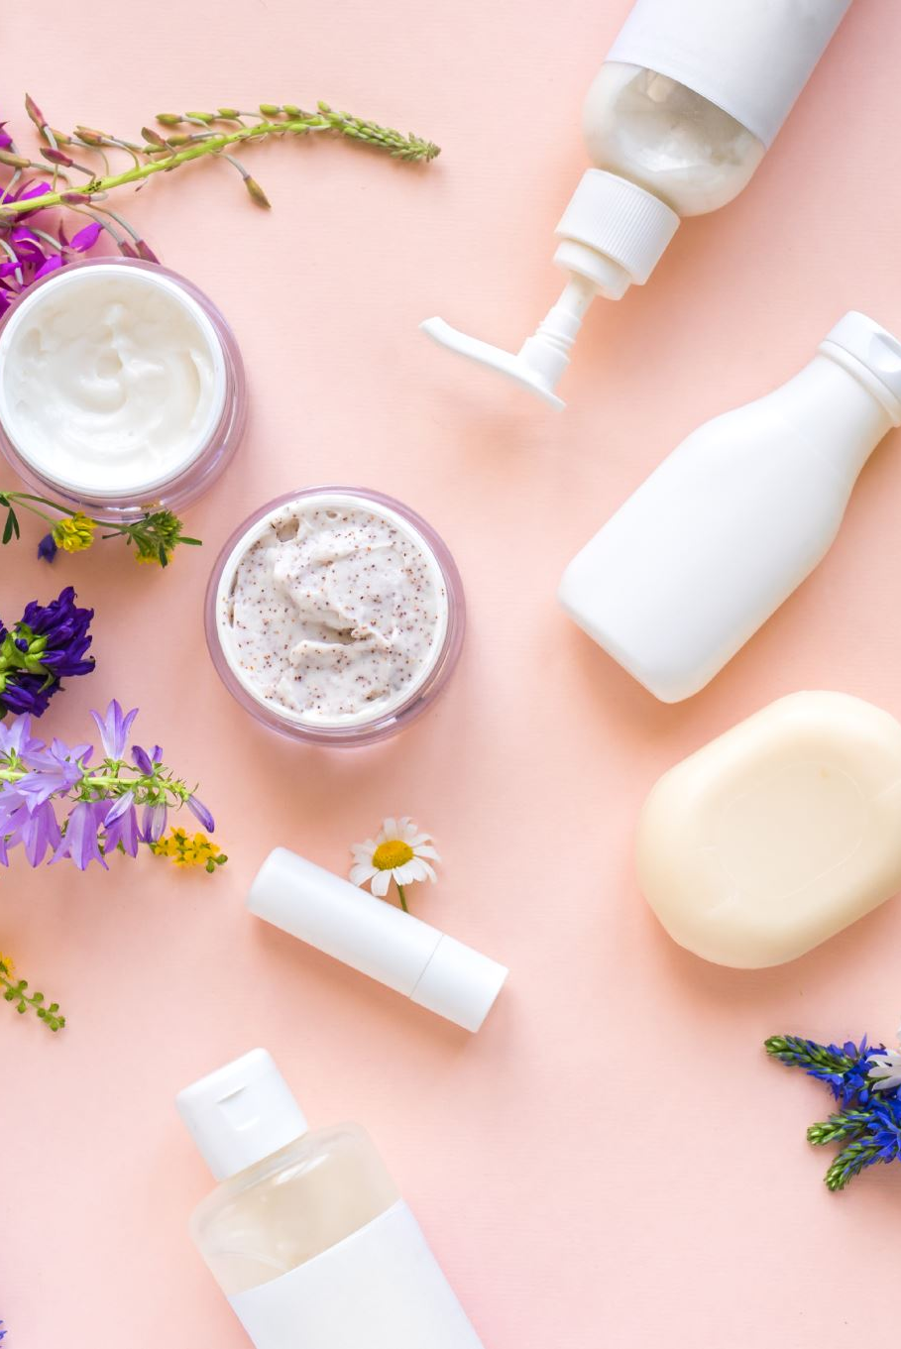
Ingredient 1 – What You Enjoy
What do you enjoy doing?
What gives you energy?
Examples:
Beauty treatments
Helping people feel confident
Makeup, nails, skincare

Slide 5
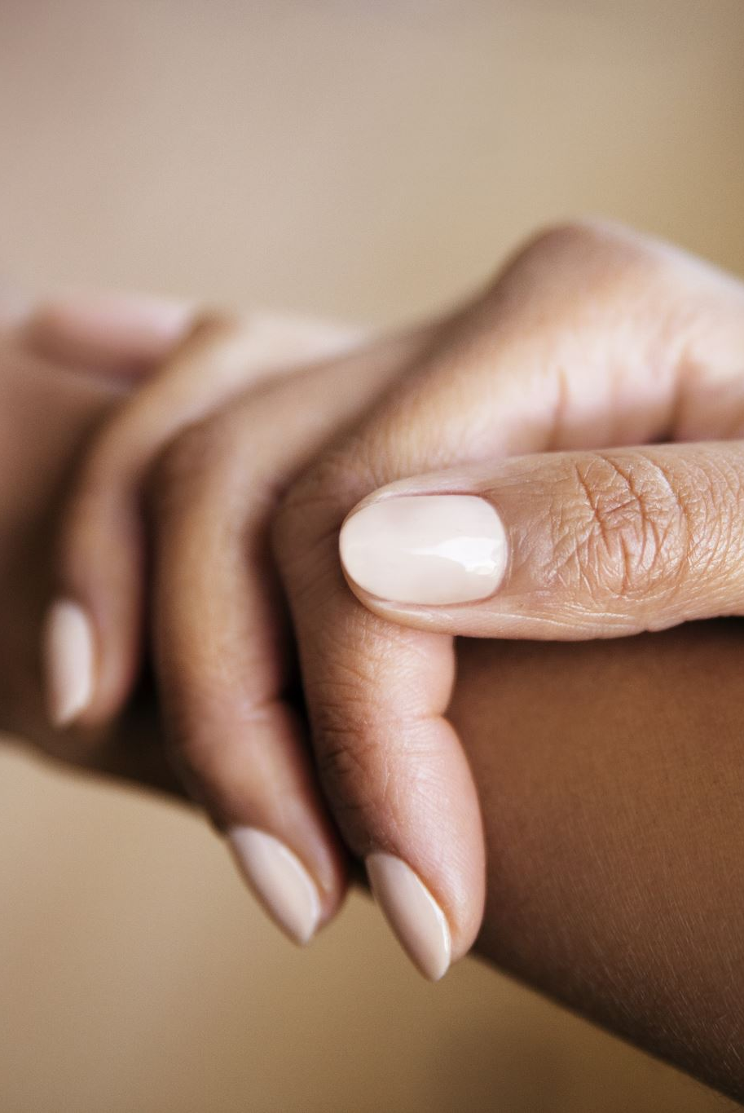
Ingredient 2 – What You're Good At
What do people ask you for help with?
What skills come naturally to you?
Examples:
Brows
Skin advice
Nail design
Customer care

Slide 6

Ingredient 3 – Businesses You Admire
What businesses do you admire?
Trinny London
What would you improve?
Examples:
Better service
Simpler pricing
More flexible appointments

Slide 7
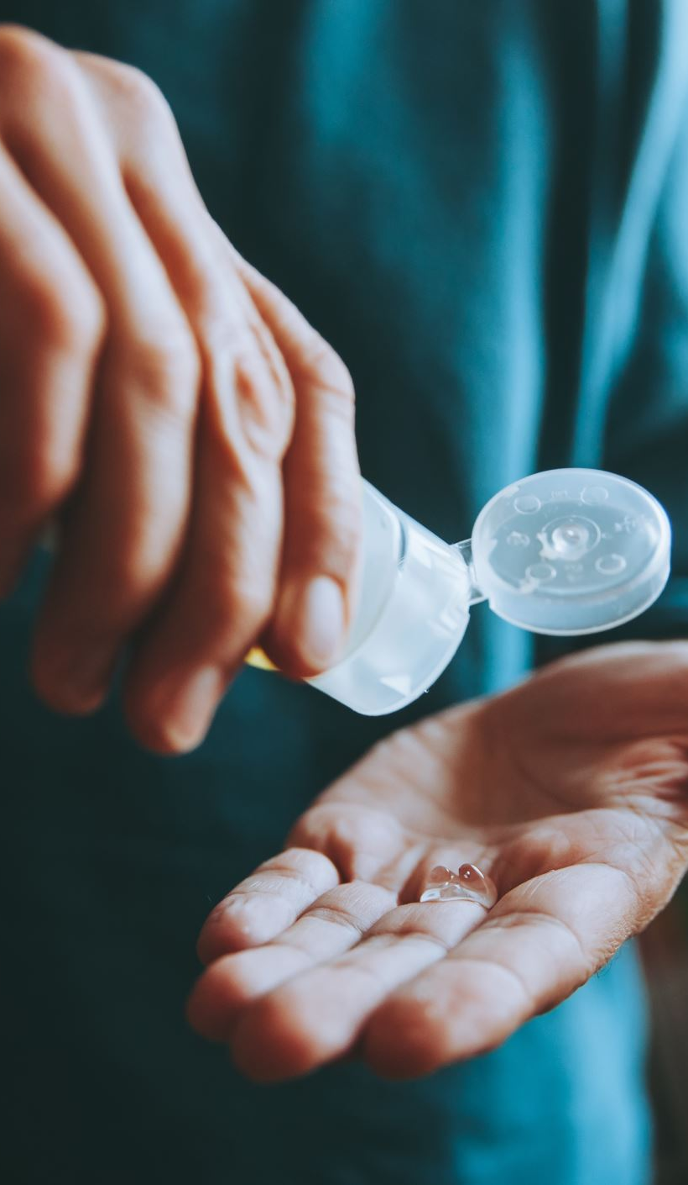
Ingredient 4 – Real Problems
What do people complain about?
What frustrates clients?
Examples:
Confusing skincare products
Nails chipping quickly
Bad waxing experiences
Acne before events

Slide 8

Ingredient 5 – Creative Constraints
How many hours do you want to work?
What income do you need?
Do you want to work alone or with people?
Constraints help shape realistic ideas.

Slide 9
AI Prompt 1
People often complain about acne before big events. Why does this problem exist and who is most affected by it?
What AI does:
Clarifies the problem
Identifies customer groups

Slide 10
Mix the Ingredients
Enjoyment + Skill + Problem + Constraint
= Business Idea

Slide 11
AI Prompt 2 – Simple Service Ideas
I enjoy skincare, I’m good at facials, and people struggle with understanding what products work.
Suggest 5 small service ideas.

Slide 12

Nursem Skin Care
Bing Videos

Slide 13
Worked Example
Enjoyment: Helping people feel confident
Skill: Brows and skin treatments
Problem: Clients confused about skincare
Constraint: Part‑time
Idea: Simple skincare consultation service

Slide 14
The Recipe – WHO / WHAT / WHY
WHO is it for?
WHAT are you offering?
WHY would they care?
Example:
Helping busy women improve their skin with simple consultations.

Slide 15
AI Prompt 3
Turn this idea into a simple business description using:
WHO it is for
WHAT the service is
WHY people would care
Example:
Idea: skincare consultations for people confused by products.

Slide 16
Where AI Fits
AI helps clarify ideas
AI helps test ideas
AI helps reduce risk
AI does not decide — you do.

Slide 17
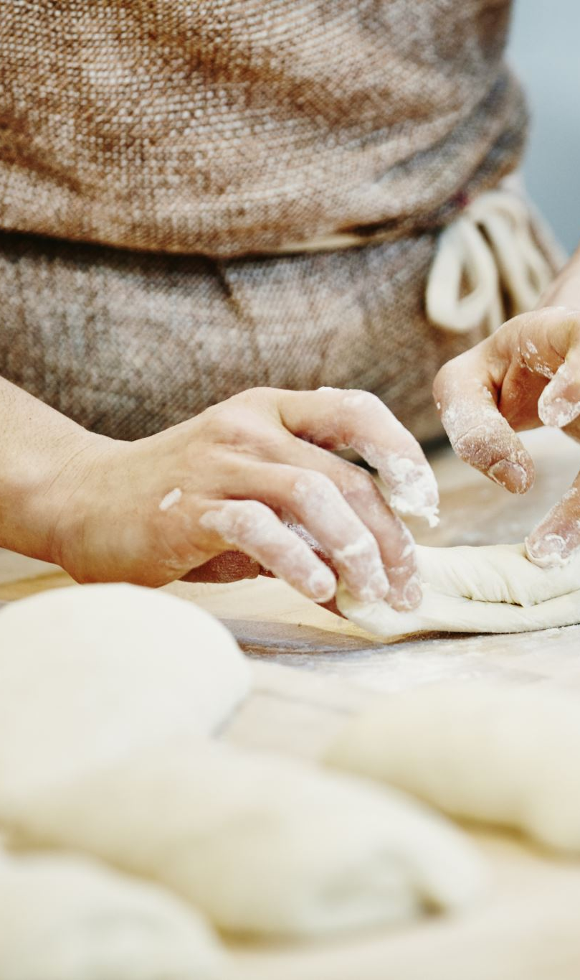
Test Before You Bake
What are three cheap ways to test the idea?
Talk to potential customers
Offer a trial service
Run a small pilot
Small tests reduce risk.

Slide 18
AI Prompt 4
Prompt
Suggest 3 cheap ways I could test this idea before investing money.
AI will suggest things like:
asking potential clients
trial services
social media polls

Slide 19
AI Prompt 5, 6, 7
Prompt 5 – Improve the idea
Prompt
How could this idea be improved
Prompt 6 – Identify Risks
Prompt
What are the biggest risks or challenges with this idea?
Prompt 7 – Naming the Idea
Prompt
Suggest 5 business names for this idea.

Slide 20

My Favourite AI Prompt
My Favourite Workshop Prompt (Use This One)
This combines everything.
I enjoy [X], I’m good at [Y], and people struggle with [Z].
I only want to work [X hours] and start small.
Suggest 3 realistic side-hustle ideas I could test.

Slide 21
AI Warning ⚠️
AI always gives an answer
Not all answers are good
Think of it as a business partner you are throwing ideas around with
Use it to think — not to decide

Slide 22
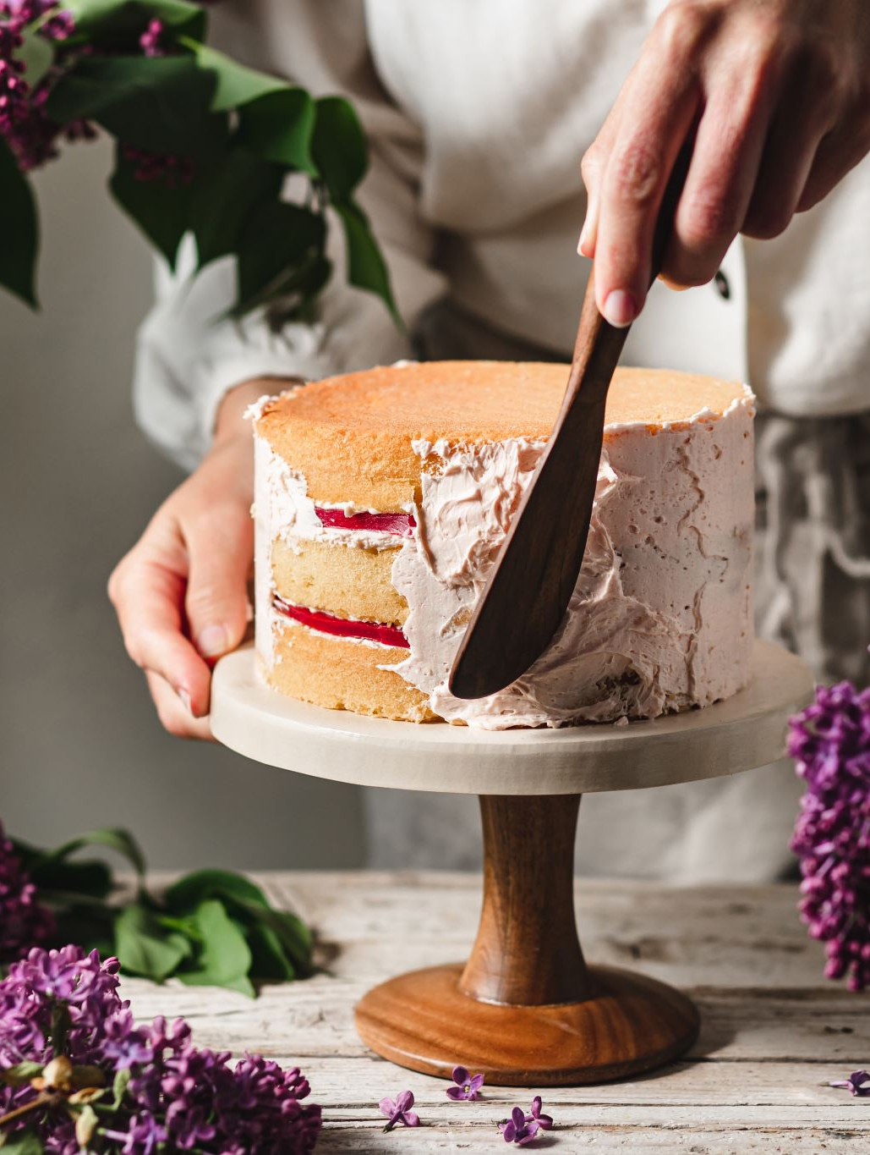
Final Thought
You don’t need the perfect cake.
You just need a recipe worth testing.

